Slide 1
AgGateway Social Media
Simple ways to amplify our message

Slide 2
AgGateway Social 101
AgGateway Social 101AAa
Getting Started
Live and love our story. Read our newsletter!
Practice LISTENING first – start by following AgGateway – simply like our updates and share.
TIP:
Don’t view social as yet another task – view it as a tool to help you reach your goals!

Slide 3
AgGateway Social 101
Publishing
Use our newsletter to post updates on Linkedin. Just cut and paste title and link.
Use appropriate hashtag(s): #AgGateway
Follow up on your own posts with likes, comments, views
TIP:
Space out your likes and comments over time to stay relevant long after posting.

Slide 4
AgGateway Social 101
Deep Dive: Hashtags
Hashtags
Our Preferred HT: #AgGateway
For your Councils, add the pound sign: i.e., #CropNutrition
For our industry, use hashtags that are popular and relevant: i.e., #corn #soybeans #plant16 #agriculture (etc.)
TIP:
Think of hashtags as “categories” or “filters”… Although sometimes they can just be clever.
Notes:
Used mainly on Twitter –
Only marginally useful on Linkedin

Slide 5
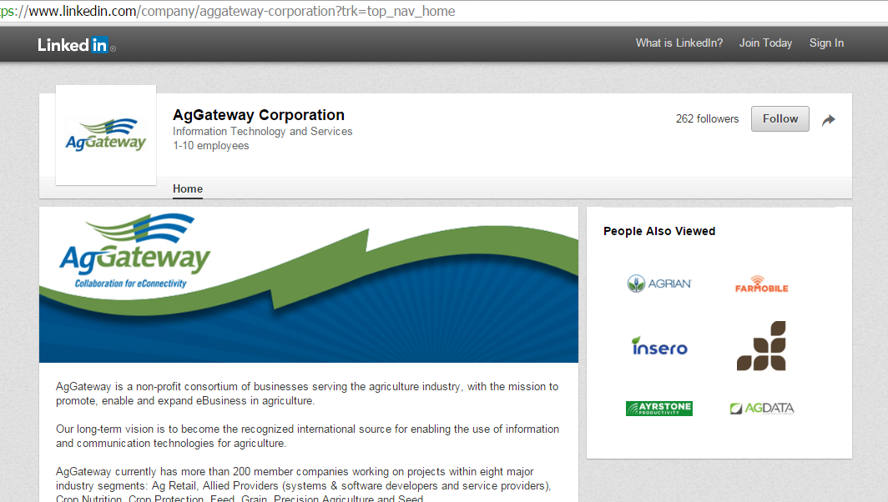
LinkedIn
Don’t have a profile? Create one (it’s free).
“Follow” AgGateway.
On your page, add that you’re active in AgGateway.

Slide 6
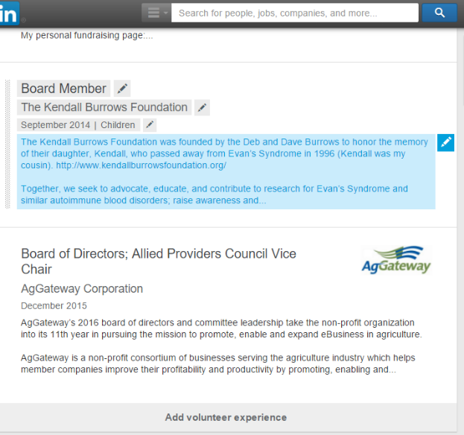
Linkedin Tips
Add AgGateway to your professional, volunteer or board experience
Notes:
Click Edit Profile
Fill out all sections as completely as possible
Add AgGateway under the “Volunteer Experience” (above) or in your Professional Experience space.

Slide 7
AgGateway Social 101
Baby Step 4
Engaging
Comment/Like posts and updates
Give credit (mention others)
Use @ symbol
Republish others
Respond and converse
TIP:
Think of social media as a new way to have a CONVERSATION

Slide 8
Twitter
Follow AgGateway
Re-tweet stuff you like!

Slide 9
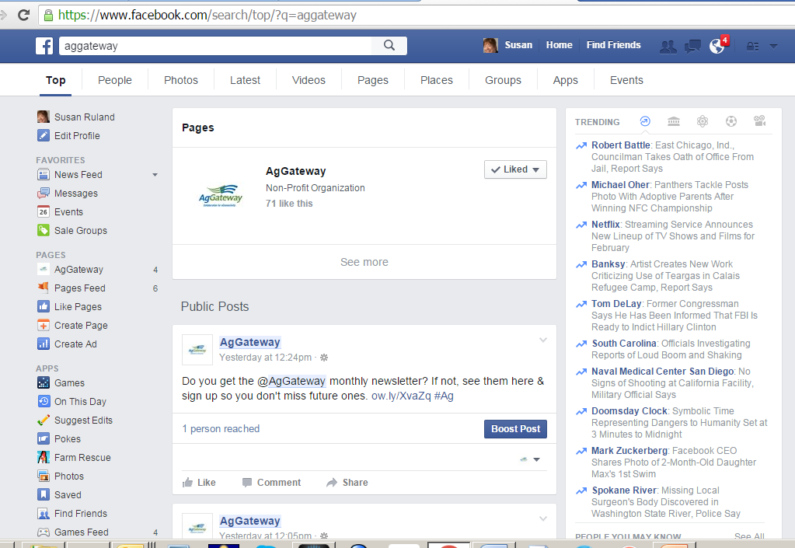
Facebook, Google+
Ditto

Slide 10
And in all cases…
If you want to send a message on behalf of AgGateway, let us know! – social@AgGateway.org.
“Can we promote a conference that a lot of AgGateway members are attending?”
“Please tell everyone about our council’s new resource.”

