Slide 1
Introduction to AgGateway
April 2013

Slide 2
What we’ll discuss…
What is AgGateway and why do we exist?
Examples of current projects
How we operate: councils, committees and task forces
Member Services
AGIIS
Standards & Guidelines
Enabling Services
Quick website tour
Getting more involved in AgGateway
Notes:
Give new members a “lay of the land”, encourage participation, and acquaint them with where to go for more information.
• Welcome
• Quick background on AgGateway – history, mission, organization, staff
o Councils (quick description of each)
o Committees (quick description of each)
o AGIIS
o Standards and guidelines available
• 2013-15 Strategic Plan
• Current Projects (quick description of each; how new projects get started)
• Quick website tour
• Description of “Member Services” resource
• Enabling Services
• Summary tips
o getting more involved in AgGateway
o getting your company more involved in eBusiness
o Immediate follow-up (on call or afterwards) – get them signed up to a council, committee

Slide 3

AgGateway: What it is
A non-profit, ag industry, membership association
Broad representation across ag segments
Focus on eBusiness for better supply chain efficiencies
Working together to develop and implement common industry standards and tools
Non-profit funded by:
Member dues
Subscriptions
Activity fees
Notes:
AgGateway is a non-profit membership organization that is funded by membership dues, database subscriptions, and activity fees. AgGateway does not sell products or information systems applications. AgGateway has broad based support from the ag industry and has been primarily focused on improving the supply chain in agriculture. Its members are a consortium of ag companies that collaboratively implement eBusiness by developing common industry standards and tools.

Slide 4
What’s the big idea?
To enable the entire agriculture community to use eBusiness to exchange information to:
  Improve business processes
  Help deliver excellent customer service
  Streamline the supply chain
  Enhance food safety
  Support sustainable agricultural practices throughout the world.

Slide 5
A critical time
eBusiness is critical today to address:
Increasing operational complexity
Increasing regulatory requirements
International and domestic market pressures
Can’t be done without eBusiness!
Ag companies need to be involved to stay competitive!

Slide 6
Main driver of current ag trends…
FEEDING A HUNGRY WORLD!
“50 – 100 – 70”

Slide 7
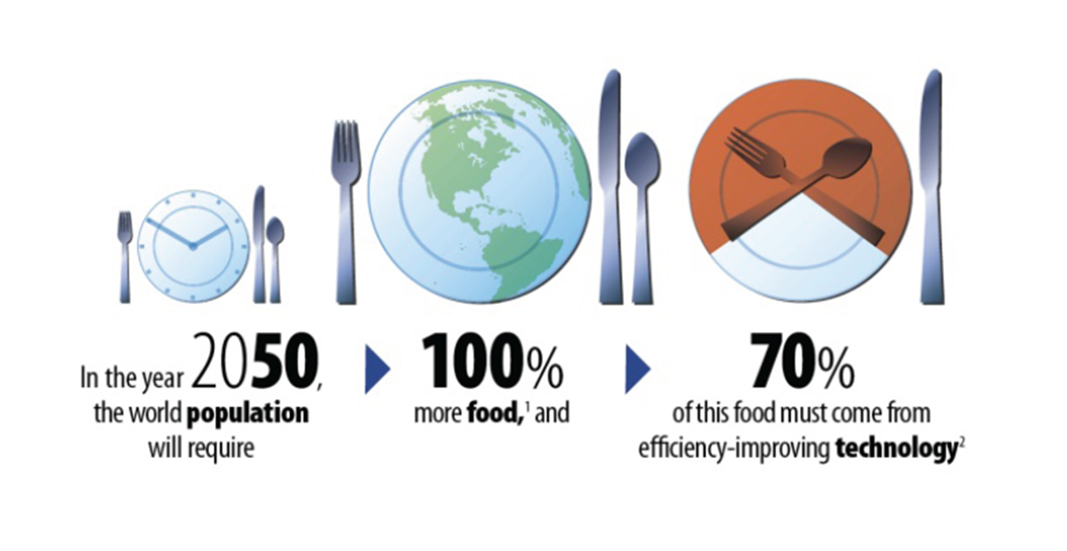
Growing demand for food –
Growing pressure on agriculture

Slide 8
Challenge of finite resources
Only 12% more arable land available globally
Analysts project only 5% more land cultivated by 2050
Water demand projected to outstrip water supply by 40% in 2030
Farmers will need to increase food production dramatically … and with less fresh water.
SOURCES: OECD-FAO, global water supply/demand model; agricultural production based on IFPRI computed general equilibrium model base case; A Daunting Task, Prof. Robert Thompson (2010)

Slide 9
Challenge of sweeping changes
Global markets
  Agribusiness is impacted by events halfway around the globe
More demanding customers w/instantaneous information
  Larger, sophisticated farms using real-time market info
Growing demand worldwide for food
Competition for natural resources
Unprecedented market volatility
Food safety / environment / global warming / sustainability
  Source: Purdue University 2010
Notes:
Global Market – Agribusiness is impacted by:
World politics, government policies on world trade, global supply and demand, weather conditions around the world, military action, terrorist activity.
Instantaneous Information Impact on Customer Loyalty
Customers/farmers are knowledgeable, sophisticated, and demanding
Real-time Market Info, email, websites, Google, satellites, cell phones
Growing operations getting larger (6% of growers, 45% of US acres)
Population Explosion - Growing Demand for Food
More people to feed, higher standard of living, demand for better food
Competition for Natural Resources
Unprecedented Market Volatility
Food safety / Environment / Global Warming / sustainability

Slide 10
What’s different this time?
Change happens faster
Impact is global & immediate – no segment is exempt
More volatility in markets – politics or events anywhere can trigger volatility
Businesses must adapt quickly or they will cease to exist quickly
Technology plays a greater role than ever in a company’s ability to adapt

Slide 11
How our members say they’ll address these challenges:
Continue streamlining the supply chain
Genetics, biotechnology
Precision agriculture
Sustainability, food safety practices
Implement mobile business aps, social media channels
Each of these areas benefits from eBusiness solutions

Slide 12
AgGateway Vision
AgGateway will be the recognized international source for enabling the use of information and communication technologies for agriculture.

Slide 13
AgGateway’s Mission
To promote, enable and expand eBusiness in agriculture.
Notes:
AgGateway's mission is a simple and straight-forward one. All we do it geared to promote, enable and expand eBusiness in ag.

Slide 14
2013-15 Strategic Objectives
Promote the value and benefits of eBusiness and membership in AgGateway.
Increase/Enable implementation by reducing implementation barriers.
Expand eBusiness by broadening the scope of representation.
Operate AgGateway efficiently.
Notes:
1. Promote the value and benefits of eBusiness and membership in AgGateway
Implement a marketing and promotional plan to increase awareness and positive impression of AgGateway and of the value of membership.
2. Increase/Enable implementation by reducing implementation barriers
Provide tools and assistance to enable eConnectivity for member companies and their trading partners by implementing solutions that significantly reduce barriers to implementation.
3. Expand eBusiness by broadening the scope of representation
Broaden the scope of representation within AgGateway by adding members from and developing working relationships with targeted industry segments and by creating and implementing a plan to internationalize AgGateway.
4. Operate AgGateway Efficiently
Ensure that all committees and councils participating in AgGateway are active and functioning in terms of planning, priorities, regular meetings and participation by their members.

Slide 15
Continued membership growth
Notes:
The steady and significant growth in our membership reflects the need and desire for better eConnectivity in agriculture.
Our membership continues to grow – our roster for 2013 has grown to 176 companies. (as of April 2013).

Slide 16
What we mean when we say…
Notes:
Let’s get into more detail about what AgGateway does, and how we do it. But first, let’s define a few terms that come up again and again in our work.

Slide 17


Standard
  A formal set of required criteria, guidelines and best practices.
  Purpose: To establish uniform technical methods and business processes.
Notes:
Everyone is very familiar with what standards are and what they mean to efficiency. An important concept in AgGateway is that they do not focus only on technical standards, but also on business process standards and best practices.

Slide 18
Connectivity
    The use of computer networks to link computers to one another. Purpose: To link information resources among various computer systems and their users
Notes:
Connectivity is a term that you’ll hear often in AgGateway meetings and discussions. The technical connectivity is, relatively speaking, easier to do than linking business systems together. Again, AgGateway focuses on both with the emphasis on delivering information seamlessly to the final user that needs it.

Slide 19

eBusiness
Inter-Company Business Activities supported by
Information and Communication Technologies
Notes:
Implementing eBusiness is what AgGateway is all about. We use the broad definition of the term to include any intercompany business activities, not only eCommerce. eBusiness is all about making business easier, less costly, and more productive.

Slide 20
How companies expand eBusiness
Sales Order
Payment
Delivery
Sales Order
Payment
Delivery
eBusiness Connectivity Projects
Company 1
Business Systems
Company 2
Business Systems
Notes:
AgGateway conducts industry projects that help trading partners resolve the differences to enable eBusiness connectivity.

Slide 21
Examples of Current Projects

Slide 22
Examples of AgGateway projects
AEC–“Accelerated Electronic Connectivity”— Complete
  Ordering, Shipping, Invoicing, Sales Reporting
  10 Distributors, 8 Manufacturers
  > 70% of CP industry sales transactions between manufacturers and distributors are electronic
Seed Connectivity (SC) — Complete
  Shipping, Invoicing, Reporting
  5 Distributors/Retailers, 6 Manufacturers
SC II now underway > 20 companies
Crop Nutrient Connectivity (CNC) — Complete
  Contracts, Ordering, Shipping, and Invoicing
  4 Distributors, 4 Manufacturers
CNC II Now underway >10 companies
Notes:
At the core of all we do is the desire to help enable our members to implement the standards, guidelines, tools, and technologies. One of the ways we do this is through projects. These projects and those on the next two slides can give you a flavor for the work that AgGateway has done and is doing with its members.

Slide 23
More AgGateway projects…
EFC – “Feed Enhanced Connectivity” —Underway
  Goal to increase efficiencies and reduce the cost of doing business
  Order to invoice process (OrderCreate, OrderResponse, ShipNotice, and Invoice)
  Ingredient suppliers (seller) to manufacturers (buyer)
  Currently 6 trading partners, recruiting additional
PCI – “Product Cost Information” — Underway
  Electronic distribution of pricing data from manufacturers to distributors
  6 Distributors, 5 Manufacturers

Slide 24
More AgGateway projects…
SPADE – “Standardized Precision Ag Data Exchange” – In Progress
  Improving data exchange processes for precision ag
  Creating common standards, implementation guidelines and data transfer protocols
  30+ companies
Tonnage Reporting (Fertilizer and Feed) – Pilot in Progress with Michigan
  Standardized format to streamline reporting to states
  Pilot – 3 companies and 3 states

Slide 25

AGIIS: A key tool in all we do
Ag Industry Identification System (AGIIS), launched 2003
A database directory provided by AgGateway that houses ag eBusiness data for industry subscribers
Provides a repository for unique identifiers and common data elements that are the fundamental building blocks for efficient electronic interactions between agricultural companies
25

Slide 26
AGIIS Today
4.7 million active entities
800,000+ licenses
82,000 products
127 subscribers
26
Notes:
AGIIS the Database provides access to:
(March 2012 Totals)
- 4.7 million active entities
- More than 800,000 licenses
- 82,000 products

Slide 27
Products
GTINs (UPC)
Entities
Manufacturers
Distributors
Licenses
Characteristics
Linkages
Categories
Ownership
End Users
GLNs, EBIDs
Unique ID
Characteristics
Etc, etc.
AGIIS
Notes:
The AGIIS directory contains unique identifiers for products, locations, growers, seed licenses and the like. The database maintains a cross reference between a subscriber’s proprietary ID and the unique industry identifier, a requirement for transacting eBusiness.
GTIN stands for Global Trade Item Number, and GLN stands for Global Location Number.

Slide 28
How AgGateway operates

Slide 29

How we operate: a consortium
Collaboration (suppliers & customers working together)
Member participation is key to success!
Work together to develop standards, and tools & techniques for implementation
Notes:
Our members work as a consortium – we work collaboratively to implement eBusiness by developing common industry standards and tools.

Slide 30
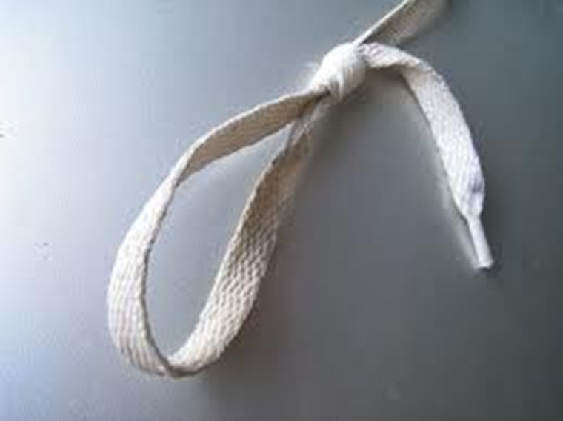
How is AgGateway organized?
Small number of staff
BOD, Management team
Councils (by industry segment)
Standing committees
  Conferences, communications, membership, etc.
Task forces
Project teams
Notes:
Staff
BOD
In addition - The AgGateway Management Team (MT) is responsible for the ongoing day-to-day management of AgGateway and is accountable to the AgGateway Board of Directors (BOD) and is led by the president of AgGateway. Members are appointed by the board of directors for either a one or two year term. The MT is authorized to execute all financial matters that are approved in the budgeting process or as authorized by the BOD. The MT is the first level of escalation on any issues that the operating committees or councils are unable to decide.

Slide 31
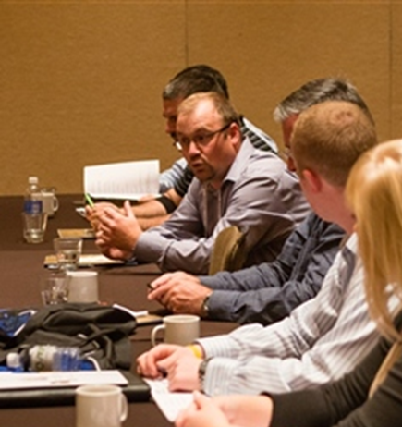
Councils
Industry segment councils operate with relative independence.
Each has a chair and co-chair.
Conference calls, face-to-face at Mid-Year Meeting and Annual Meeting.
Decide on and manage the priorities and project work that make eBusiness a reality.

Slide 32
Currently 9 ag industry segments
(so, 9 councils)
Ag Retail
Crop Nutrition
Crop Protection
Feed
Grain
Precision Agriculture
Seed
Allied Providers
Horticulture
Notes:
AgGateway is organized by industry segment. Each segment forms a council that operates autonomously within the over all guidelines of AgGateway. AgGateway recognizes that each ag industry segment has its own needs and priorities. The structure allows councils to determine their own eBusiness priorities and projects, they are responsible for funding their own projects, not projects of other councils. Each council elects its own leaders that represent it on the AgGateway Board of Directors.

Slide 33
Committees
  Communications
  Conference
  Directory Oversight (AGIIS)
  Education
  Emerging Technologies
  Future Direction
  Membership
  Standards and Guidelines

Slide 34
Communications Committee
2013 Chair: Nancy Appelquist, Entira
2013 Vice Chair: Andriana Doukas, Agrian
Newsletter Editor: Lorie Gasso CSC
Purpose: Support AgGateway marketing and communications activities. Promote AgGateway to members, potential members and the media through the AgGateway website, electronic newsletter, and other communications outreach.
Participation: Open to anyone with an interest
Notes:
The Communications Committee is responsible for promoting AgGateway both internally and externally. The committee helps promote AgGateway activities and events, works with the industry trade press, and manages the website, the monthly electronic newsletter, and other AgGateway communications tools.

Slide 35
Conference Committee
2013 Chair: Karen Thomas, Southern States
2013 Vice Chair: Sarah Denty, XS Inc
Purpose: Plan and execute the Mid-Year Meeting and Annual Conference to ensure experience is beneficial for all participants and further AgGateway mission to promote, enable and expand eBusiness in Agriculture
Mid-Year Meeting Subcommittee
  2013 Chair – Pam Wilson, AgData
Participation: Request councils provide at least one representative
Notes:
AgGateway encourages participation in conferences as a way for member companies to be informed of various council & committee activities as well as providing opportunities to collaborate and learn about current industry trends and topics. Two events are planned annually: the Mid-Year Meeting and the Annual Business Meeting and Conference. Both of these events require a team of dedicated AgGateway members to meet on a regular basis to ensure an experience that is beneficial for all members of the organization.

Slide 36
2013 AgGateway Mid-Year Meeting
June 17-20, 2013, John Deere Financial Facility, Johnston, Iowa
Be there because:
Face-to-face council, committee and project meetings
  Opportunity to move strategic planning and projects forward
Cross-council communication
  Board of Directors meeting
  Participation in committee meetings, other councils’ meetings
Networking
  Breakfasts, refreshment breaks, luncheons, & receptions
  Invite a Trading Partner
Bring a colleague – no registration fee for this meeting

Slide 37
2013 AgGateway Annual Meeting & Conference
November 12-14, 2013, The Vinoy Resort & Golf Club, St. Petersburg, Florida
Theme: Collaboration for Connectivity – Ensuring Success for the Future
Be there because:
AgGateway’s main meeting of the year
Insightful keynote and educational sessions
Face-to-face council, committee and project meetings
Networking opportunities

Slide 38
Directory Oversight Committee
2013 Chair: Brent Kemp, Southern States
2013 Vice Chair: Open
Purpose: Establish policies and procedures in the operation of AGIIS, evaluate, prioritize and execute enhancements; respond to subscriber and project requests; and oversee data maintenance
Participation: Limited to subscribers
  Voting Participants: Council representatives and At Large members, each of whom serve three year terms. Each AgGateway council may appoint up to two representatives to the committee. At Large members are nominated by the committee and approved by the membership.
  AgGateway staff and AGIIS database hosting company representatives are non-voting members. Non-voting advisory positions may also be created as needed.
  In the interest of conducting business efficiently, meetings and conference calls are open only to committee members or invitees.
Notes:
DOC: The AgGateway AGIIS Directory Oversight Committee (DOC) is charged with establishing policies and procedures in the operation of AGIIS, the industry recognized repository of common entity and product information. This includes evaluating, prioritizing and executing enhancements; responding to subscriber and project requests; and overseeing the maintenance and care of the data in the directory.

Slide 39
Education Committee
2013 Chair: Judy Serra, Mosaic
2013 Vice Chair: Open
Purpose: Identify and deliver topics for informing and instructing members on why and how to use eBusiness to improve their operations and develop annual tactical plan that enables AgGateway to achieve its strategic educational objectives.
Participation: Open to anyone with an interest
Notes:
The purpose of AgGateway’s Education Committee is to identify educational needs, content delivery approaches, and content delivery opportunities for AgGateway members; and to develop an annual tactical plan that enables AgGateway to achieve its strategic educational objectives.

Slide 40
Emerging Technologies Committee
2013 Chair: Jay Rushing, ARMtech
2013 Vice Chair: Open
Purpose: Central clearinghouse for new and evolving technologies that might provide benefits to agriculture. Committee members provide recommendations to AgGateway and its membership on those technologies that show real benefits to the companies that would use them
Participation: Open to anyone with an interest
Notes:
The Emerging Technologies Committee will be the central clearinghouse for new technologies and advances in existing technologies that might provide benefits to agriculture. The members of the committee will discuss and debate these technologies. The committee will also provide recommendations to AgGateway and its membership on those technologies that show real benefits to the companies that would use them

Slide 41
Future Direction Committee
Created and reports directly to the AgGateway Board of Directors. Its purpose is three-fold:
  Periodically review the AgGateway vision and mission to validate that they are still appropriate and valid for the organization
  Review the current and future state of agriculture to identify challenges and opportunities for AgGateway
  Review and revise as needed the current strategic plan and extend the plan into future years.
The committee is reformed and reconvened every 2-3 years and usually completes its work in 4-6 months, at which time it is adjourned until needed again.

Slide 42
Membership Committee
Notes:
We track existing membership levels and targeted goals and provide support and materials to help reach those goals. Since our organization is based on linkages between trading partners, much of our efforts are focused on helping existing members identify, contact and recruit new members that are current or potential trading partners.

Slide 43
Standards & Guidelines Committee
2013 Chair: Tammy Creswell, Simplot
2013 Vice Chair: Victoria Peoples, Bayer
Purpose: Coordinate standards and guidelines development, maintenance and publication, encourage collaboration among councils, and respond to requests for assistance with standards-related efforts
Participation: Open to anyone with an interest
Notes:
The AgGateway Standards and Guidelines Committee coordinates standards and guidelines development, maintenance, and publication. It encourages collaboration among councils and responds to requests for assistance with standards-related efforts.

Slide 44
AgGateway Member Services

Slide 45
Member Services
One-stop, centralized resource for AgGateway members
Responds to your needs, questions and requests.
Any and all requests (e.g., info on AGIIS, new project idea, where to find specific eConnectivity resources, sharing contact info for new member prospect, webinar info, etc.)
Member.Services@AgGateway.org
or 1-866-251-8618
45

Slide 46
AGIIS & Other Enabling Mechanisms

Slide 47
Ag Industry Identification System (AGIIS)
Purpose: To provide unique identifiers for the facilitation of eBusiness
  Subscriber owned
  Subscriber maintained
Notes:
Both partners are confident they are using the correct and same id for a given entity

Slide 48
AGIIS - Database
Products
Entities
Licenses
Added/maintained by Manufacturers
AGIIS
Added/maintained by AGIIS users
Added/maintained by Manufacturers
48
Notes:
Reminder slide to reinforce AGIIS being subscriber owned and subscriber maintained

Slide 49
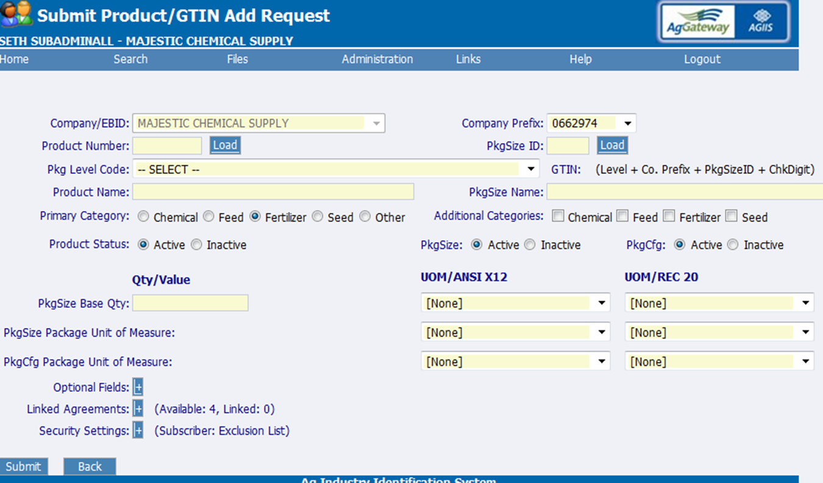
AGIIS - Software
Web services
Product extracts
AGIIS.org web interface
Batch processes
49

Slide 50
Unique identifiers
GTIN – Global Trade Item Number
  Used to identify products at the lowest salable unit
GLN – Global Locator Number
  Used to identify entities
  All active entity records in AGIIS have a GLN identifier
  [Add EBID??]
50

Slide 51
Entities
Entities are added and maintained by AGIIS subscribers.
Entities may be licensed by a manufacturer to indicate they have the authorization to purchase certain products.
All AGIIS subscribers have access to view entity records
Only subscribers with full privileges can maintain an entity subset, which also authorizes the subscriber to add, update, import or extract entity information.
51
Notes:
51

Slide 52
Maintain Entity Subsets
Subsets are established by a subscriber linking their internal identifier (customer ID) or prop code to the corresponding GLN or EBID.
Subsets enable subscribers to keep their internal data and data in AGIIS synchronized, ensuring accurate eBusiness transactions. Subscribers with full privileges can then:
  Add or update entity records in AGIIS
  Download their subset information (identifiers, name and demographic information)
  Receive notification when data in their subset changes

Slide 53
Products
Products are added and maintained by manufacturers that subscribe to AGIIS.
Manufacturers can restrict access to their product information using flexible product security features.
Subscribers with full privileges can download all product information (where they have authorization)
Products and agreements can be linked to indicate that the purchase of the product requires a license.

Slide 54
More information
Several enhancements scheduled for implementation over this year and into next
Future Vision Task Force identifying next generation needs for potential new platform
For more information contact Member Services at
  Member.Services@AgGateway.org
  1-866-251-8618

Slide 55
Standards & Guidelines

Slide 56
Standards & Guidelines
Messages
  Ag eStandards (XML schemas)
    Specifies the structure and data types of messages such as purchase orders, invoices and ship notices
  EDI guidelines
    EDI from the 1990s
Identifier Encoding
  RFID guidelines
  Bar code guidelines
56

Slide 57
Standards & Guidelines
Sales reporting reconciliation format
Code lists
Guidelines for transport, routing, and packaging (i.e., how to move messages from from one trading partner to another)
  Web service guidelines
  ebMS implementation guidelines
57

Slide 58
Tools
AGIIS
NEXUSe2e
  An open-source messaging server
Business Use Case
  Approach for documenting processes in text and diagrams
58

Slide 59
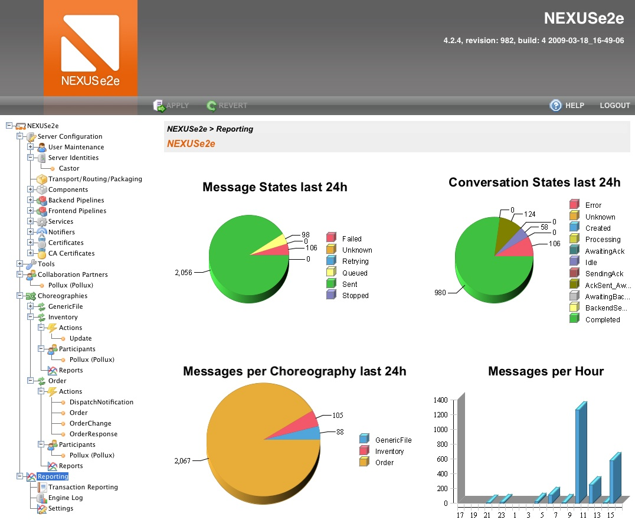

Slide 60
Tools
Various project-related tools
Message-use templates
  Tool for documenting message implementation in a particular context
CLICK
  Tool for comprehending the messaging standards, producing message use templates, and various other utilities
60

Slide 61
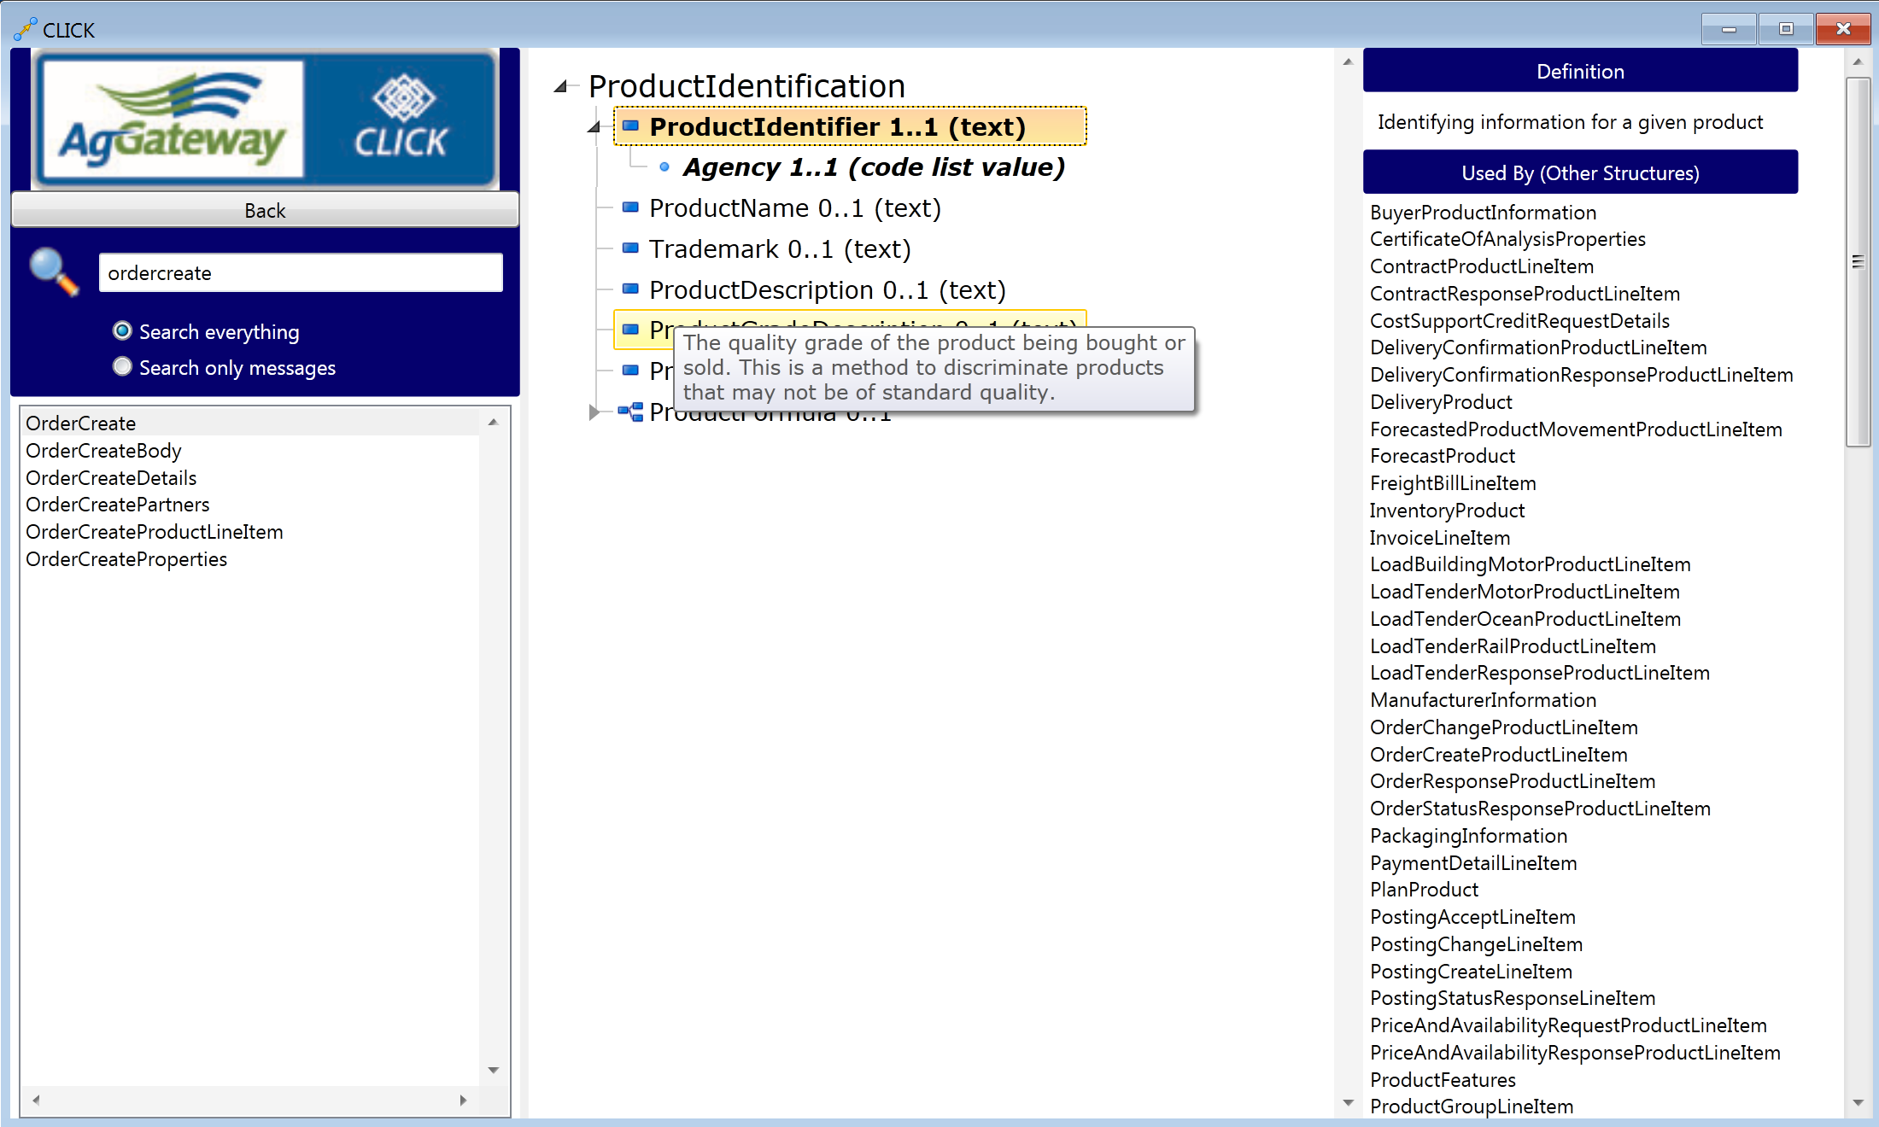
CLICK

Slide 62
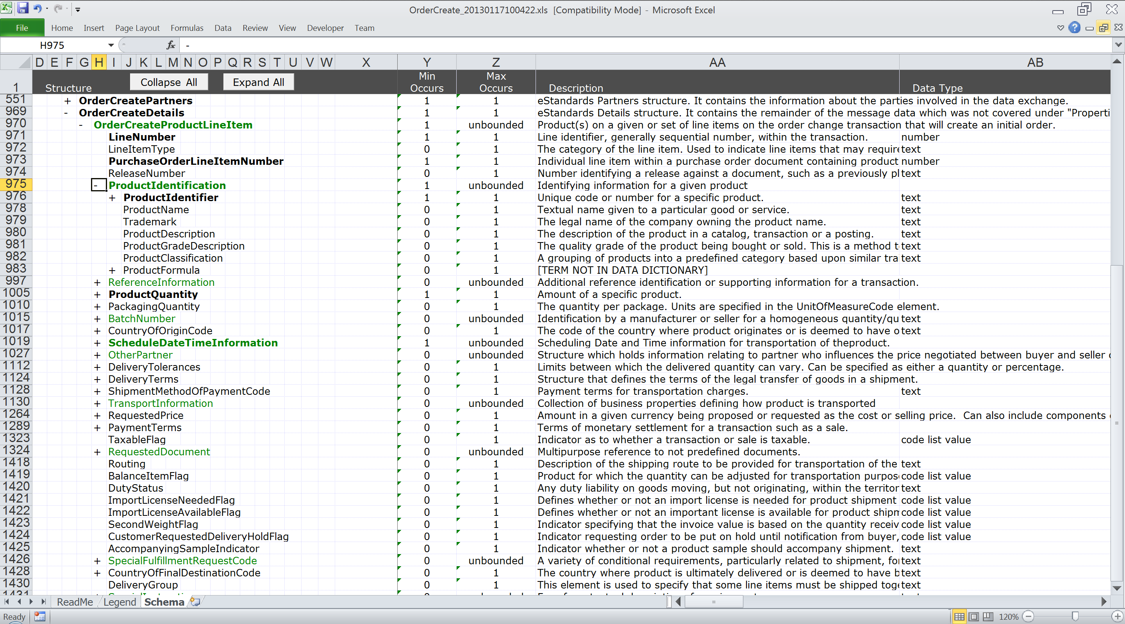
Message use template

Slide 63
AgGateway Enabling Services

Slide 64
Helping companies get connected
Project Management
Trading Partner Connectivity
eBusiness Readiness
Standards Consulting
AgGateway Enabling Services
Notes:
As part of the AGW mission to promote, enable and expand eBusiness for our members, it important that we continue to help enable those not currently enabled and help to expand those that are with other trading partners, messages, and functionality.

Slide 65
Enable & expand connectivity
Historically, we’ve expanded connectivity primarily through large industry projects sponsored by the councils.
Since 2010 we provide help and knowledge to expand connectivity by enabling individual companies to connect with members who are already enabled.
Not every company is ready or able to jump into a project – this provides multiple options.
65

Slide 66
eBusiness Enabling Services
eBusiness Readiness Assessment
  Helps companies evaluate their readiness for connectivity
eBusiness Readiness Development
  Helps companies that are not “ready” develop a plan to achieve connectivity
Getting Started/Expanding eConnectivity
  Helps companies implement specific standard messages and guidelines specific to their business
66

Slide 67
eBusiness Enabling Services
Connectivity Training
  Provides training on specific topics to enhance individuals’ skill sets.
Project Management Consulting
  Custom consulting for eConnectivity or general project management
  Industry collaborative project management and facilitation
67

Slide 68
How it works
Individual Company wants to connect…
  Contact the enabling services director to determine requirements
  eBusiness Readiness Survey is sent to company
  Agreement of services and SOW is determined
    Each SOW is geared to the member company’s needs/requirements
    May be one message, one trading partner, or may be multiple messages and/or multiple trading partners
  Enabling services director executes agreement
Self-directed Enabling Services…
  Although in the works, this service on the web has not yet been fully published
68

Slide 69
How we start industry collaborative projects…

Slide 70
Pathway for starting projects
Conceptual: idea presented to Council; task force formed, charter developed
Approval: Council approval, project leadership designated
Plan: Funding and timing
Design: Team determines rules for implementation
Implementation: Develop, test and implement standards
Wrap-up: Documentation so others can implement

Slide 71
AgGateway Website 101

Slide 72

Goals of the website
Ease of use in finding information
Communicate benefits of AgGateway membership and collaboration
A go-to source for eConnectivity
Reflects our growth and successes

Slide 73
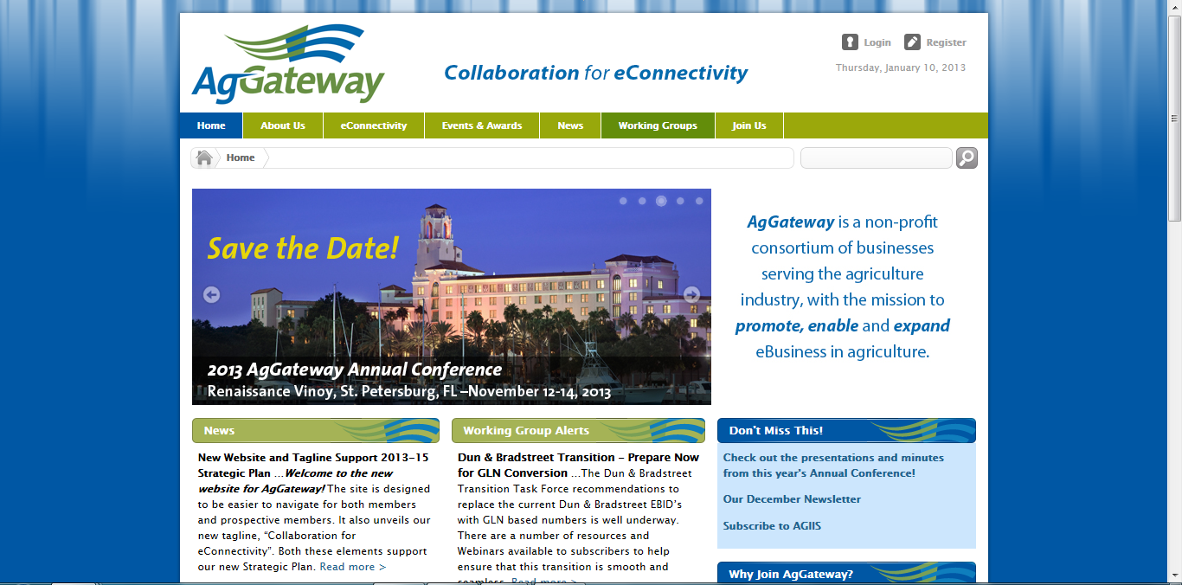
Notes:
Home page content and general navigation as meeting the goals for the site. Note difference between public and members-only.

Slide 74
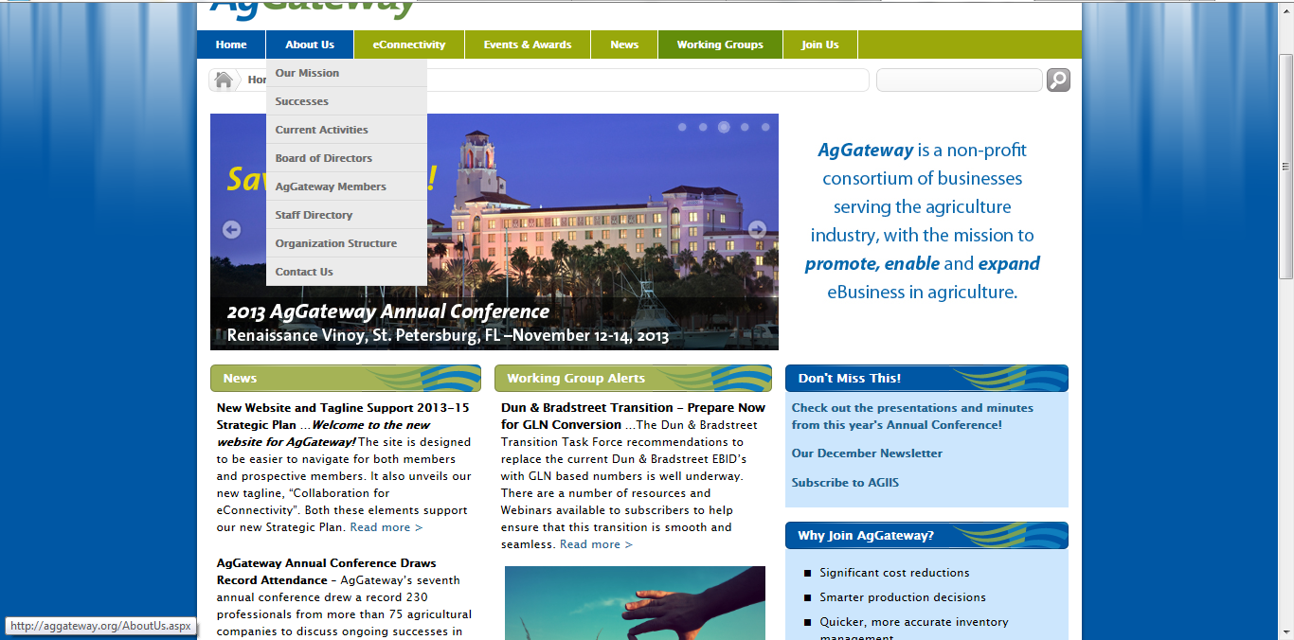
Notes:
About Us topics that cover not just who we are, but successes and current activities that help demonstrate the value of AgGateway and the eConnectivity efforts.

Slide 75
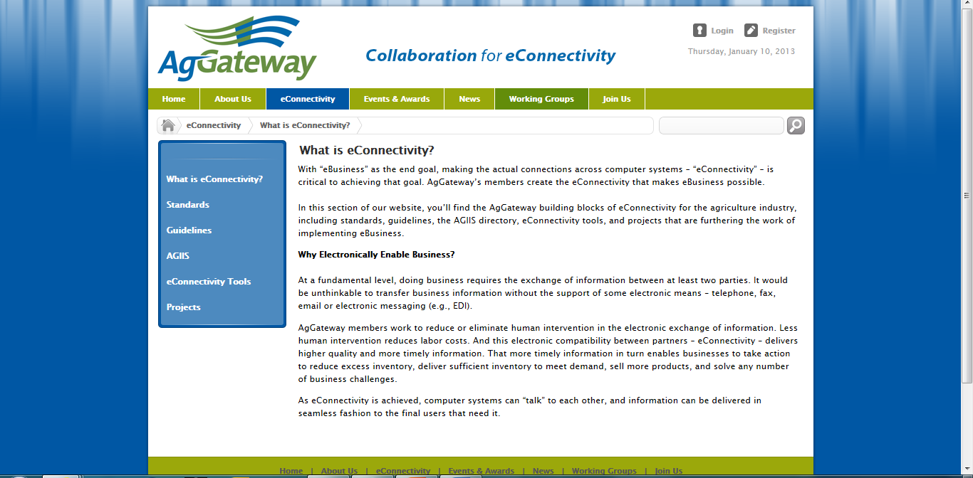
Notes:
eConnectivity has its own tab to help be a central spot where the industry can go to understand the benefits of eConnectivity, and for housing the information, tools and projects that are immediately relevant. This tab also houses the AGIIS information. If you go to AGIIS…

Slide 76
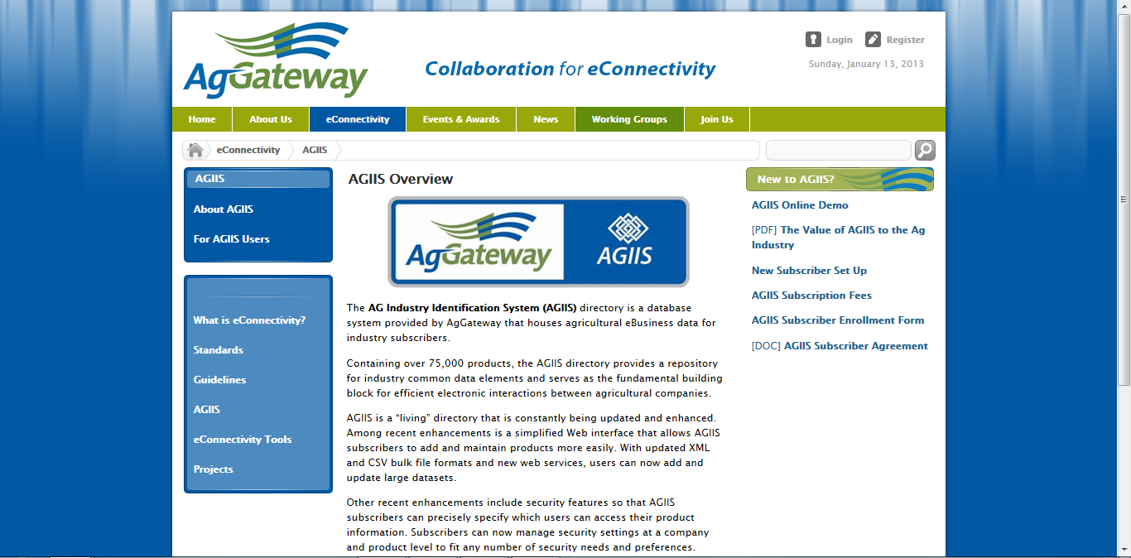
Notes:
You are on a general page where you can choose either basic information about AGIIS if you’re new to the directory, or very easily access information that AGIIS users need.

Slide 77
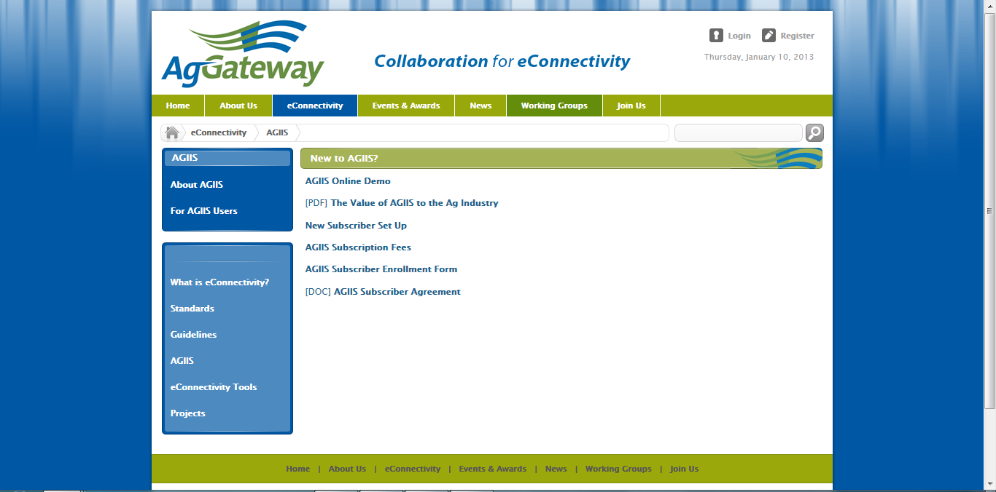
Notes:
So here is the “About AGIIS” list to give new folks an orientation.

Slide 78
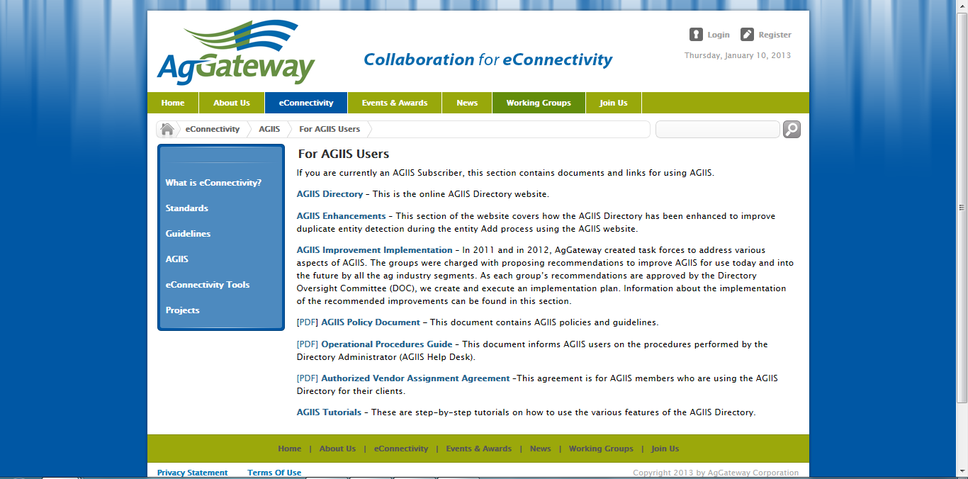
Notes:
And here is the more in-depth information and updates for active AGIIS users.

Slide 79
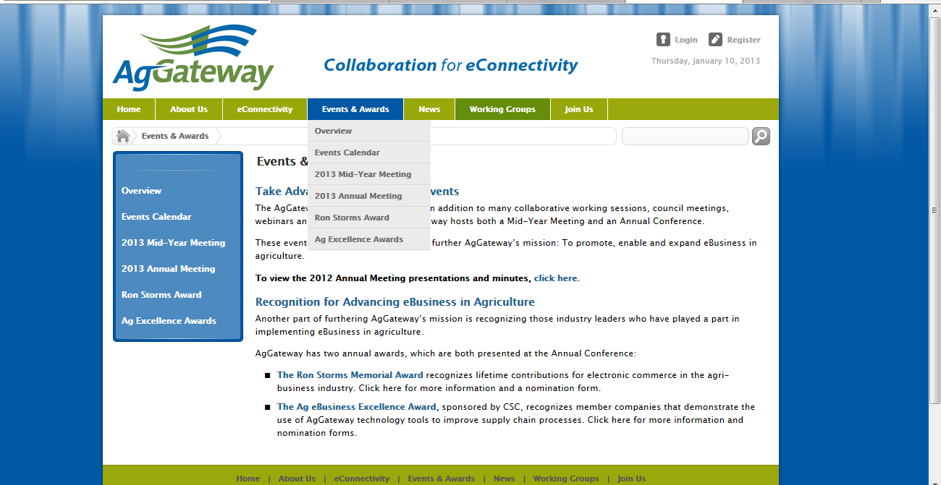
Notes:
Next on the general navigation is the Events & Awards tab. It’s great having this central place to promote our meetings, and also the awards that recognize leaders in ag eBusiness. This is also where the calendar lives.

Slide 80
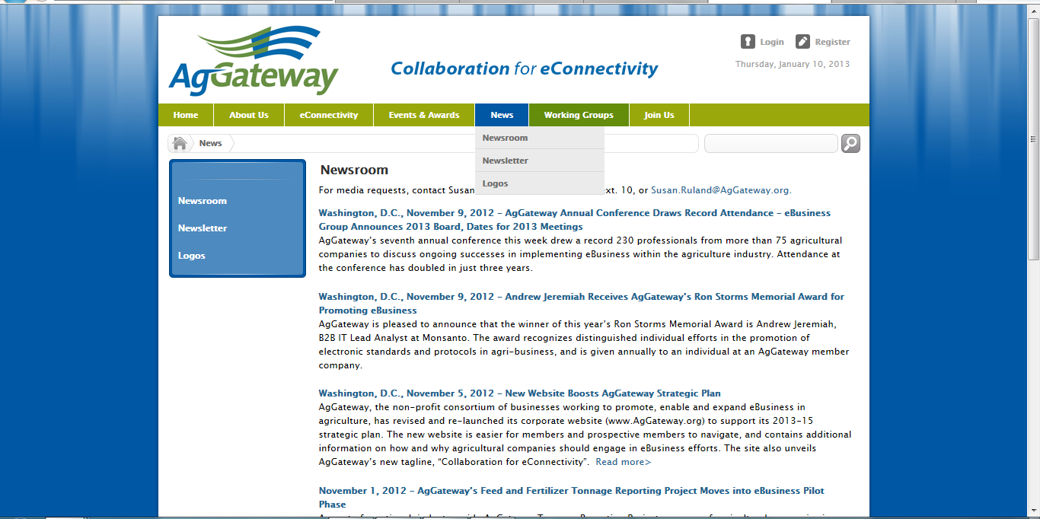
Notes:
Next is our News section, which obviously has all of our press releases and the newsletter. You can also access the AgGateway logos here, but only by putting in your member password.

Slide 81
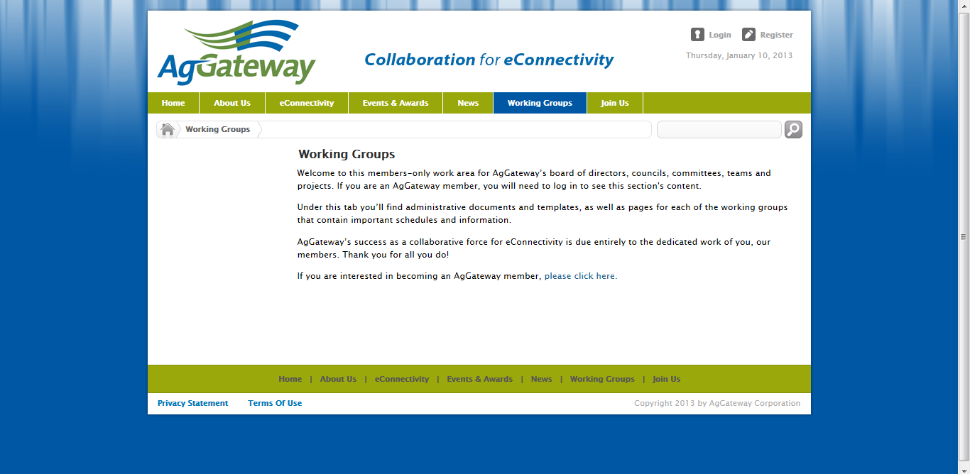
Notes:
The Working Groups tab is the main doorway into all the active work at AgGateway. What I’ve done here is click on Working Groups before logging in – as you can see in the upper right corner I’m still not logged in and am only seeing this page as part of the public site. So what I get is just this brief description of this section, and the request to log in as a member to see more.

Slide 82
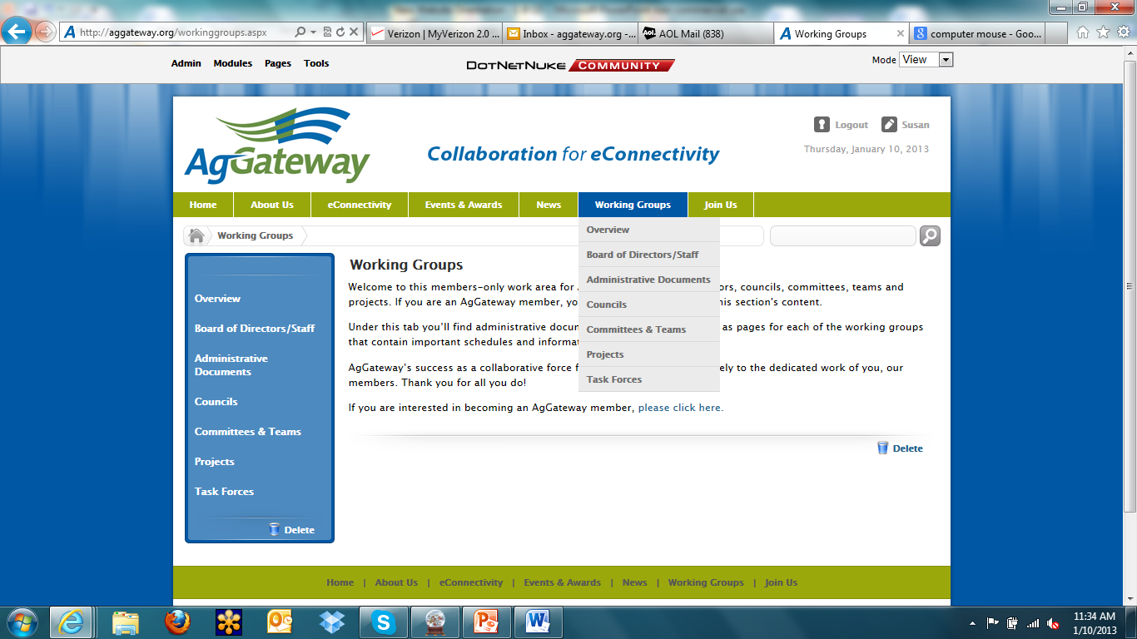
Notes:
Once I log in, I see all the options under Working Groups, which includes our Board page, Administrative Documents, and the work of the Councils, Committees and Teams, Projects and Task Forces.

Slide 83
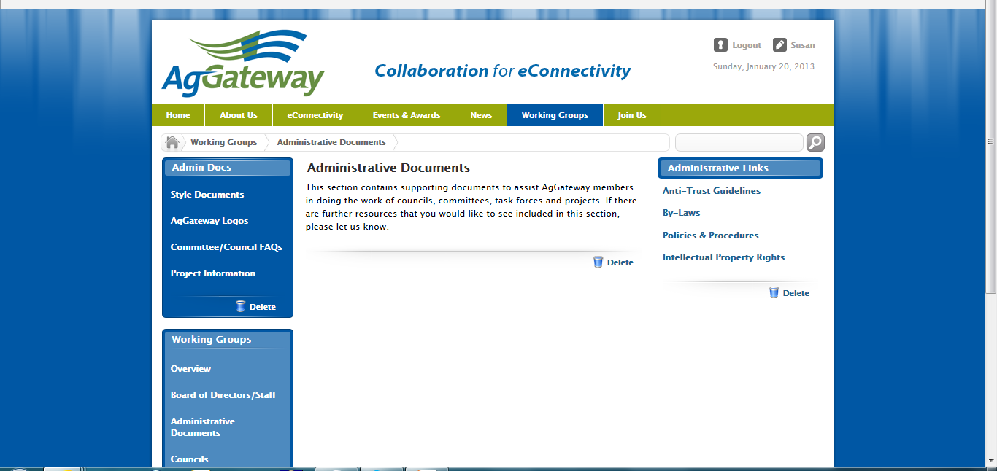
Notes:
Here’s the Administrative Documents page, which can be accessed by all the members, and where you can access anti-trust guidelines and by-laws, and other helpful documents for running the business of AgGateway.

Slide 84
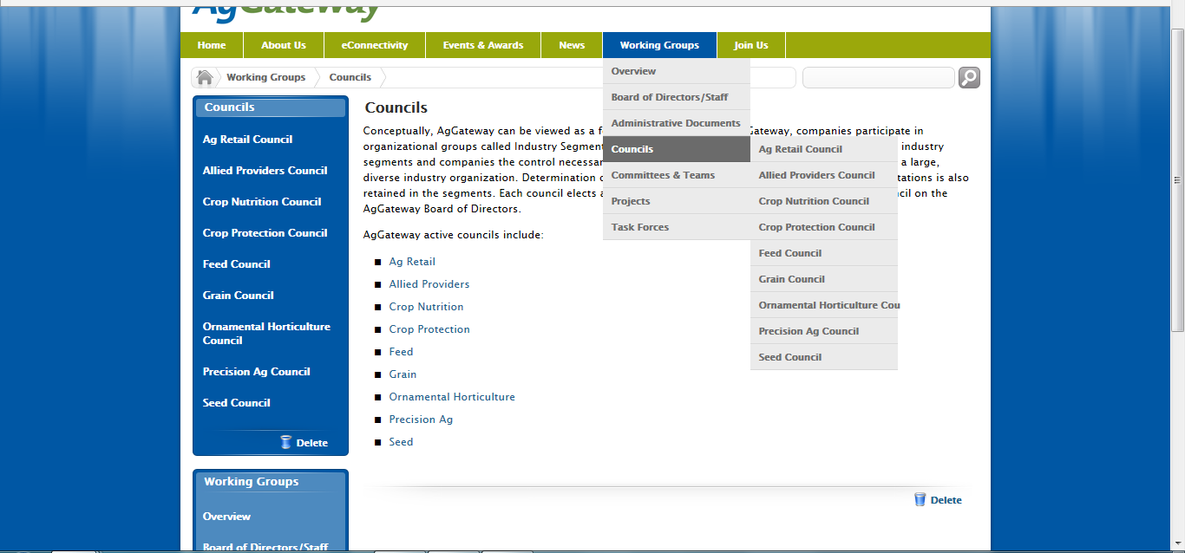
Notes:
And if you go to, say, the Councils page, you’ll see the various councils, which you can access either from this main page, or from the drop-down navigation.

Slide 85
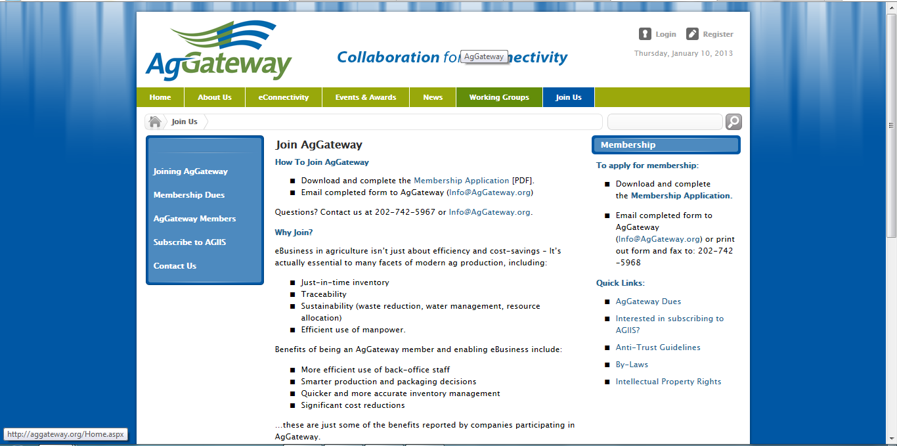
Notes:
Finally, back to the general navigation, we have this public page that houses more of the benefits and value of AgGateway membership, and how to join. Now Meri will walk through some of the tips for how members can do some basic tasks on the site.

Slide 86
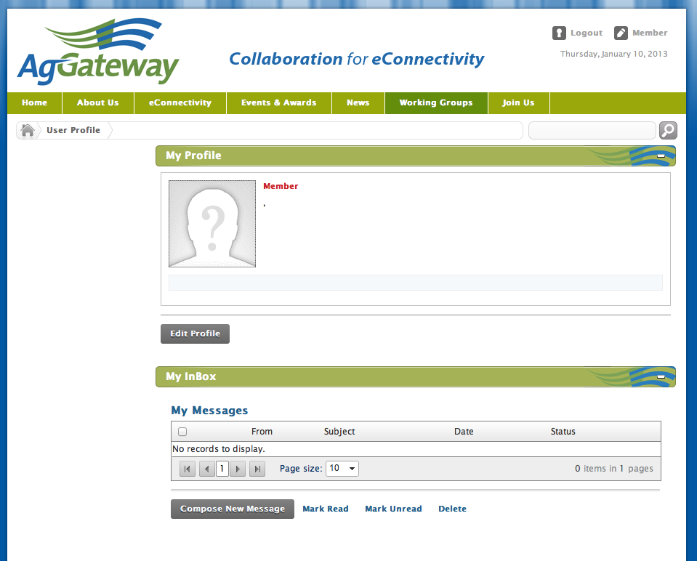
Practical Tips
Profile Management
1
2
Notes:
Access profile by clicking on your name in the right hand corner
The “My Profile” page represents data you’ve input into your profile when you registered. At this time, user profiles are PRIVATE on AgGateway so other users cannot view this information.
You may edit your user profile by clicking on the “Edit Profile” button. This will allow you to change any information on your profile.
Each user has different ROLES or permissions on the website. A permission may allow you to view or edit content not available to someone else. Some permissions are automatic when you register and others must be assigned, such as access to certain PROJECTS. If you need to either add or change something on the website regularly, please contact Meri for information. We can give specific access to sections on the website without having to change your Role.
You may also use the Profile page to send messages to other members of the website. The email cannot be used to send messages outside of the membership of the website.

Slide 87
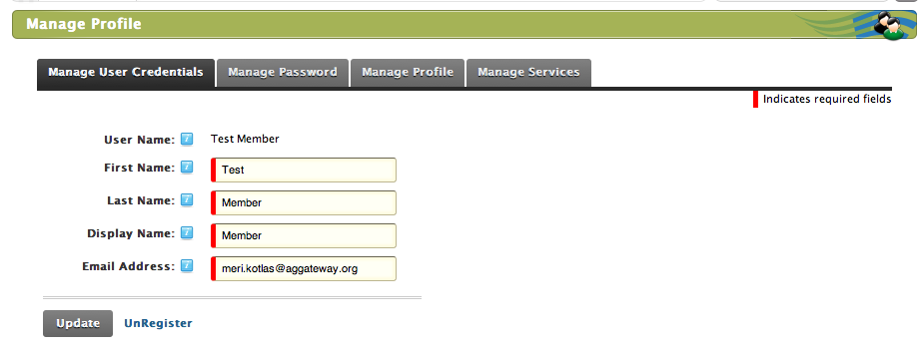
Practical Tips
Profile Management
1
2
3
Notes:
This is where you change your profile information.
You are able to change anything that is in a box.
All red-highlighted information is mandatory.
The Manage Password Tab allows you to change your password.
The Manage Profile Tab allows you to change information that may be public on your profile or to choose who may see it. At this point, our profiles are PRIVATE, so you may choose to not use this section of the profile.

Slide 88
Practical Tips
File management
Uploading files
Calendar management
SHOULD WE INCLUDE ANY OF THIS? OR JUST LET THEM KNOW THERE IS A GUIDE TO HELP THEM IF THEY EVER HAVE THE NEED TO DO THIS?

Slide 89
Getting more involved in AgGateway

Slide 90
Getting involved
Council participation
Join a committee
Attend the MYM and Annual Conference
Others?

Slide 91
Questions?

