Slide 1
Warehouse Movement Process Flows
Auto Identification Data Capture (AIDC)

Slide 2
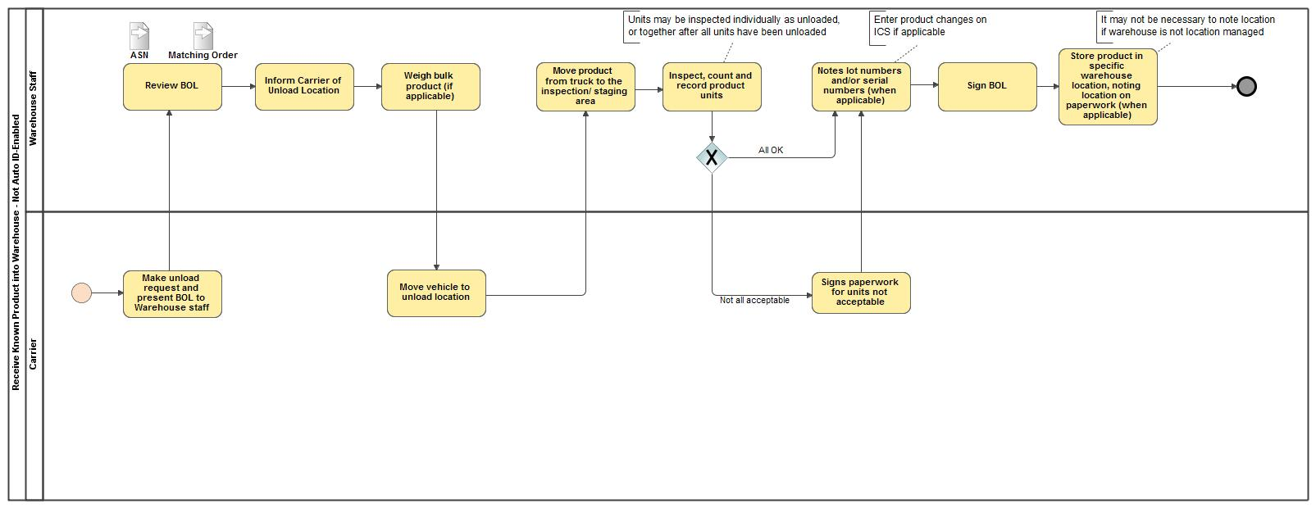
Receive Known Product into Warehouse - Not Auto ID Enabled

Slide 3
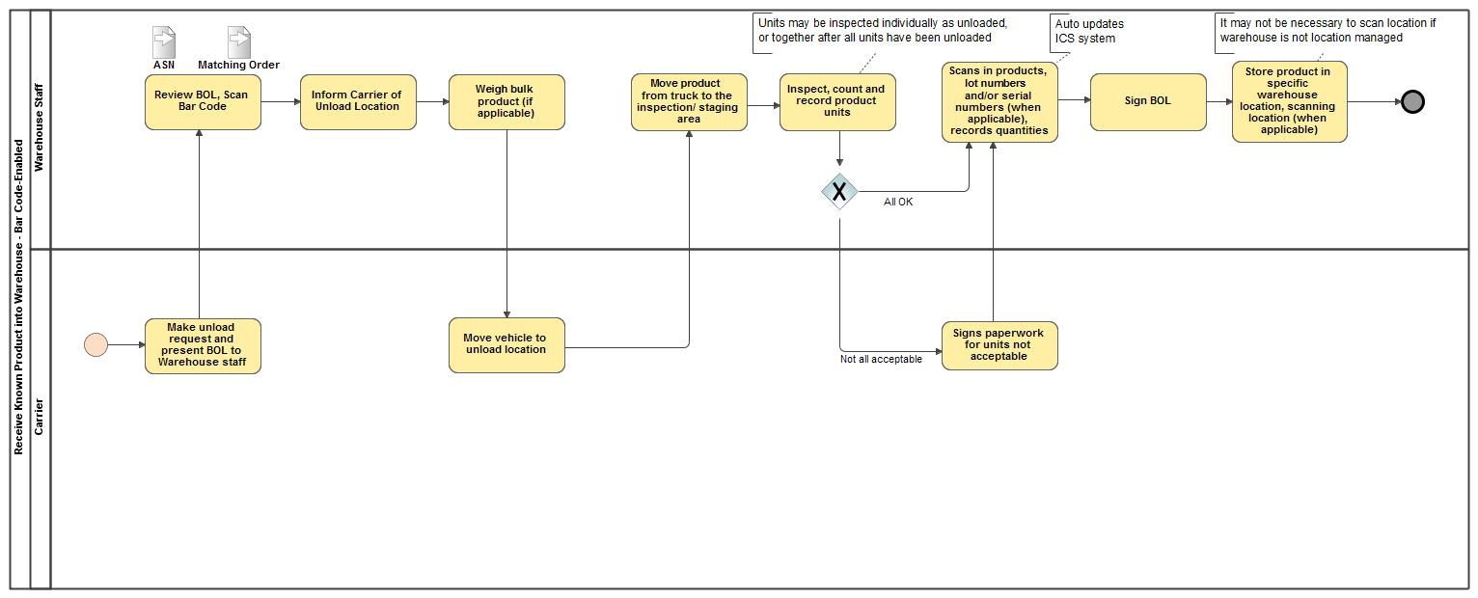
Receive Known Product into Warehouse - Bar Code-Enabled

Slide 4
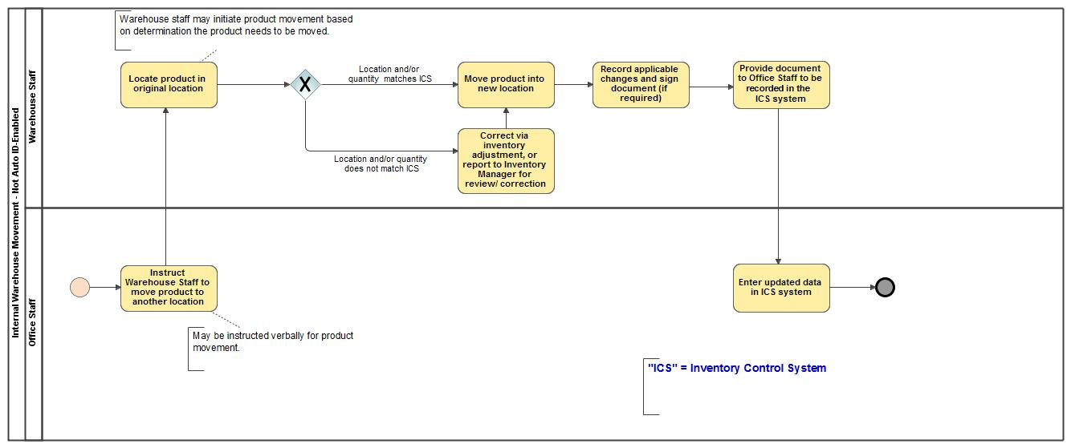
Internal Warehouse Movement
- Not Auto ID-Enabled

Slide 5
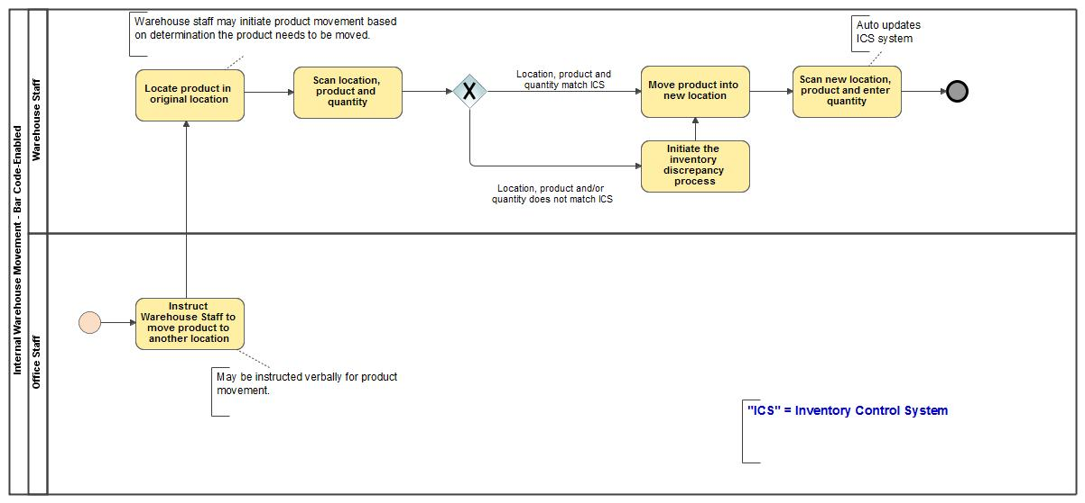
Internal Warehouse Movement
- Bar Code-Enabled

Slide 6
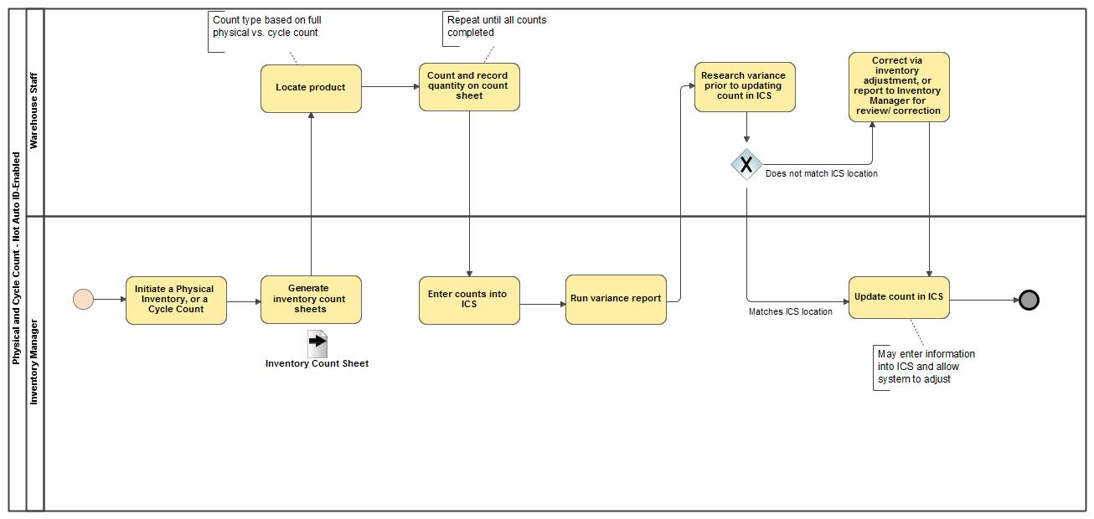
Physical and Cycle Count
- Not Auto ID-Enabled

Slide 7
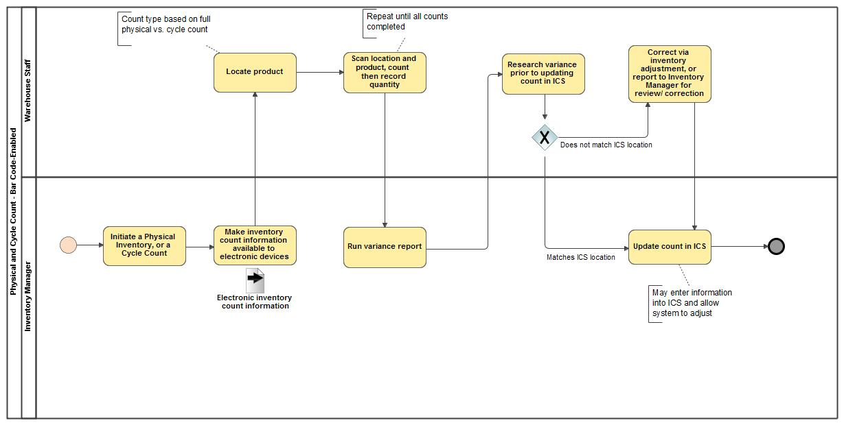
Physical and Cycle Count - Bar Code-Enabled

Slide 8
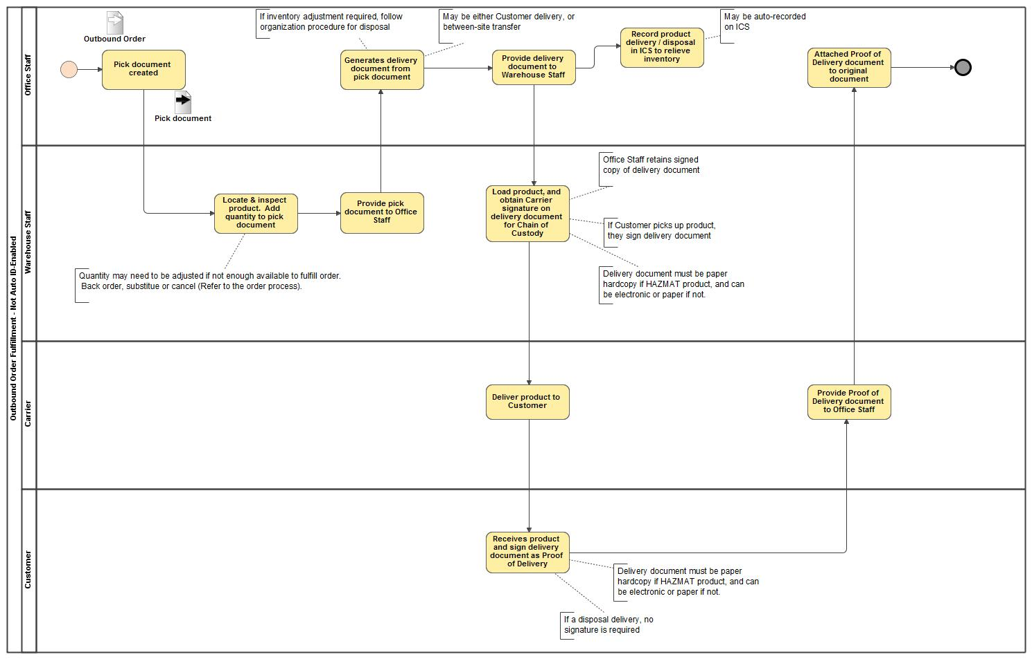
Outbound Order Fulfillment
- Not Auto ID-Enabled

Slide 9
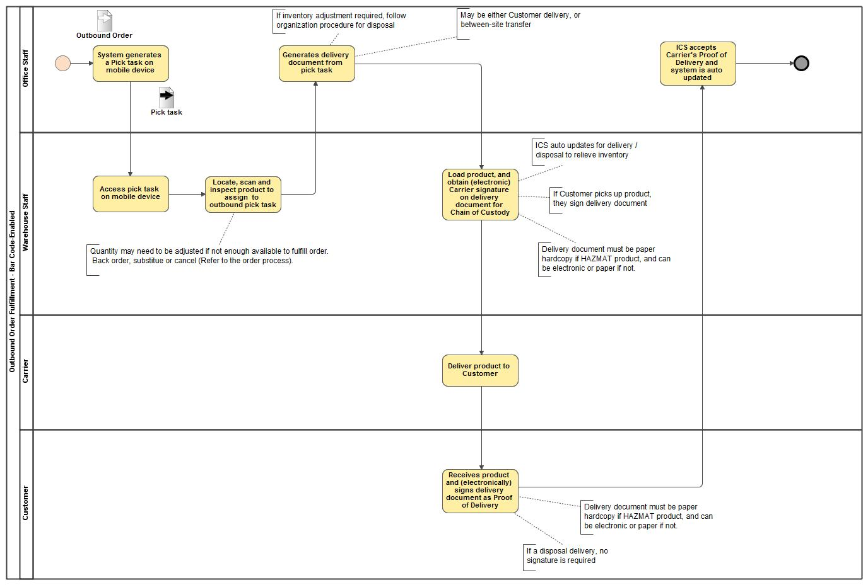
Outbound Order Fulfillment - Bar Code-Enabled

Slide 10
Refillable/Returnable Container Management Process Flow
Auto Identification Data Capture (AIDC)

Slide 11
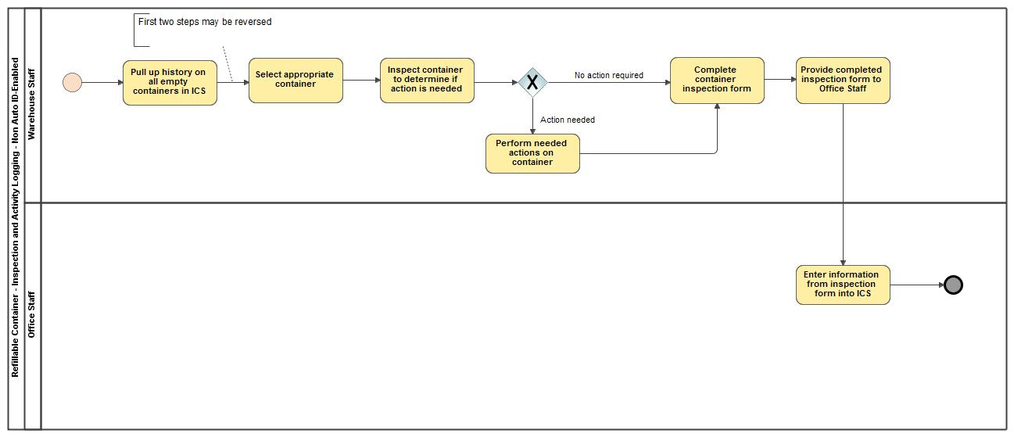
Refillable Container - Inspection and Activity Logging - Not Auto ID-Enabled

Slide 12
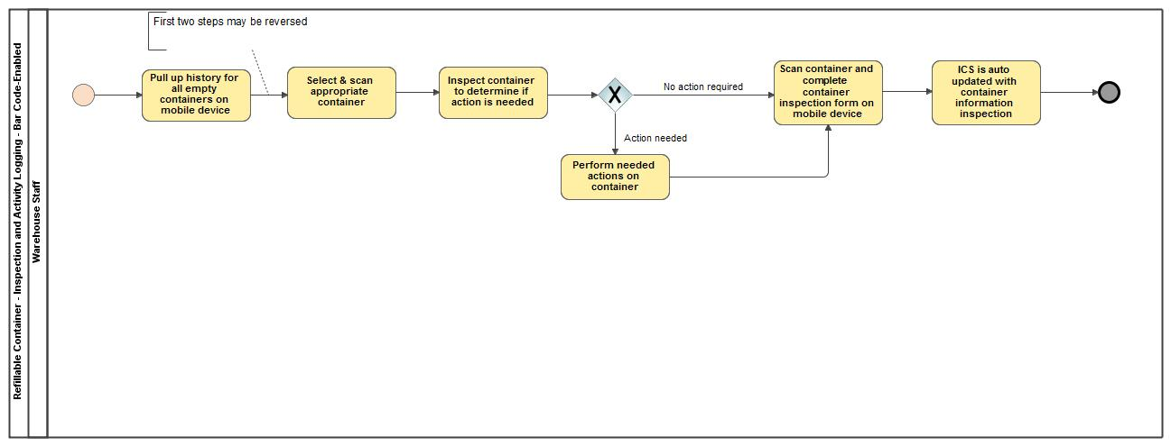
Refillable Container - Inspection and Activity Logging - Bar Code-Enabled

Slide 13
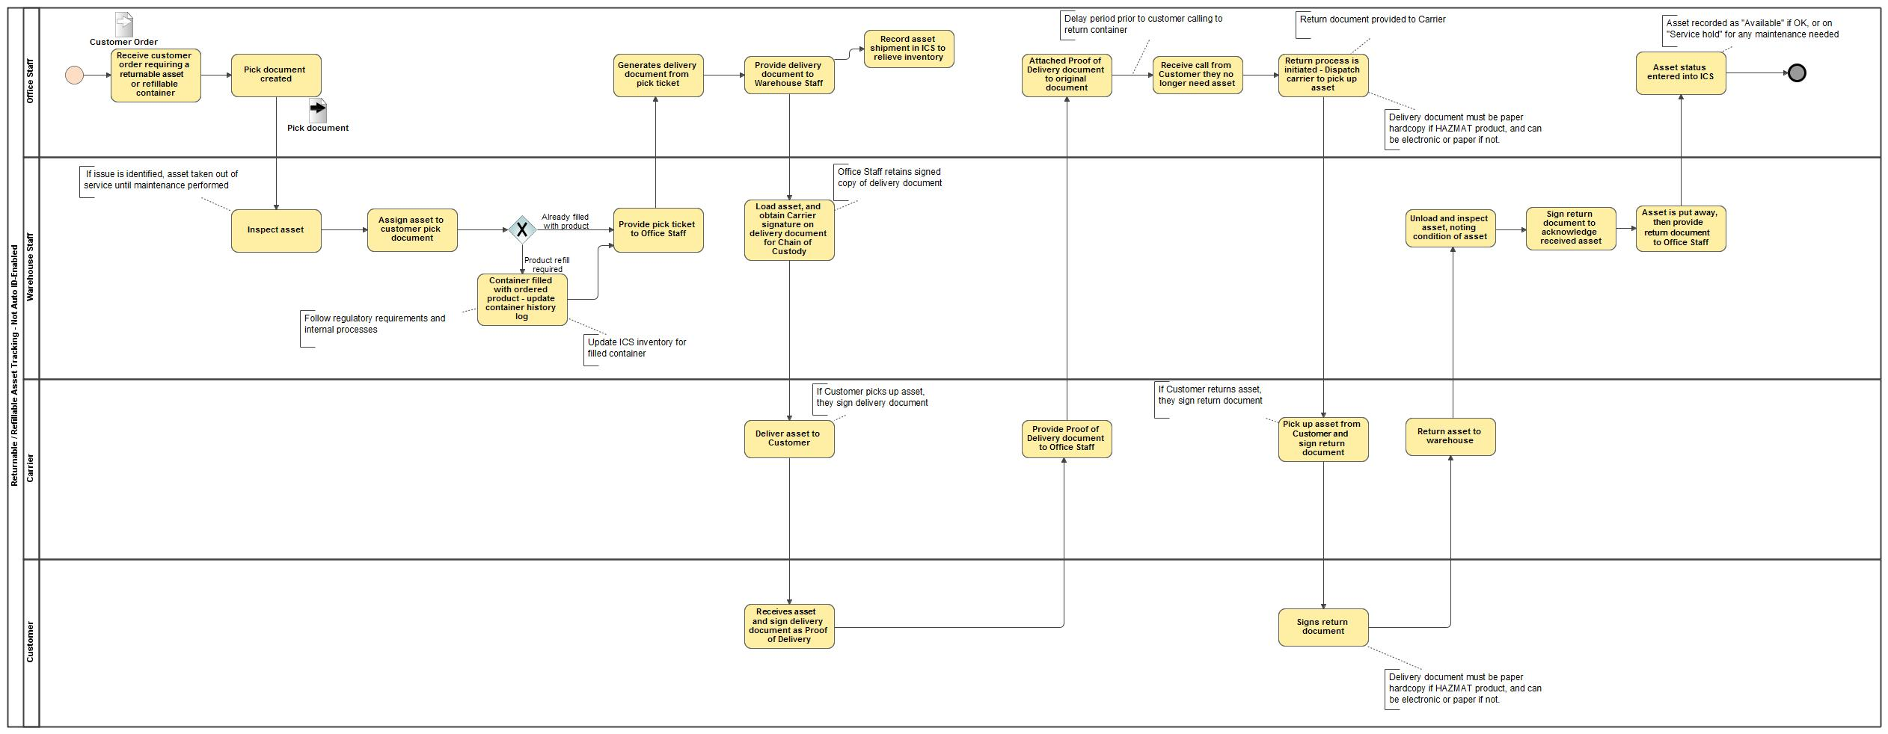
Returnable / Refillable Asset Tracking - Not Auto ID-Enabled

Slide 14
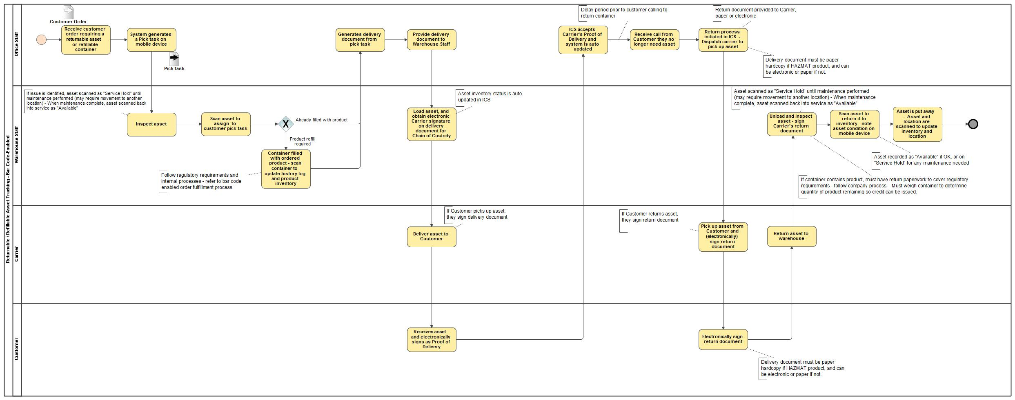
Returnable / Refillable Asset Tracking - Bar Code-Enabled

