Slide 1
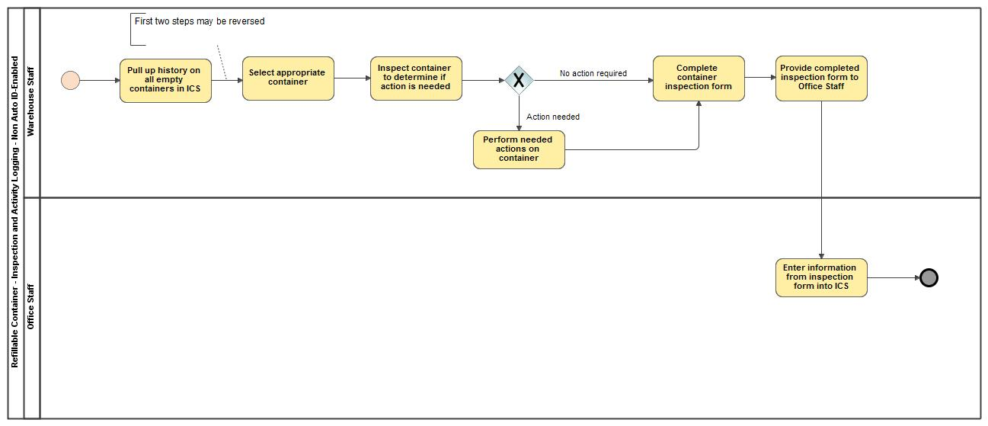
Refillable Container - Inspection and Activity Logging - Not Auto ID-Enabled

