Slide 1
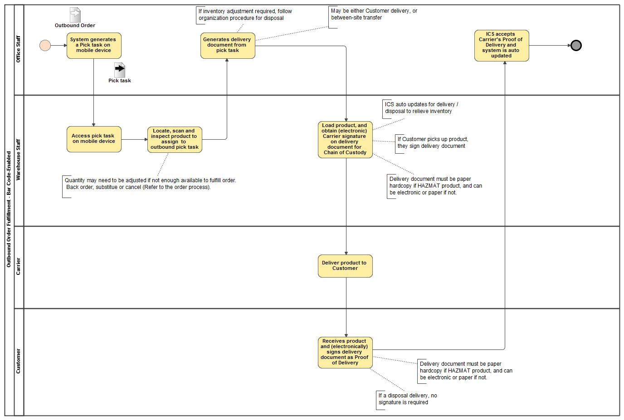
Outbound Order Fulfillment - Bar Code-Enabled

