Slide 1
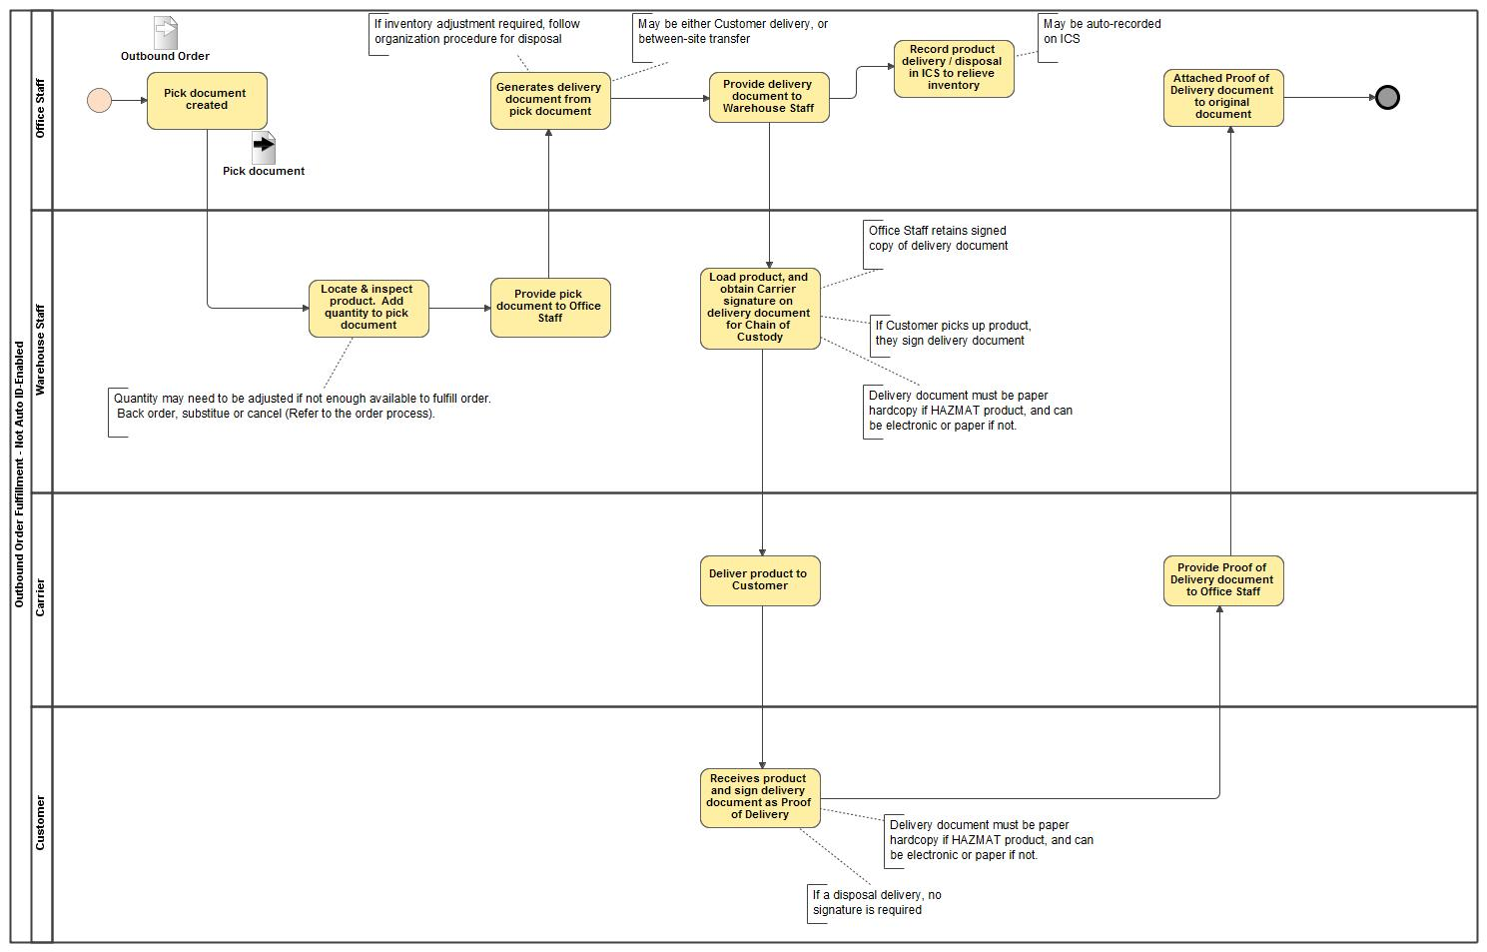
Outbound Order Fulfillment
- Not Auto ID-Enabled

