Slide 1
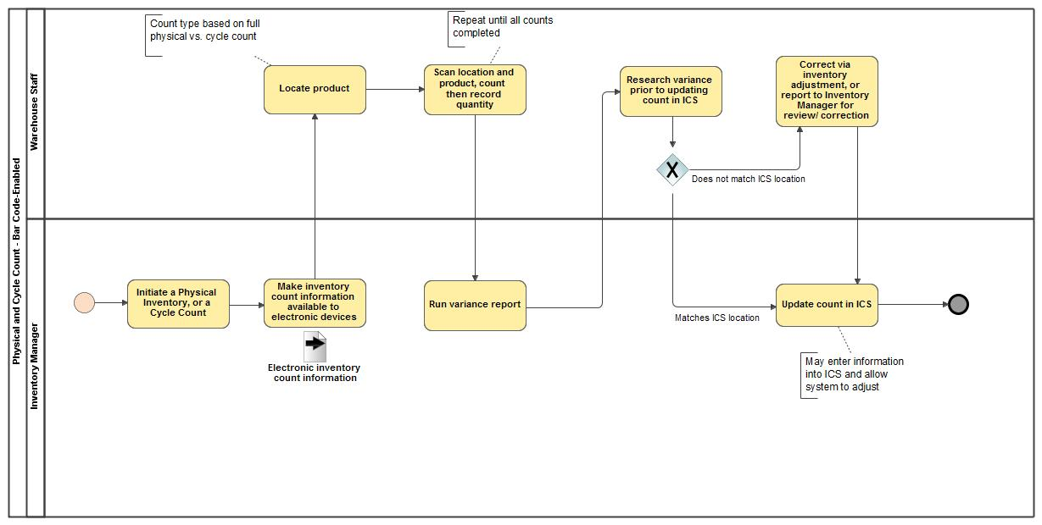
Physical and Cycle Count - Bar Code-Enabled

