Slide 1
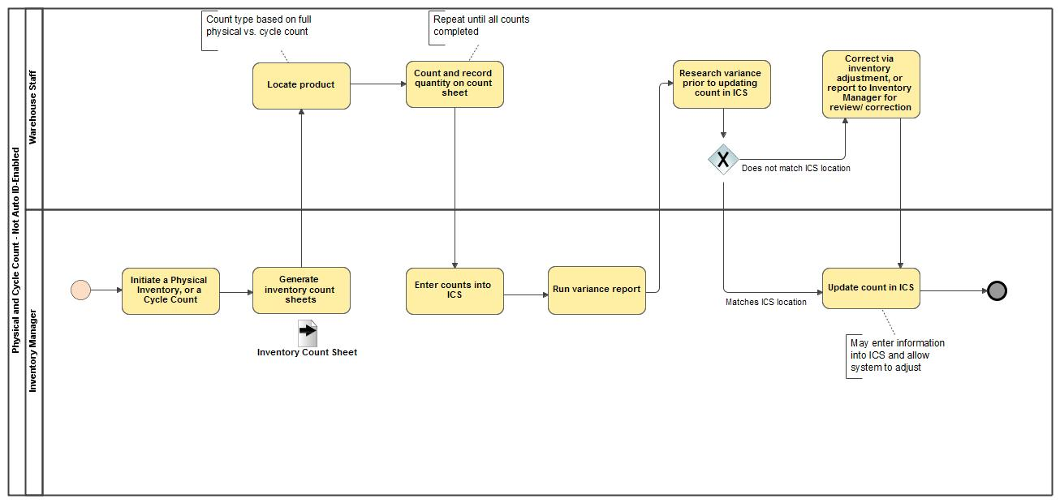
Physical and Cycle Count
- Not Auto ID-Enabled

