Slide 1
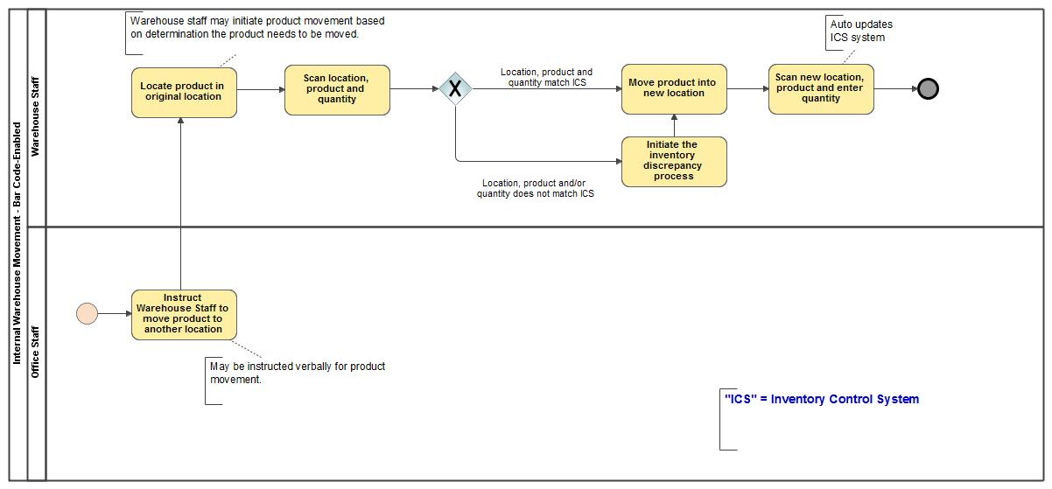
Internal Warehouse Movement
- Bar Code-Enabled

