Slide 1
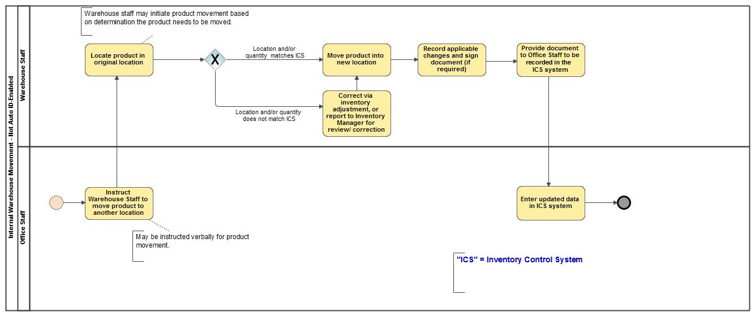
Internal Warehouse Movement
- Not Auto ID-Enabled

