Slide 1
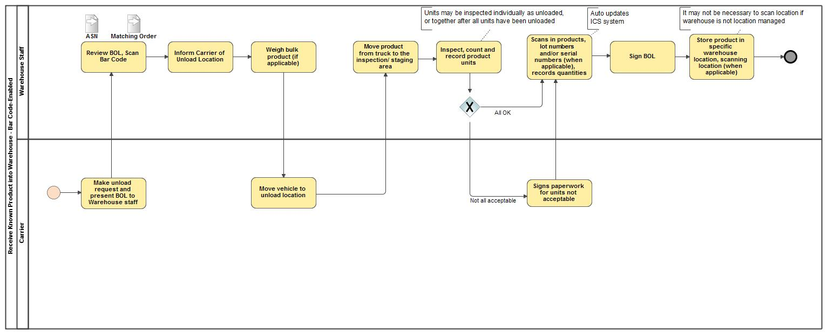
Receive Known Product into Warehouse - Bar Code-Enabled

