Slide 1
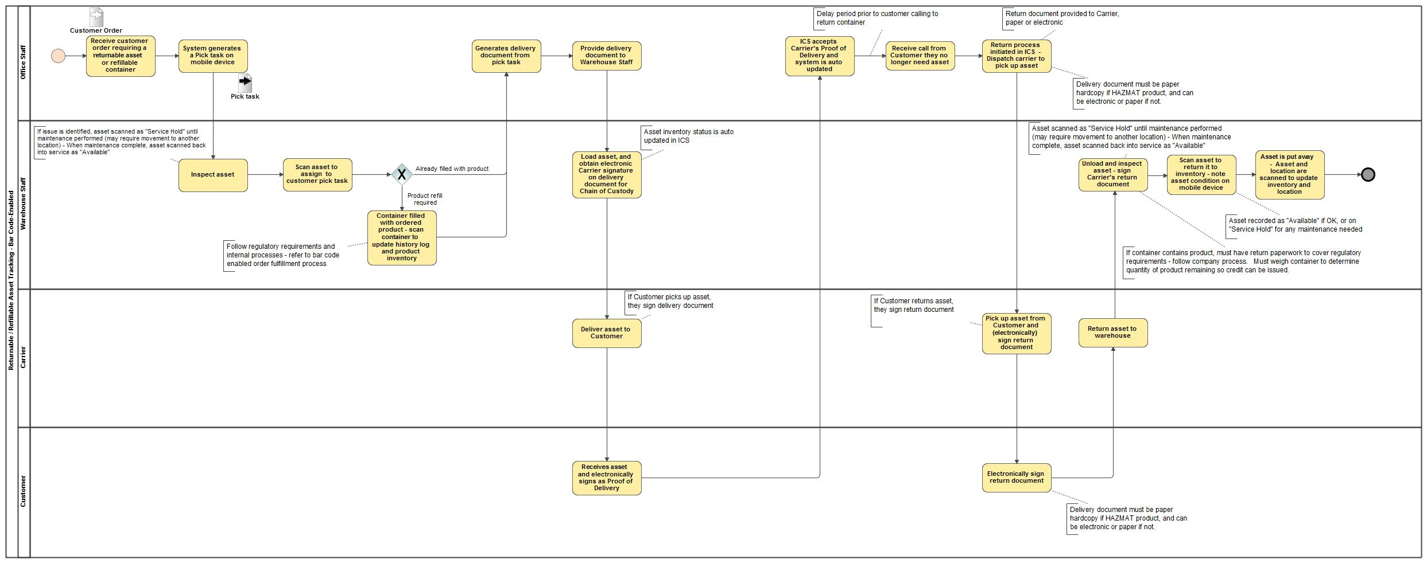
Returnable / Refillable Asset Tracking - Bar Code-Enabled

