Slide 1
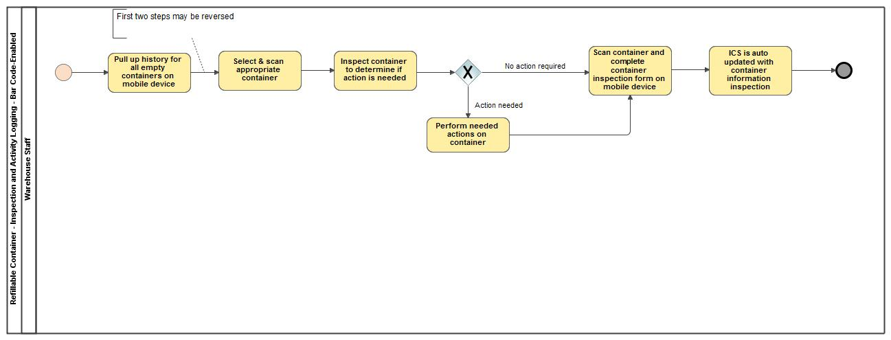
Refillable Container - Inspection and Activity Logging - Bar Code-Enabled

