Slide 1
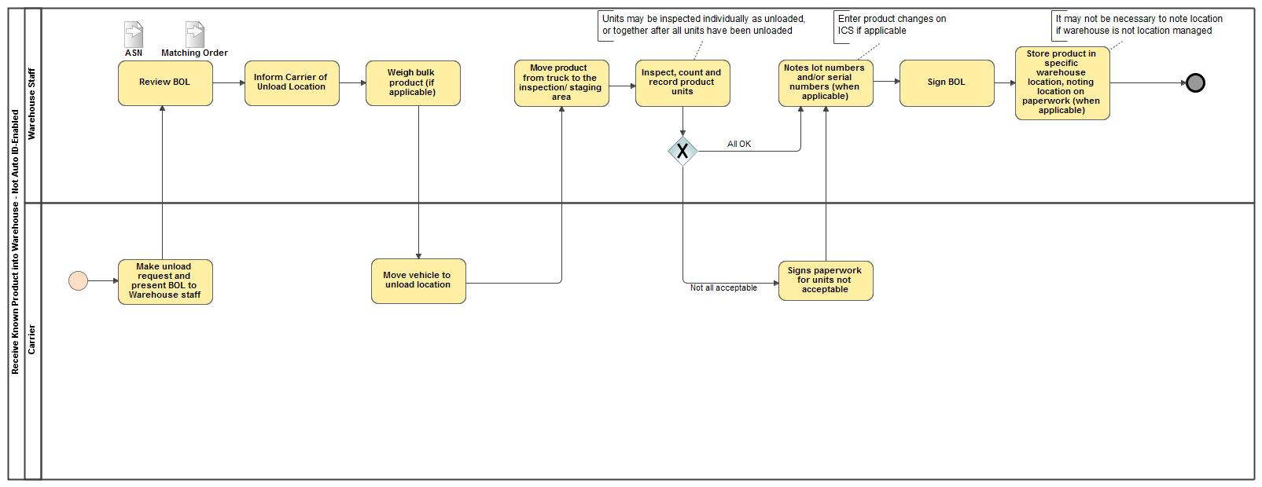
Receive Known Product into Warehouse - Not Auto ID Enabled

