Slide 1
2020 Communications Plan
February 10, 2020

Slide 2
Overall Strategic Objective
Objective: Communicate Successes and Value of Membership
Develop multi-year marketing and communication plan focused on communicating AgGateway successes and the value of membership through appropriate media by 31 January 2020 and implement throughout 2020
Supports all three 2018-2022 Strategic Goals
Tactics:
Develop and implement speaker/presentation strategy for 2020
Execute annual promotion and awareness program
Establish global communication processes and protocols
Increase awareness of implementation through production of new testimonials, case studies, etc.

Slide 3
Priorities
Communicate/promote to membership and industry:
New features of AgGateway (global activities, PMC, DRC, Working Groups, staffing, etc.), and
Associated opportunities to be involved, as these features are implemented.
Activities of Working Groups in ways meaningful from an industry-wide and corporate perspective (e.g., traceability, production efficiency).
AgGateway as a focal point in the transition to digital ag.
Also:
Establish global communication processes and protocols.

Slide 4
Key Messages
2020 Theme: Driving Digital Solutions
AgGateway is approaching its global project work in a more agile, cross-sector manner, addressing critical areas in agriculture and ag-related industries such as traceability, sustainability, interoperability in field operations, supply chain efficiencies, and more.
AgGateway helps agri-businesses streamline their processes and boost their efficiency.
Using AgGateway standards can help companies save money and respond more quickly in the marketplace.
Working with AgGateway can facilitate efforts to grow your business as the industry increasingly relies on digital exchange of information.

Slide 5
Tactics: Branding Guidelines
2020 Goals:
Draft (edit) and implement a policy on global branding, formalize standard policies and procedures for communication.
- Goal for draft by end of Q1, including review by staff and the board.
- Implement beginning in Q2, including adoption by Regional Steering Committees
As part of guidelines, explore such usage as “LATAM”
Also explore how we approach “Specialty” and whether we develop a separate brand treatment.

Slide 6
Tactics: Speaker/Presentation Strategy and Trade Shows
2020 Goals:
Promote AgGateway/drive participation and recruitment via key meetings
Arm staff and members as ambassadors.
Quarter 1:
Set up central location to post activities/opportunities (wiki page?)
Assess opportunities for 2020 and 2021, including conferences, trade shows, Allied Provider conferences.
Begin assessing existing and possible speakers to fit event/opportunities.
Review basic AgGateway PowerPoint presentation and update as needed for versatile use.
Work with the Quick Connect Task Force on promoting their event.
Quarter 2:
Review other presentation tools/hand-outs and update as needed.
Continue assessing possible speakers to fit event/opportunities.

Slide 7
Current shortlist of engagements/opportunities
Groundwater Resource Association meeting (Dan presenting), March 3-4, Monterey, CA.
CAAR (Canadian Ag Association of Retailers) – Feb 12-13, Saskatoon (Brent presenting)
InfoAg (US), July 28-30, St. Louis, MO
CropLife America Annual Meeting, Sept. 27-30, Aventura, FL
Ag Retailers Association Conference & Expo, Dec. 1-3, Las Vegas, NV
ASTA’s CSS & Seed Expo 2020, Dec. 7-10, Chicago, IL
Q1 goal - Work on this list - Latin America? Europe? GSI, other groups?

Slide 8
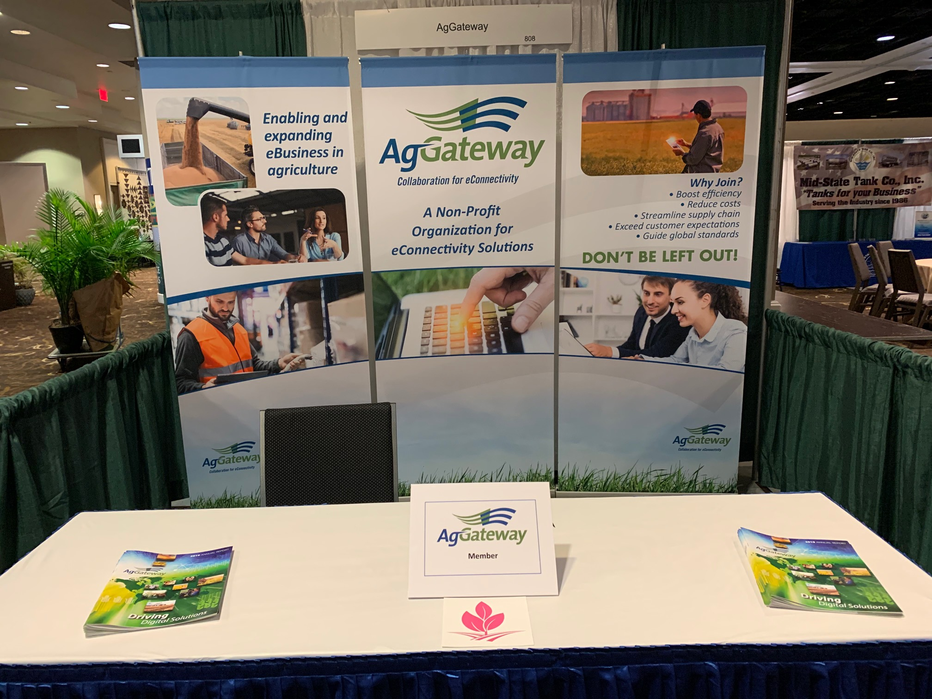
Tactics: Trade Shows
Produce new banners by Mid-Year Meeting
Reflect global scope, fresh images and messaging

Slide 9
Tactics: Website
2020 Goals:
Continue to leverage the site as our primary marketing tool, helping newcomers get connected, and promoting resources and activities.
Q1 - Work through updates needed as part of the transition.
Evaluate and execute information that needs translation into Portuguese and possibly Spanish as budget allows.
Explore concept of a separate facing for Specialty (as part of branding discussion)

Slide 10
Tactics: Case Studies
2020 Goals:
Build on the successful case study library to bolster outreach efforts.
Complete 5 additional case studies by Mid-Year Meeting 2020; Promote new studies.
Innovation Profiles: Explore whether we should encourage production of more of these.

Slide 11
Tactics: Newsletter
Continue mix of articles that demonstrate importance of our mission, successes/achievements, breadth of sectors covered, participation of major industry players.
Q1: Promote changes/improvements related to 2020 and how members will interact with the new structure.
All year: Promote Working Group activities, new members, information from Member Services, etc.
Monthly updates from Latin America and Europe.

Slide 12
Tactics: Other Materials
Video:
Fix YouTube channel problems
Explore developing graphic explainer video(s) and/or testimonial video
Flyers:
Create flyers as needed that are specific to areas of activity. (e.g., traceability, production efficiency, etc.).
Annual Report:
Produce annual report (fall).
Translations: Explore need/budget to translate some materials into Portuguese.

Slide 13
Tactics: Media Relations
Press Releases: At least 1 press release/month
Guest columns/features that focus on specific areas of achievement

Slide 14
Tactics: Social Media
Daily activity via Communications Committee - Current focus is on LinkedIn and Twitter
Explore ways to leverage WhatsApp and Instagram
Expand use of photos and video
Include Latin America and European posts

Slide 15
Tactics: AgGateway Meeting Promotion
Mid-Year Meeting and Annual Conference: Work with new staff in promoting the two meetings to drive attendance.
Promote other meetings as needed (e.g. in other regions)

Slide 16
Tactics: Awards Program/Volunteer Recognition
Continue Ron Storms Leadership Award, AgGateway in Action Awards, President’s Award
Establish ongoing process for AgGateway in Action Awards (formerly given by Council chairs) -- new process via Regional Steering Committees.

Slide 17
2020 Communications Plan
February 10, 2020

