Slide 1
2023 Marketing and Communications Plan

Slide 2
2023 Communications goals
Regular, direct communication with membership to connect companies with AGG activities/needs/successes
Begin to segment and communicate with members based on what they hope to gain from membership
Increase communication with c-suite execs/decision-makers in targeted member and prospective member companies
Support member recruitment efforts

Slide 3
2023 Key Messages
2023 Theme ….. Still delibrating!

Slide 4
Value Proposition
AgGateway membership helps companies:
Reduce errors in procurement, inventory, sales and reporting, saving time and money.
Achieve interoperability among myriad hardware and software systems, to turn data into value.
Leverage global resources and business relationships needed to enhance productivity, traceability and sustainability.

Slide 5
Who We Are
AgGateway is a global, non-profit organization that develops standards and other resources so that companies can rapidly access information. We focus on implementation of these resources in the field, to realize the benefits of digital agriculture.
No one else is doing what AgGateway does, providing a unique forum across industry sectors where companies come together to solve digital challenges for agriculture and related industries.

Slide 6
Why
AgGateway helps businesses streamline their processes and boost their efficiency.
Using AgGateway standards can help companies save money and respond more quickly in the marketplace.
When companies implement AgGateway standards, they can get in sync with countless other processes and trading partners around the globe, which is fundamentally good business.

Slide 7
2023 Tactical Plan

Slide 8
Current Hot Potato: Roadshow!
Events in IA, IN, and NE
Work with volunteers to promote, support, etc.
Social media support, flyer distribution, etc.
Jan 11, Feb 1, Feb 22

Slide 9
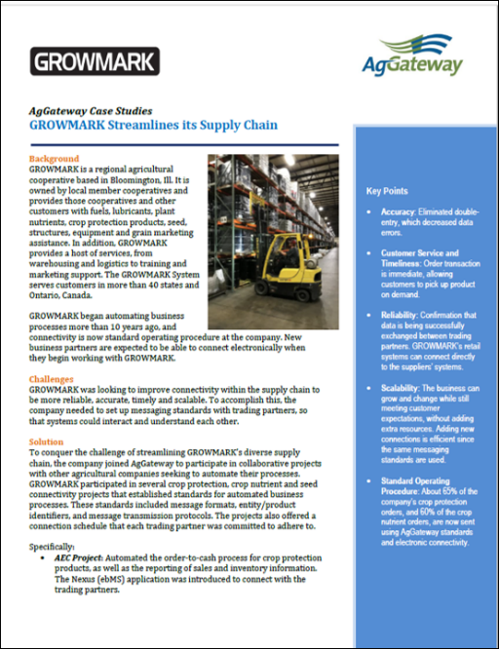
Case Studies
Refresh Case Study library
Tighten text, make them more accessible
Update with additional evidence of benefits, statistics, etc.

Slide 10
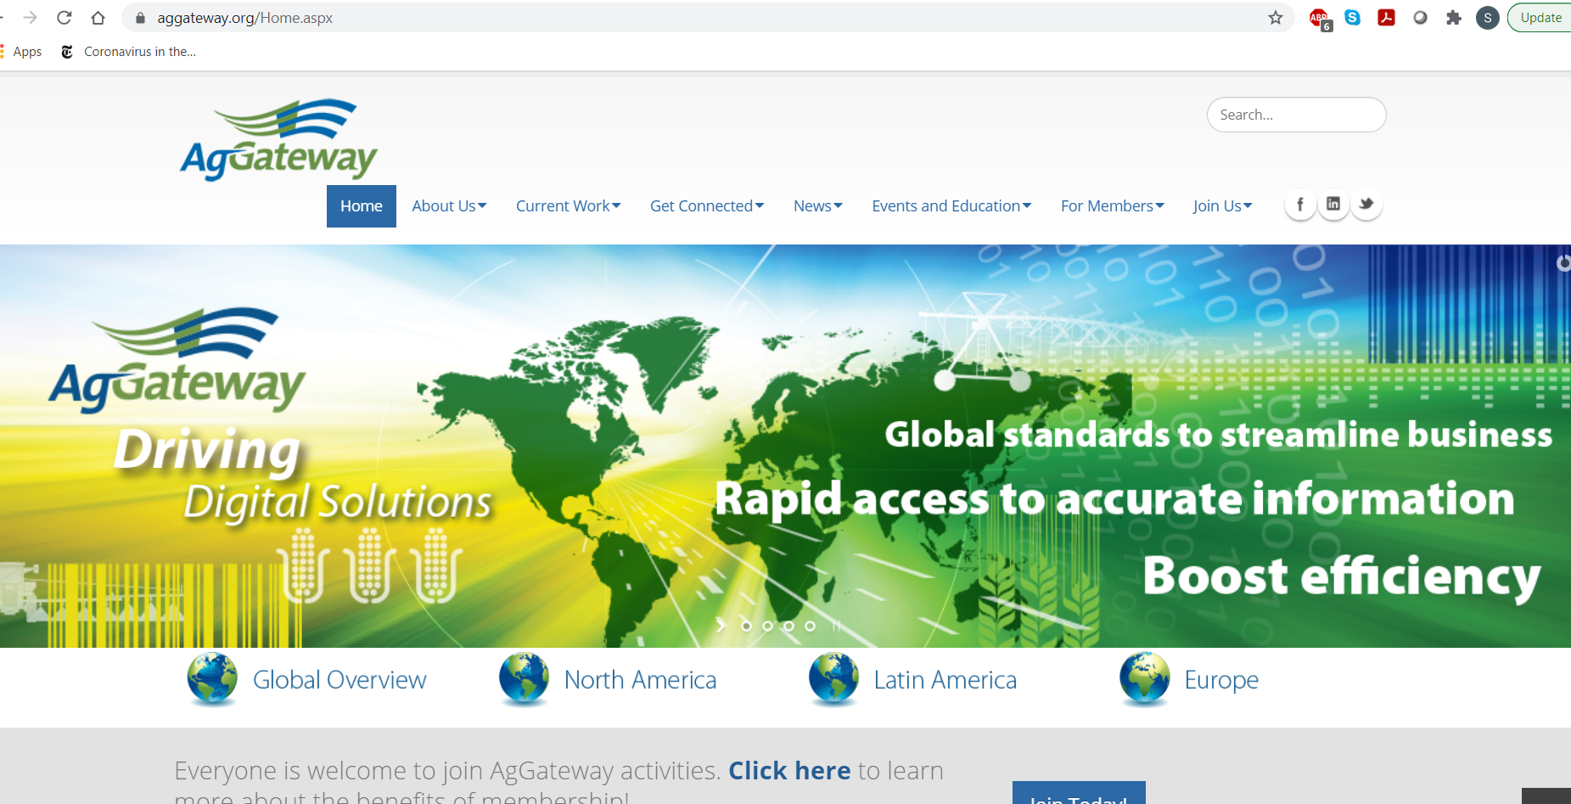
Website
Redesign home page to ensure the mission and message is clear to first time visitors.
Gentle reorganization of key member content
Revisit Communications Kit

Slide 11
Newsletter
Monthly focus will shift to member news and activities.
Promote Working Group activities, reports from regions, new members, etc.
Timing: All Year

Slide 12
Other Materials
Video: “How Ideas Become Standards”
Timing: Complete by MYM
Flyers: Create flyers as needed that are specific to areas of activity.
Timing: As needed
Annual Report: Produce annual report
Timing: End Q4
Other: continue to explore use of infographics
Timing: Year-Round

Slide 13
Presentations:
President/CEO and Chairman remarks at MYM and Annual Conference
Timing: For MYM (Q2) and Annual Conference (Q3) and as needed

Slide 14
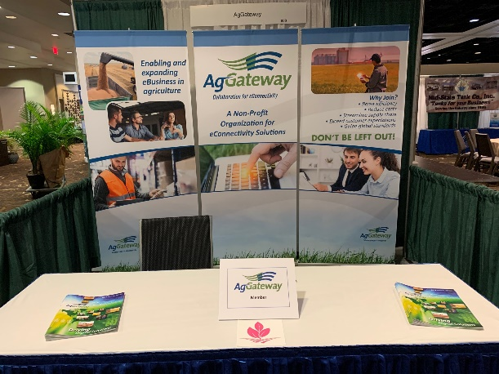
Conference and Trade Show Strategy
Drive participation/recruitment via key meetings. Assess priorities for participation for 2023 in all regions
Seek speaking opportunities; support speakers w/collateral as needed
Seek strategic partnerships with other organizations where possible
Timing: Quarter 1 & 2:
Update list of activities (wiki), assess and set priorities for 2023
Consider speakers to fit opportunities
Refine or create materials as needed

Slide 15
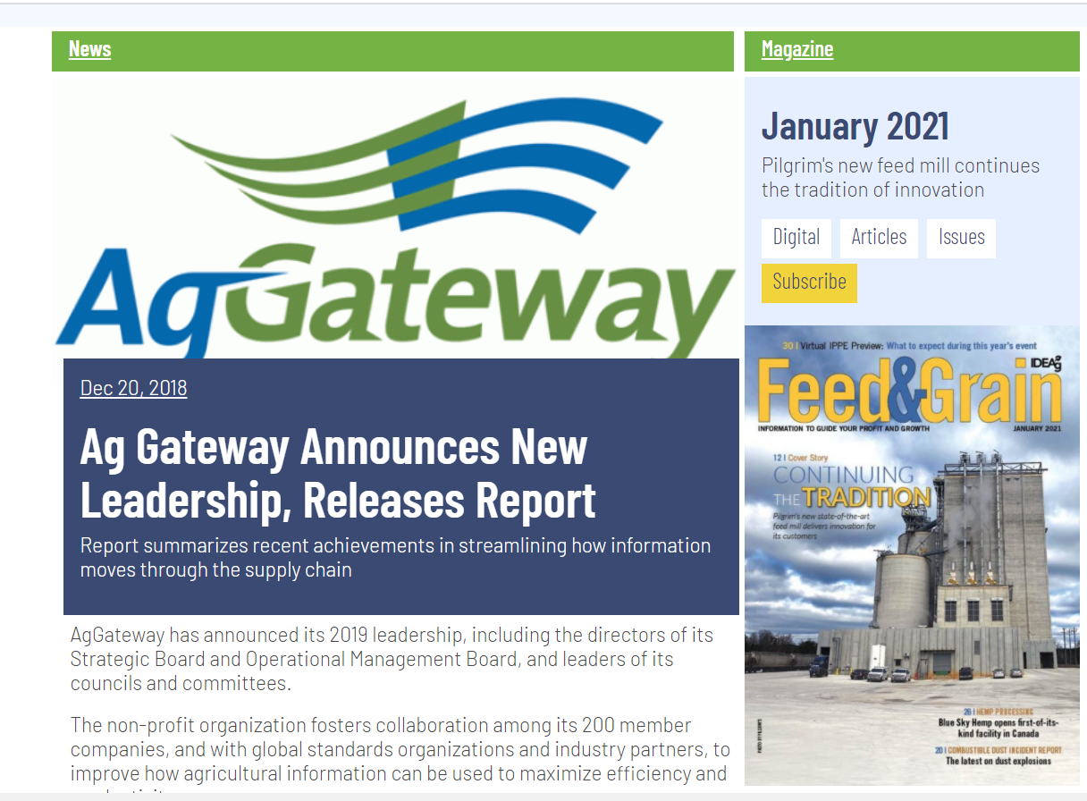
Media Relations
Press Releases
Update media lists (ugh)
Guest columns/features that focus on specific areas of achievement
Timing: All Year; review and update media lists in Q1 & Q2

Slide 16
Big Year for Portfolio Releases
Modus 2.0
Field Boundaries
In-Field Product ID
Much more in the hopper as AgGateway 2020 Advances!

Slide 17
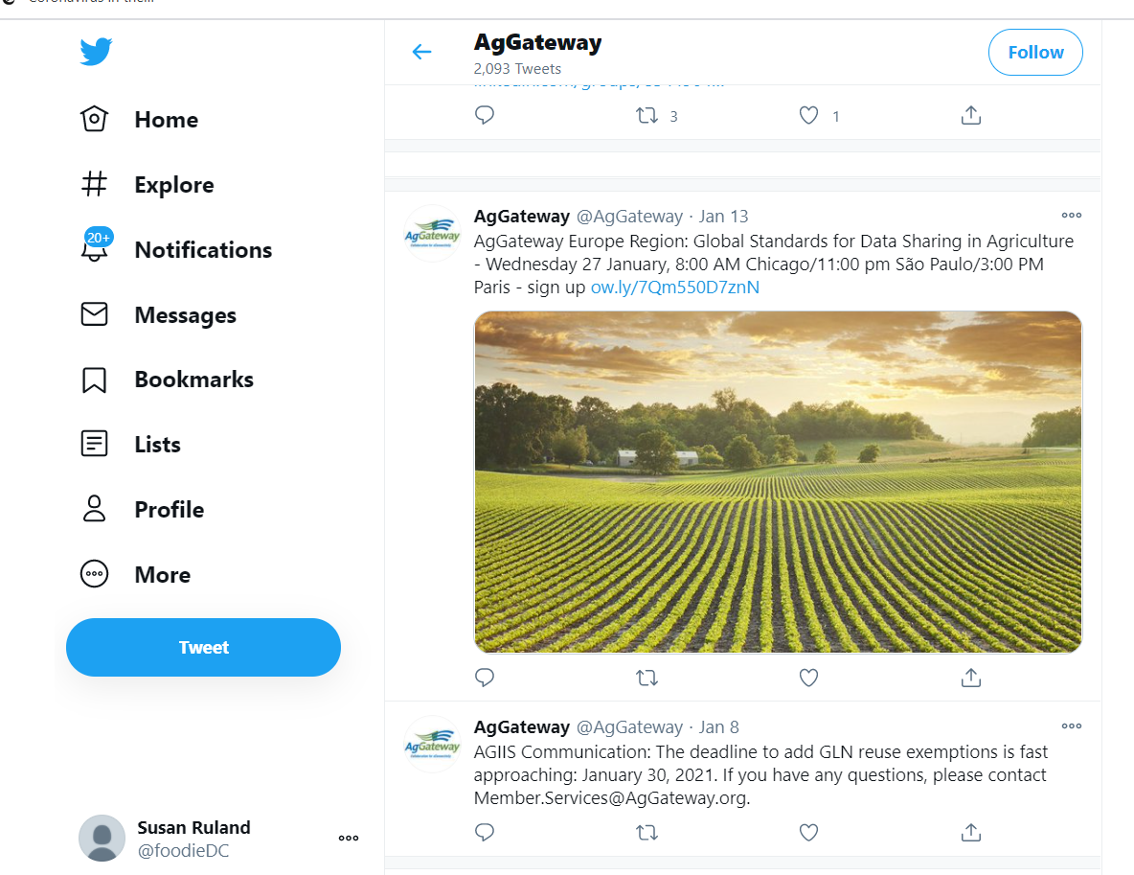
Social Media
Daily activity via Communications Committee
Include Latin America and European posts
Timing: All Year

Slide 18
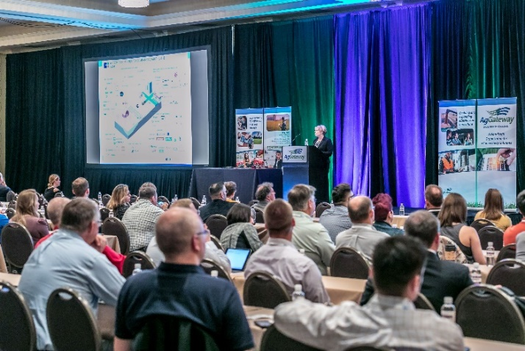
AgGateway Meeting Promotion
Mid-Year Meeting and Annual Conference: Work with staff in promoting the two meetings to drive attendance. Assist in producing sponsorship brochure.
Promote other meetings/events as needed
Timing: Q1 & 2 - Mid-Year Meeting promotion
Timing: Q3 & 4 - Annual Conference promotion

Slide 19
Awards Program/Volunteer Recognition
Ron Storms Leadership Award, AgGateway in Action Awards, President’s Award
Timing: Q3 & Q4 - execute and promote

Slide 20
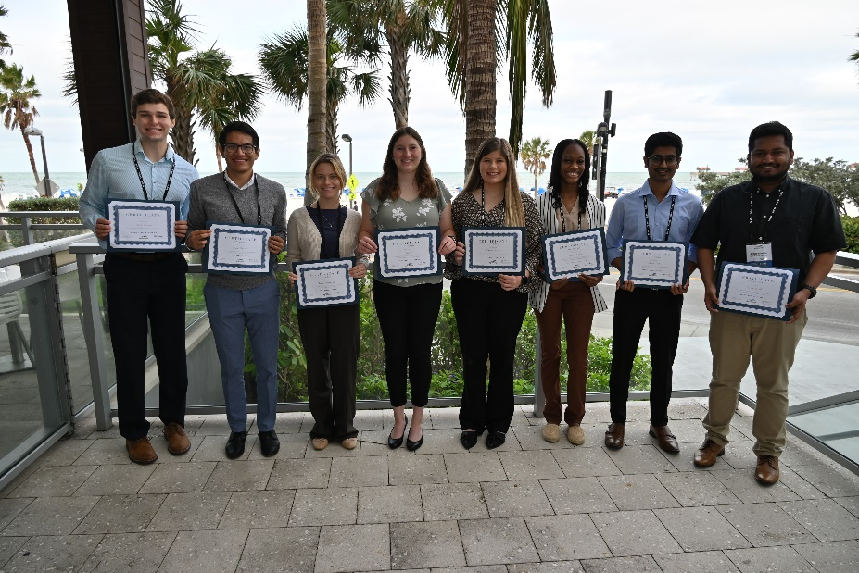
Gateway to Ag Careers
Increased Visibility, Logo
6 outstanding recipients in 2022
Timing may be adjusted to summer … stay tuned!

Slide 21
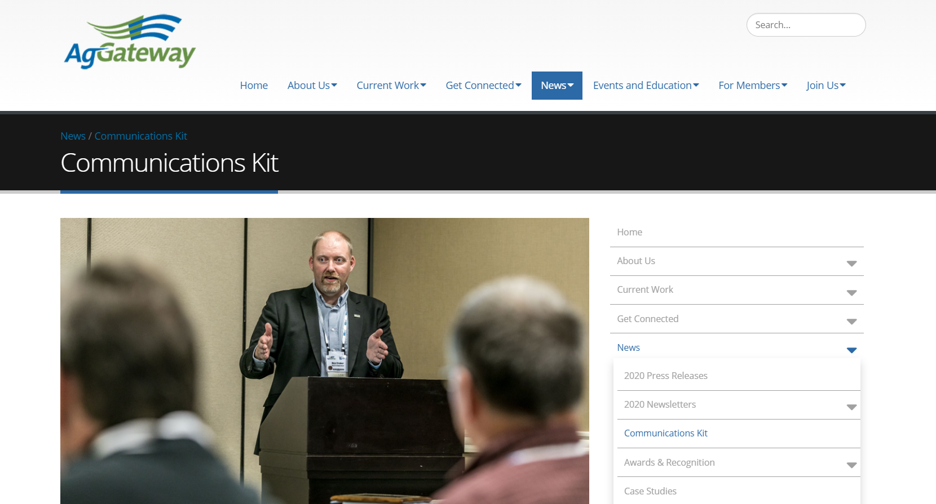
Reminder

Slide 22
How to make 2023 better
Make sharing content part of processes
Working Groups, Committees
“News” can be:
Setting goals that benefit members/industry
Calling for participation
Progress on goals
Involvement of significant companies
Producing a new resource
Implementation progress on the resource
Etc.!

