Slide 1
2021 Communications Plan
January 2021

Slide 2
2021 Communications goals
Promote continued AgGateway activities and successes to members and the industry
Increase communication with c-suite execs/decision-makers in targeted member and prospective member companies
Support member recruitment efforts

Slide 3
2021 Key Messages
2021 Theme:
Create, Engage, Grow

Slide 4
Value Proposition
AgGateway membership helps companies:
Reduce errors in procurement, inventory, sales and reporting, saving time and money.
Achieve interoperability among myriad hardware and software systems, to turn data into value.
Leverage global resources and business relationships needed to enhance productivity, traceability and sustainability.

Slide 5
Who We Are
AgGateway is a global, non-profit organization that develops standards and other resources so that companies can rapidly access information. We focus on implementation of these resources in the field, to realize the benefits of digital agriculture.
No one else is doing what AgGateway does, providing a unique forum across industry sectors where companies come together to solve digital challenges for agriculture and related industries.

Slide 6
Why
AgGateway helps businesses streamline their processes and boost their efficiency.
Using AgGateway standards can help companies save money and respond more quickly in the marketplace.
When companies implement AgGateway standards, they can get in sync with countless other processes and trading partners around the globe, which is fundamentally good business.

Slide 7
2021 Tactical Plan
Refine or create marketing materials as needed for engagement and growth.
Numerous tactics…

Slide 8
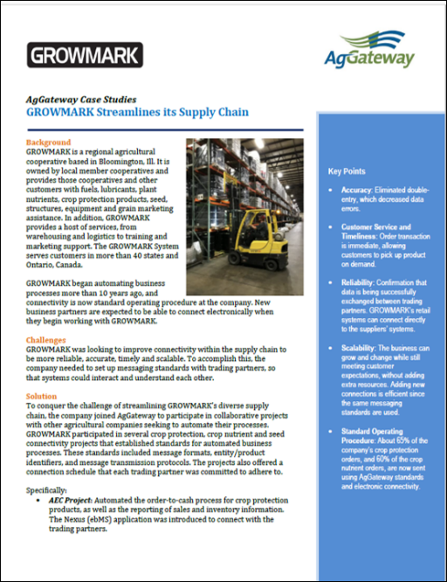
Case Studies
Build on the successful case study library to bolster outreach efforts.
Timing: Complete 3 additional case studies by MYM 2021; Promote new studies Q2 & Q3

Slide 9
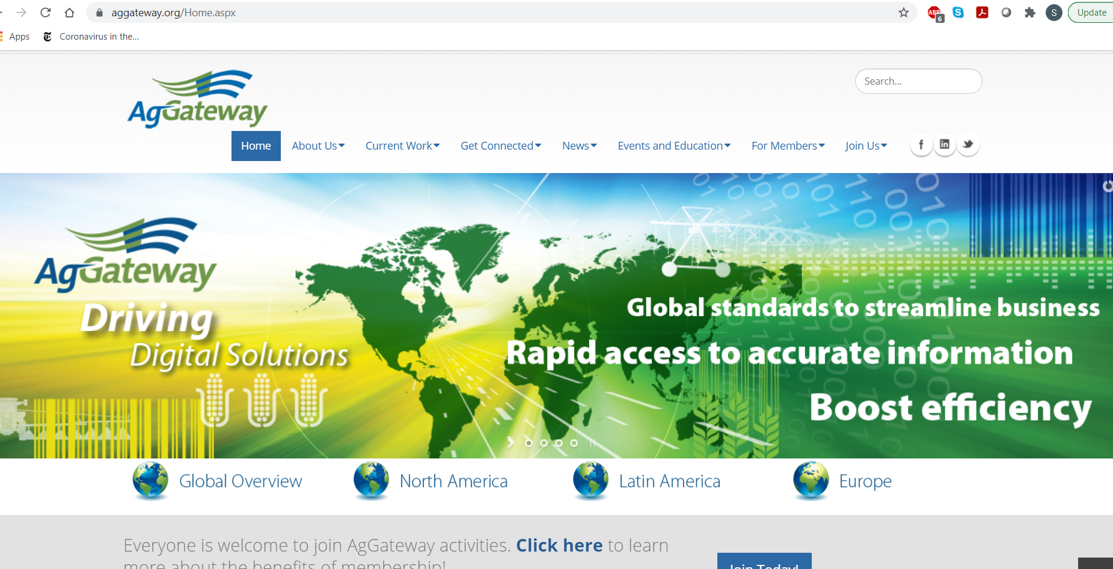
Website
Continue to leverage the website as our primary marketing tool, helping newcomers get connected, and promoting resources and activities.
Evaluate and execute information that needs translation into Portuguese and Spanish as budget allows.
Timing: All Year

Slide 10
Newsletter
Continue mix of articles that demonstrate importance of our mission, successes/achievements, breadth of sectors covered, participation of major industry players
Promote Working Group activities, reports from regions, new members, etc.
Timing: All Year

Slide 11
Other Materials
Video: Develop next in series of graphic explainer videos
Timing: Produce 2nd in series by MYM
Flyers: Create flyers as needed that are specific to areas of activity.
Timing: As needed
Annual Report: Produce annual report
Timing: Q3
Other: continue to explore use of infographics
Timing: Year-Round

Slide 12
Other Materials
Translations: Translate select materials and web pages into Spanish and Portuguese as needed and as budget allows.
Timing: All Year

Slide 13
Presentations:
President/CEO and Chairman remarks at MYM and Annual Conference
Timing: For MYM (Q2) and Annual Conference (Q3) and as needed

Slide 14
Board Briefing Book
Produce 2022 book
Timing: Q3 & Q4

Slide 15
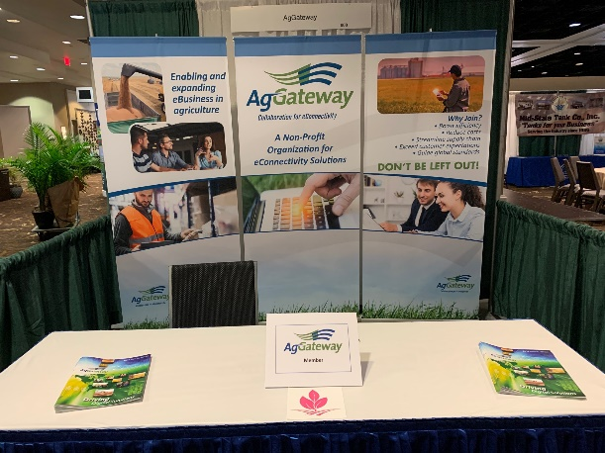
Conference and Trade Show Strategy
Drive participation/recruitment via key meetings. Assess priorities for participation for 2021 and 2022 in all regions
Seek speaking opportunities; support speakers w/collateral as needed
Seek strategic partnerships with other organizations where possible
Timing: Quarter 1 & 2:
Update list of activities (wiki), assess and set priorities for 2021 and 2022
Consider speakers to fit opportunities
Refine or create materials as needed

Slide 16
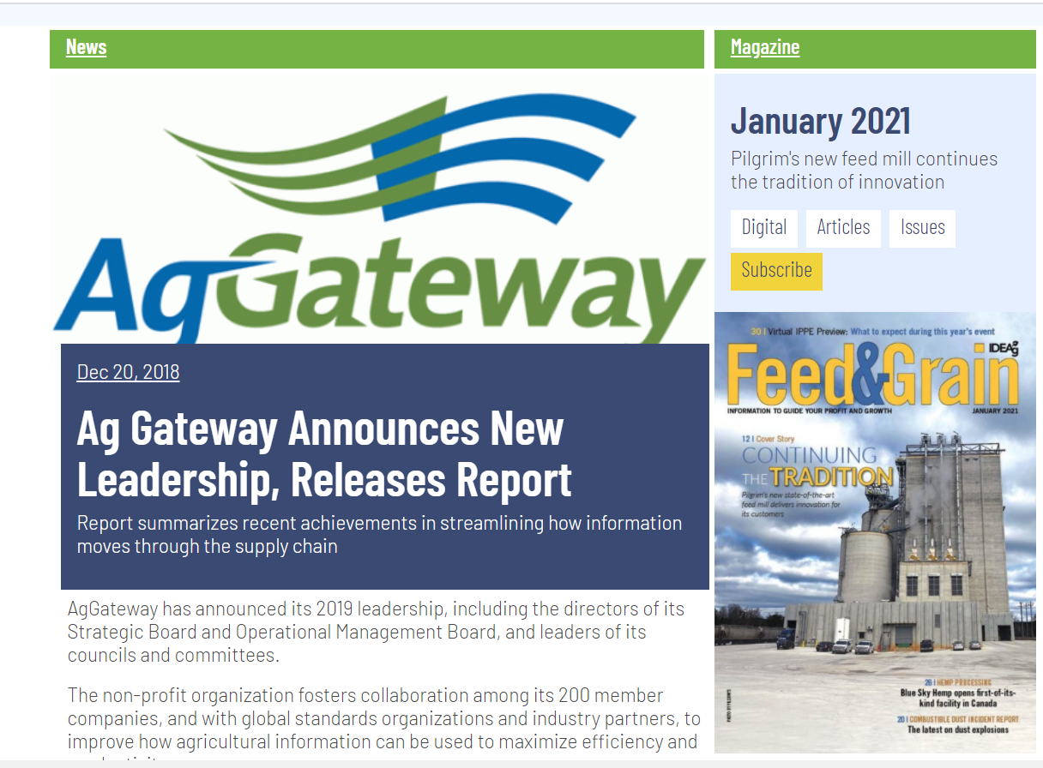
Media Relations
Press Releases: At least 1 press release/month
Update media lists
Guest columns/features that focus on specific areas of achievement
Timing: All Year; review and update media lists in Q1 & Q2

Slide 17
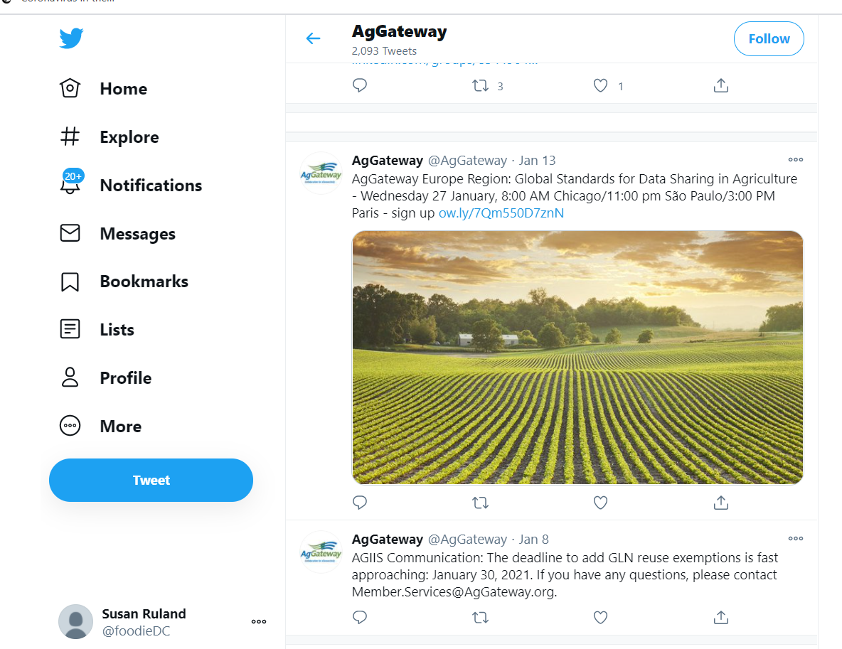
Social Media
Daily activity via Communications Committee
Include Latin America and European posts
Timing: All Year

Slide 18
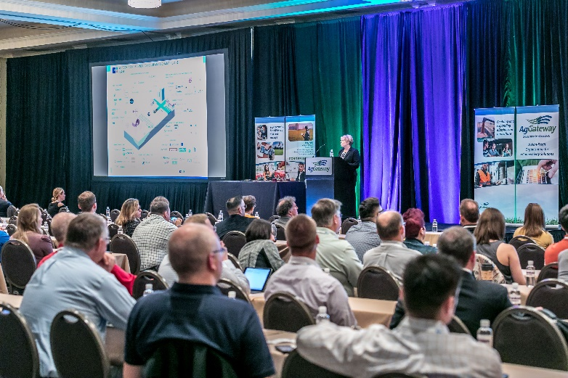
AgGateway Meeting Promotion
Mid-Year Meeting and Annual Conference: Work with staff in promoting the two meetings to drive attendance. Assist in producing sponsorship brochure.
Promote other meetings/events as needed
Timing: Q1 & 2 - Mid-Year Meeting promotion
Timing: Q3 & 4 - Annual Conference promotion

Slide 19
Awards Program/Volunteer Recognition
Ron Storms Leadership Award, AgGateway in Action Awards, President’s Award
Timing: Q3 & Q4 - execute and promote

Slide 20
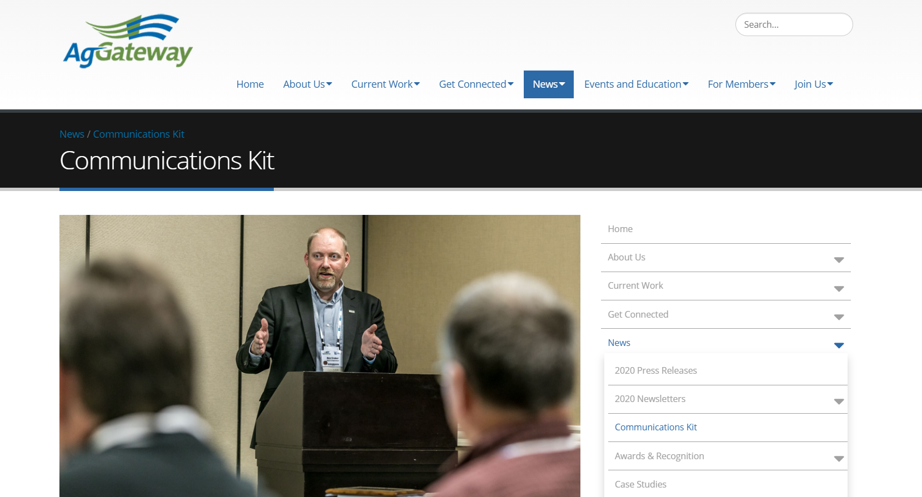
Reminder

Slide 21
How to make 2021 better
Make sharing content part of processes
Working Groups, Committees
“News” can be:
Setting goals that benefit members/industry
Calling for participation
Progress on goals
Involvement of significant companies
Producing a new resource
Implementation progress on the resource
Etc.!

Slide 22
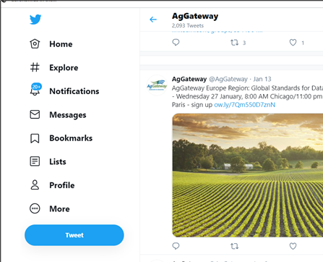
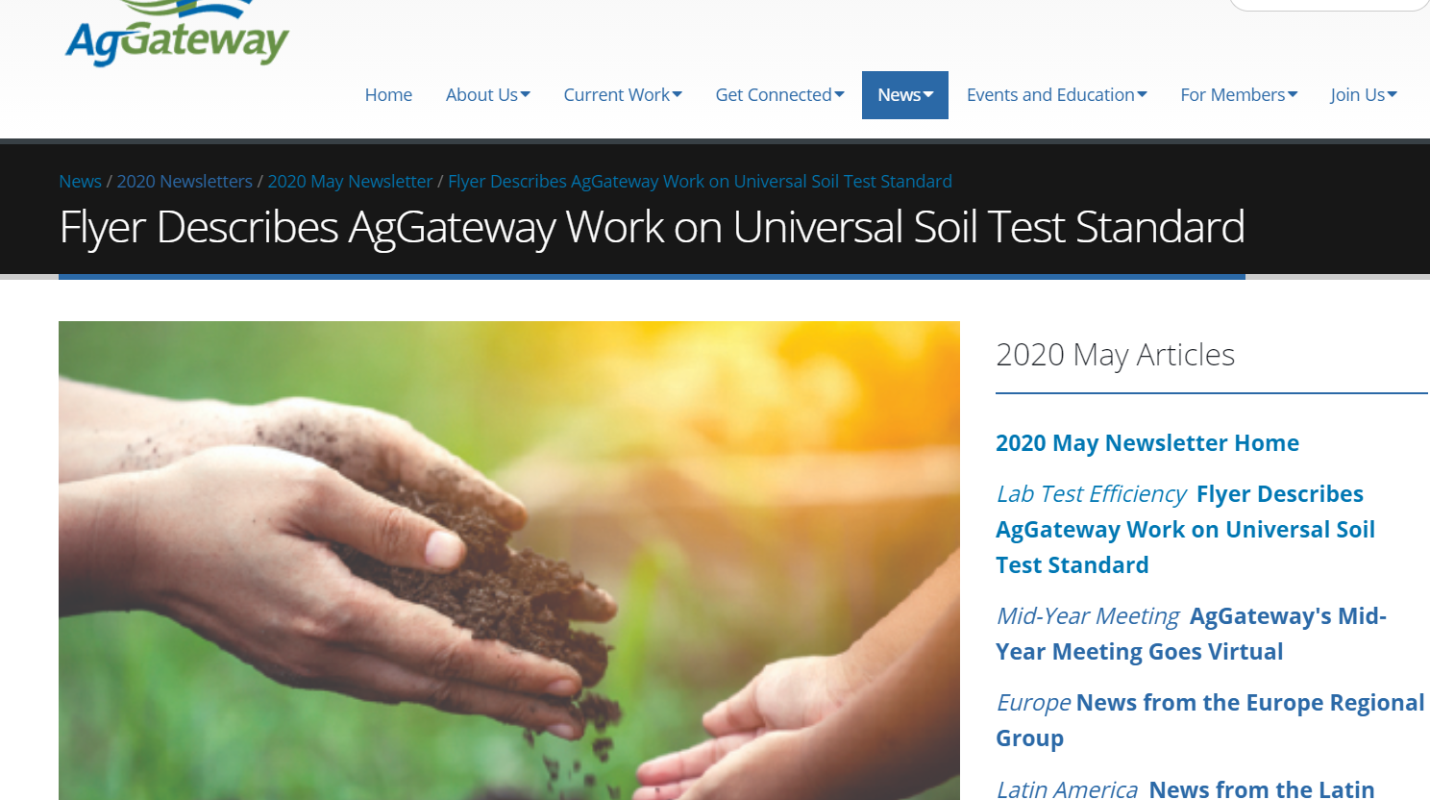
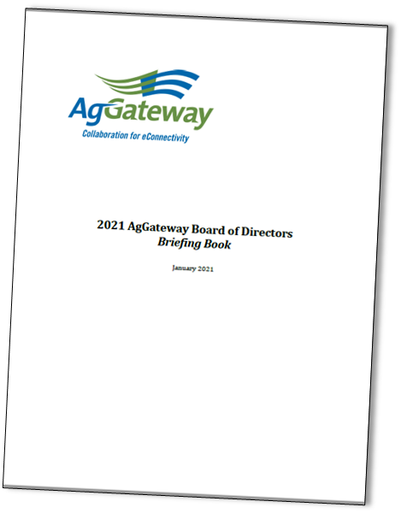
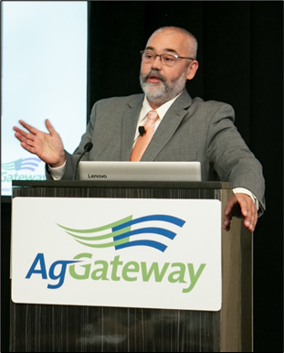
What we can do with good content

