Slide 1
Wiki & Member Portal Training
November 2018

Slide 2
What We Will Cover
What is a Wiki?
Why AgGateway uses a wiki
How to get to the AgGateway wiki page
How to create your user account
Wiki homepage contents and security
Define a Space and a Page
How to find content
How to import a Word document
Creating and updating a page
Page history
Moving and reordering pages
Managing your profile

Slide 3
What is a Wiki?
Wikipedia Definition – A wiki is a website which allows collaborative modification of its content and structure directly from the web browser.
Merriam Webster Definition – A website that allows visitors to make changes, contributions, or corrections
Impress Your Friends- Wiki/Wiki/Web was the first wiki and was developed by Ward Cunningham in 1994. The term “Wiki” was named by Cunningham and is derived from a Hawaiian term meaning “Quick” or “Fast

Slide 4
Why Use a Wiki?
Confluence or the Wiki, allows you to create, organize and discuss work with your team
All work is centralized
Allows for collaboration
Real Time Updates
Notes:
WHY DO WE USE THE WIKI?
AgGateway uses the wiki to provide a tool for members to create, organize, and discuss work their team.
The wiki provides centralization, organization, the ability to create, discuss, search and get answers, all in one place. Most importantly, the wiki provides us a tool that allows members to collaborate more efficiently.

Slide 5
How Do I Get Access?
General Access – Access the Wiki at https://aggateway.atlassian.net/login
Self Register
Click on “Create an Account”
Restricted Access – Contact the Council or Committee Chair/Vice Chair or Project Lead
Notes:
HOW TO GET ACCESS
To get access to the wiki, go to https://aggateway.atlassian.net/login and click “Create an Account”. Once registered, you will have immediate access to the public content on the wiki. Member Services will receive a notification that you have signed up and we will give you membership access.
Some spaces are restricted at an individual or group level. To get access to spaces that are restricted to certain groups, contact the groups council chair or vice chair, or a project lead to request access. This person will send the request to Member Services so that we can update your user profile with access to the space.
Login

Slide 6
Spaces and Pages
Spaces – Containers for pages and blog posts with related content
Site Spaces – These are areas where you can create content and collaborate with other users
Personal Spaces – You, and other wiki users, can create your own personal space. Your space can be kept private, or you can open it up for others to view and edit
Pages – Allow you to create content and store it in a space
Notes:
SPACES AND PAGES
Before going much further, I want to define what a Space is and what a page is.
Spaces are containers for pages and blog posts with related content. Each space that is created is automatically created with a home page – this is the first page you will see when navigating to a space. There are two types of spaces, Site Spaces and Personal Spaces.
Site Spaces – These are areas where you can create content and collaborate with other users. The links here on the AgGateway home page will take you to a site space. Only AgGateway Staff, primarily Jim Wilson or Marilyn Hunter, along with Member Services, can create a Space.
Then there are personal spaces.
Personal Spaces – You can also create your own personal space to store personal documents, links, etc. for personal use. Your space can be kept private, or you can open it up for others to view and edit. Later in this demonstration I will show you where you can create your own personal space.
Pages on the other hand allow you to create content and store it in a space so that it can be shared.

Slide 7
Wiki Home
Documentation, Standards, Guidelines, and Tools
Councils
Projects and Initiatives
Committees
Other
Notes:
The wiki home page provides links to spaces and as you can see, they are grouped under the following categories, (1) Documentation, Standards, Guidelines, Tools (2) Councils (3) Projects and Initiatives (4) Committees (5) Other.
These spaces each have their own set of permissions that determines who can access the space, who can view, add, update, and delete content.
If you notice, each of these spaces has a number at then end. This number represents the permission level, whether it is:
1- Accessible to the public
2- Accessible to authenticated AgGateway North America members
3-Accessible to authenticated participants of the associated group
4-AgGateway Global Network Staff

Slide 8
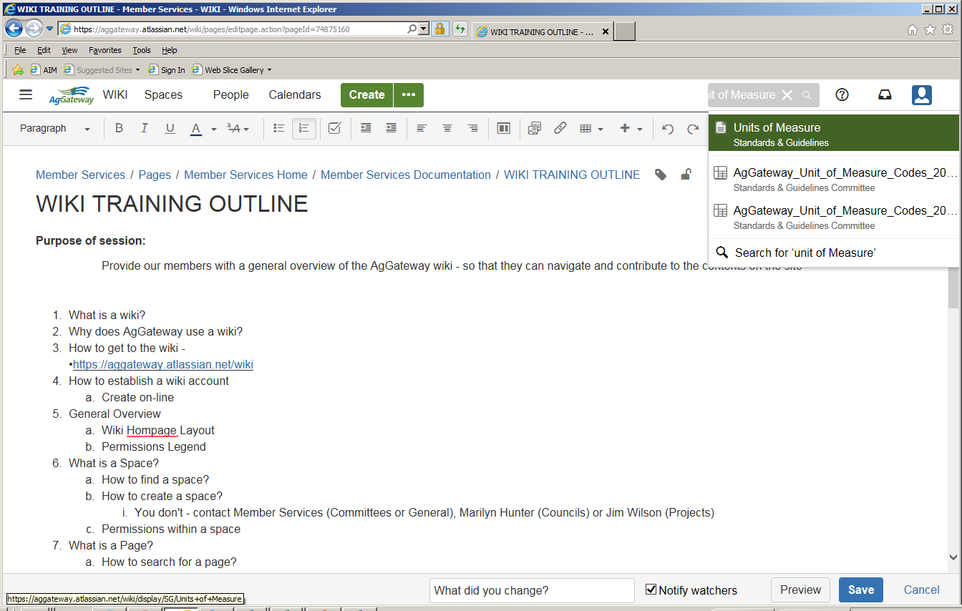
Searching for a Page
Use the Search Box in the top right-hand corner of the screen. Simply type a key word into the box and choose from the list of available options.
Notes:
Got To AGW Home Page
Now lets look at how to search for a page on the wiki. The easiest way to find a page or document on the wiki is to start entering key words in the search box at the top of the screen. Then simply choose from the list of available options.
For example, if I am wanting to find Entity Functional Group, I start typing – I can choose from the list provided or hit enter to see additional options
Show how to Export to Word or PDF – Click on Bread Crumbs
Show how to see where page is located by clicking on Bread Crumbs then “View in Hierarchy.”
Show how to get back to Home Screen by Clicking on AgGateway logo top left

Slide 9
The Editor
Editor Functions
Page Layout (column setup)
Files and Images
Links/Attachments
Symbols
Emoticons
Horizontal Rule
Task List
@User mention
Table of Contents
Macros
Keyboard Shortcuts
Adding & Editing a Table
Notes:
The Editor is the toolbar that helps create page content.

Slide 10
Importing a Word Document
Click on Breadcrumbs > Import Word Document
This adds a page to the space
Use the “Links” icon from the Editor
This adds a link on an existing page to the document
Notes:
Import Blank Agenda from Desktop. – MS Home page.
There may be times when you want to import a Word document into your space. There are two ways to do this. The first is click on Bread Crumbs, then Import Word Document. This will bring the document into the space as a new page. If the document is not exactly where you want it, it can be moved and we will cover how to move pages a little later on. The other option is to create a link from your page to your document. When we discuss creating and updating I page, I will show you how to do this.

Slide 11
Recording Changes and Notifying Watchers
Change Comment – A short description that summarizes the changes made to a page after editing it
Watchers of the page can be notified when changes occur to the page
Administrators can manage watchers of a page
Users can choose to quit watching a page
Notes:
RECORDING CHANGES AND NOTIFYING WATCHERS
When done creating or updating a page, click save.
When a page is updated, the author can add a change comment to the “What did you change?” field and choose whether or not to notify the watchers of the page.
Administrators of the space can manage the watchers for all pages in the space by adding or removing the individuals.
Individuals can choose to quit watching a page by clicking on their profile, choosing “watches” and then removing any pages that they no longer want to watch.

Slide 12
Page History
Restore a previous version
Compare versions
View changes made to a page
Notes:
PAGE HISTORY
Wiki tracks the history of changes to each page by creating a new version of the page each time it's modified. You can view the changes between different versions, and roll back to a previous version if you need to. To view the history of a page, click on “…Page History”
To view recent changes to a page or to learn more about the page, you can also choose, “…Page Information”. In the section titled 'Recent Changes' you'll see the most recent versions of the page, along with the date of their modification and the name of the modifying author. Under Hierarchy, I can see where the page resides within the Space. Under Outgoing Links, I can see what links on the page will take me to another Space or another page.

Slide 13
Moving and Reordering Pages
Change the default location of a new page.
Move an existing page to a different space.
Move an existing page to a different parent page within the same space.
Reorder pages that are children of the same parent.
Notes:
Moving and Reordering Pages.
At some point it may be necessary to move or reorder pages. To move a page, you need the following permissions:
'Add' permission on the page you are moving, and
'View' permission on the page's parent page. So if you are moving the page to a different parent, you need 'View' permission on the new parent.
To move a page to a new space, click on “…Move”. Type in the Space name and the new parent page.
In most instances you will be moving pages within the space. You can do this a another way by clicking on SPACE TOOLS>REORDER PAGES

Slide 14
Managing Your Profile
If you need to update your password, click on Person, bottom left-hand corner.
You can also view any tasks that have been assigned to you, or those that you have assigned others.
This is also where you can create your own personal space, by clicking on Personal Space under your profile.

Slide 15
Member Portal Training
November 2018
Notes:
Individual
PMahommes
#15Touchdown
Business
cristinlee
1Arrowhead!

Slide 16
Why Are We Using a Member Portal?
To Keep Records Up to Date
Provide a Tool to Look Up Members’ Contact Information and Participation in the Organization
Provide an Easy Way to Review and Pay Invoices
Provide an Easy Way to Review and Purchase Sponsorships

Slide 17
The Member Portal Allows You to…
Update Your Contact Information
Update Your Council/Committee Participation
View Invoices for Membership, AGIIS Subscriptions, Sponsorships, etc.
Pay Dues and Other Invoices Using a Secure System
Lookup Member Contact Information and AgGateway Participation
Manage Your Profile

Slide 18
Home Page
Notes:
Registration Link - https://app.etapestry.com/hosted/AgGateway/donorLogin/Register.php
Log In Link - https://app.etapestry.com/hosted/AgGateway/donorLogin/Login.php
Web Navigation
Welcome, My Profile, My Account, Search, Contact Us, Log Out

Slide 19
My Profile Page
Notes:
The “My Profile Page” allows you to edit your personal log in credentials, set your privacy settings, and view your public profile.

Slide 20
My Profile – Edit Login
Notes:
The “My Profile” page allows you to create your user ID and Password.

Slide 21
My Profile – Edit Privacy
Notes:
The “Edit Privacy Settings” page allows you to choose which personal attributes to display or keep private.

Slide 22
My Profile – View Public Profile
Notes:
The “View Public Profile” page allows you to see what other members can see about you in the member portal.

Slide 23
My Account
Notes:
The “My Account” page allows you to see your outstanding invoices with AgGateway/AGIIS

Slide 24
My Account – Detailed History
Notes:
The “Detailed History” page allows you to see all invoices, paid and unpaid.

Slide 25
Search
Notes:
The Search page allows you to search for an individual, company, or for those that participate in a Council, Committee, Working Group, or AGIIS.

Slide 26
Send a Message
Notes:
Email messages can be sent directly to other members. The members’ email address is not displayed. This screen shows your email address, the “from” address, but we don’t provide other member’s email information. If this email would be rejected, say for an out of office, however, the intended recipients email may display within the out of office notification.

Slide 27
Contact Us
Notes:
This feature allows you to send an email directly to Member Services.

Slide 28
Log Out

Slide 29
Sponsorship Shopping Cart
Notes:
The AgGateway shopping cart will be a separate link, not within the member portal but from the AgGateway website, that will allow companies to choose from various sponsorship opportunities and pay for them online.

Slide 30
Questions?

