Slide 1
Communications Committee
November 13, 2018

Slide 2
Agenda
Role Call
AgGateway Antritrust Guidelines
Review 2018 Goals and Accomplishments
Set 2019 Goals

Slide 3
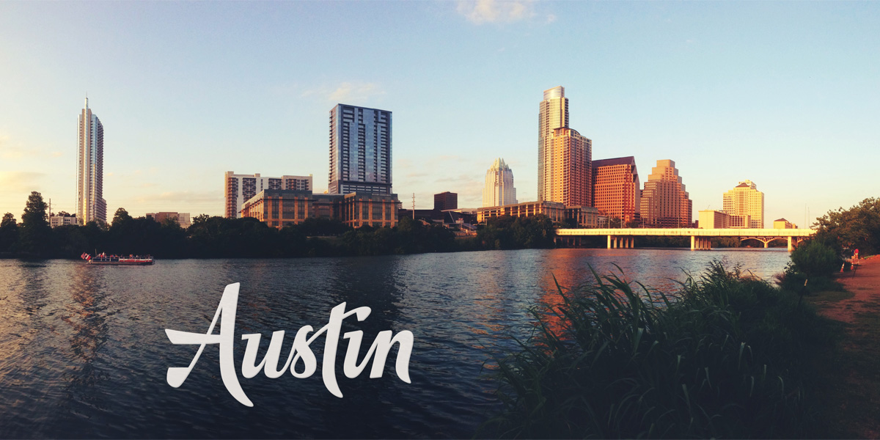
Roll Call
Name
Company
Position
Involvement in AgGateway
Years, Councils, Committees
Favorite type(s) of music
2018 Accomplishment
2019 Goal
This Photo by Unknown Author is licensed under CC BY-SA-NC

Slide 4
AgGateway Antitrust Guidelines
While some activities among competitors are both legal and beneficial to the industry, group activities of competitors are inherently suspect under the antitrust laws. Agreements or combinations between or among competitors need not be formal to raise questions under antitrust laws, but may include any kind of understanding, formal or informal, secretive or public, under which each of the participants can reasonably expect that another will follow a particular course of action.
http://s3.amazonaws.com/aggateway_public/AgGateway_Antitrust_Guidelines.pdf

Slide 5
2018 Goals
Operations
Get a Vice-Chair
Fill all Council/Working Group/Committee Liaisons
Increase membership size of Communications Committee
Job Description and Expectations for positions within the Committee (Member, Article Writer, Social Media)
Social Media
Increase interaction with social media platforms, especially LinkedIn Group and Twitter
Pre-load and semi-live tweet at relevant trade shows
Operations
New Vice-Chair: Matthew Grassi of Meister Media
Still needing Crop Nutrition Liaison
Added new members for 2017
Social Media
Will be sharing social analytics at least 1 time per quarter
Loaded Tweets prior to InfoAg and MYM

Slide 6
2018 Goals
Newsletter:
Leadership Profile in each newsletter
New Member Profile in each newsletter
Each Council have at least two significant update article
Each Committee have at least 1 significant update article
Get publication of AgGateway related articles within company internal newsletters
Publish Case Studies
Newsletter
Will miss Leadership Profile in each newsletter, but will have many with this article
Will miss New Member in each newsletter, but will have many with this article
Will miss Council having 2 updates, but each will have at least 1
Case studies have been published

Slide 7
AgGateway 2019 Objectives
Digital Ag Leadership: Obtain approval for the AgGateway transformation plan by 31 January 2019 AND implement the plan to support the establishment of AgGateway as the leader in the transition to digital agriculture so that the transformed AgGateway is in operation effective January 1, 2020, WHILE maintaining current activities focused on enabling integration in the value chain.
Member Value: Expand influence and increase member value through the development and completion of three joint activities, designed to address an existing or anticipated challenge, with industry or standards association, government groups, and/or institutions of higher learning by 31 December 2019 that result in publication, industry awareness or industry efficiency.
Increase Membership and Engagement: By 31 December 2019 increase use of AgGateway digital resources by 1) identifying, recruiting, and acquiring three key companies, 2) developing a simple, streamlined process to facilitate eConnectivity initiatives, and 3) initiating and making significant progress on at least three compelling eConnectivity initiatives.

Slide 8
2019 Goals
Resource Related
Letting members & industry know about resources.
Additional case studies, especially for chemical and seed.
Develop graphic video depicting AgGateway processes
Newsletter Articles
Council Updates (minimum 1 per year)
Future state articles to get members aware of emerging technologies (block chain, tracability)

Slide 9
2019 Goals
Social Media
Cross share with other organizations
Trade Show support
CLA, InfoAg, AGA
Shows Jim Wilson is speaking
Banner awareness to members
Operational
Committee Membership growth plan
Vice Chair

Slide 10
Thank You!!

