Slide 1
Allied Providers Council
Council Meeting
22 Jan 2018

Slide 2
Allied Providers Council
Introductions
Welcome to 1st time Attendees!
Murray Equipment
Foris
Beck Ag

Slide 3
Allied Providers Council
Attendance Sheet
Minutes Recorder
Anti-Trust Guidelines

Slide 4
Agenda
Recent Updates
Annual Meeting Recap
Council Leadership Meeting
AgGateway Strategic/Tactical Objectives
AP Council Initiatives

Slide 5
Updates on Your Requests
Better Cross-council communication
Meetings posted on AgGateway website (drop into Google calendar).
Council/Committee Liaisons will be a more informal process
Forwarded AgRetail/Seed council request for “quick connect” involvement
General Knowledge Sharing/Speakers
AgGateway will have more speakers at conferences
Recommended more webinars/presentations (to conference committee)
Create Value
All councils mobilized around case study creation (Eileen/Josh)
Products & Services Directory
Proposal on how to better evaluate usefulness of Directory (Eileen)
Provide Input to AgGateway Staff on campaign to mobilize inactive members (Steve)

Slide 6
Council Leadership Meeting Recap
Team-building - Solidify relationships; Aid cross council communication
Understand AgGateway’s organizational health
2017 was challenging (M&A activity reduced revenue)
Early action (delaying initiatives) reduced spend and kept finances in order
2018 limited investment on the part of AgGateway. Members to drive.
Understand AgGateway 2018 Vision, Mission, Objectives
Increased Participation is where we can impact most, and we used that to develop out Allied Provider 2018 Objectives (value your feedback)
Let’s break down each of those objectives.
Approved cross-council business rules harmonization task force (charter on wiki)

Slide 7
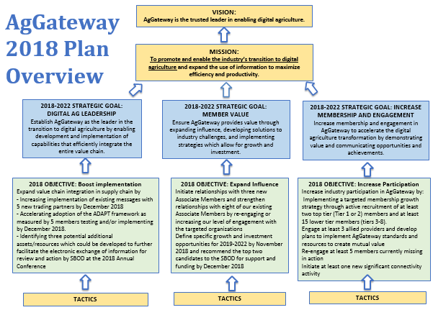

Slide 9
Allied Providers Council – 2018 Goals
Advancing eAgriculture. Provide the AgGateway membership with a dynamic and holistic group of technology and service providers who will help advance eAgriculture across the value chain.
Awareness and Branding. Support AgGateway by building awareness in our unique networks and communities outside of AgGateway.
Advisory and Advocacy. Support AgGateway by acting as an advisory and advocate arm for the Ag industry.
Notes:
Matrix
Social Media
Emerging Tech
Enabled by Logo

Slide 10
Allied Providers Council – 2018 Objectives
Develop and communicate opportunities, success stories, business cases (ROI), etc. (Eileen)
Reach out to Allied Providers to determine how to increase and leverage their engagement and product lines (Josh)
Develop target list of companies to re-engage and contact to determine why not engaged currently and how to get re-engaged (Steve)
Develop communications specifically targeted to sr. management re: value and benefits of engagement with AgGateway (Steve)
Improve tracking on the effectiveness of the Allied Providers Products and Services Directory (Eileen)
Notes:
Matrix
Social Media
Emerging Tech
Enabled by Logo

Slide 11
Allied Providers – Objective 1
Reach out to Allied Providers to determine how to increase and leverage their engagement and product lines

Slide 12
Allied Provider Engagement
2018 Strategic Objective – Increase Participation
Tactic – Reach out to Allied Providers to determine how to increase and leverage their engagement and product lines.
I have been designated of the owner of the tactic
Plan
Create a survey directed towards Allied Providers (Early February)
Review survey data combined with other resources.
Select Allied Providers (3) to highlight specific products/projects that are using or will use AgGateway Standards and Resources (End of March)
Work with Allied Providers defining the project and capturing results (April – September)
Project Evaluation (September – November)
Review lessons learned
Determine the viability for expanding/sharing the implementation to other members
Development of Case Studies

Slide 13
AgGateway Case Study Repository
Goal:
Develop a Repository of Case Studies (accessible on Wiki and Website) representing all AgGateway Councils, showcasing success stories
Specific focus on Allied Providers to highlight specific products/projects using (or will use) AgGateway Standards and Resources
Focus on
Background, challenges, solution implemented, results and future plans
How would you define ROI outside of revenue?
Stretch goal: Twelve (12) completed new case studies by November 2018
How you can participate:
Has your company implemented AgGateway Standards and Resources? Let’s talk!
Will you be implementing AgGateway Standards and Resources? Let’s talk!
Do you know members who have had success using AgGateway solutions? Make an intro!

Slide 14
The Case Study Template is ready to go
Eileen will help interview and write up the case study
Just help us make the right connection!

Slide 16
Allied Providers – Objective 2
Develop and communicate opportunities, success stories, business cases (ROI), etc.

Slide 17
Allied Providers – Objective 3
Develop target list of companies to re-engage and contact to determine why not engaged currently and how to get re-engaged

Slide 18
Allied Providers – Objective 4
Develop communications specifically targeted to sr. management re: value and benefits of engagement with AgGateway

Slide 19
Allied Providers – Objective 5
Improve tracking on the effectiveness of the Allied Providers Products and Services Directory

Slide 20
Updates from Councils/ Committees

Slide 21
Other Business
Motion to Approve
Minutes, November 7 Annual Meeting
Notes:
Proposed meeting schedule – starting on Jan 26 at 2PM ET meet every quarter. Last Thursday of the first month of every quarter.

Slide 22
Thank you! Connect with us on LInkedin

