Slide 1
GTAC Student Presentation
Ryanna Tietje
Notes:
Hello, my name is Ryanna Tietje. I would like to start by saying thank you for the opportunity to be here. These past few days have been ????

Slide 2
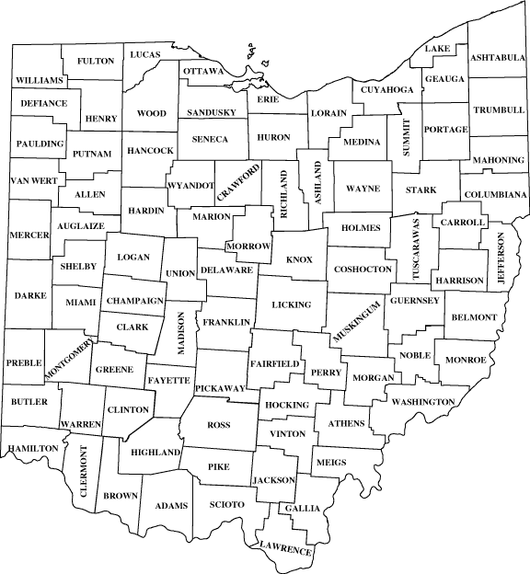
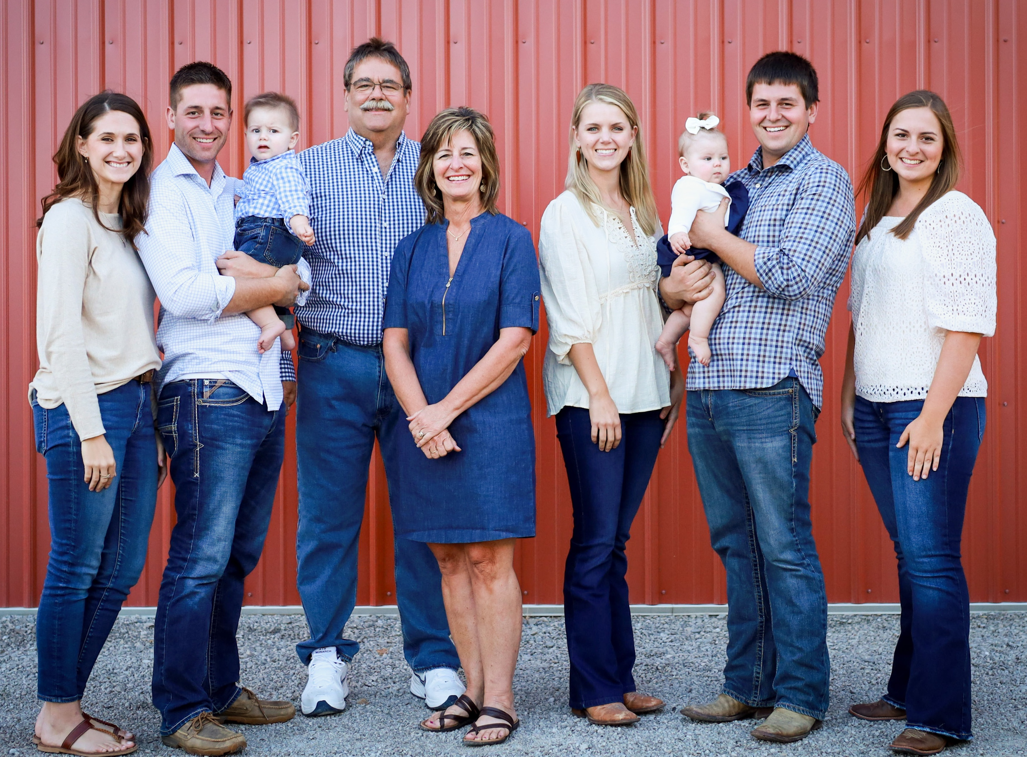
Background
Raised on the family farm
Studying Agribusiness and Applied Economics
Notes:
I grew up with my older two brothers on my family’s farm in Deshler, Ohio which is in Northwest Ohio. My dad worked as a grain merchandiser but maintained the corn and soybean farm. My brothers and I are the 4th generation on the farm and working to expand the operation to sustain our families and ensure a successful future for future generations. My roots in agriculture encouraged me to pursue a degree in Agribusiness and Applied Economics from The Ohio State University. There, I have had the unique opportunity to challenge my current knowledge and perspective through my work with Dr. John Fulton and the Digital Ag Team, internships, involvement on campus, and challenging coursework.

Slide 3
Digital Ag Team
Student Research Assistant
Collaborate to create the yearly eFields report
2022
3,810 Acres
49 Counties
292 Research Sites
Assist with data collection and summarization
Spray Drone Effectiveness
Soybean Protein Content Study
Notes:
I work with Dr. John Fulton and Dr. Elizabeth Hawkins on the OSU Digital Ag Team. Our main focus is to research, compile, and document precision agriculture technologies for extension and education use. Annually, we create the eFields report which is a collaboration between farmers, extension educators, and faculty at OSU. This report features on farm studies that are completed across the state and at farm scale so they provide relevant results for farmers. Most recently, the 2022 report featured 3,810 acres from 292 research sites across 49 counties. Final harvest data is being collected now and the 2023 report will be available in early January 2024. In addition to the report, I assist with data collection and summarization for studies completed in Ohio.

Slide 4
AgCredit, ACA
Findlay, OH
Branch Intern
Learned duties of:
Account Officer
Loan Specialist
Loan Accountant
Loan Processor
Branch Assistant
Notes:
I started college in the middle of the pandemic. Due to classes being switch to online, I had the unique opportunity to live at home and start my first internship. Starting in the fall of 2021 and continuing until autumn semester 2022, I interned at AgCredit. This extended internship experience allowed me to gain a deep understanding of agricultural lending. Throughout my time at AgCredit, I assisted each of the employees in the office including: account officer, loan specialist, loan accountant, loan processor, and branch assistant. I thoroughly enjoyed this opportunity to learn and interact with customers in Northwest Ohio to understand their unique financial needs.

Slide 5
StoneX
Bowling Green, OH
Grain Risk Management Intern
Analyzed the markets
Worked with Co-ops and farmers across the Great Lakes Region to mitigate risk
Notes:
During the summer of 2022, I interned at StoneX in Bowling Green, Ohio. As a Grain Risk Management Intern, I worked closely with brokers to analyze the market trends and understand their reasoning behind recommendations to clients. I developed a network with co-ops and farmers across Indiana, Ohio, Michigan, and Canada. While 3 months was not long enough to completely understand all the strategies used and causes of market performance, I valued gaining exposure to ???

Slide 6
Antolino & Associates
Columbus,OH
Financial Planning Intern
Gained exposure to financial planning
Evaluated unique situations of clients across the country

Slide 7
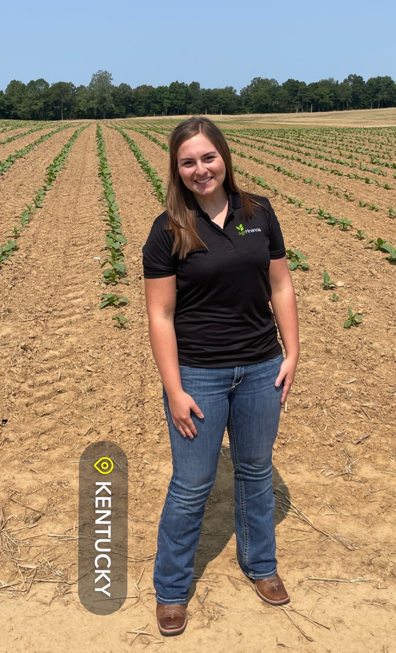
AgriFinancial
Louisville, KY
Finance Intern
Diversified agricultural knowledge
Gained a deeper understand of credit and loan underwriting
Notes:
fix border

Slide 8
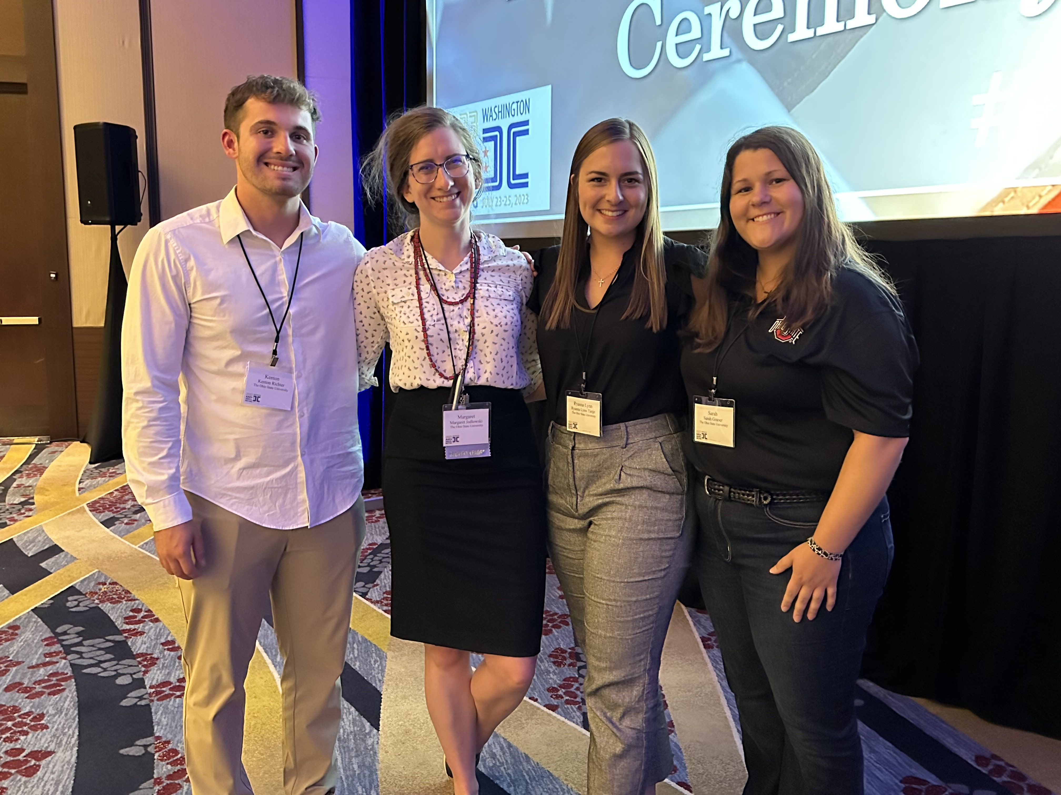
Ohio State Involvement
August 2020-May 2024
Agribusiness Club
Alpha Zeta Partners
Agricultural Systems Management Club
Collegiate Farm Bureau
OSU Honors Peer Mentor
Farm Financial Management and Policy Institute Advisory Council
Notes:
I strive to be involved on campus to grow both personally and professionally while increasing my network. Through various opportunities, I also work to help my peers thrive in academically and develop their career interests. Specifically, I am currently serving as the President of the OSU Agribusiness Club, Vice President of Alpha Zeta Partners, Reporter for the Ag Systems Management Club, member of Collegiate Farm Bureau, and a peer mentor for the Honors Program. Each of these roles has pushed me out of my comfort zone, exposed unique opportunities to grow, and allowed me to maximize my time and potential while at Ohio State.

Slide 9
My Future
Graduation May 2024
Conducting research on farm succession planning
Contribute to the family farm
Notes:
I collaborate with Dr. Margaret Jodlowski to research farm succession planning. I am getting ready to launch a survey to Ohio’s farmers to evaluate their current succession plans and factors that impact the level of detail of their plans. I am eager to evaluate the results of the study. Based on my internship and educational experiences, I have developed a passion for farm succession planning where I believe I can combine my knowledge for agricultural finance, experience in financial planning, and passion for agriculture to assist farmers as they transition their operations from one generation to the next. While I have not yet accepted a job yet, there are opportunities to purse this area, and I am excited to see where my career will lead. Most importantly, I want to play an active role on my family’s farm along with my brothers.

Slide 10
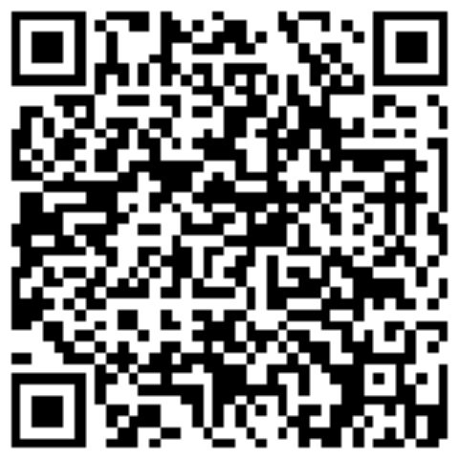
Connect
Ryanna Tietje
Phone: 419-966-1187
Email: Tietje.9@osu.edu
LinkedIn: linkedin.com/in/ryanna-tietje

