Slide 1
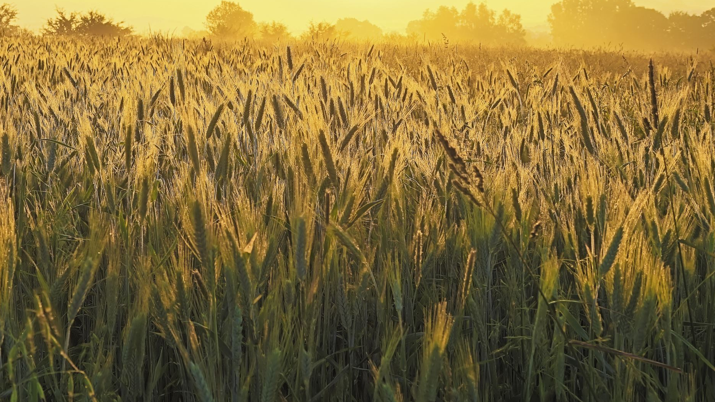
“From Code to Crops: My Journey from Software Engineering to pursuing a PhD in Digital Agronomy” - ChatGPT
Phillip Lanza
pjl242@cornell.edu

Slide 2
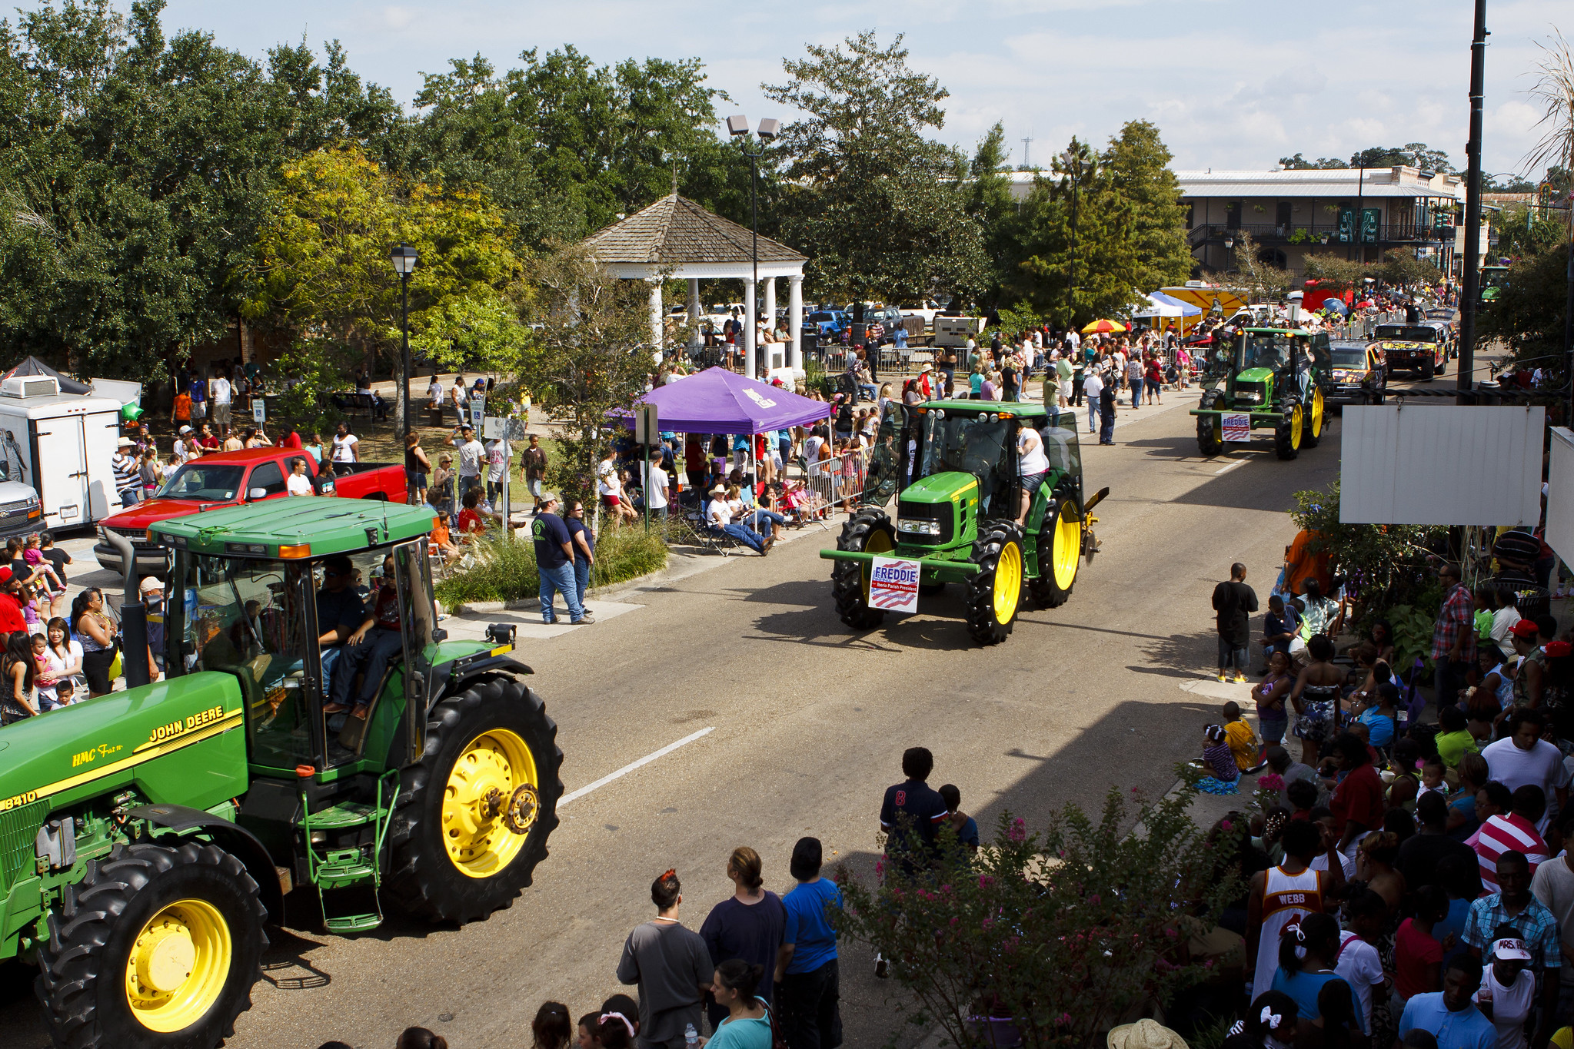
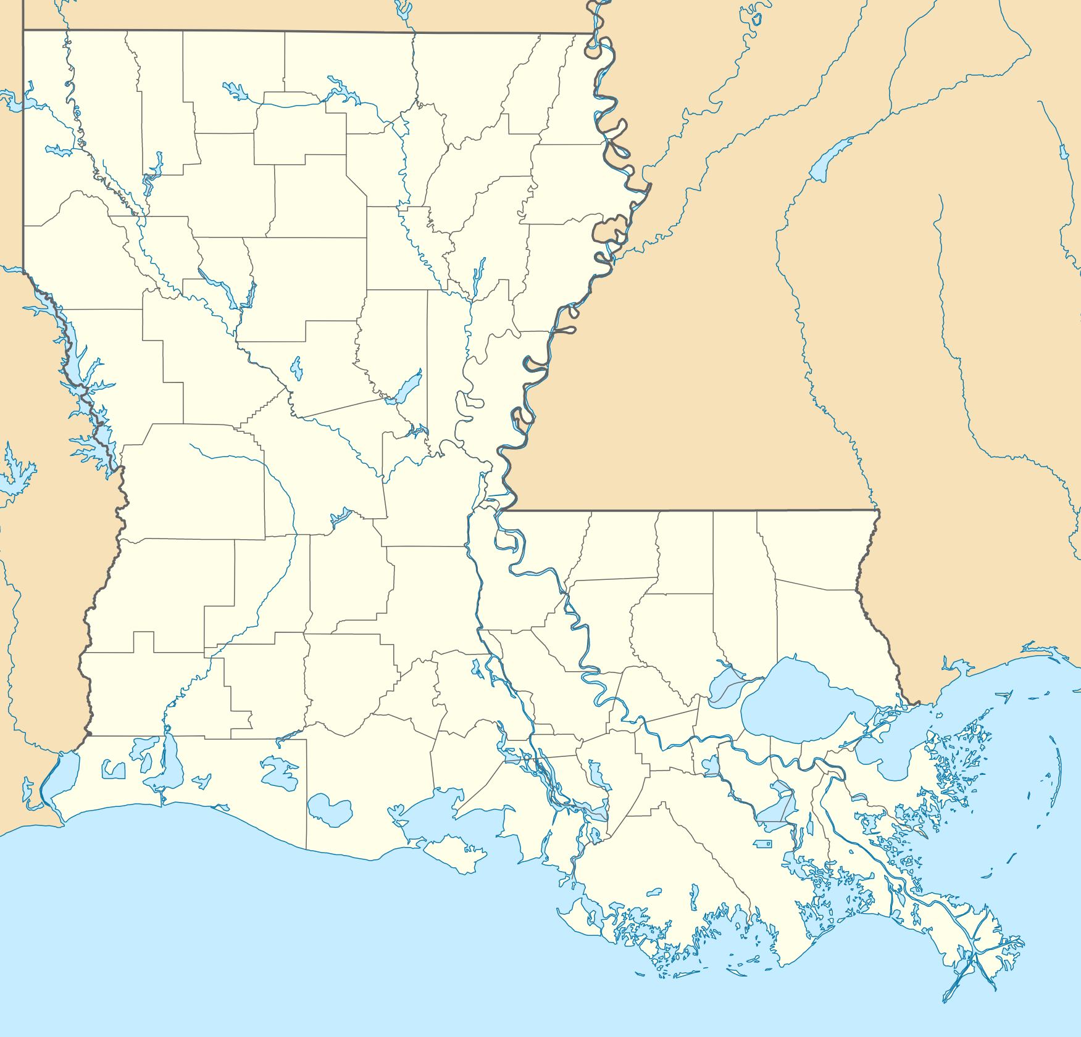
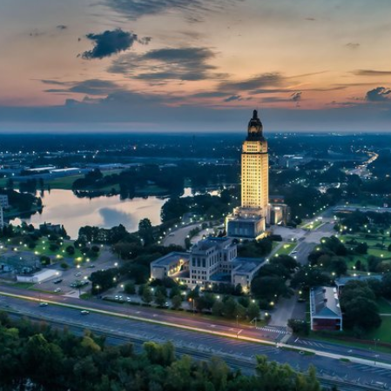
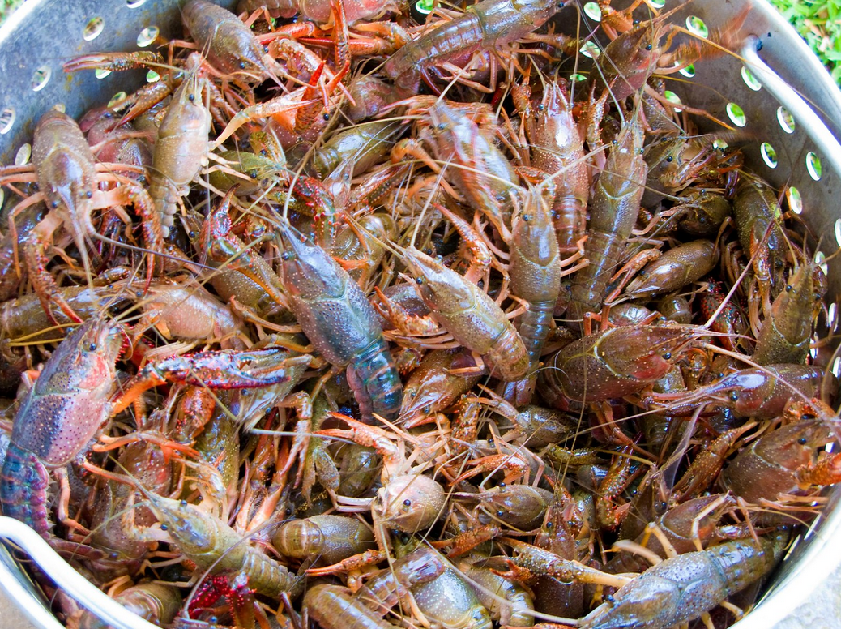
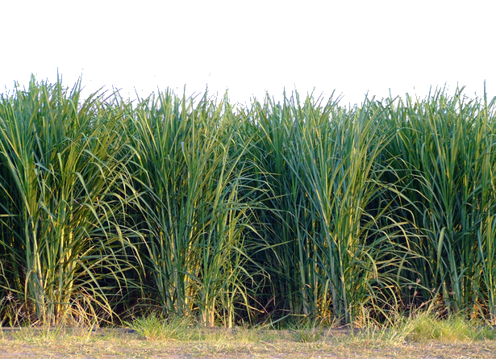
Background
Hometown: New Iberia, LA
Baton Rouge
B.S. Information Systems and Decision Sciences (ISDS), LSU
Software Engineer
Back to New Iberia
Still programming
Started Companies:
Residential Rentals and Property Management
Off-grid Hydroponic Urban Farm and Community Garden – Iberia Community Garden
501(c)(3) Nonprofit – Acadiana Growers’ Alliance
Food desert relief
Empower local producers
Semi-retired
Kayak every day?
Boring when your friends still work

Slide 3
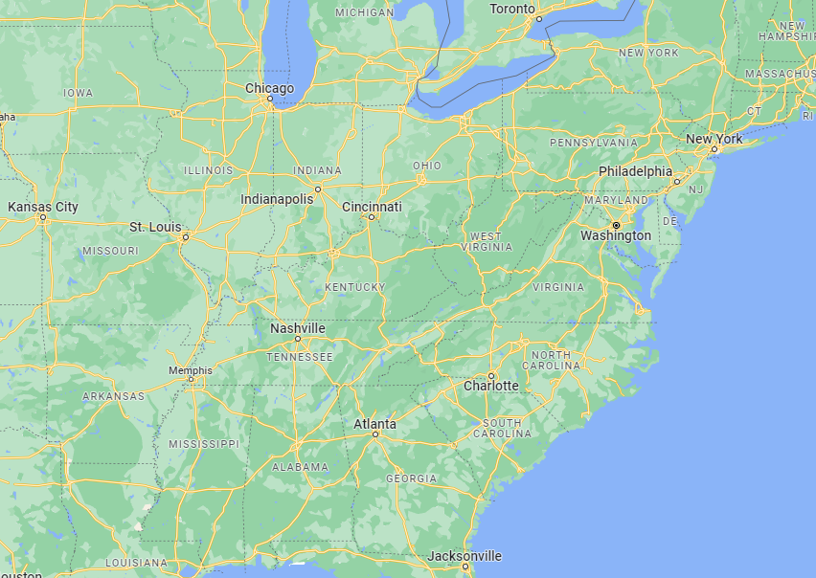
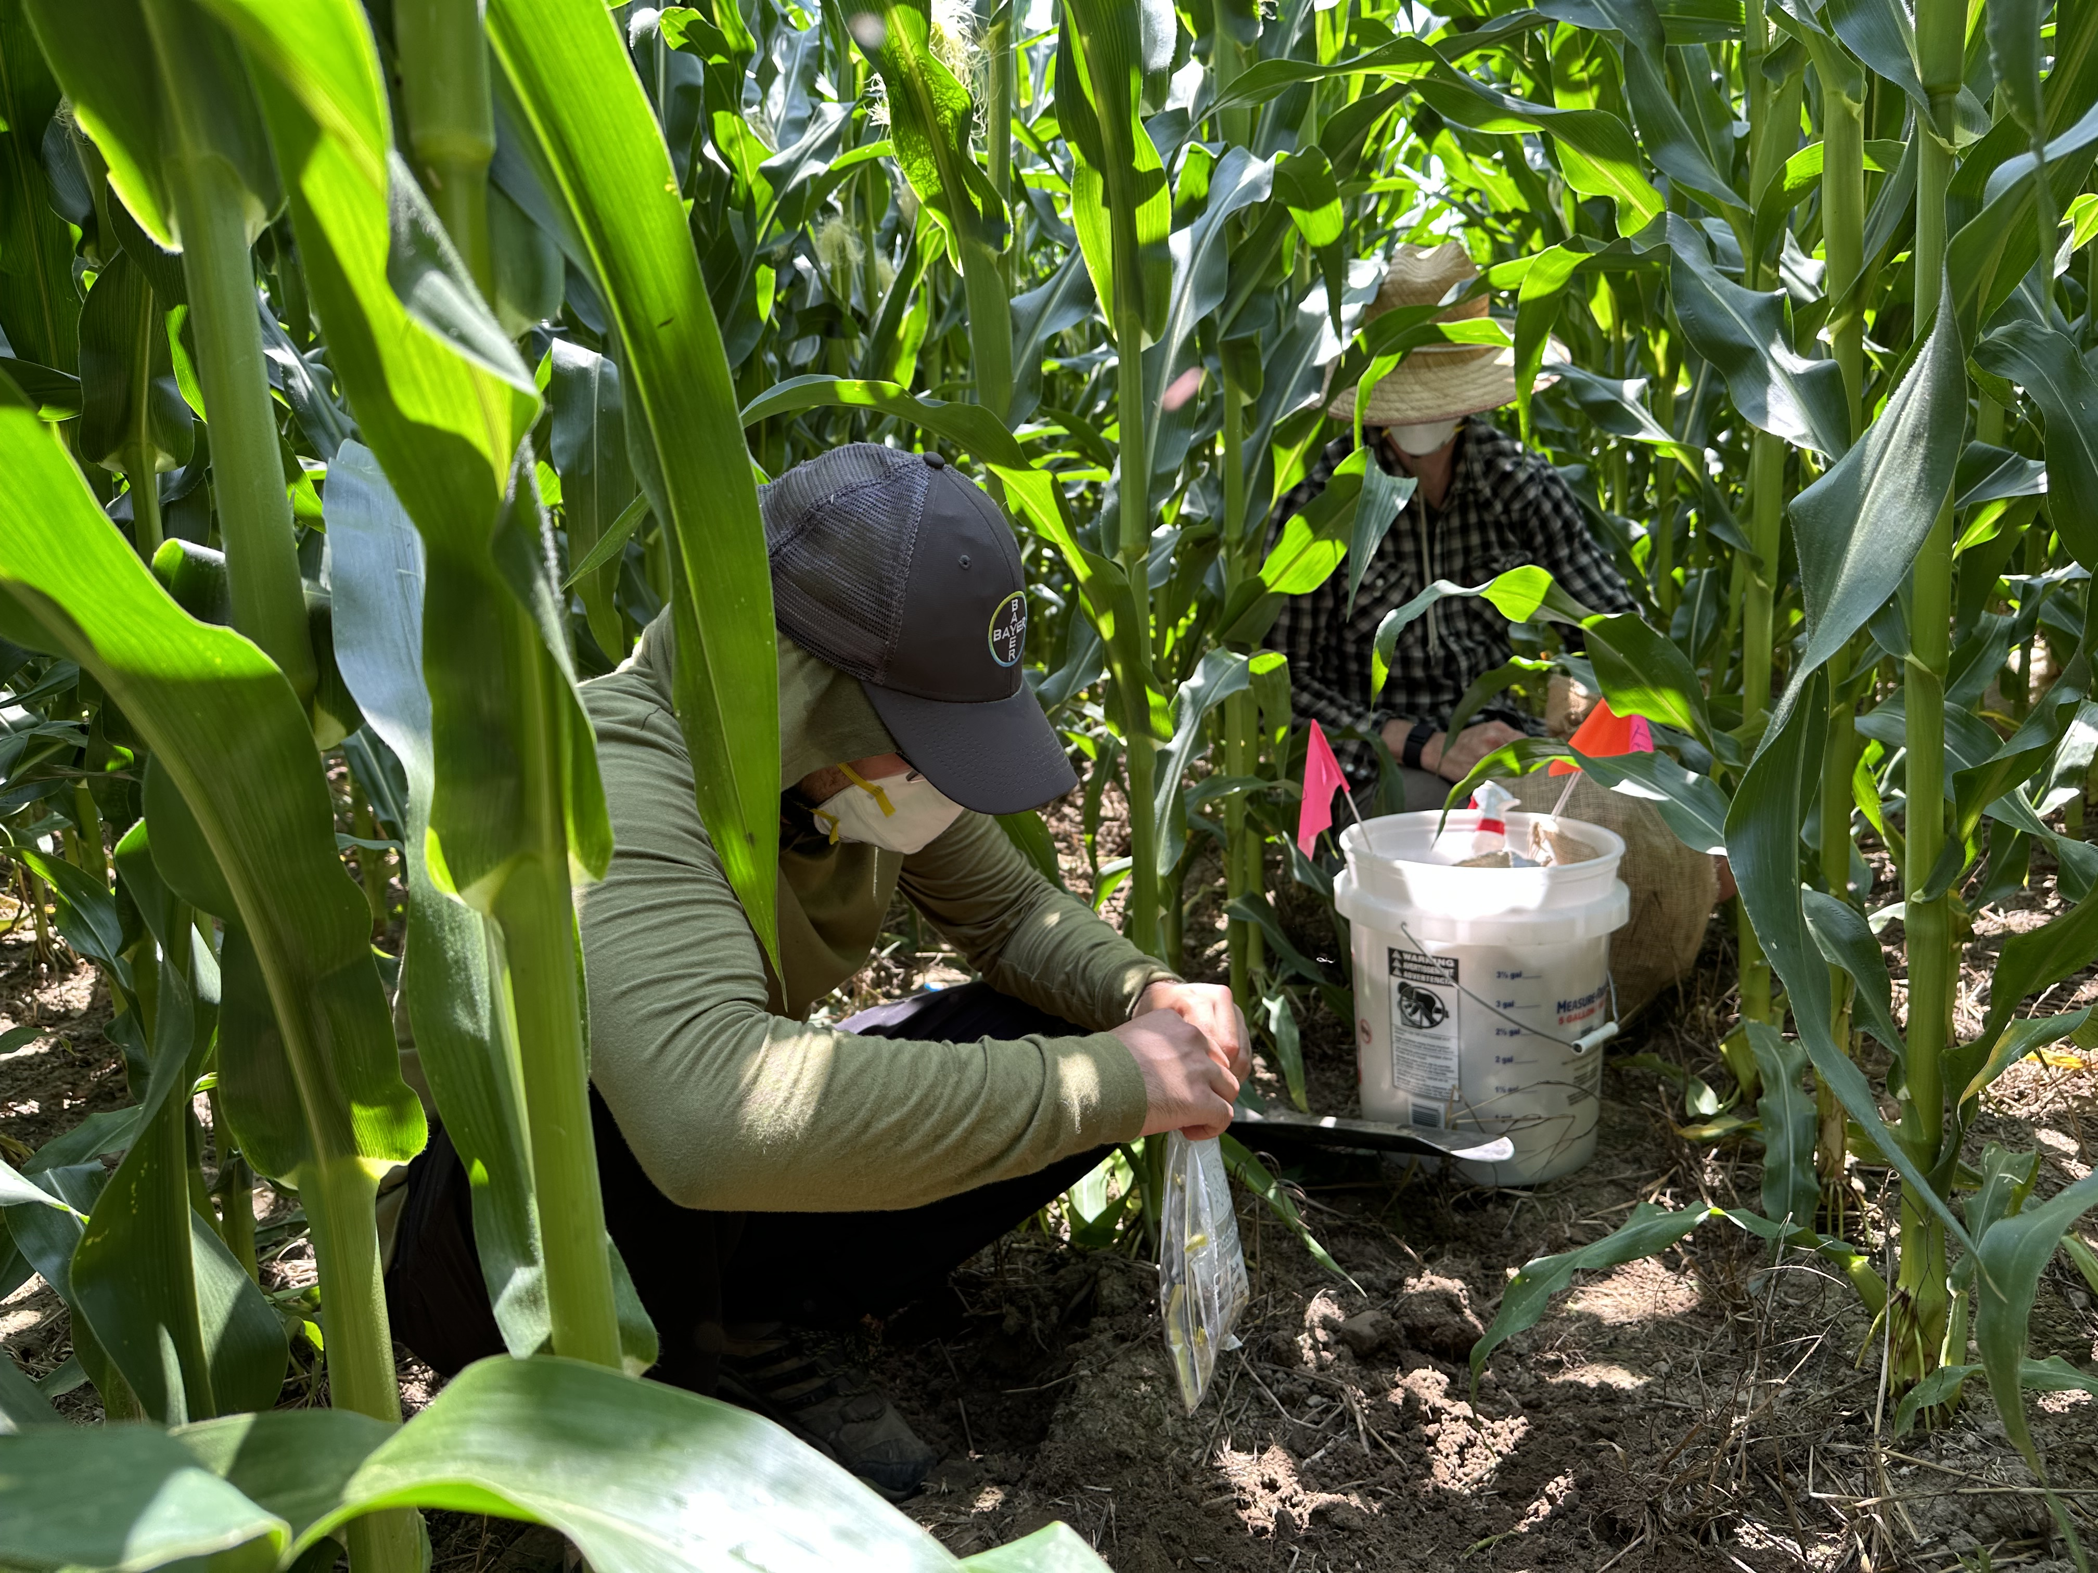
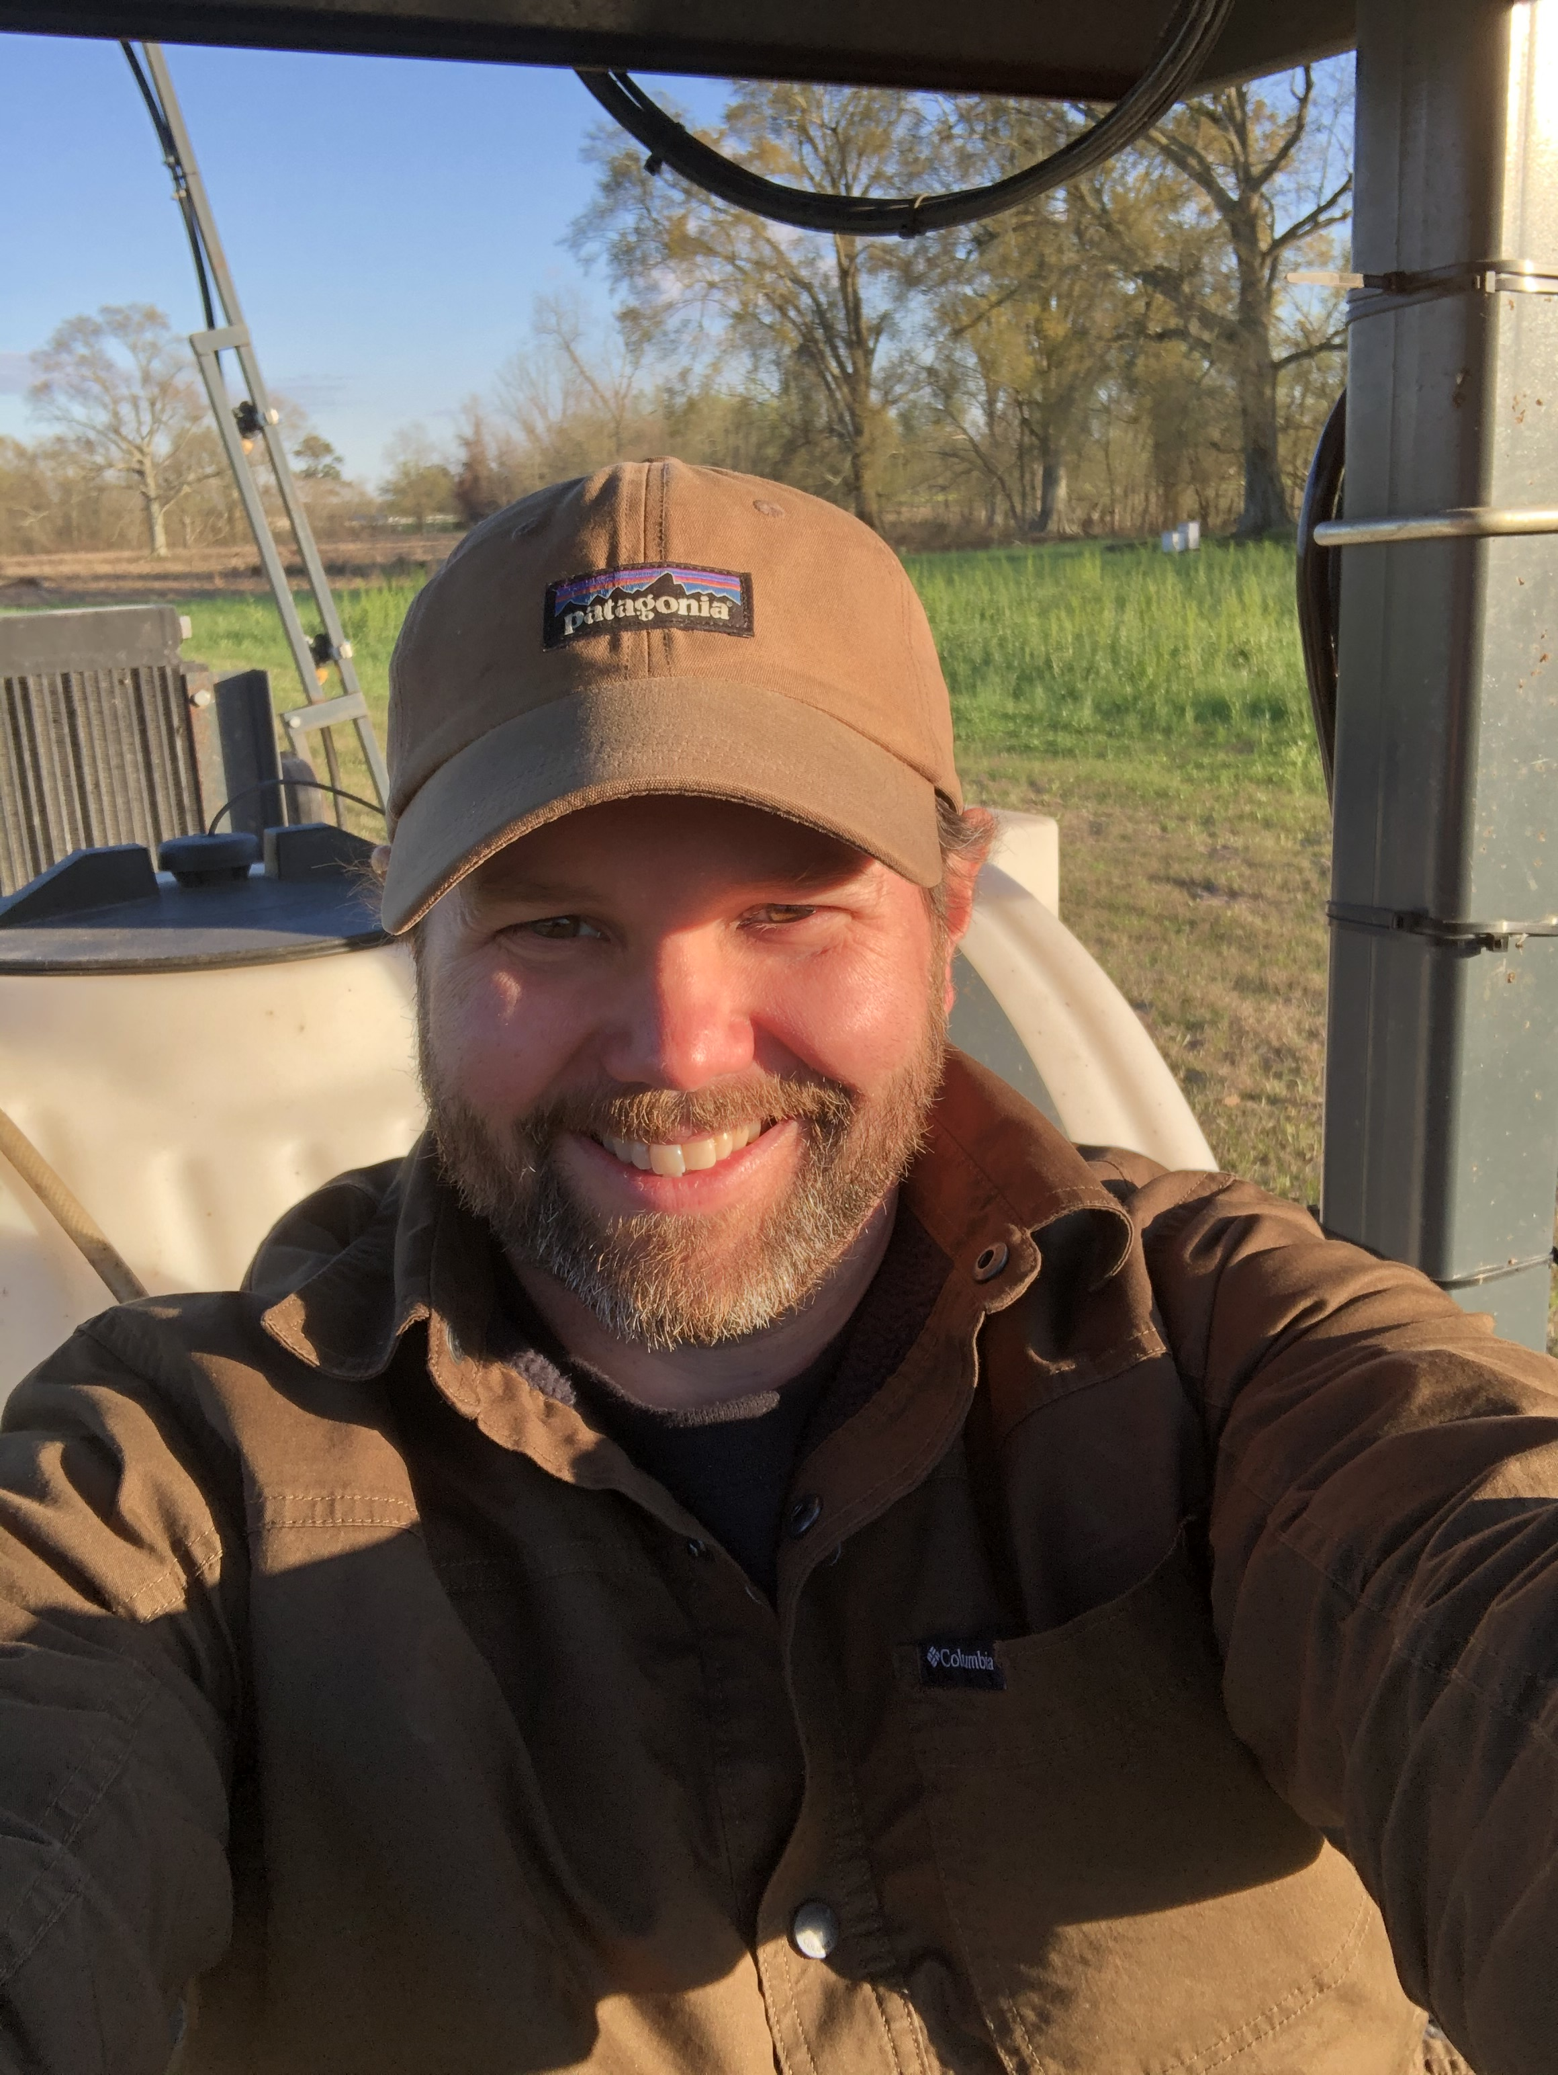
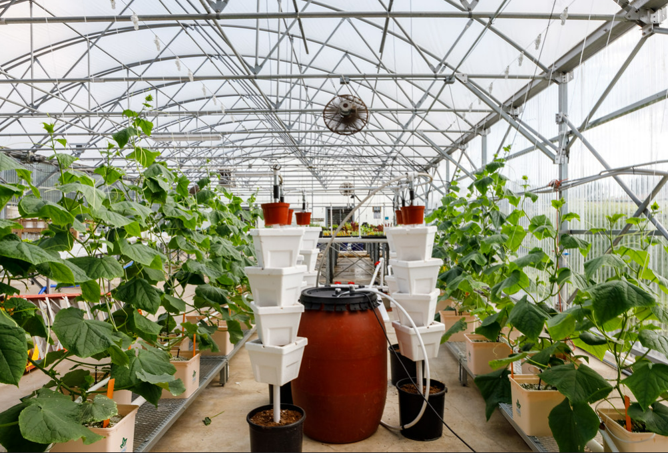
Back to School
Returned to LSU for advanced degree (2019)
School of Plant, Environmental and Soil Science
B.S. Horticulture Science (2019)
M.S. Precision Agriculture (2021)
Cornell University (Ithaca, NY)
College of Agriculture and Life Sciences (CALS), Soil and Crop Sciences Section
Doctoral Student – Digital Agronomy

Slide 4
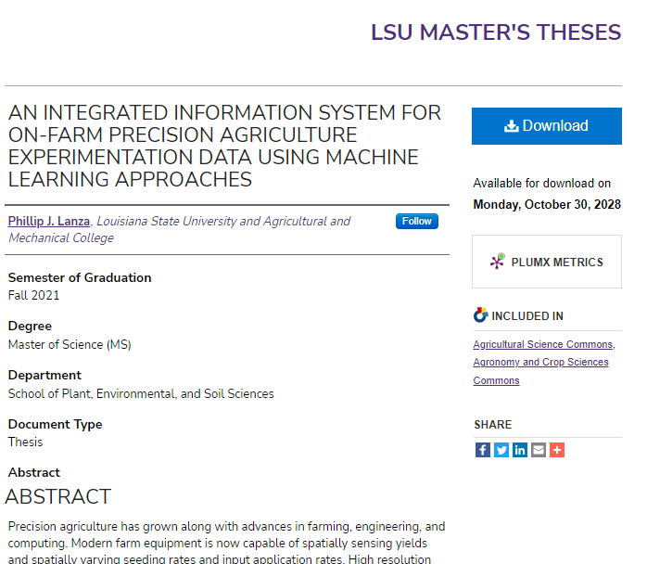
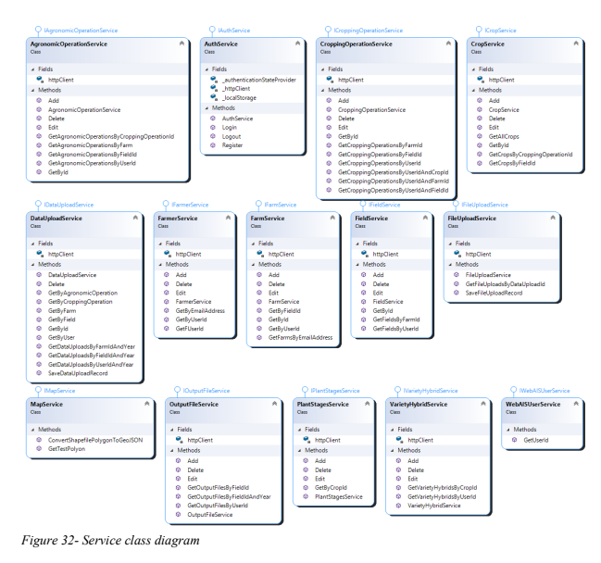
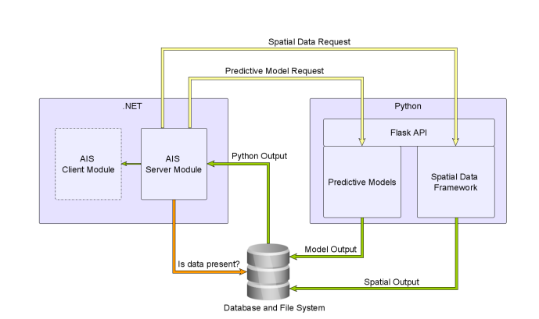
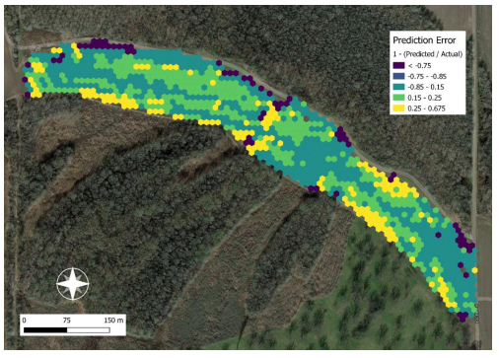
M.S. Thesis
Committee
Luciano Shiratsuchi – chair
Thanos Gentimis
Jeffrey Beasley
Chapters:
Literature Review
Spatial Data Framework
Web-based Agronomic Information System
A Comparison of Statistical and Machine Learning Spatial Yield Prediction Models

Slide 5
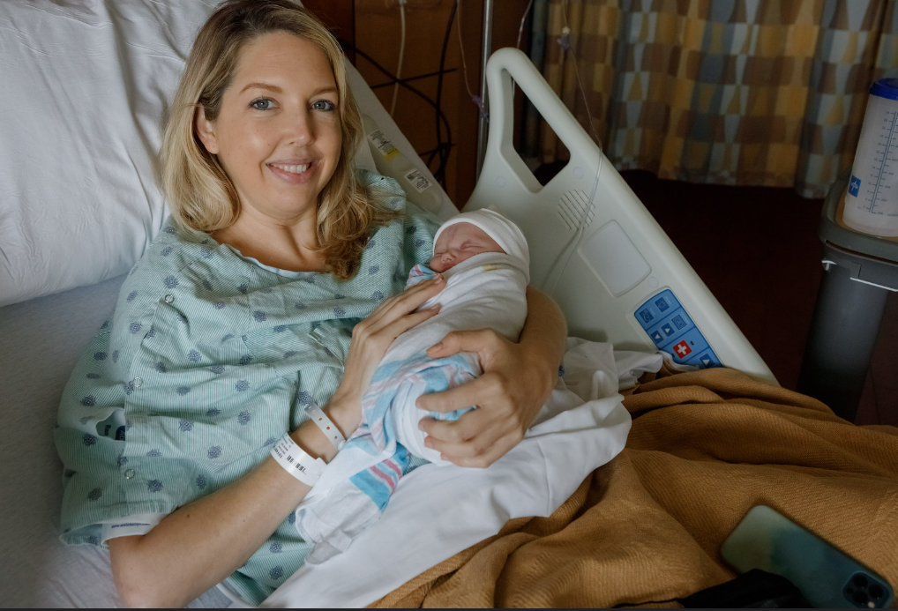
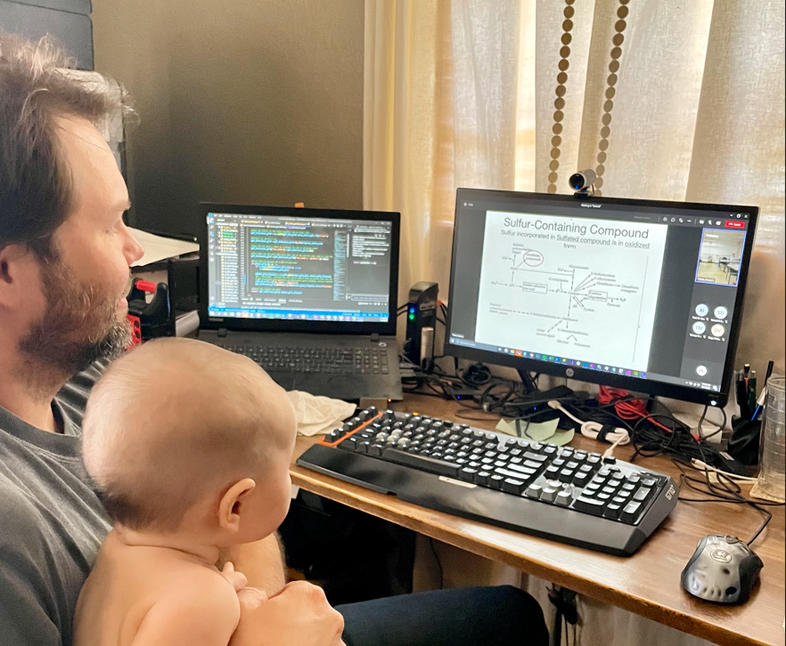
Thesis – Bonus

Slide 6
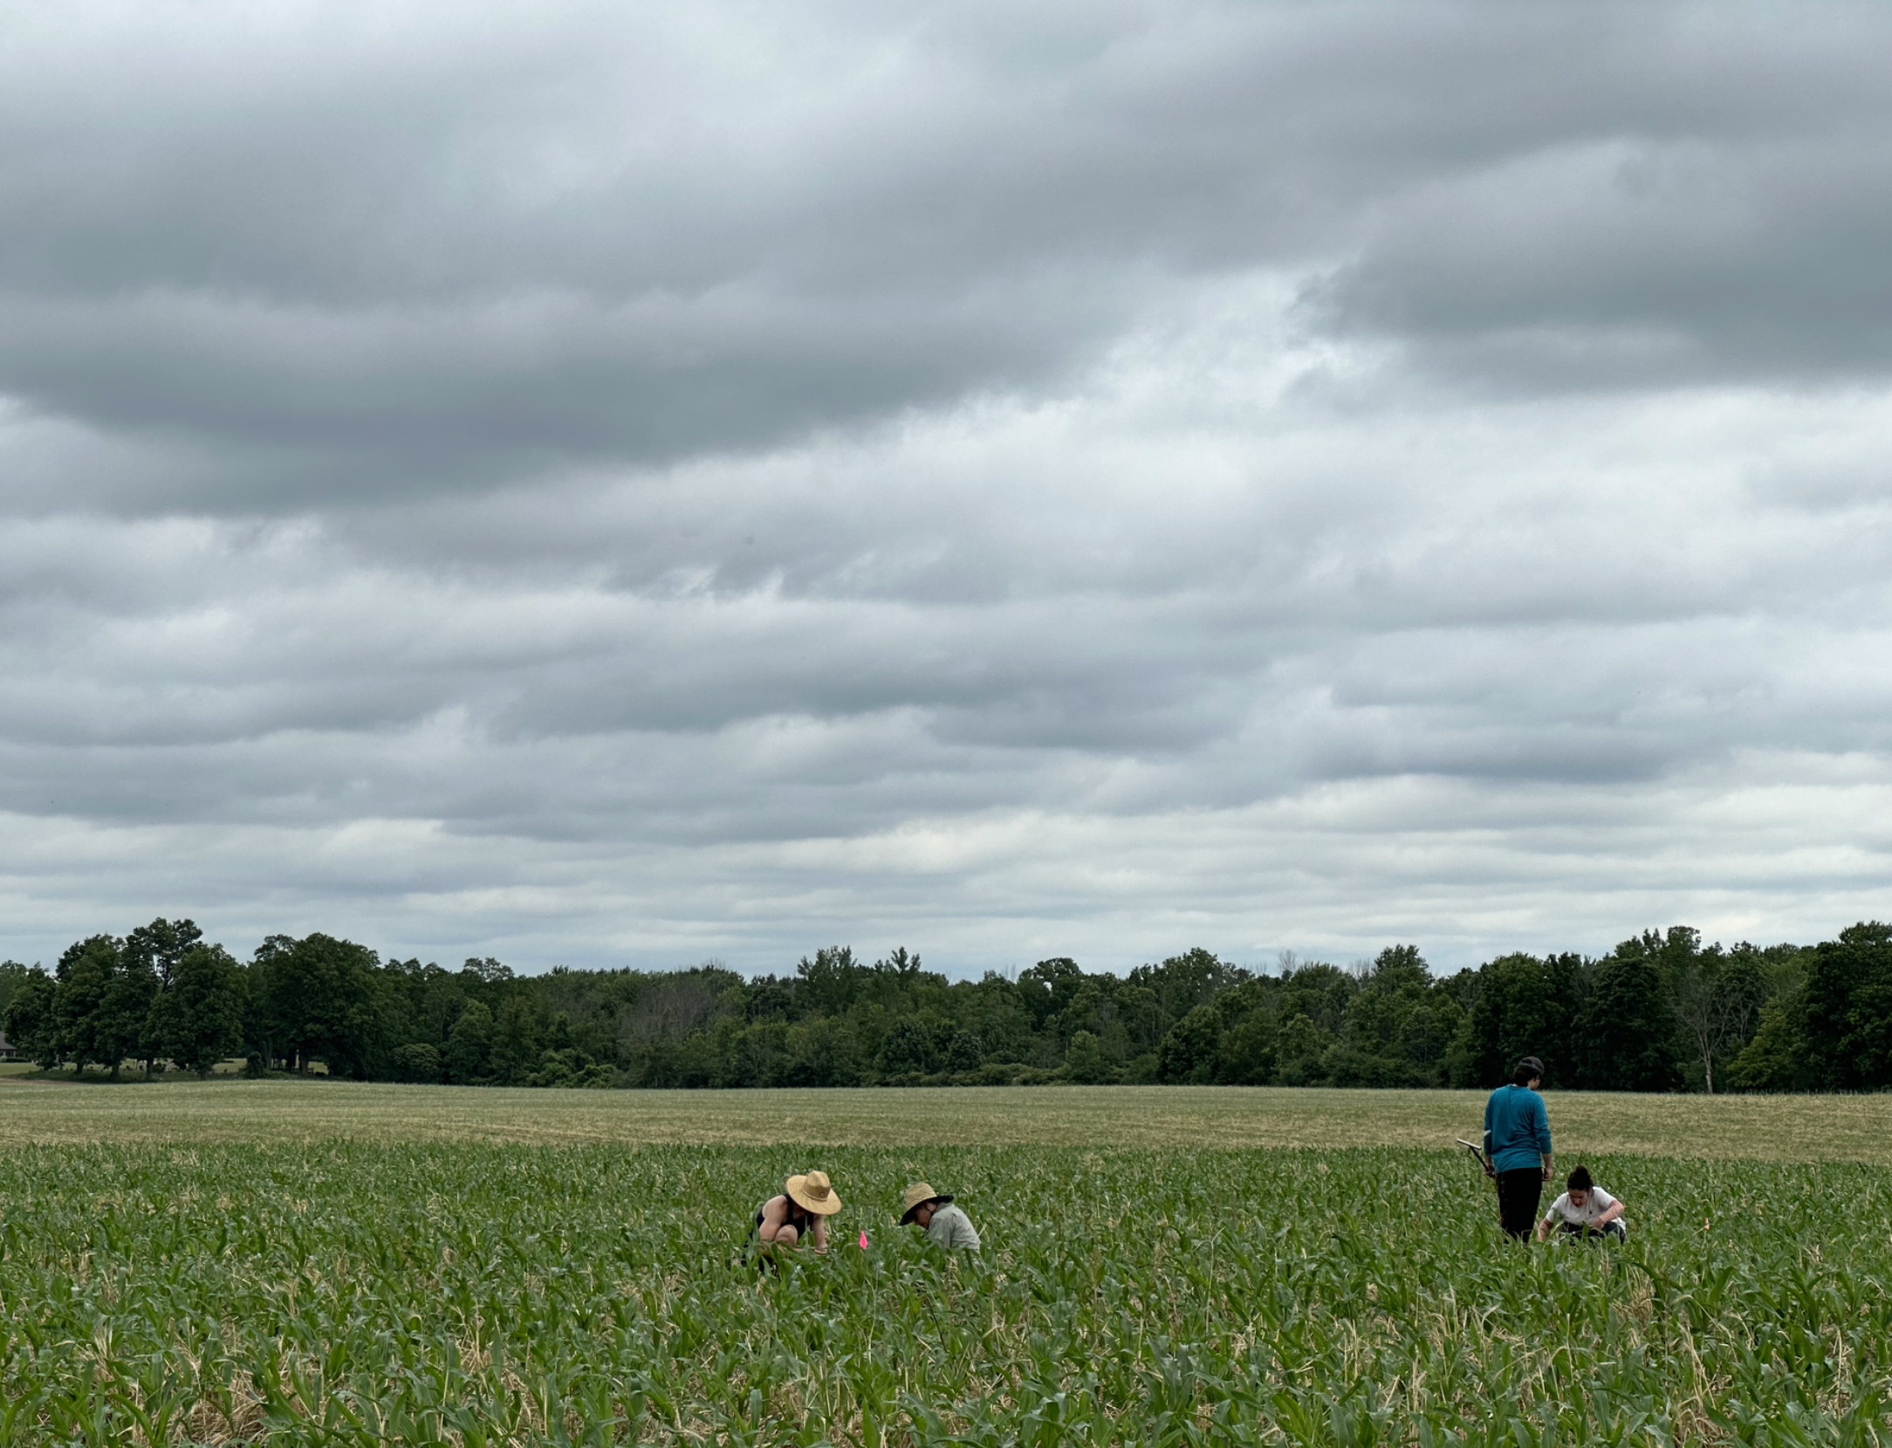
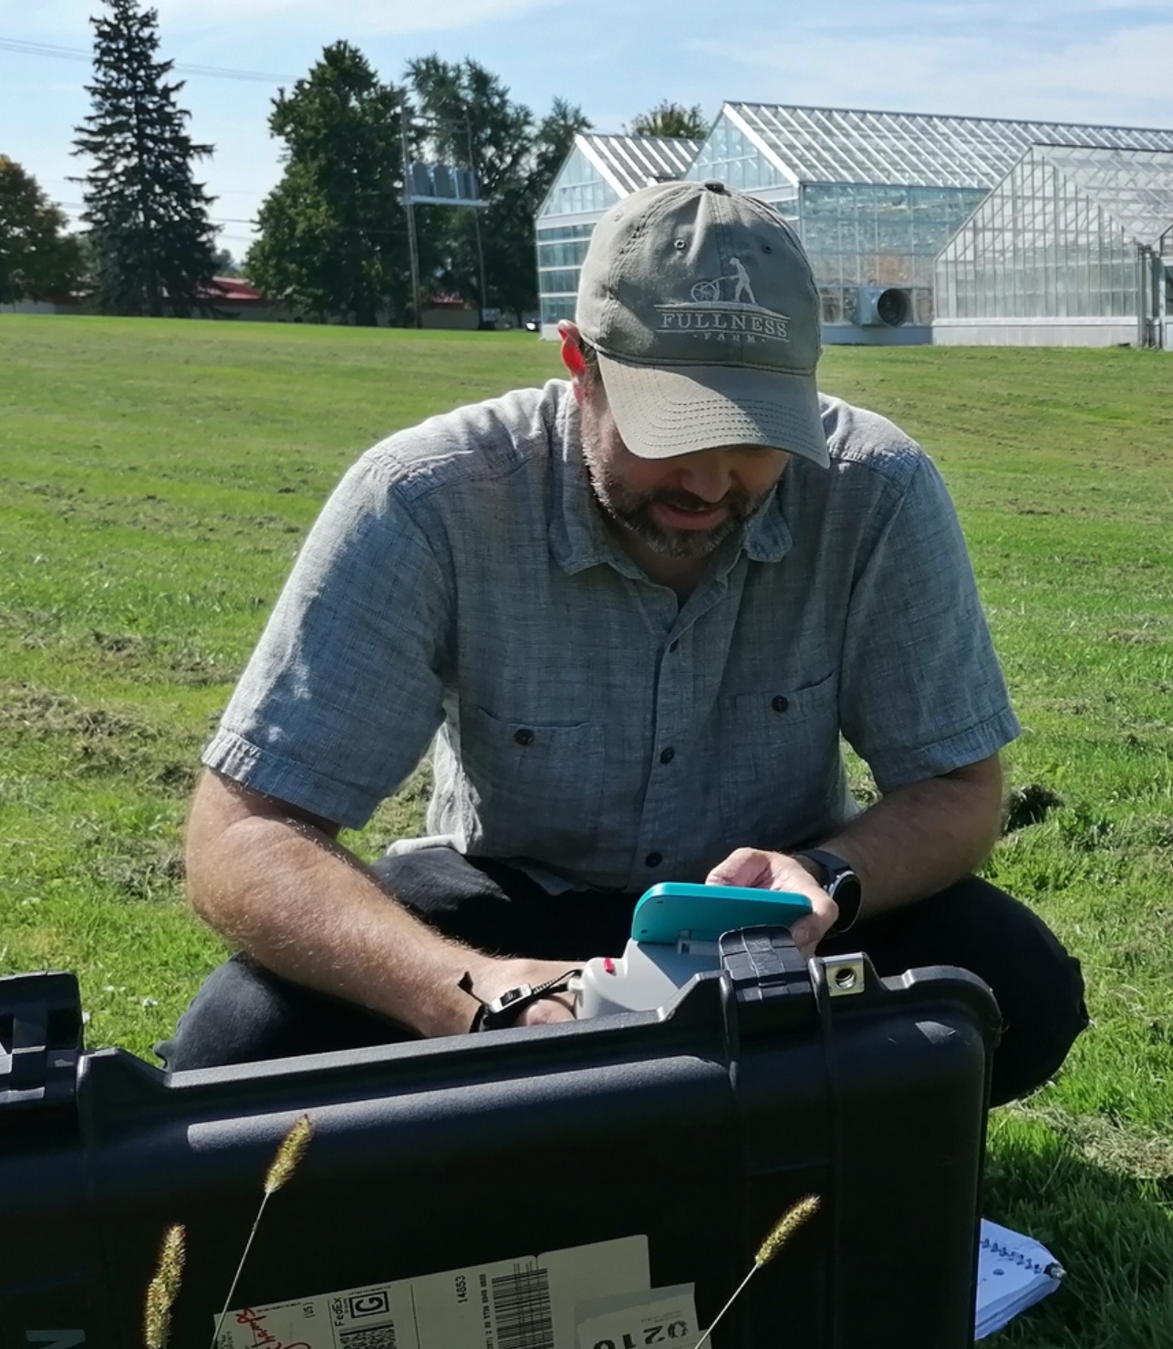
Current Work
Digital Agronomy Lab @ Cornell University
Major Advisor – Louis Longchamps
Minor Advisors:
David Rossiter
Diana Sinton
Observational, farmer-led on-farm experimentation
Adapt methodologies proven in medical, social sciences to agriculture
Goal: Rapid development of practical solutions to improve agronomic production system efficiency, resiliency, and sustainability

Slide 7
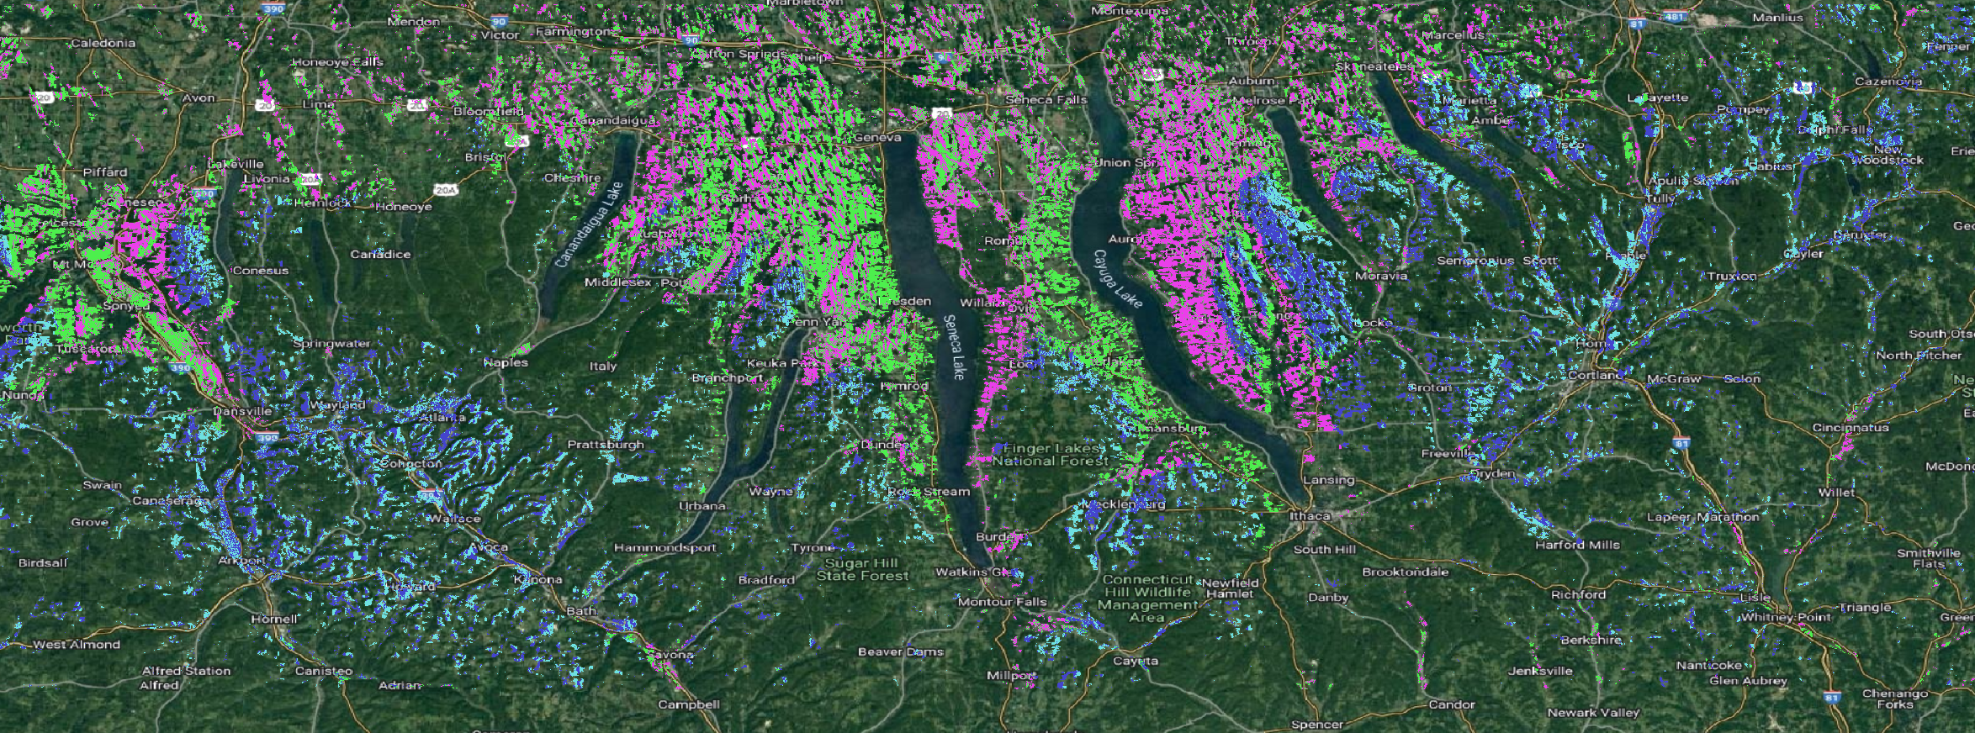
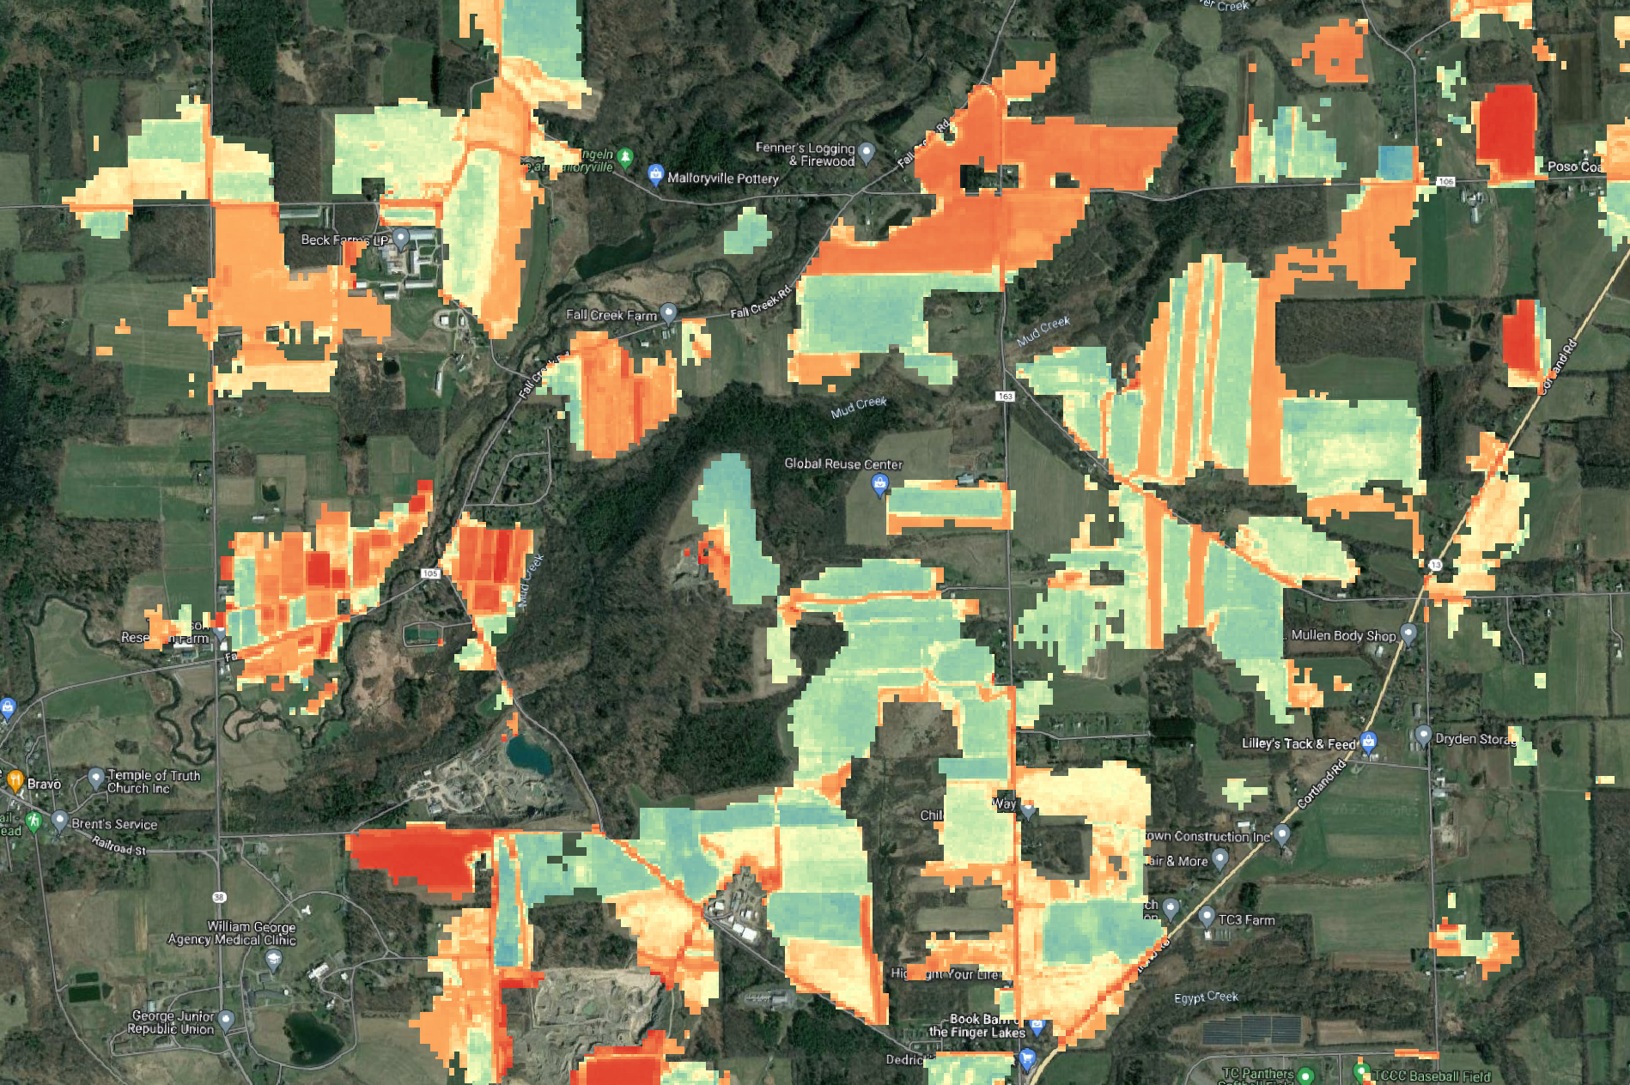
Research Focus
How can Digital Agronomy help inform and contextualize on-farm experimentation?
Projects:
Geospatial Data Retrieval Tool (GeoDaRT)
Spatiotemporal Agronomic Anomaly Detection System
Data Standardization
Complexity and Dimensionality Reduction (“envirotyping”)

Slide 8
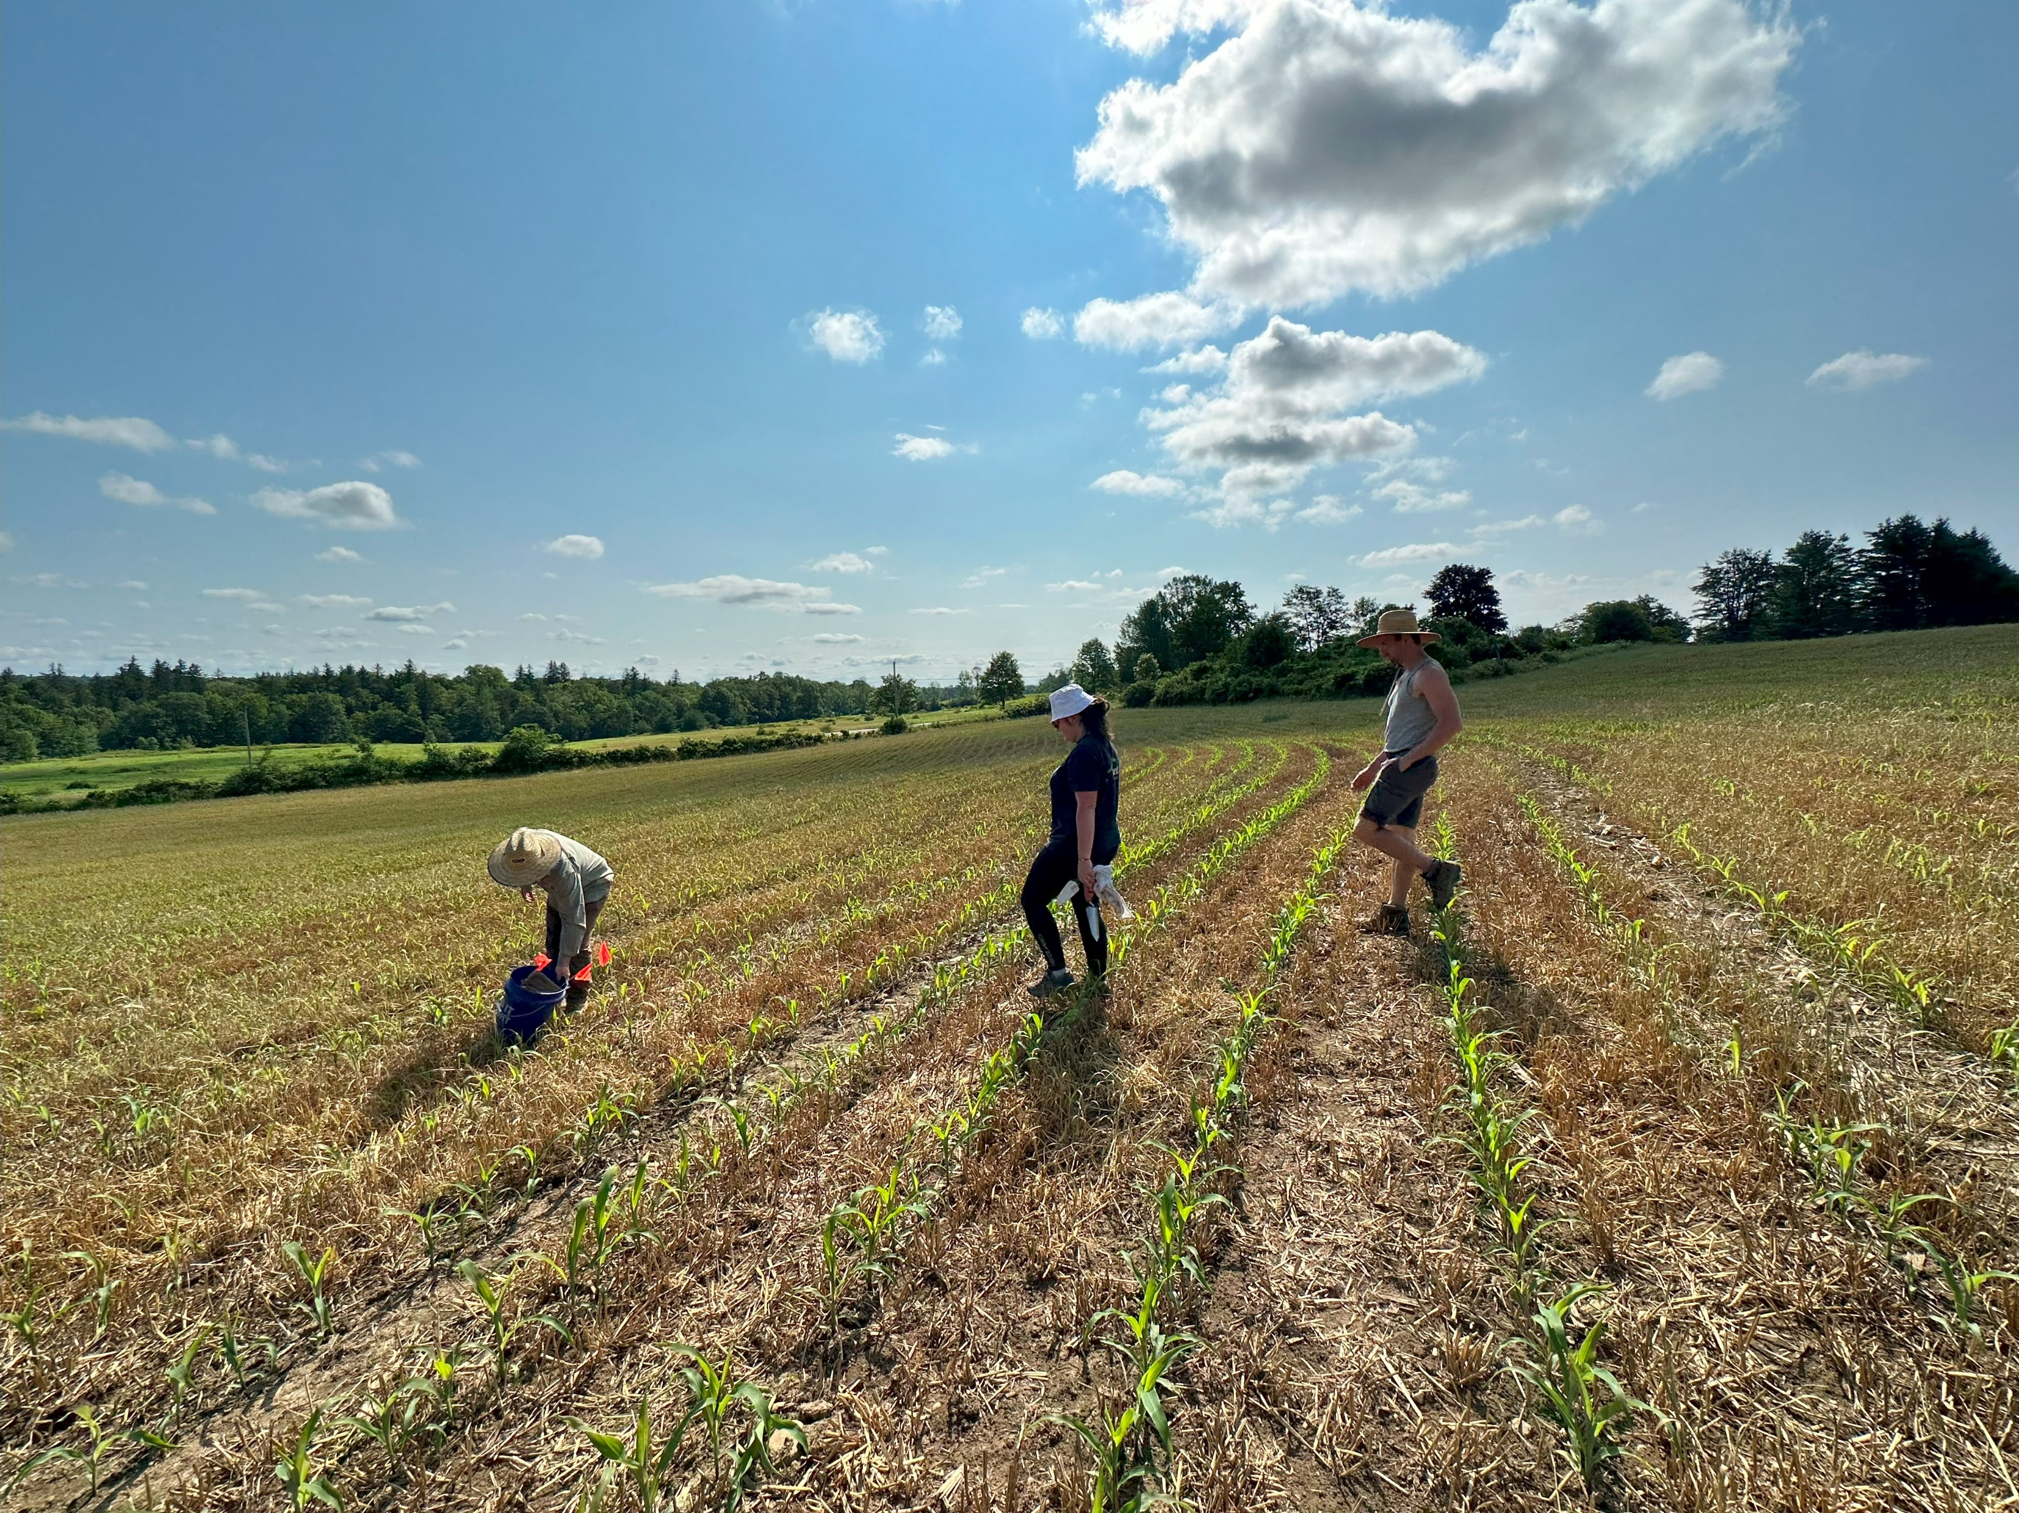
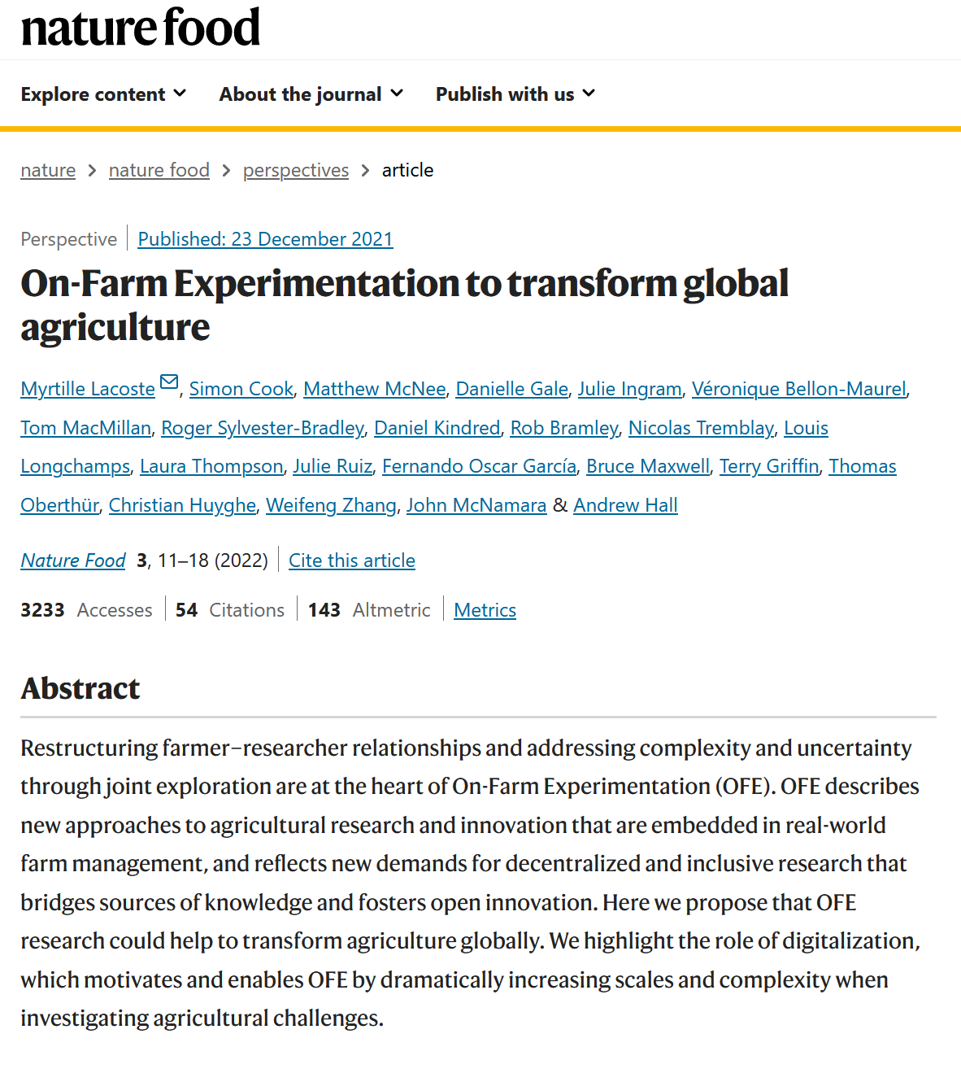
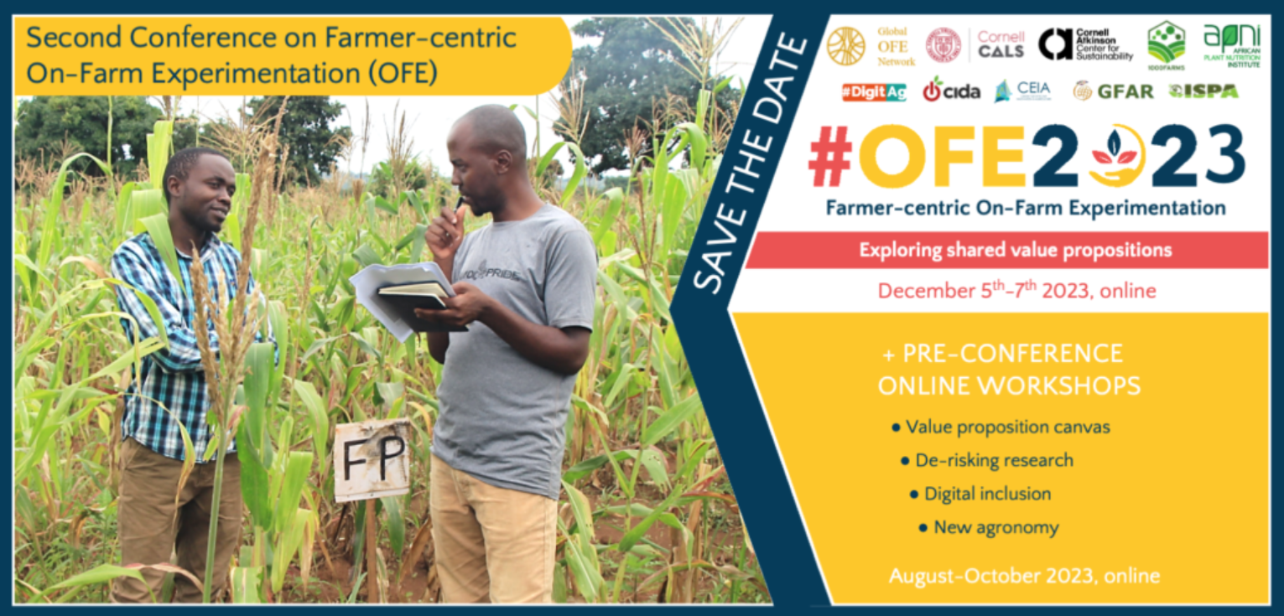
Longchamps Lab
https://cals.cornell.edu/louis-longchamps
https://www.goFEN.org
https://www.nature.com/articles/s43016-021-00424-4

Slide 9
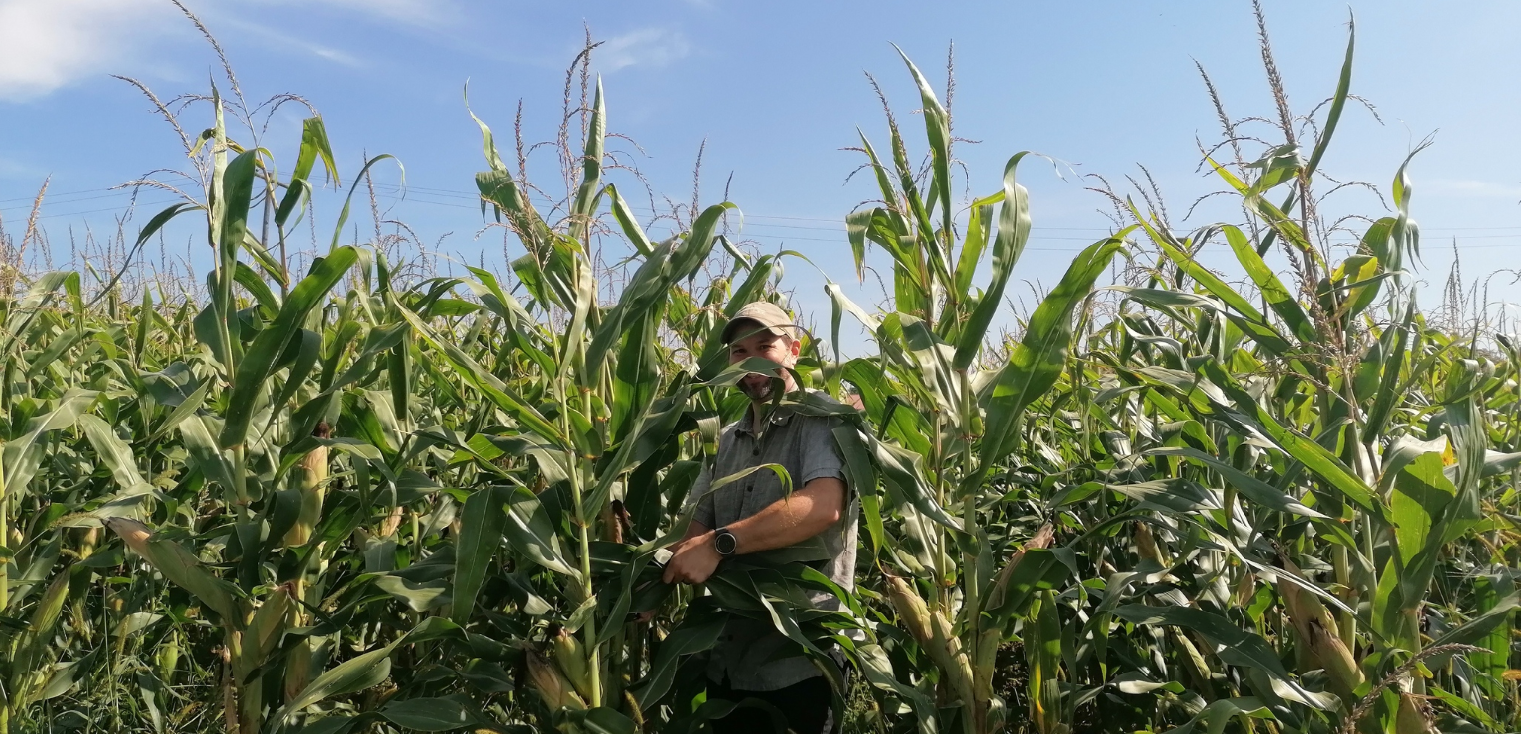
Thanks!
Questions?
pjl242@cornell.edu

