Slide 1
Gateway to Ag Careers
2023 Presentation
Kelsey Vourazeris
Third-Year Ph.D. Candidate
Morrison School of Agribusiness

Slide 2
Background
PhD in Business Administration with a concentration in Agribusiness
Masters of Business Administration (MBA)
Masters of Science in Agricultural Economics
Dual Bachelors of Science in Food & Agricultural Economics ; Global Studies
Investment Bank Securities Specialist @ UBS
Interned @ Kroger Transportation Center
Kelsey Vourazeris

Slide 3
Research Interest: Green Technology
Vertical Farms
Greenhouses
Precision Agriculture
Kelsey Vourazeris

Slide 4
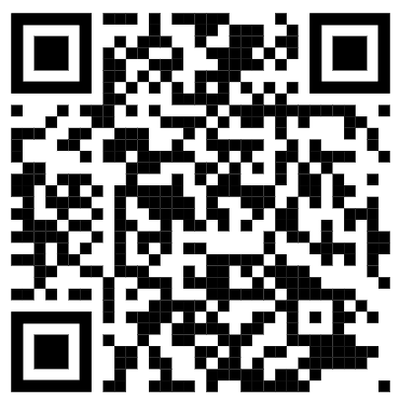
W. P. Carey School of Business
Thank You
Connect with me on LinkedIn
Third-Year Ph.D. Candidate
Kelsey Vourazeris
kvouraze@asu.edu
Notes:
https://asu.co1.qualtrics.com/jfe/form/SV_4HInayOjRiNUsR0

