Slide 1
Gateway to Ag Careers 2023
Justin Allange

Slide 2
About Me
Purdue ‘24
B.S. - Computer and Information Technology
B.A. - Spanish Language and Culture
From Avon, Indiana
Grew up in New Orleans, LA
Campus Involvement
Boiler Gold Rush Team Leader (2020)
Polytechnic Student Council
Outreach and Recruitment Chair (2022-23)
Vice President and Interim Membership Chair (2023-24)

Slide 3
Ag Experience
CRC Global Solutions (2016-2022)
3PL warehouse storing Bayer Corn and Soy seeds
Helped out where needed during Summers
Land O’ Lakes (2023-Present)
Supply Chain IT Intern

Slide 4
Why Ag?
Room for Innovation
A Good Cause
Solving Real Problems

Slide 5
My Impressions
Cross-company collaboration
Everyone has a different story
A common goal

Slide 6
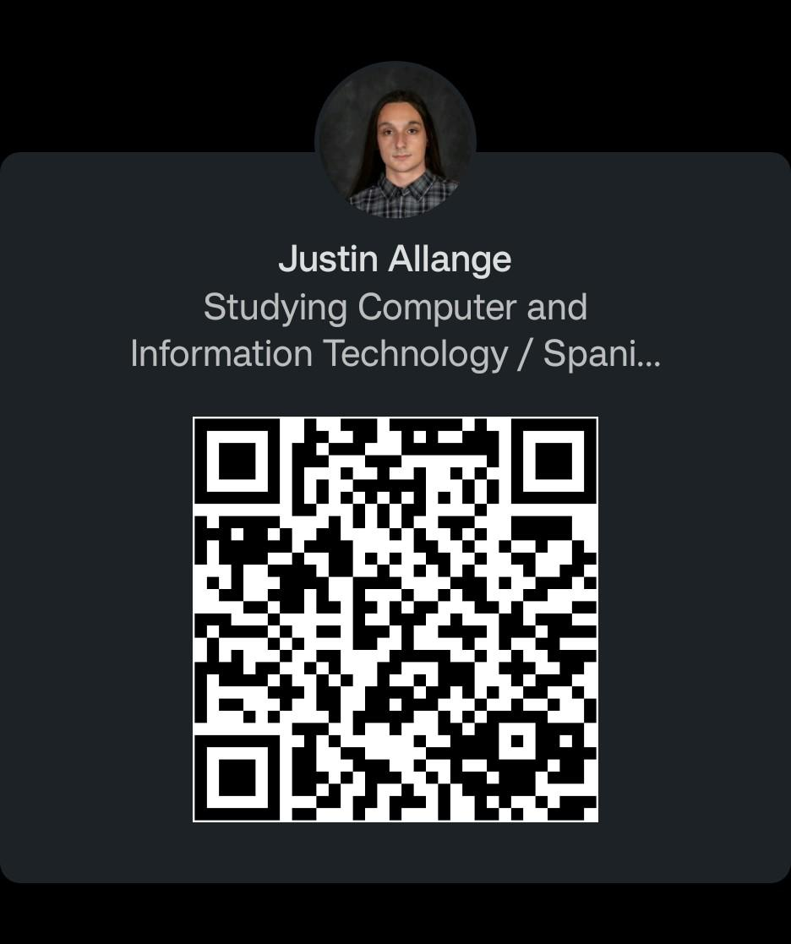
Where to find me!
Email - justinvallange@gmail.com
LinkedIn - https://www.linkedin.com/in/justinallange/
Scan QR Code!

