Slide 1
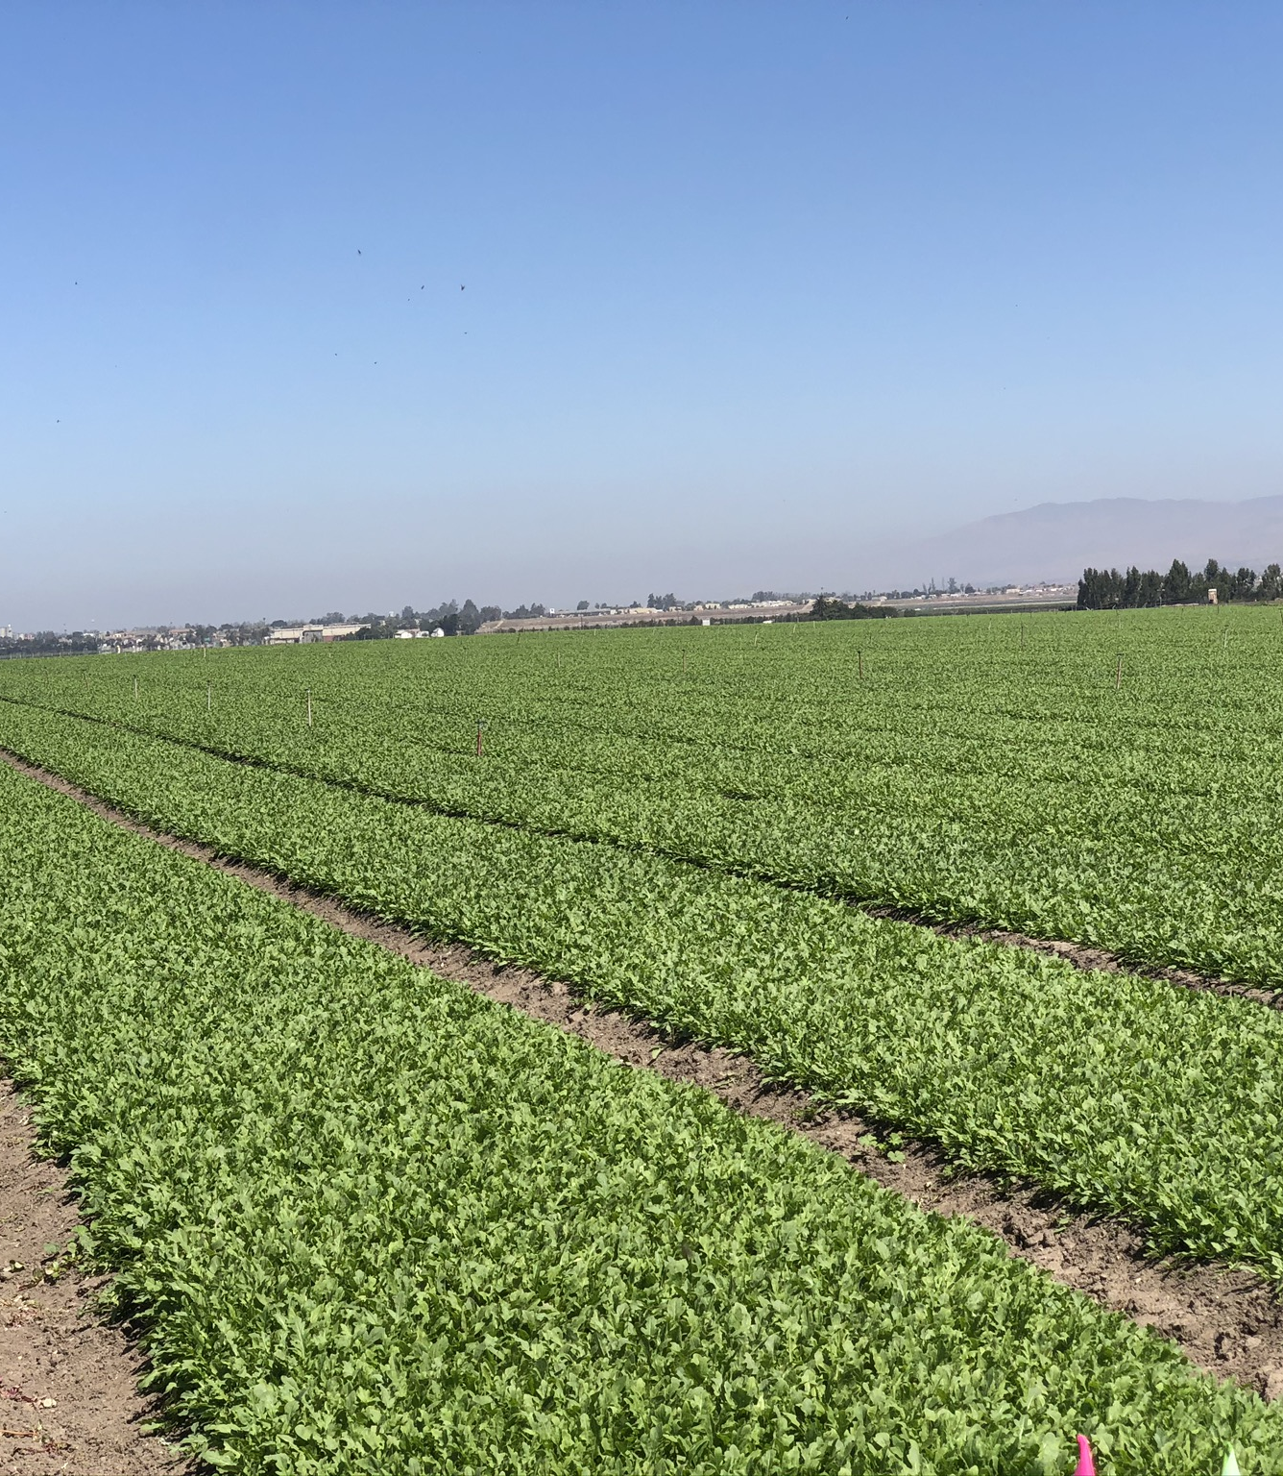
Gateway to Ag Careers AgGateway 2023
Jake Dempsey

Slide 2
Background
Born and raised in Yuma, Arizona
Family owns and operates large-scale farming LLC with focus in leafy greens (spinach, arugula, chards, etc.)
Senior at Arizona State University studying BA Business - Global Agribusiness
ASU - Barrett, The Honors College

Slide 3
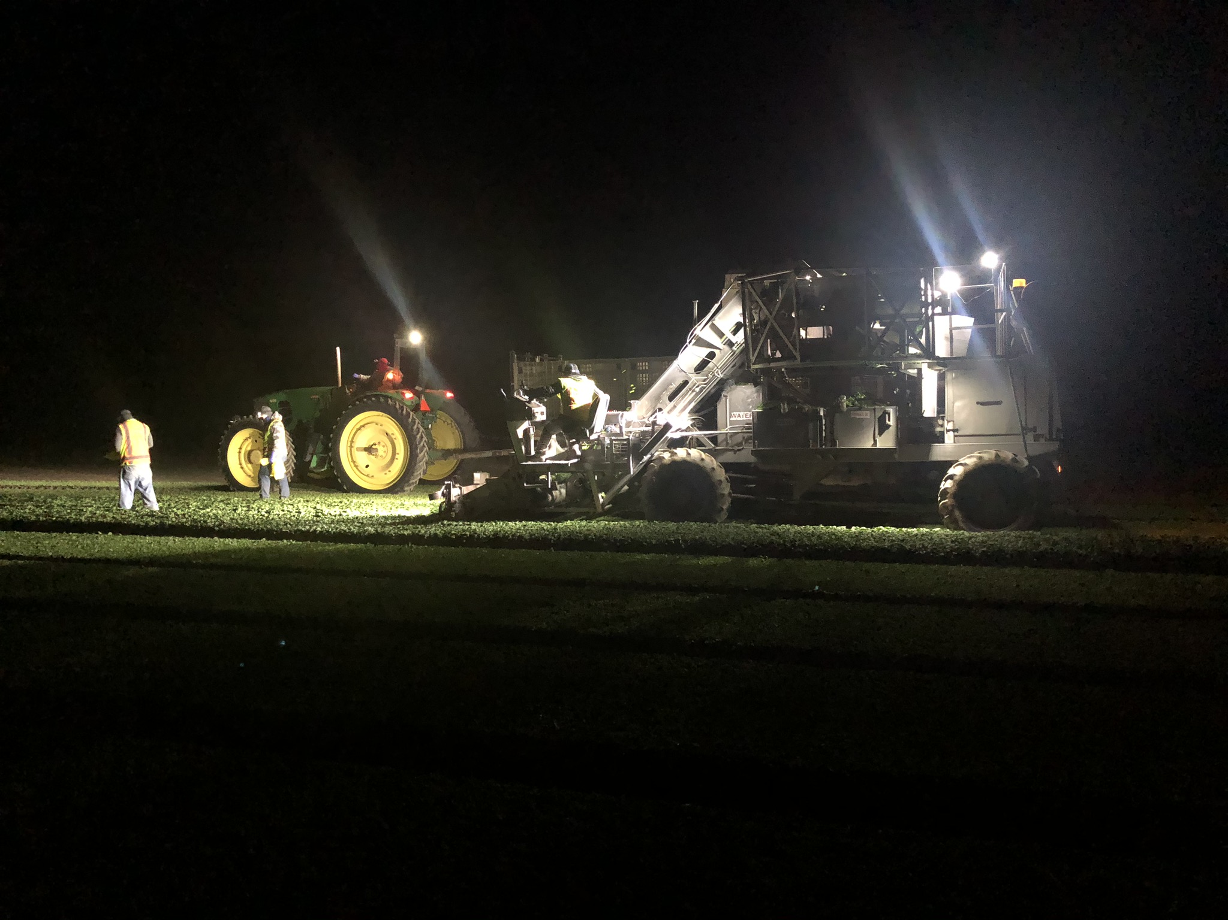
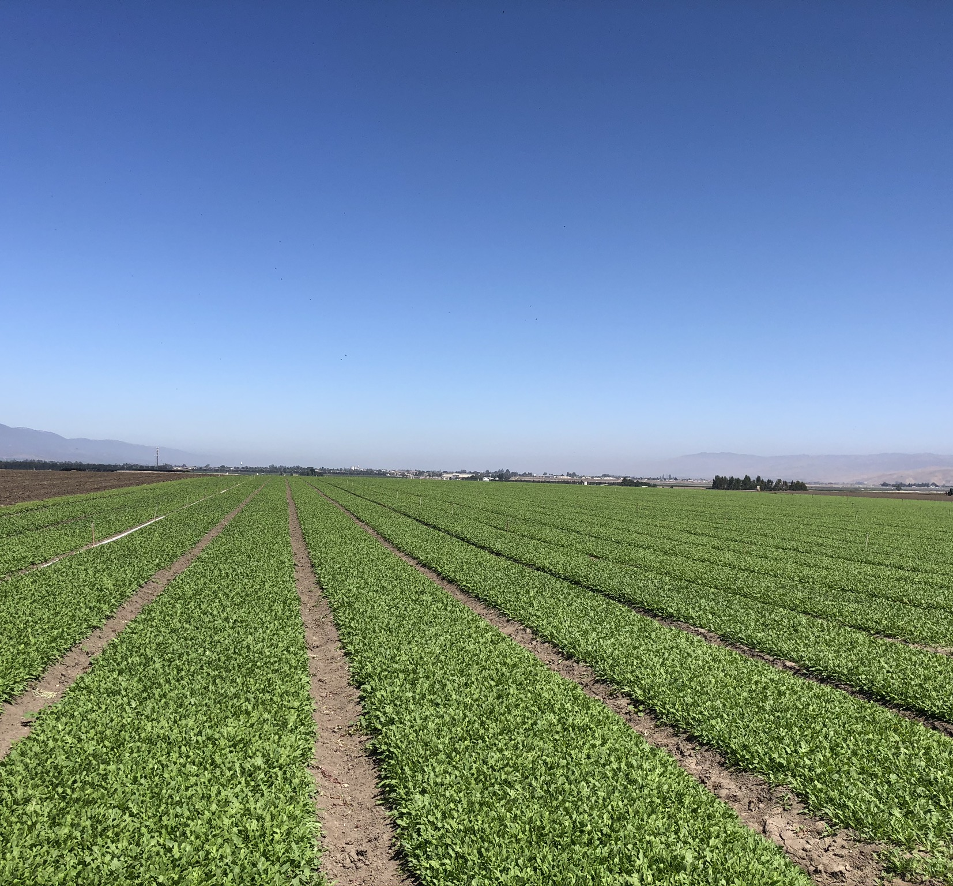
TLC Custom Farming Yuma, Arizona
Human resources
Accounting
Technology integration
Equipment management and inventory

Slide 4
LeaderBrand Gisborne, New Zealand
Developed an international view of agriculture
Salad house operations - cleaning, packaging, shipping
Transportation and associated problems
Weather and its effects on the industry

Slide 5
Future of the Industry
Less People, More Automation
AI and Agriculture
Utilization of Data

Slide 6
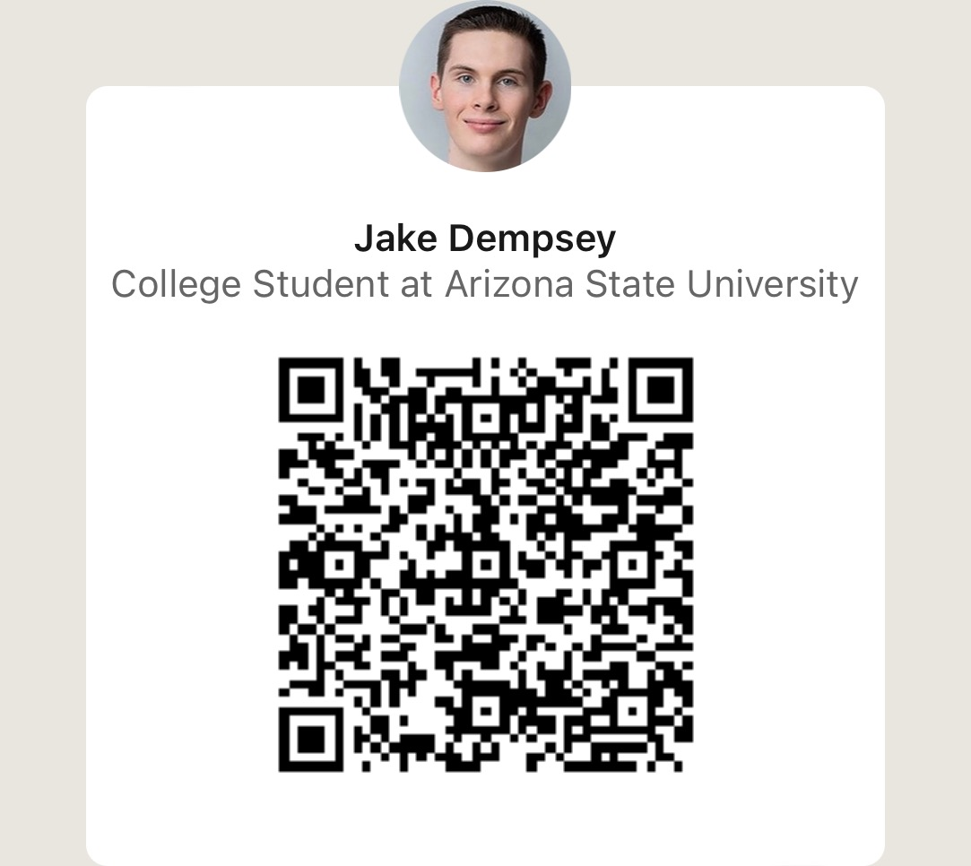
Connect
Email: jakedempsey42@icloud.com
LinkedIn: https://www.linkedin.com/in/jake-dempsey-71951b193/

