Slide 1
Gateway to Ag Careers 2023 Presentation
Fei Xyza Asuncion

Slide 2
About Me – Fei Xyza Asuncion
From the Philippines
B.S. and M.S. in Agricultural Engineering, University of the Philippines Los Banos, Major in Agricultural Power and Machinery Engg
Graduate Research Assistant and PhD Candidate, Carl and Melinda Helwig Department of Biological and Agricultural Engineering, Kansas State University

Slide 3
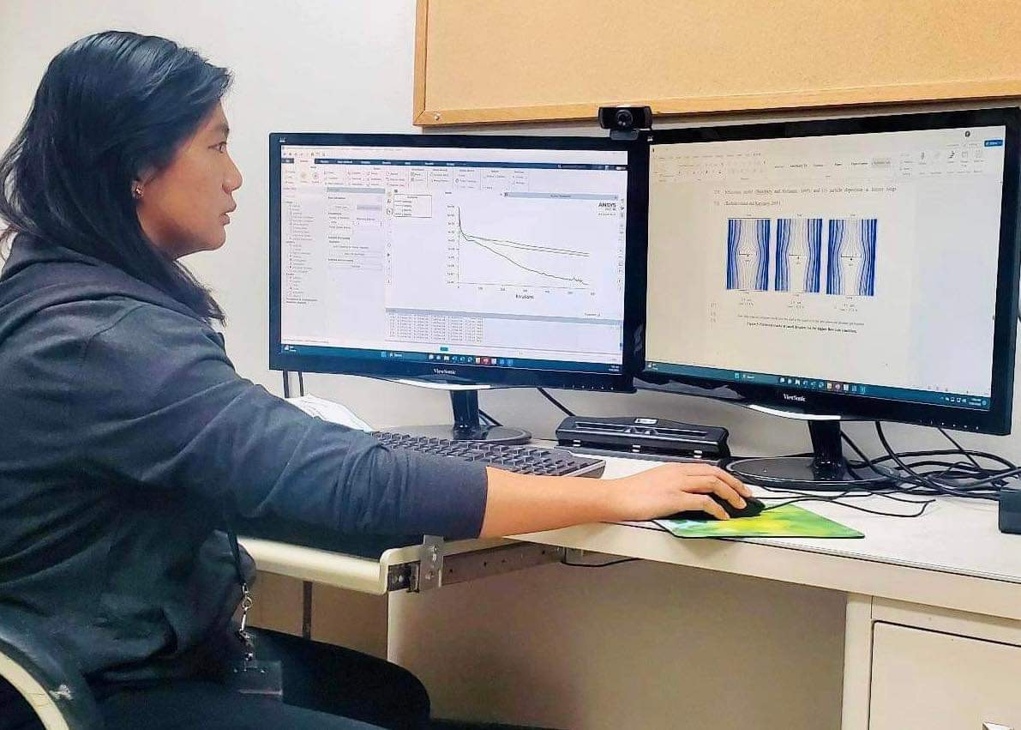
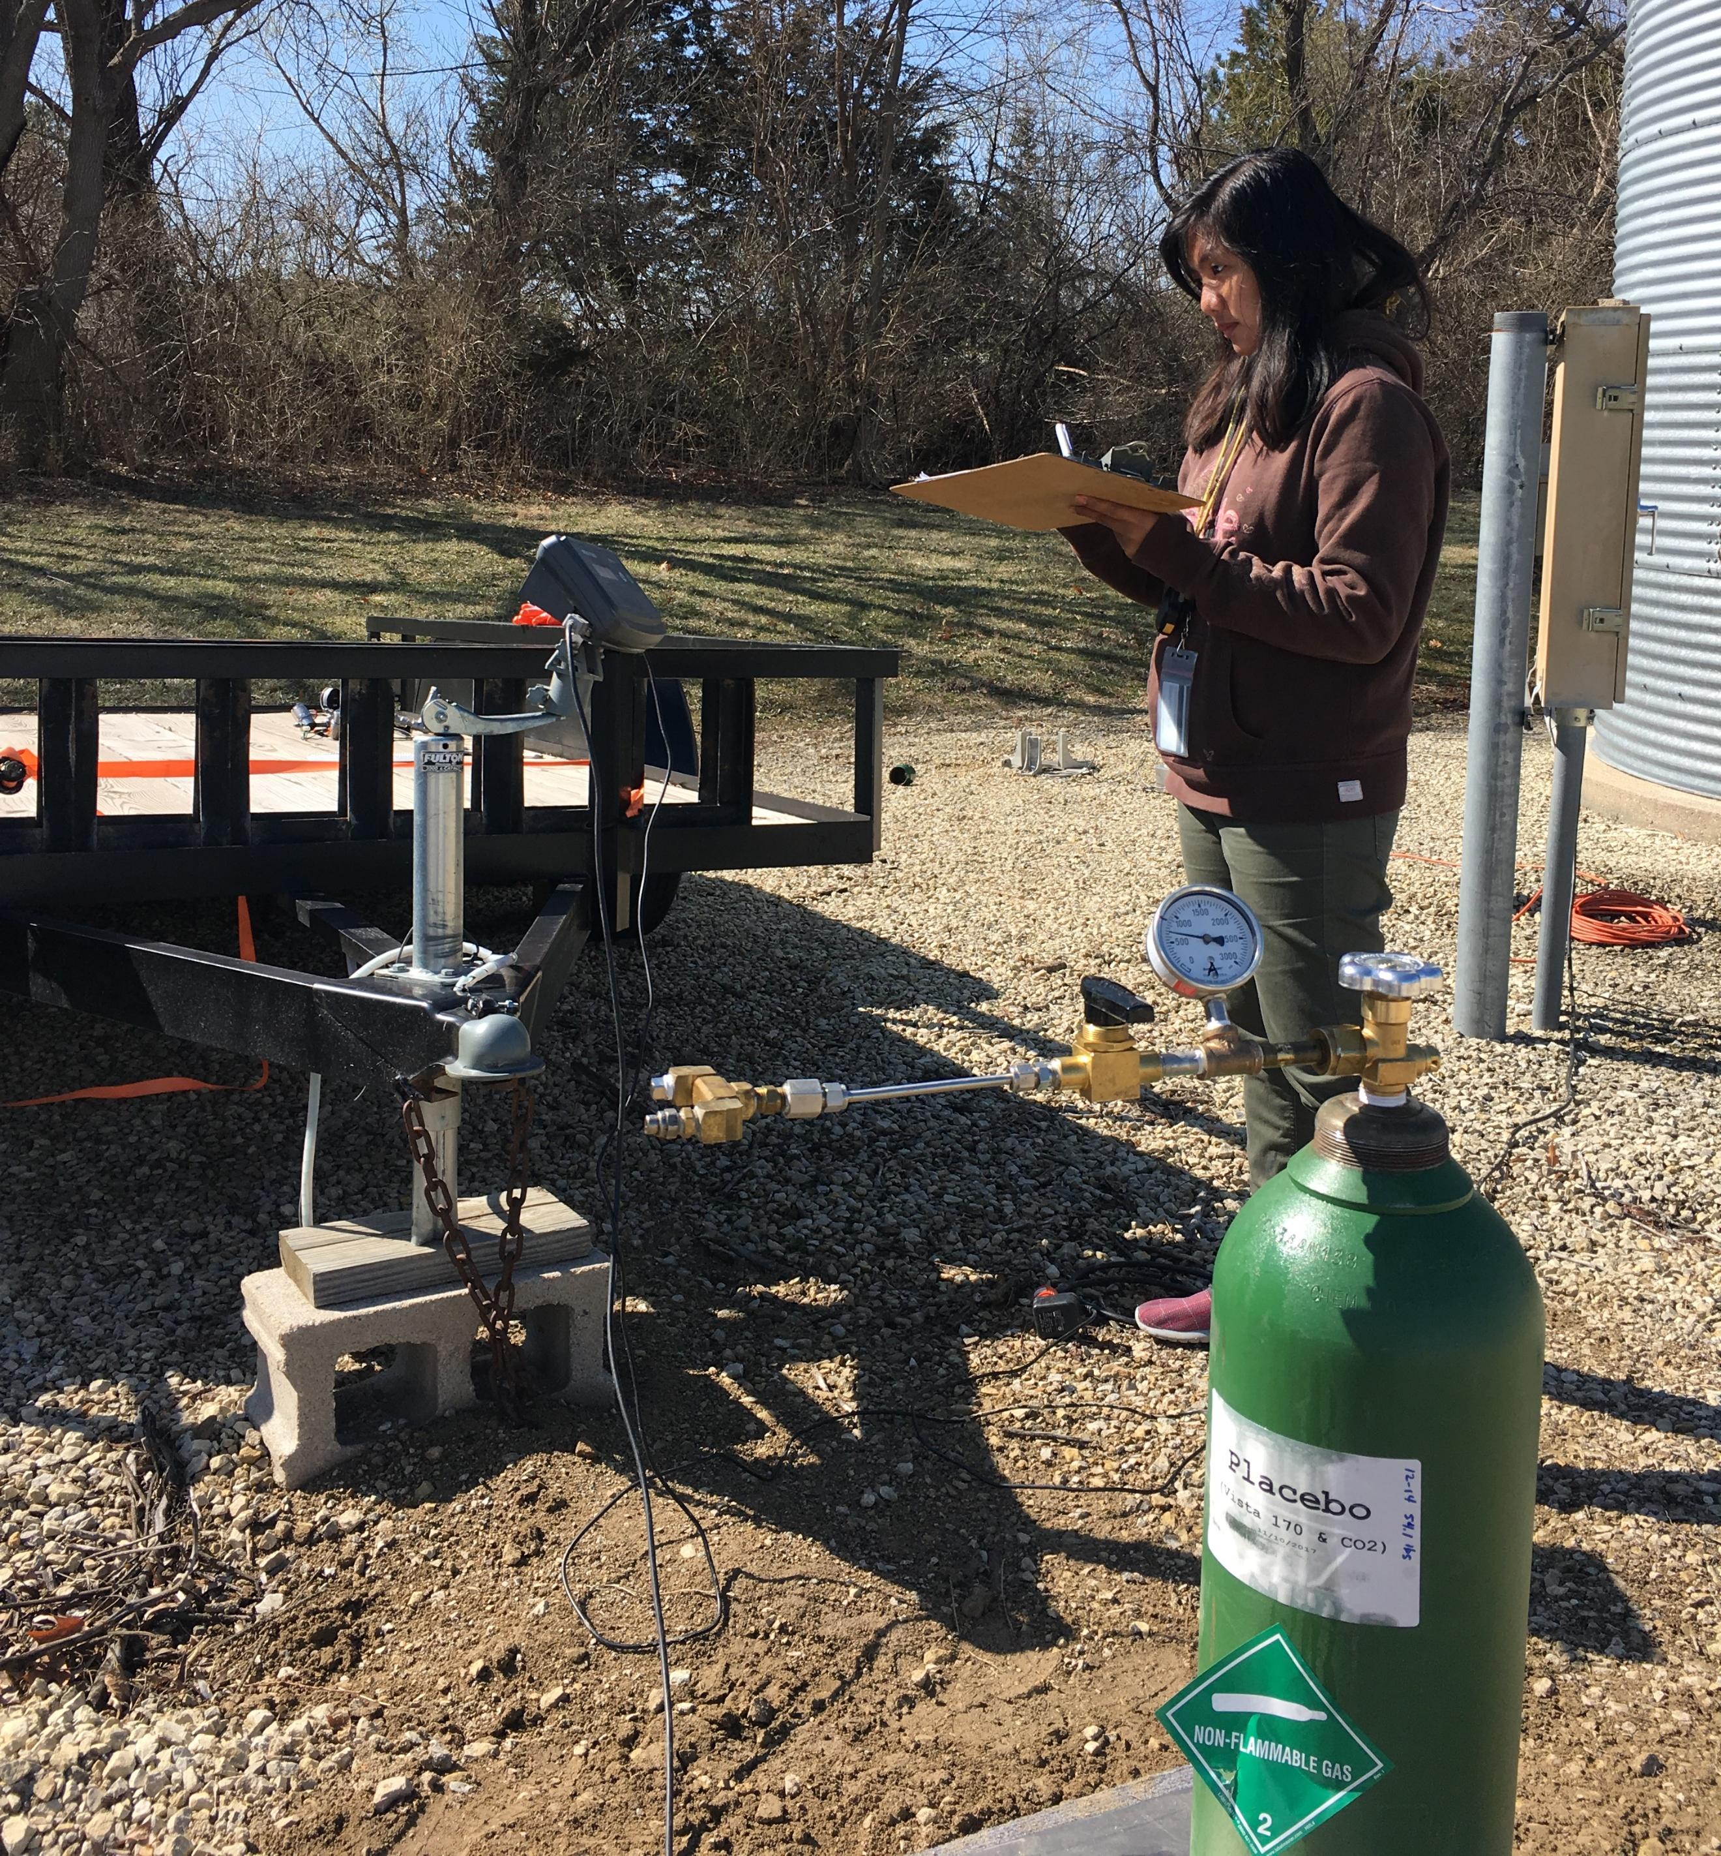
My Research
Computational Fluid Dynamics Modeling of Aerosol Insecticide Particle Transport for Stored Product Insect Control
To improve spray application techniques.
Develop CFD models that simulate air flow, track the motion of individual aerosol insecticide particles, and estimate the efficiency of the spray application through the deposition of the particles.

Slide 4
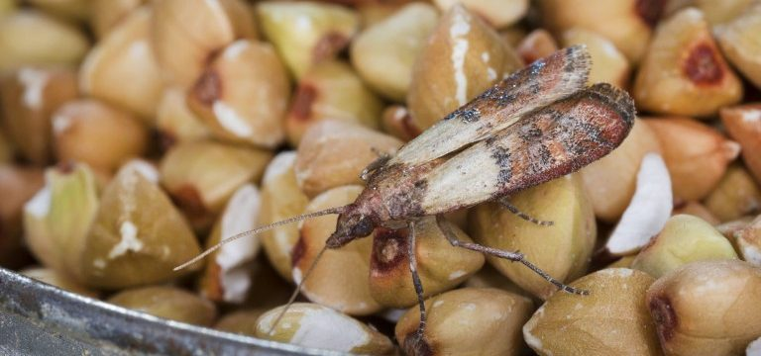
Stored product insects
Insect pests that are attracted to food; they spend significant part of their life living inside their preferred food.
Harder to notice than common pests because they are much smaller in size.
They are threat to food supplies.
Source: http://media.releasewire.com/photos/show/?id=93374
Source: https://www.rentokil.com/us/blog/indian-meal-moths-dont-let-eat-revenue/

Slide 5
Computational Fluid Dynamics (CFD)
Computational fluid dynamics (CFD) is a very powerful simulation tool which uses computers and applied mathematics to model fluid flow situations, heat, mass and momentum transfer and optimal design in agro-industrial processes (Xia and Sun, 2002).

Slide 6
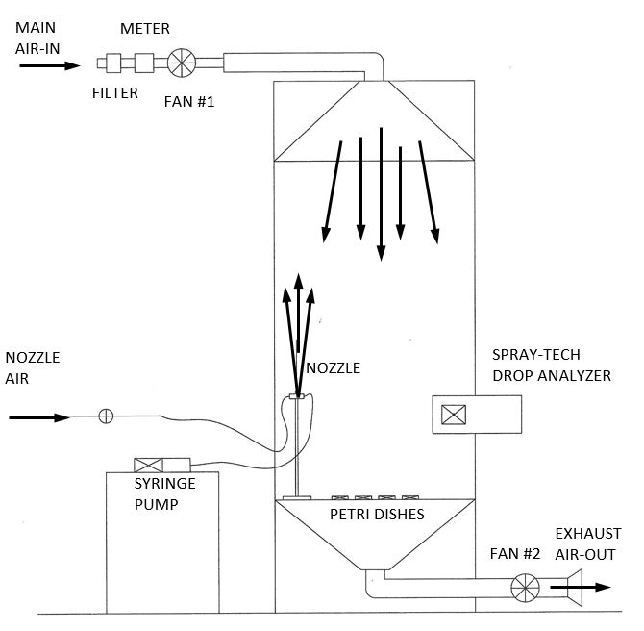
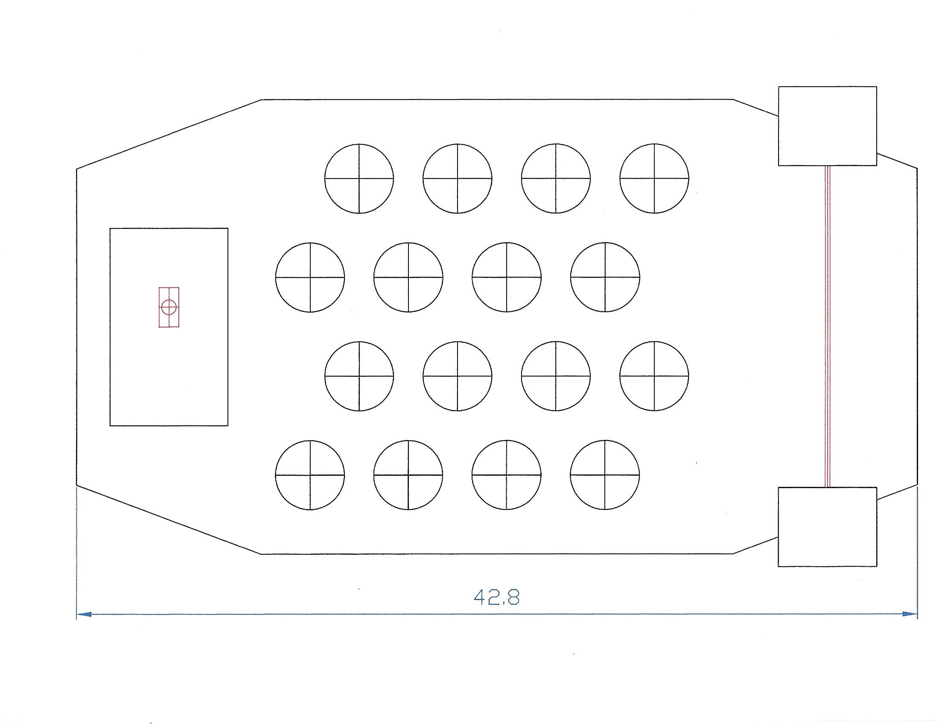
CFD modeling
Dish distribution inside the chamber
Experimental setup
(Vertical flow aerosol exposure chamber)
Schematic diagram of the chamber
Understanding the physics of the problem

Slide 7
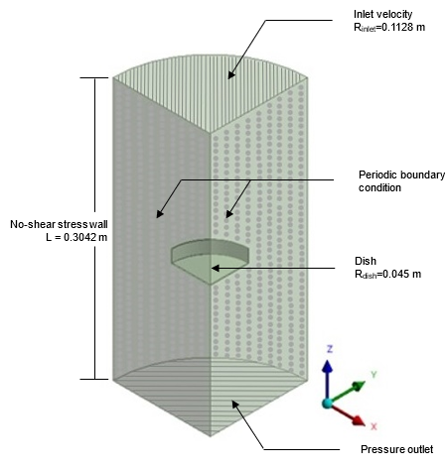
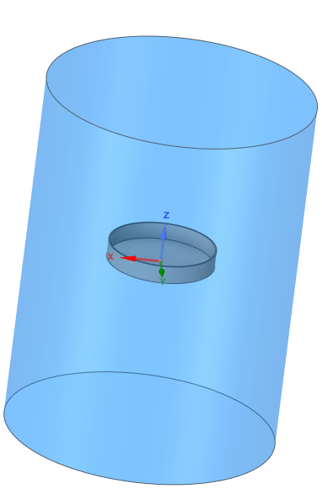
CFD modeling
Inlet
Dish
Outlet
Chamber and dish representation
(ANSYS FLUENT 2021 R1)
Boundary conditions for simulation

Slide 8
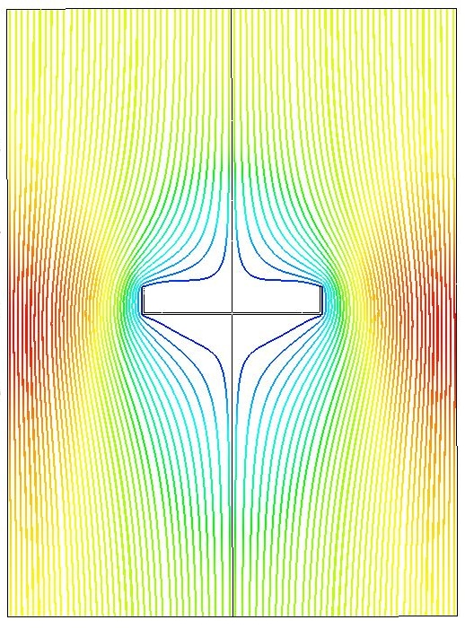
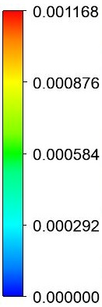
CFD simulation results
Velocity
Streamline
11.68 $×$ 10⁻⁴
8.76 $×$ 10⁻⁴
5.84 $×$ 10⁻⁴
2.92 $×$ 10⁻⁴
0.00 $×$ 10⁻⁴
[m s⁻¹]
Predicted air flow (streamlines) and particle motion (velocity vector) inside the chamber

Slide 9
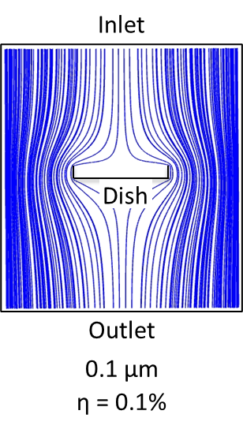
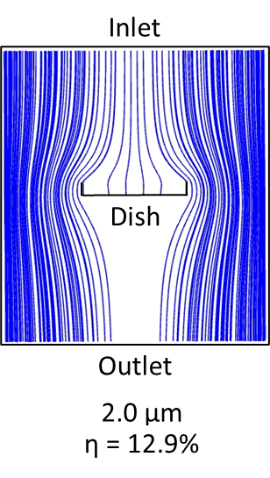
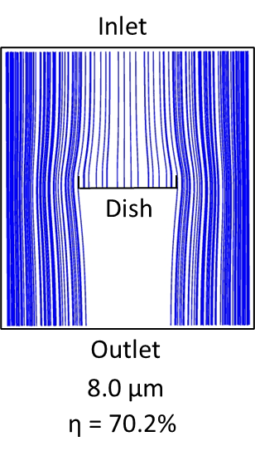
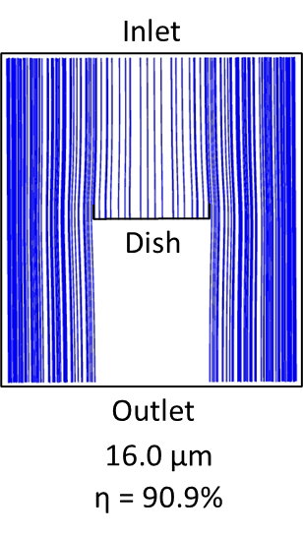
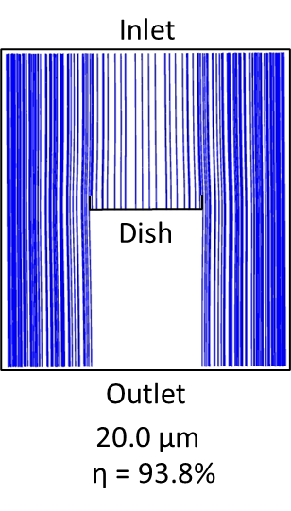
Predicted particle tracks and efficiency

Slide 10
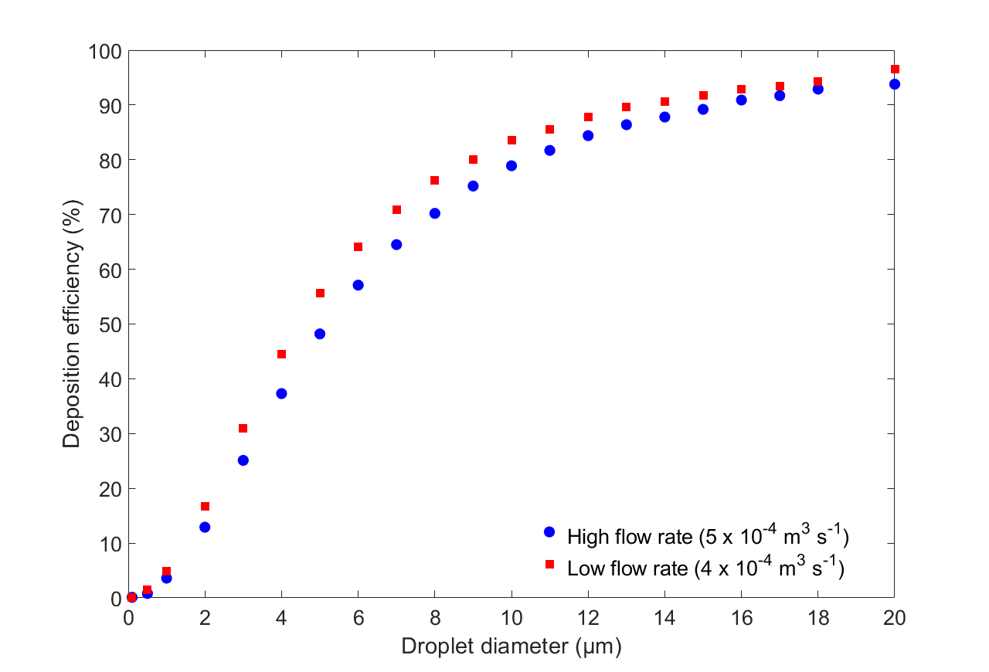
Deposition efficiency

Slide 11
RESULTS
Predicted deposition of pyrethrin increased with increasing droplet size.
Larger droplets tended to settle quickly while smaller droplets tended to continually flow with the air without settling out.
Large droplets above the dish settled in the dish 90% of the time, while 12% of the small droplets settled in the dish.
Results of the simulation support previous experimental results.

Slide 12
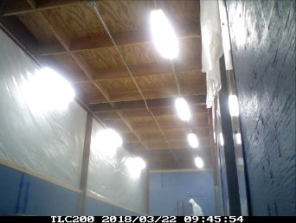
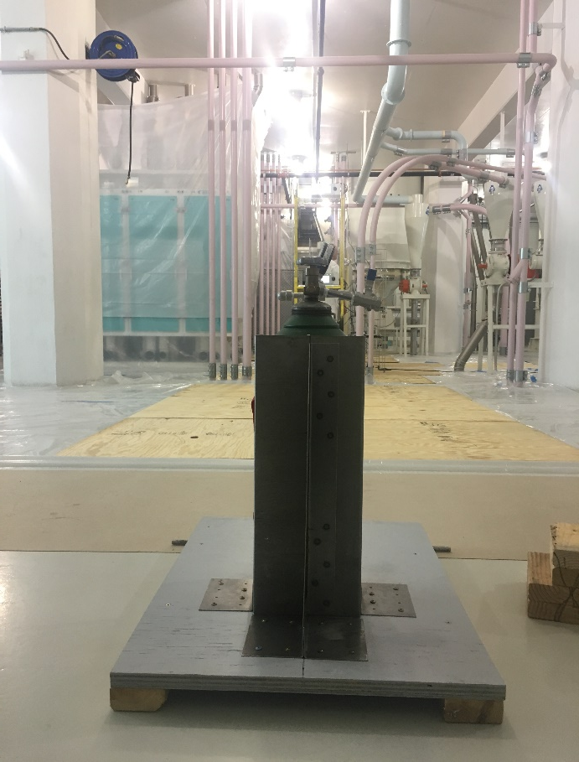
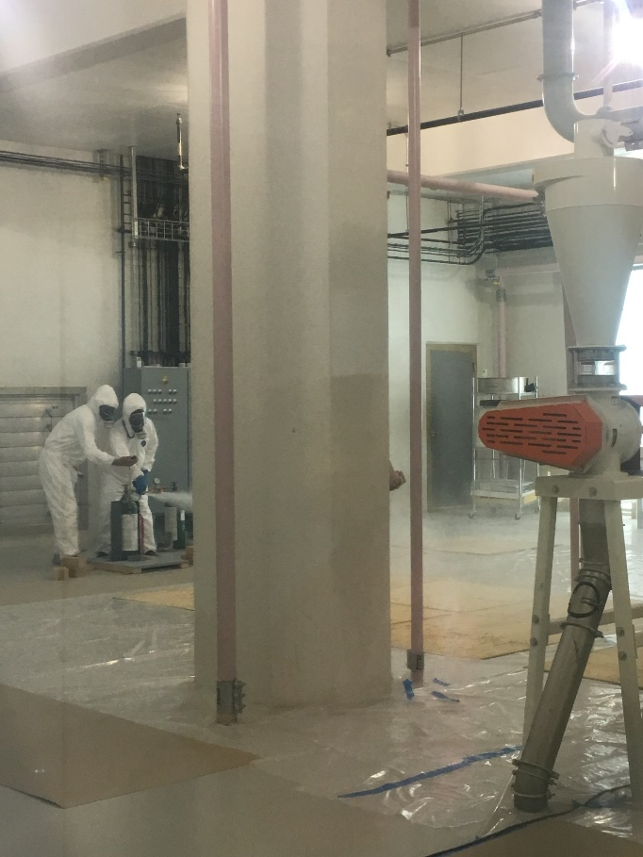
CURRENT AND FUTURE WORKS
Ongoing development of CFD model for a controlled room and for an operating flour mill.

Slide 13
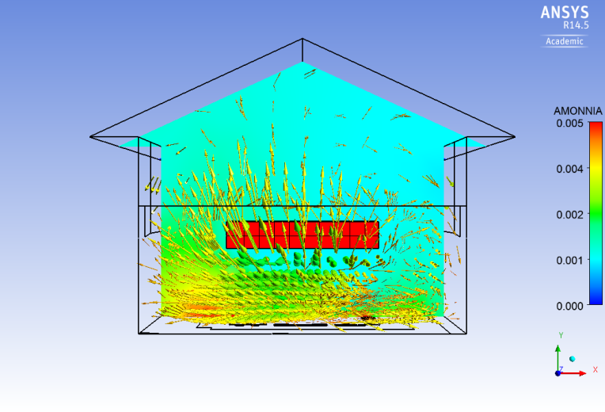
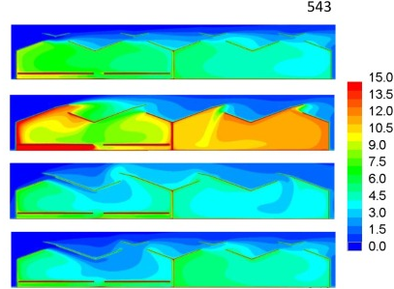
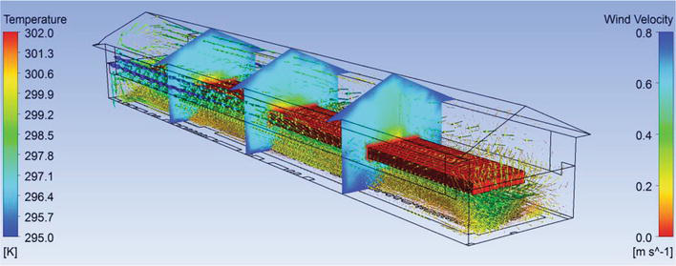
CFD applications in Agriculture
Agricultural building modelling
Bournett and Rojano, 2022
For optimal crop production, heat and mass transfer for climate control in a greenhouse (Flores-Velazquez et al., 2015; Rodriguez and Velazquez, 2019)
Agricultural drone sprayer
MR-CFD Co.

Slide 14
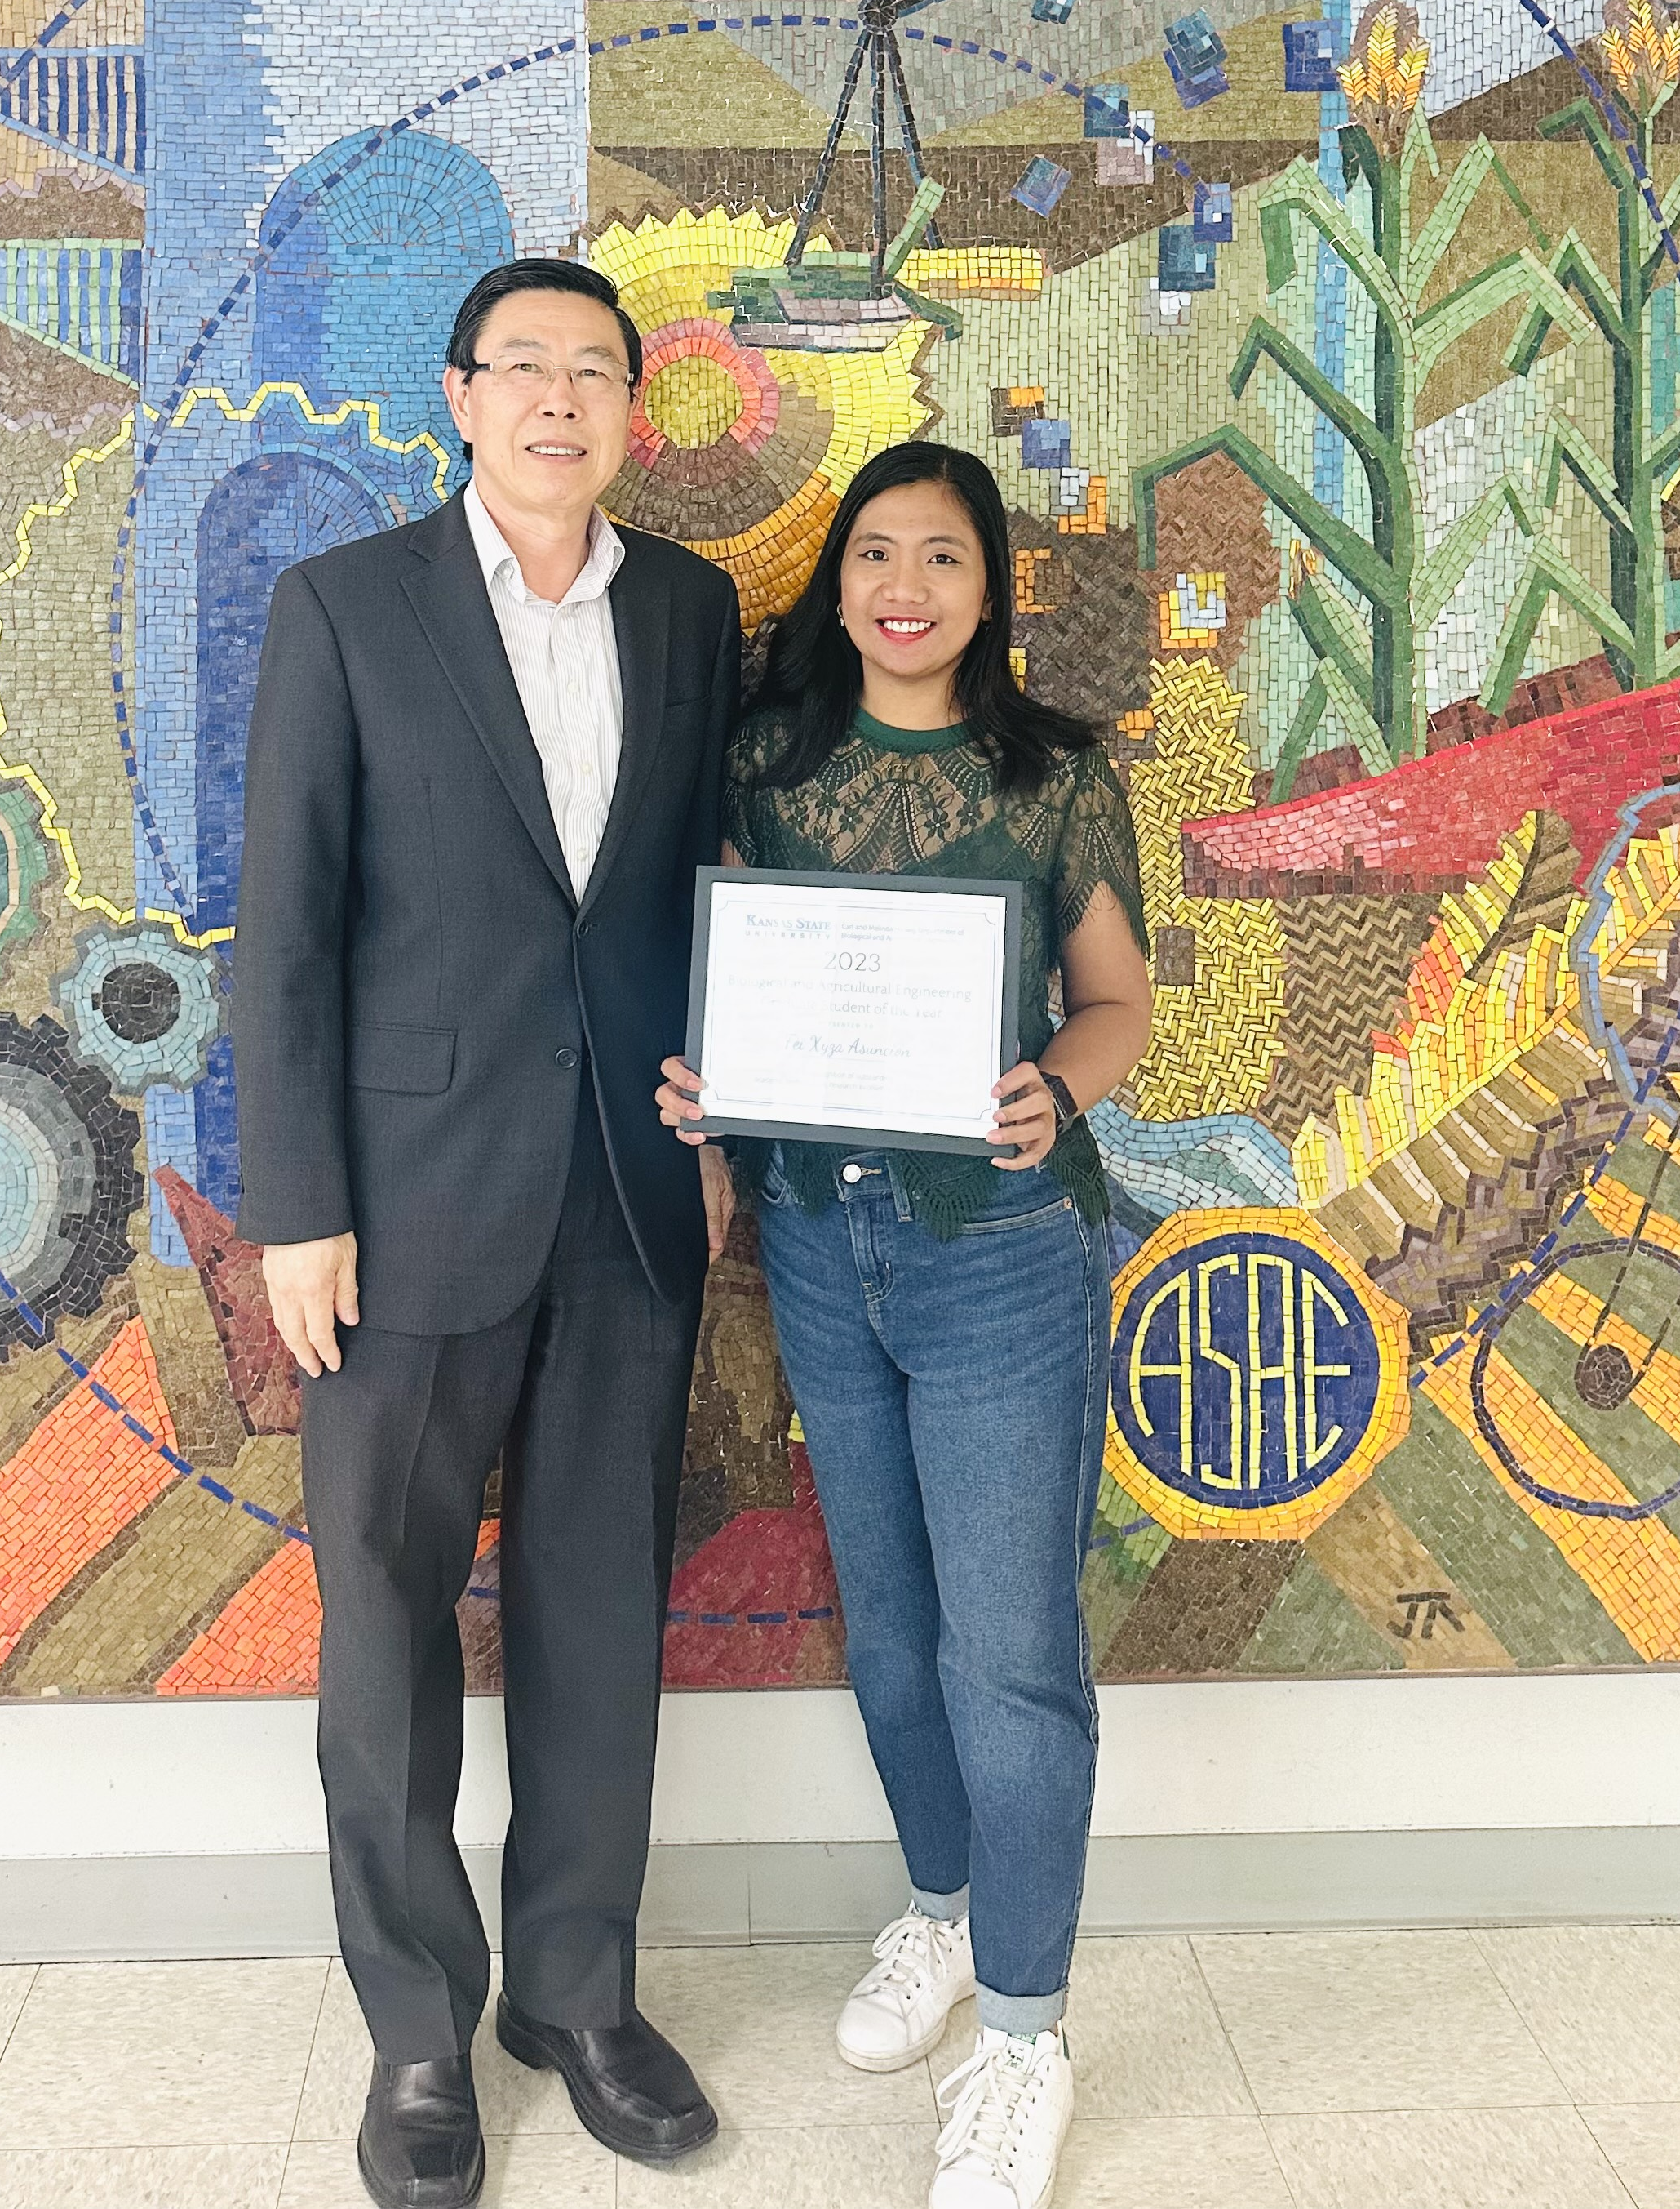
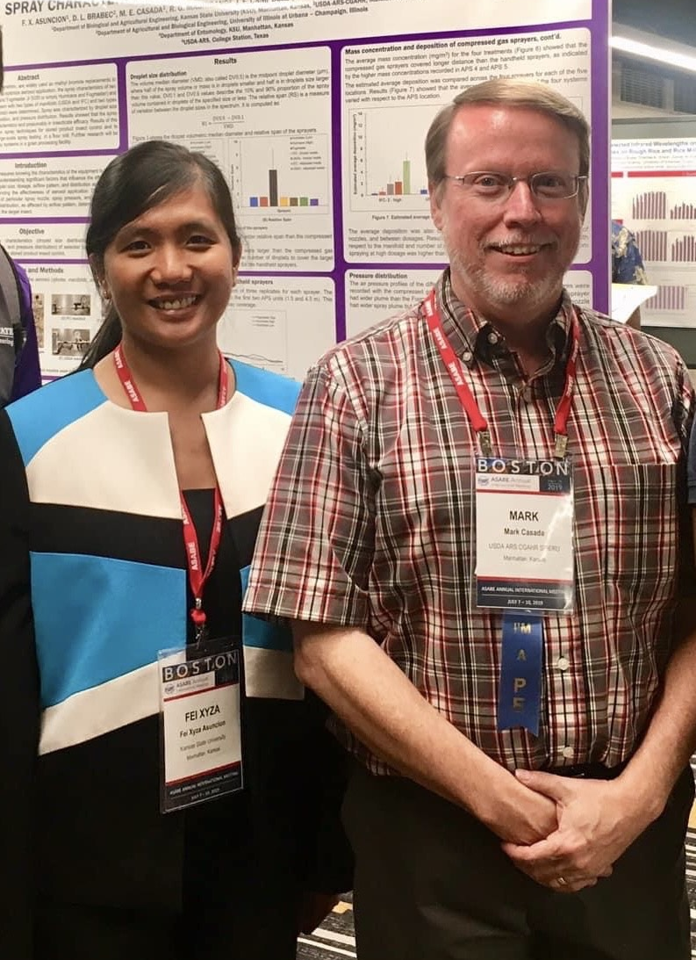
Acknowledgment
AgGateway and the Ag CIO Roundtable
My major Professors – Dr. Donghai Wang, Dr. Mark Casada, and Dr. Ronaldo Maghirang

Slide 15
Thank you! ☺
fxbasuncion@ksu.edu

