Slide 1
2023 AgGateway Annual Meeting | Nashville, Tennessee
Unmanned Aerial Spray Systems and their Role in the Future of Agriculture
Coleman Byers
MS Student
College of Engineering
University of Georgia

Slide 2
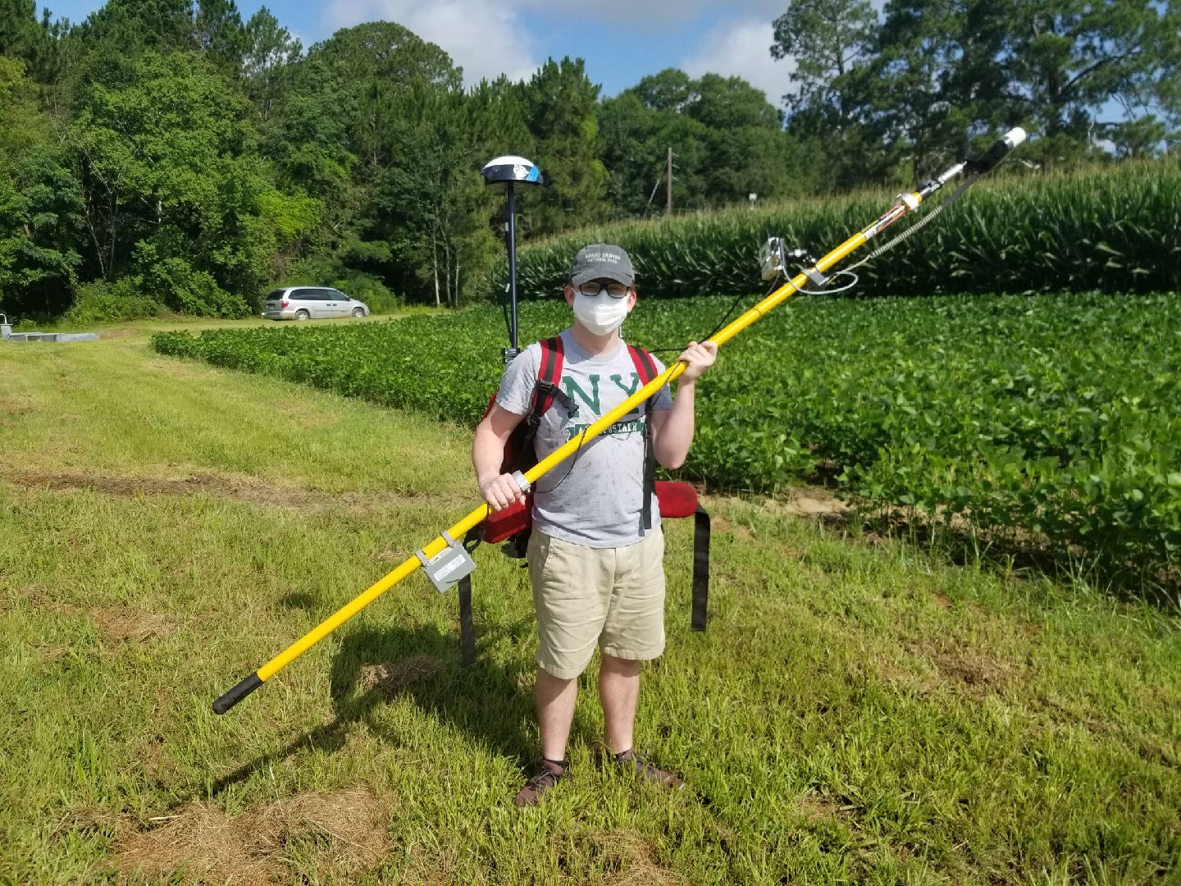
Background
Native of Tifton, GA
First Exposure to Precision Agriculture – Young Scholar Program
Graduated from the University of Georgia in 2022 with a BS in Environmental Engineering
Pursuing an MS degree in Agricultural Engineering from UGA

Slide 3
Precision Ag Experience
Experience with a variety of precision agriculture topics:
Variable Rate Fertilizer and Pesticide Applications
Remote Sensing for Crop Health
Spray System Technologies
Unmanned Aerial Spray Systems (Spray Drones)
Research focuses on the evaluation of spray coverage and swath uniformity at various operational parameters utilizing spray drones.
Responsible for secondary studies evaluating spray coverage and efficacy in corn, cotton, and peanuts.

Slide 4
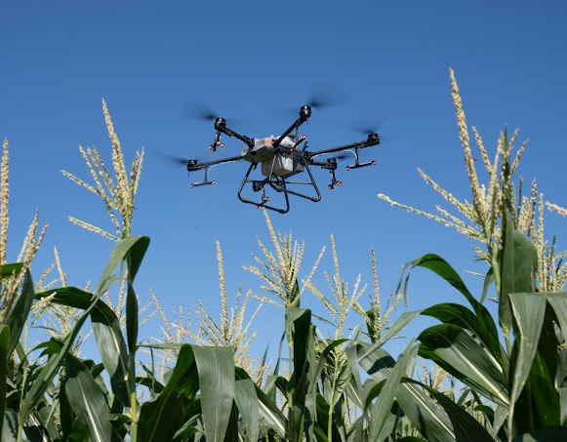
Spray Drones in Ag
The application of Unmanned Aerial Systems (UAS) is widespread in modern agriculture
Multiple platforms are available commercially today for aerial application of pesticides
Drone sprayers are another potential application technology that allow for timely applications, especially in areas inaccessible to ground equipment

Slide 5
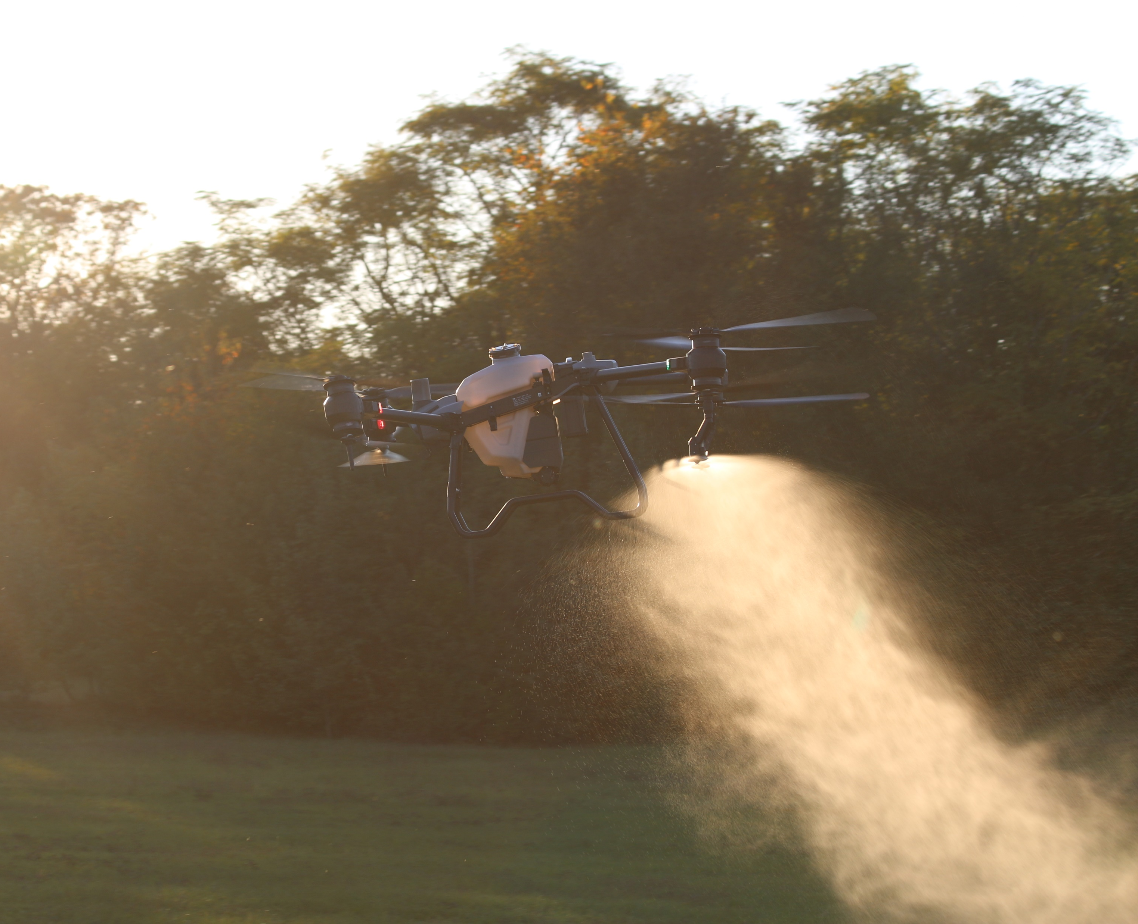
Current Capabilities
Typically has a 2 to 18-gallon tank as compared to ground sprayers
Low volume pesticide applications (1-5 gallons per acre)
Battery life typically last 5-15 minutes during applications
Likely to be a large amount of back and forth on regulations on these large drones
Specific uses for the technology on farms

Slide 6
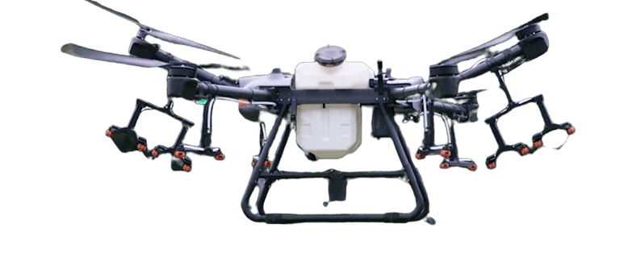
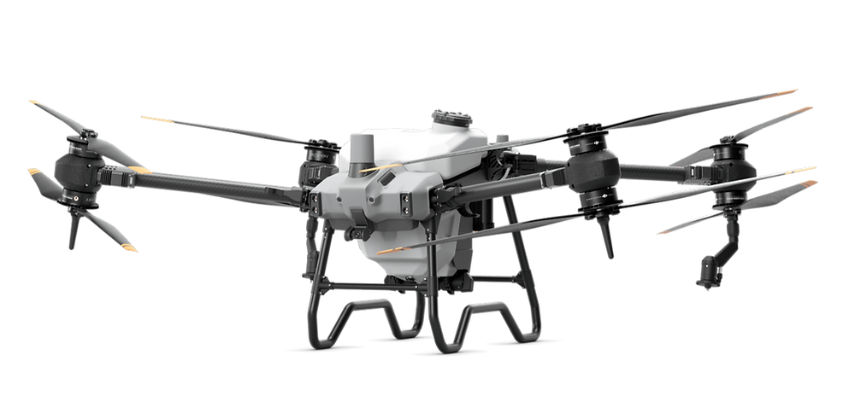
Advancements in Spray Drones
Improved capabilities in latest drone sprayers/models – swath, speed, droplet size etc.
Unlike ground sprayers, limited information is available on selection of parameters for effective pesticide applications (e.g. speed, height)
Assessing application performance of these platforms is important to inform best management practices and effective technology utilization
DJI Agras T30
DJI Agras T40

Slide 7
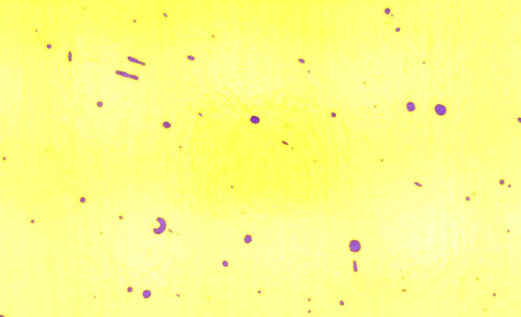
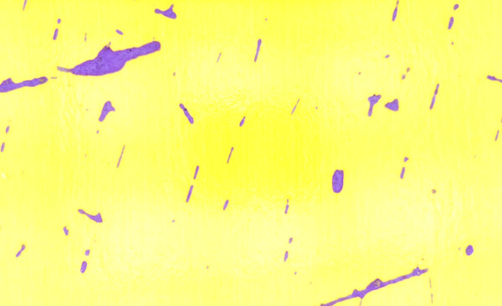
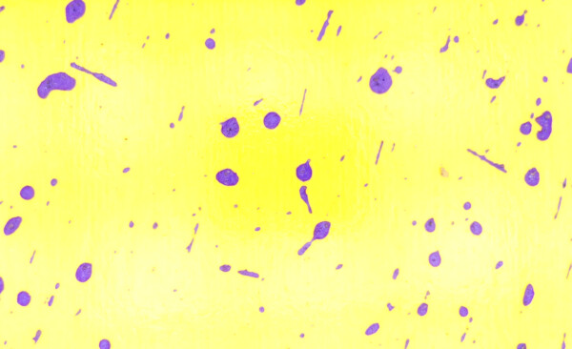
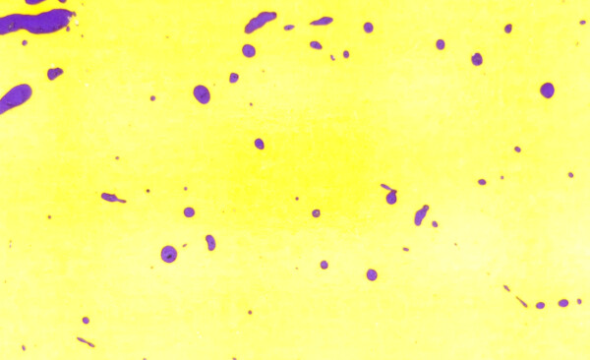
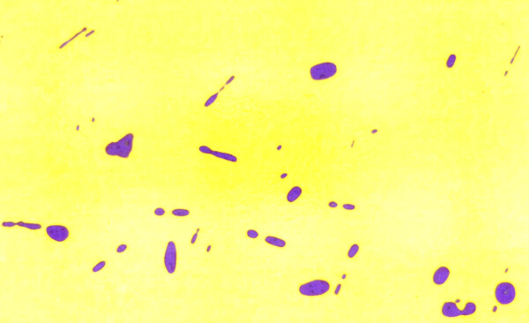
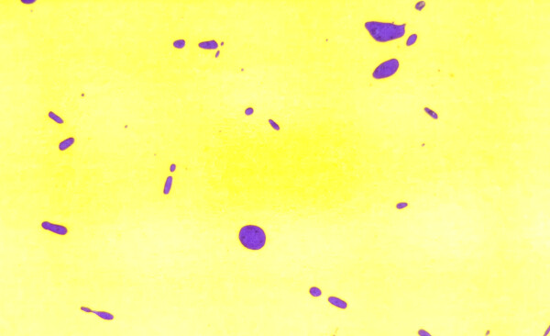
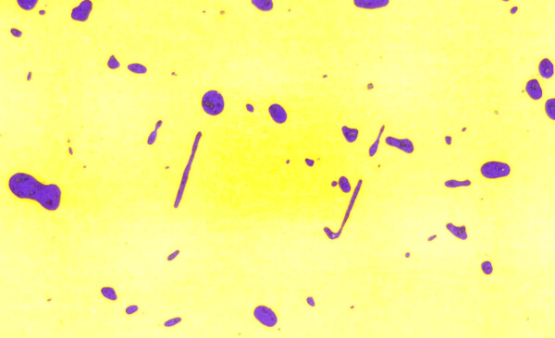
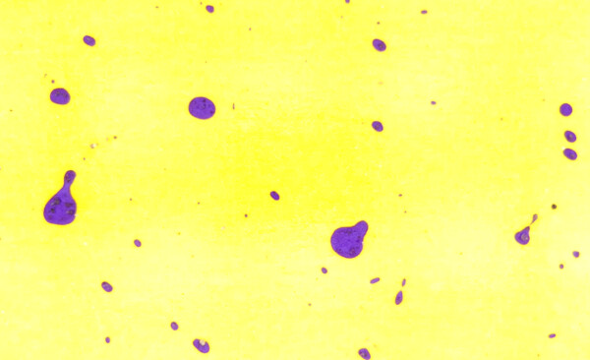
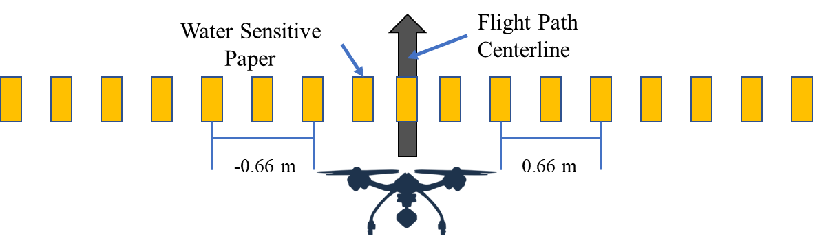
Coverage Example
Spray Height = 2.3 m
XR
AIXR
TTI
-2 m
-1.33m
-0.66m
0 m
0.66m
1.33 m
2 m

Slide 8
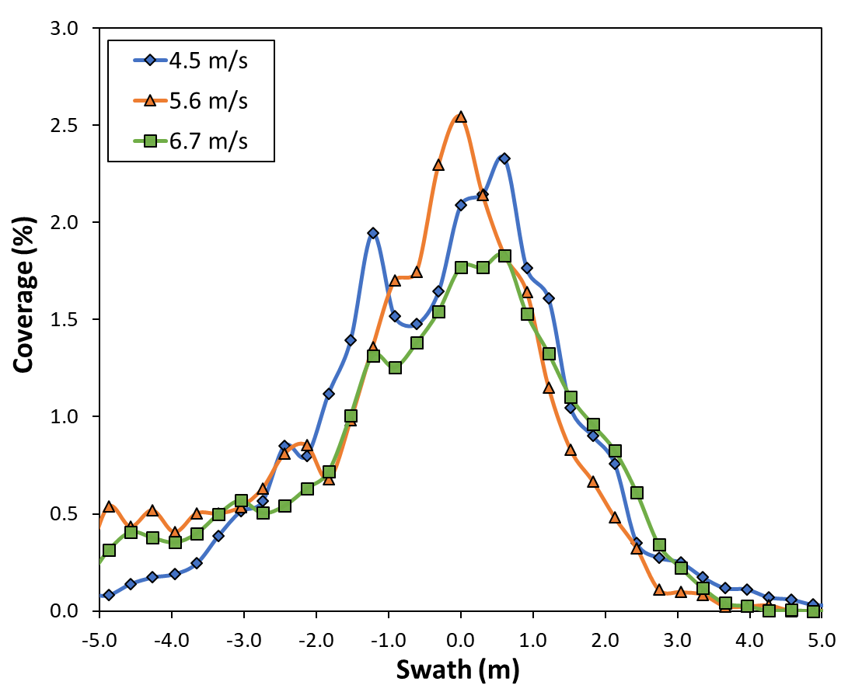
Effect of Flight Speed on Coverage Uniformity
Center Swath
Speed (m s⁻¹) | Coverage (%) | CV (%)
4.5 | 1.84 a | 76.02
5.6 | 1.82 a | 73.39
6.7 | 1.52 b | 65.28
Entire Swath
Speed (m s⁻¹) | Coverage (%) | CV (%)
4.5 | 0.66 a | 160.29
5.6 | 0.64 a | 153.06
6.7 | 0.57 a | 142.40

Slide 9
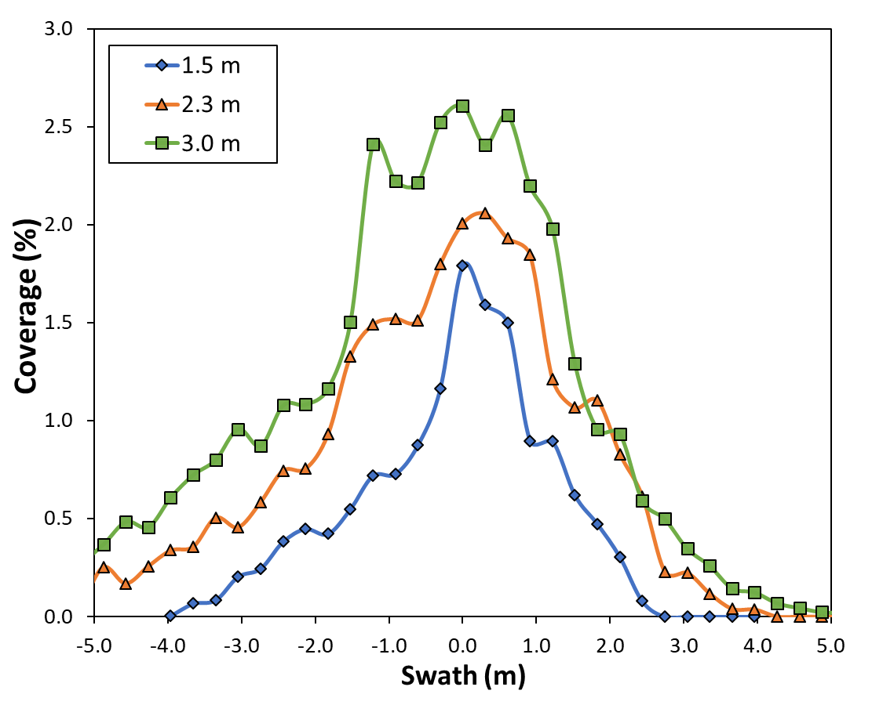
Effect of Application Height on Coverage Uniformity
Center Swath
Height (m) | Coverage (%) | CV (%)
1.5 | 1.13 a | 99.86
2.3 | 1.71 b | 67.45
3.0 | 2.35 c | 51.28
Entire Swath
Height (m) | Coverage (%) | CV (%)
1.5 | 0.52 a | 163.89
2.3 | 0.62 b | 156.29
3.0 | 0.73 c | 144.46

Slide 10
Practical Implications
Commercial applicators need to perform swath testing to determine optimal parameters. In the aforementioned study, the T30’s default nozzles and maximum application speed showed consistently lower coverage.
Performance of drone sprayers will likely vary in the presence of a crop canopy from bare ground. Applicators need to test coverage in the presence of crop canopies and adjust parameters accordingly.
DJI Agras T30
DJI Agras T40

Slide 11
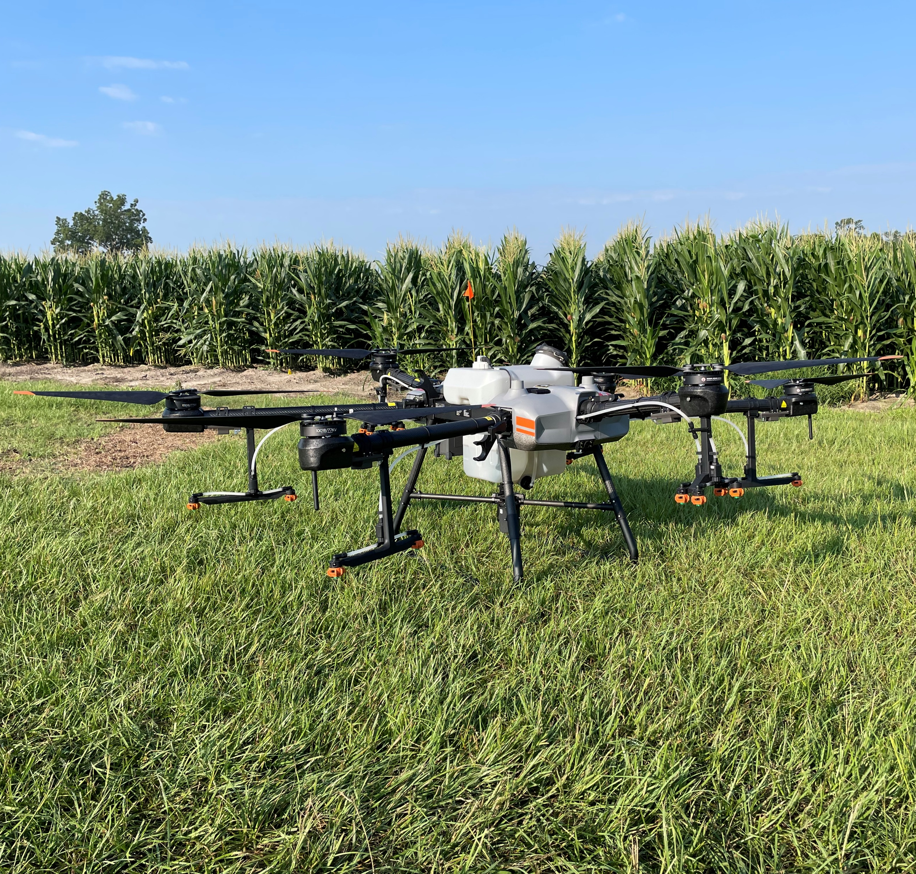
Thanks!
Cole Byers
Coleman.Byers@uga.edu
Graduate Research Assistant
College of Engineering
University of Georgia
Tifton, GA Twitter: @ENGRTechCole https://agtechdata.uga.edu/

