Slide 1

Settlement Sheet Meetup

Slide 2
Agenda
Settlement sheet: The Problem
Interest in a new Working Group:
  Yes → Define scope, deliverables
  No → What else is of interest
    AgXML move to Connect Center?

Slide 3
The Problem
Links scale tickets to contracts for settlement/payment
  Goal for standardization effort?
    What is shared between systems regarding settlement sheet?
  Requires similar data to scale ticket
  Links to other documents that have not been standardized like Scale Ticket
    Need to do other documents first (contract, payment, etc.)?
Controlled vocabulary for quality attributes?
  Also identified as need in Scale Ticket

Slide 4
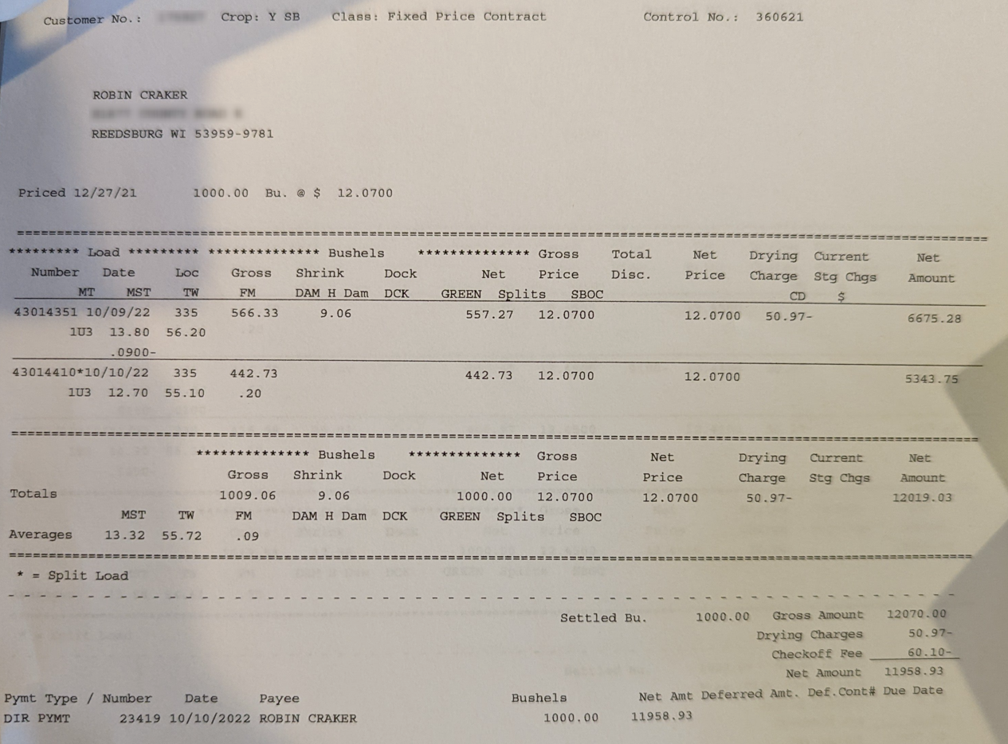
Example

Slide 5
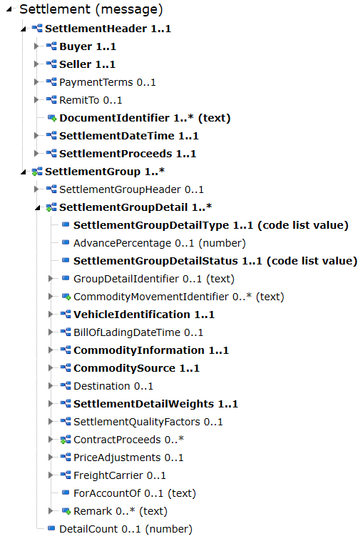
Settlement Sheet WG Scope, Deliverables
Scope
  Grain, feed, inbound/outbound, truck delivery only (match scale ticket)?
  Relation to AgXML Settlement
    AgXML Definitions:
    1) Message that brings together several other messages/documents including contracts, shipments, grades, etc. to reach final payment value
    2) The final amount that is paid to the seller from the buyer. This takes into account all of the discounts, grades, weights, and contact price. It reduces the final value by any advances that were paid against it.

Slide 6
AgXML → Score
Would there be more value in just moving AgXML from Click to Score, aligning with OAGIS?
Pro’s and Con’s discussion

Slide 7
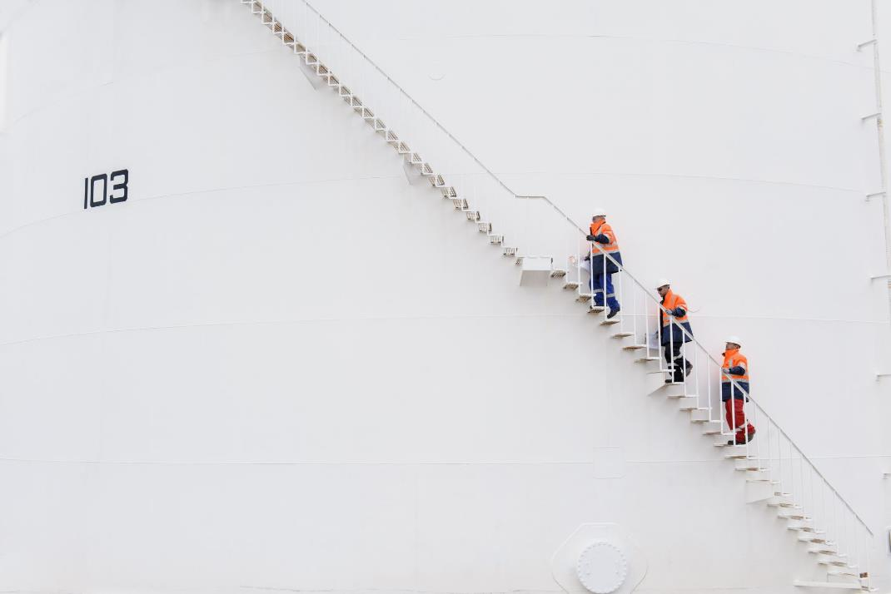
Next Steps

