Slide 1

Data Stewardship

Slide 2
Agenda
State of data access and permission in Agriculture
What does the industry need
How do we meet the needs

Slide 3
Data Stewardship Today
Who owns data?
  Who actually has access or control of data?
Who needs/wants access?
How is data tracked, what access logs are needed?
How is data quality determined?
What is the regulatory landscape?
Who derives value from data?
How do we handle data used to train AI models?

Slide 4
Data Privacy Whitepaper
Data Privacy Committee Wiki page
Whitepaper
Update? Start new?

Slide 5
GDPR regulations
The 7 data protection principles are:
  Lawfulness, fairness, and transparency
  Purpose limitation
  Data minimisation
  Accuracy
  Storage limitations
  Integrity and confidentiality
  Accountability

Slide 6
Industry Needs
How do we move forward
Is there a real barrier
AI/ML, AR/VR/XR what will the future require

Slide 7


Terminology: Sharing or Access Permissions
Sharing
Sharing Data

Slide 8
How do we address the needs
Document use cases, identify complexity

Slide 9







Information Flow on the Farm
Equipment Brand 1:
  As-planted
Equipment Brand 2:
  Yield maps
Service provider 1:
  Soil sample data
  Fertilizer as-applied
Neighbor
  Manure as-applied
Seed Retailer:
  VRT Seeding maps
  Crop scouting observations
  Aerial imagery
Service provider 2:
  Crop protection as-applied
USDA:
  Soil maps (SSURGO)
Crop Scout or Other Data Source
Crop Plan
Reports
Observations & Measurements
Partners & Sustainability
Grower
Work Record
History
(Work Records, Observations & Measurements)
University Field-Scale Researcher
Advisor
Work Order
Service Provider
Recommendation

Slide 10


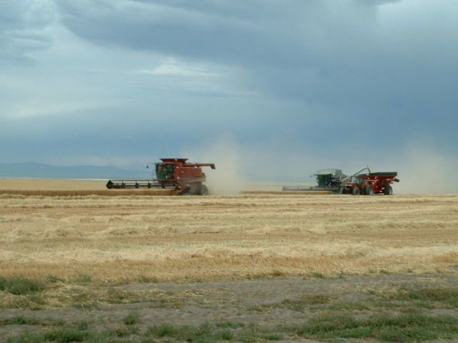



The Messy Example
Grower/Farm Manager (Tennant)
FMIS System
Custom Operator 1
OEM Platform 1
Custom Operator 1
OEM Platform 2
Landowner
Service Provider
Fertility Rx Tool
ERP Platform
CPG/Grain Contract holder

