Slide 1
Animal Ag Meetup

Slide 2
Agenda
Drivers
AgGateway and Animal Ag
Areas of Interest

Slide 3
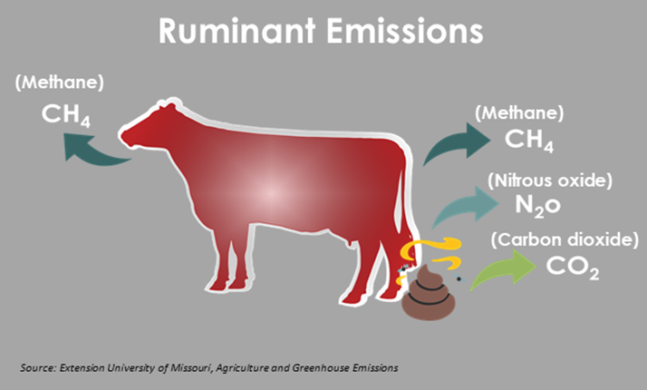
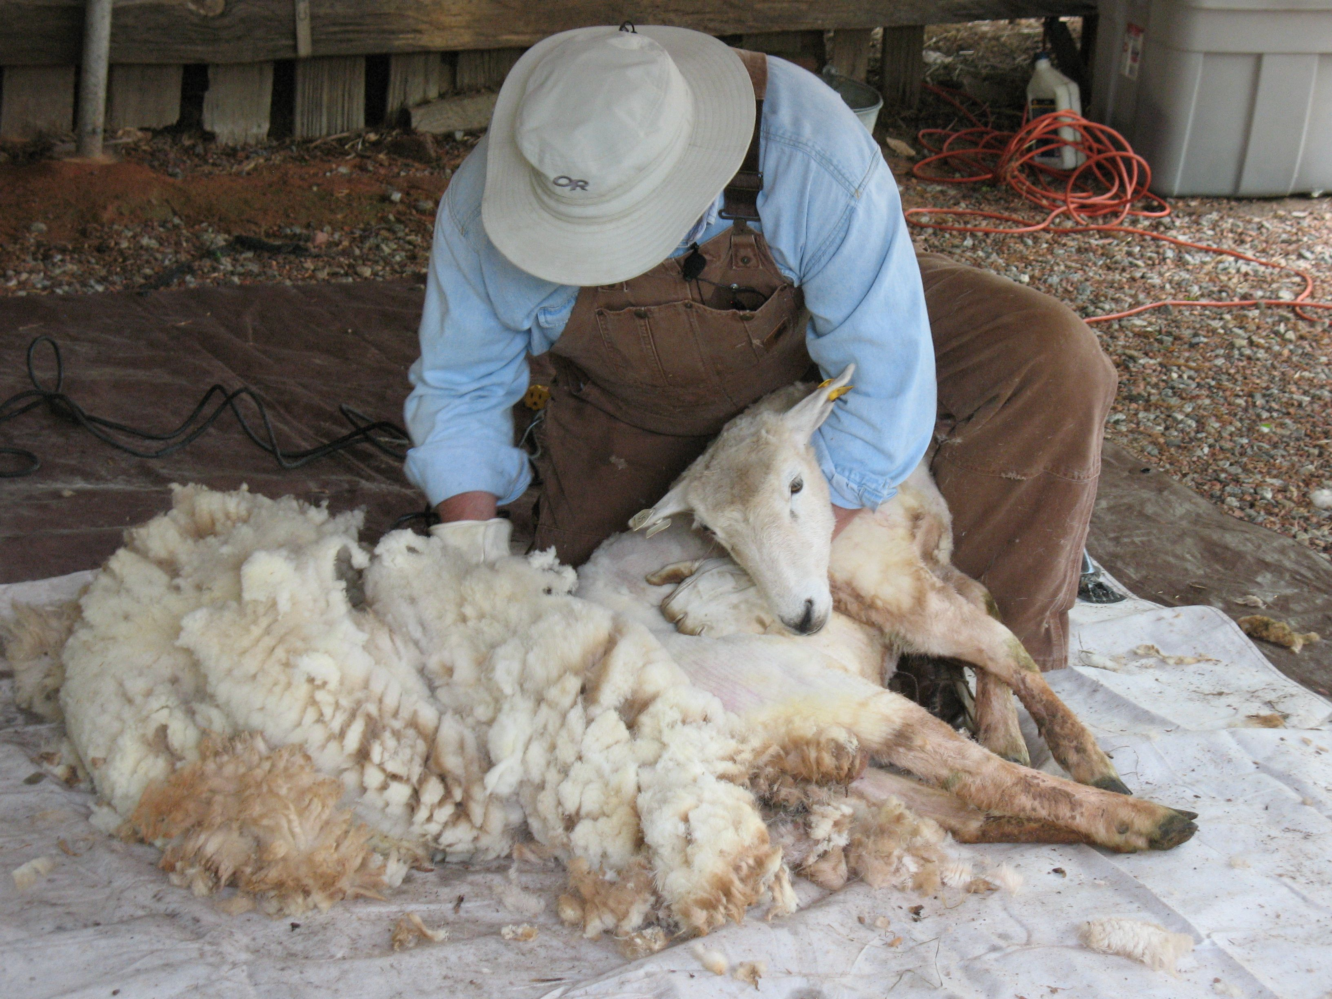
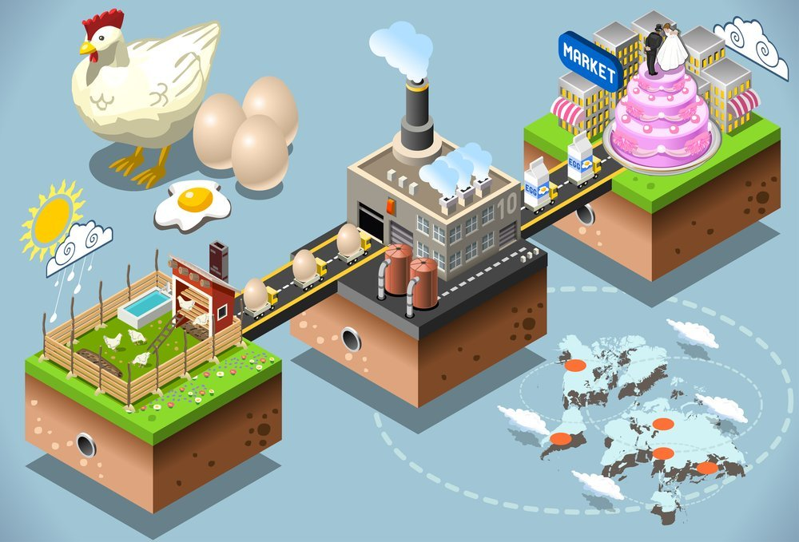
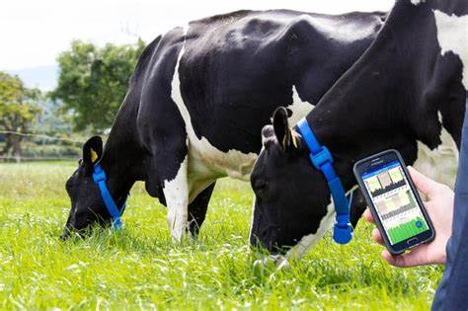
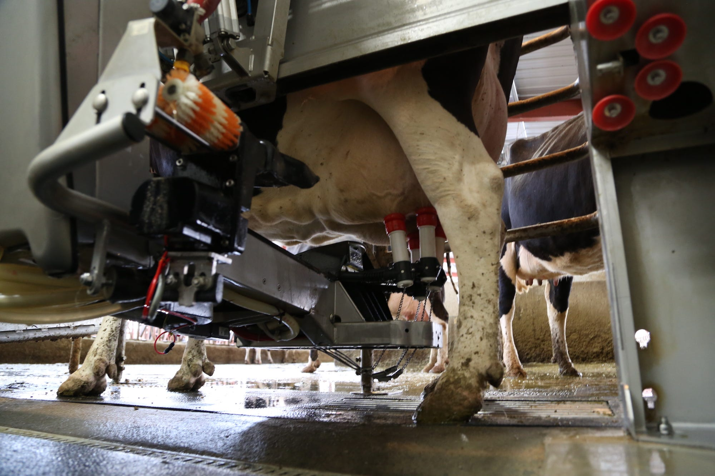
Drivers

Slide 4
AgGateway & Animal Ag
Dairy Feed Data Exchange WG
Digital Resources with potential application
AgXML (feed)
Scale Ticket
Mix Ticket
Modus
…

Slide 5
What are areas of interest?

