Slide 1
Ag Retail Meet Up
Charlie Will Sr. Programmer Analyst – E-Business Development Southern States Cooperative, Inc. Charles.Will@sscoop.com

Slide 2
What are we doing here?
We are here to inform members on the state of current work; identify industry pinch points that can benefit from process improvement, standards implementation, or both; and offer an opportunity for idea generation and collaboration.

Slide 3
New Retailers
Who are you?
What brought you to the conference AgGateway?
What do you hope to get out of a partnership?

Slide 4
Review of Current & Emerging Topics
Current Business Items
EDI in Retail
Awareness and implementation of message and master data standards
New Business Items
2D Barcoding from a retail perspective
Legal and security implications for implementing LLM / generative AI
More Retail Voices –
Potential Outreach for MYM
Others?

Slide 5
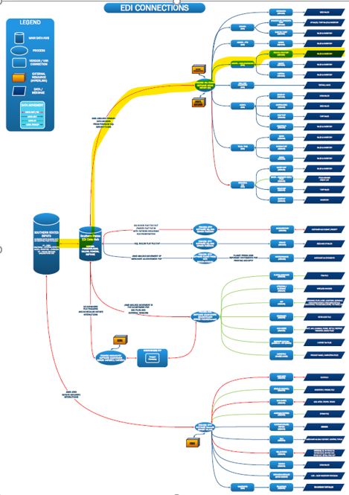
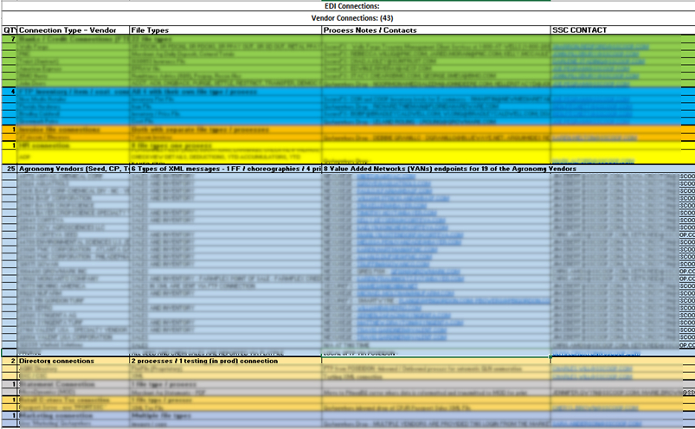
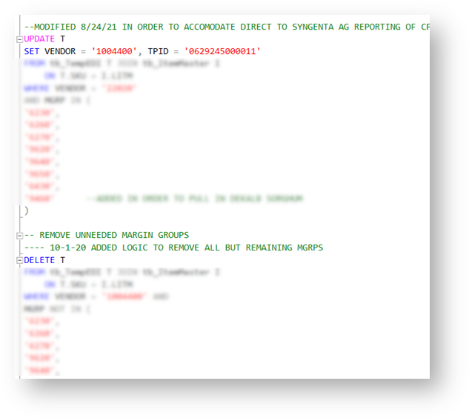
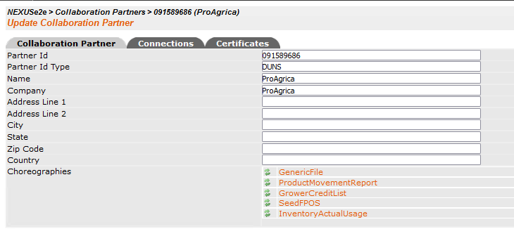
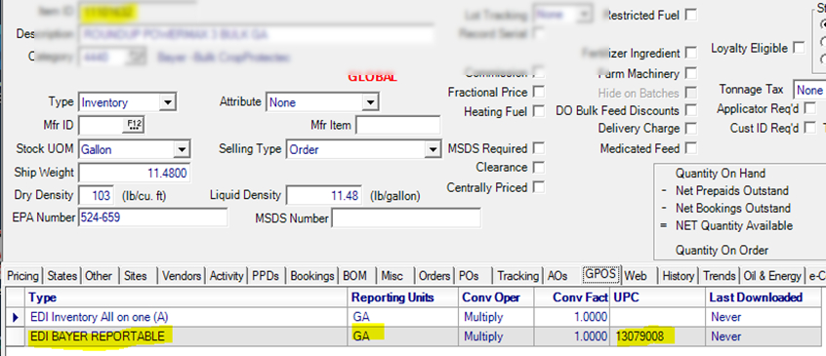
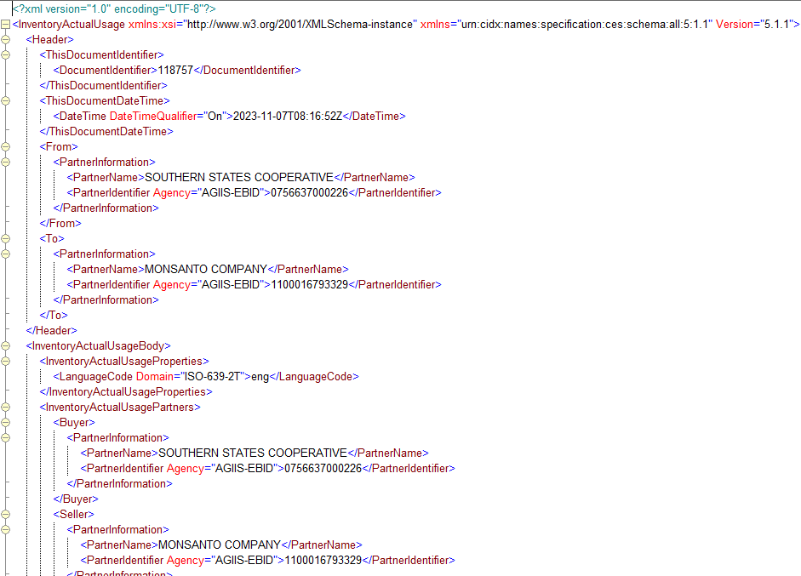
What does EDI mean to Retail?
Classify your connections
Flesh out details
Verify Item Setups
Code for Vendor Logic
Build the appropriate message
Verify Comm Endpoints
Ensure Successful Transmission
Where this fits

Slide 6
Awareness and Implementation of Message and Master Data Standards
New Connections
Could be a: Distributor, Manufacturer, Vendor, FMIS, e-Commerce or any disparate system’s connection point.
Where to direct them for messages that you trade?
Is there a need for a new process?
Are there any ROI stories to be shared? (Case Studies to be added to AgGateway)
Every situation and every Retailer relationship with these connections is unique
Existing Connections
Value in keeping up-to-date standards?
Value in additional messages / simplifying processes?

Slide 7
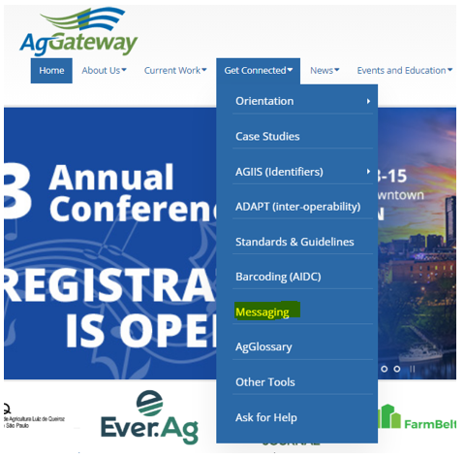
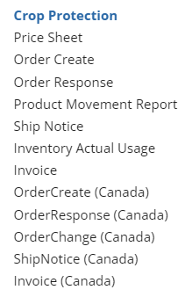
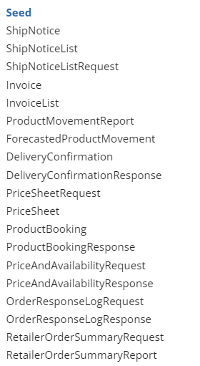
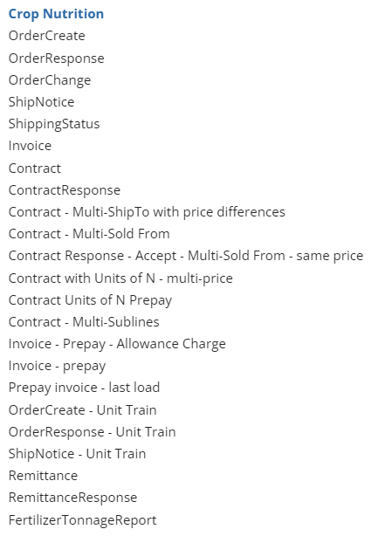
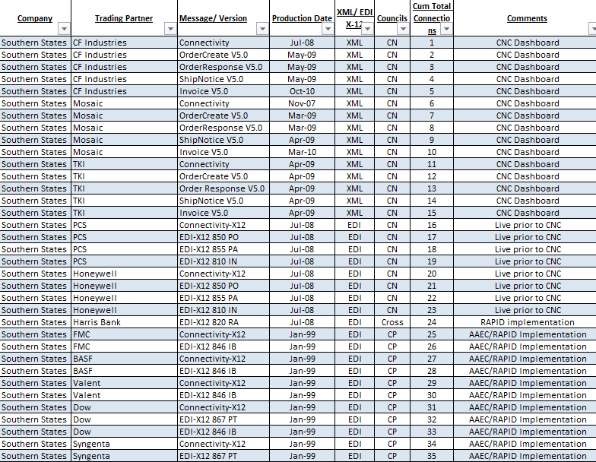
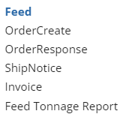
One Stop Connectivity Options
Current Functionality
Value in keeping up the E-Connectivity Forms?
Marilyn Hunter used to send you a reminder:
Would this be able to flow to AgGateway.org so that when establishing new connections the capabilities are readily visible?

Slide 8
Liz Sertl – Future of Identification Process
Baseline for 2D barcodes and sharing possibilities

Slide 9
Process Documents:
SPADE
Plan
Observation
Recommendation
Work Order
Load
Load Destination
PAIL
Irrigation
Water Management
Observations & Measurements
Farm
Field
Records
Retailer
Connectivity:
Value Added Network
Direct Connection
Message Format:
EDI (ANSI X12)
XML (Ag eStandards, AgXML, OAGIS)
JSON (OAGIS)
Delivery
MODUS:
Soil and Laboratory Testing Standards
Field Ops
Distribution
Insurance
Labs
Messages:
Contract (CN)
Seed Booking
Order
Shipment
Invoice
Product Movement
Inventory
Tonnage Reporting (CN)
Resources
Ag Industry System (AGIIS)
Entity Directory
Product Directory
Seed Licenses
Ag Data Application Programming Toolkit (ADAPT)
AgGlossary
Standards Navigators (CLICK, SCORE)
Message Implementation Guidelines
Crop Input Manufacturer
Regulator
Consumers

Slide 10
Legal and security implications for implementing LLM / generative AI
Generative AI – any Artificial Intelligence capable of creating original content.
LLM / Text Output = ChatGPT
Image Output = Stable Diffusion
LLM – Large Language Model – Text-Generating part of AI
Create text-only outputs
Expansion of parameters to 175 billion with GPT-4
AI Lawsuits
Center on Data use
GitHub Copilot – Converts commands written in plain English into computer code in dozens of different coding languages.
Developed on billions of lines of open-source code already written which leads to questions of attribution.
Copilot does not adhere to attribution requirements – breaching software licensing terms
Stable Diffusion / Midjourney
Scraping images from the internet to train the AI models
Law suits claiming new images are derivative works

Slide 11
Legal and security implications for implementing LLM / generative AI
Can be utilized to great effect in productivity improvements but it is a double-edged sword
Generative AI Issues
Data Privacy / Security – Mishandling test sets could result in leaks of sensitive data (Personal ID Info PII)
Misinformation / Harmful Content – AI building a business-wide email could contain offensive language,etc
Plagiarism / Copyright infringement – know your source
Amplification of Bias – use diverse SMEs to ID unconscious bias
Workforce / Morale - accelerated pace of workforce replacement of content creators
Provenance – Vet data set to learn from to ensure what is being mined is not garbage
Interpretability – AI searches for correlations not causality, humans need to be able to interpret models
Trust but Verify
Should be used to AUGMENT but not REPLACE humans or processes
All outputs from models must be vetted
Are there any interested parties in joining a session to discuss this topic further?

Slide 12
New Retail Voices: Potential Member Outreach
Current draft of invitation:
Dear (first name),
I hope you and your company have had a productive spring! I know our company is seeing more reasons than ever to focus on increasing electronic connections with trading partners, so we can be as efficient and cost-effective as possible, and better serve customers along the supply chain. That's why I'm excited about the upcoming AgGateway Mid-Year Meeting, and wanted to be sure you were considering attending or asking others in your company to attend. I think it would be beneficial for your company to be at the table as we discuss better ways to make these essential connections. The meeting takes place XXXXXX, at Prairie Meadows in Altoona, Iowa (just outside of Des Moines).
Our company has been a member of AgGateway for a number of years and we have enjoyed the benefits of our participation. The Mid-Year Meeting is an opportunity to:
Network and take part in important face-to-face team meetings that advance eConnectivity in agriculture - in crop protection, crop nutrition, seed, grain & feed, precision ag, specialty chemical, ag retail and more. More than XXX industry professionals will be attending.
Explore the latest eConnectivity resources for precision agriculture, ag retail sales reporting, barcoding, fertilizer tonnage and more!
Consider attending the Ag Retail eConnectivity Forum - The Ag Retail Council is sponsoring a half-day education forum for senior managers and directors in the retail segment on Tuesday, June 13, 10:00 am - 3:00 pm CT (this includes lunch). The forum will present information on the value of a company’s investment in eConnectivity initiatives, particularly focused on the efficiencies and competitive advantages as retailers, manufacturers and distributors move to seamless electronic data exchange.
Meeting registration is $150 (which includes the Ag Retail Forum) for AgGateway members and non-members alike. If you attend only the Ag Retail Forum, registration is just $50. You'll find everything you need - registration, agenda, hotel, etc., at the conference webpage. (http://aggateway.org/Events/2017Mid-YearMeeting.aspx)
I hope you will join me in Altoona next month! Be sure to register and book your hotel room, and if you have any questions, please let me know.
Sincerely,

Slide 13
Any other Topics to Discuss?
Issues currently facing some Retailers
Inventory:
Manufacturers changing MPNs for items and handling the inventory fall-out.
Inventory currently in stock will need to reflect the newer MPN
Need for Manufacturers to be on the same page when it comes to inventory in-transit at the time of reporting.
Sales Rebate Programs:
Rebate Program White Papers can be confusing as to what the Manufacturer requires.
With permission we can review 2024 programs of a few Manufacturers.
Is there a possibility of utilizing a message such as a ‘PriceSheet’ in conjunction with any rebate program white papers so that valid MPNs, Reporting UOM (different than sales UOM), and other product information can be more readily consumed by our systems.
Data Black Holes:
Can prove data has been transmitted but then have to work with VAN and Manufacturer to determine where data was corrupted or dropped.
Correcting Data:
Some VANs have ability to correct data or drop it, others require retransmission of negating transactions.

Slide 14
Any other Topics to Discuss?
What Can AgGateway do for you?

Slide 15
Thank you!
Charlie Will Sr. Programmer Analyst – E-Business Development Southern States Cooperative, Inc. Charles.Will@sscoop.com

