Slide 1

Weather and Forecast Data API

Slide 2
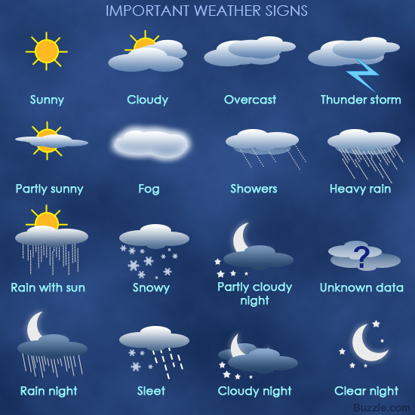
Agenda Déjà vu
Review Purpose, WG Scope, Deliverables, Timeline
Coordination and alignment with ISO 7673-2
Identify WG leader(s), meeting cadence, duration, etc.

Slide 3
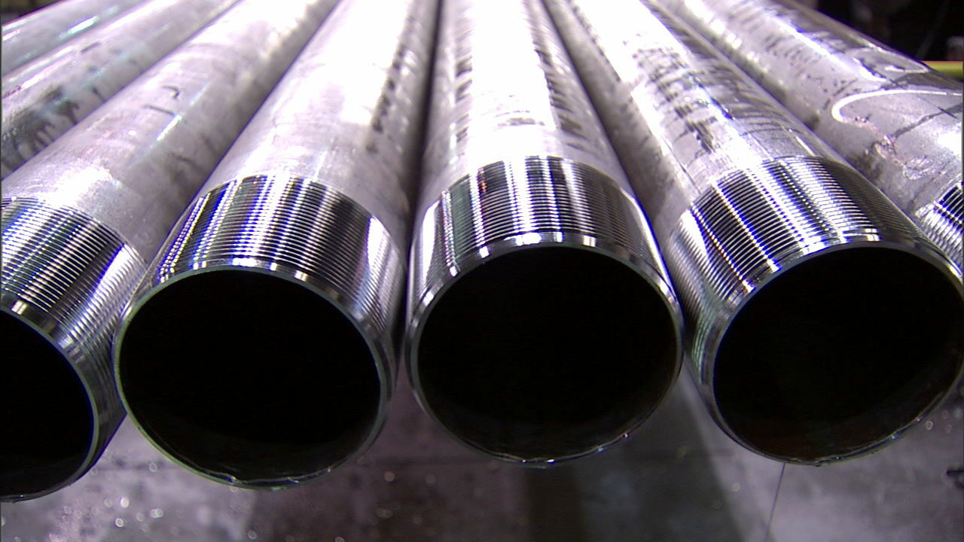
The Problem
Numerous weather data consumers and providers
No standard interfaces for sharing data

Slide 4
Proposed Scope & Objectives
Aggregated Earth observation and weather forecasting data
  Precipitation amount, margin of error, probability
  Evapotranspiration
  Relative Humidity
  Temperature
  Dewpoint
  Soil moisture
Out of Scope
  Sensor data from individual weather stations and soil probes
  Weather model used to provide simulated data
  Assertiveness Index

Slide 5
Use Cases
Process diagrams covering the use cases
Data Requirement for each use case
List of data elements and definitions to be used by the subsequent working group(s)
Documentn query path pattern required by use case (e.g. point, box, polygon, zip code)
Planting window
Soil Trafficability
Irrigation

Slide 6
Alignment with ISO 7673 (PAIL)

Slide 7


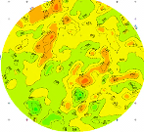
Integrated Decision Support Solution
INPUTS
Iterative Feedback Loop
OUTPUTS
On-Farm information
DYNAMIC
Weather
Optimal Irrigation management
Telemetry
Moisture sensors
Pumping +
distribution system
Uniform Fields
Decision support
static Data
Soil maps
Yield maps
VRI Fields
Online advisory system
Crop type, ET, weather integration, irrigation scheduling, etc.
FIXED
data output
Reports, trends, analysis, etc.
Risk management
Notes:
Review our concept of an integrated system
With an integrated decision support solution in place, all the tools and technologies “talk” to each other and offer growers the opportunity to rely on the data, not the consultants or people in the fields, to choose the right prescription for their fields. This allows growers to reduce their energy consumption or extend it further, improve yield and improve profitability. The problem is a lack of interoperability: the many pieces of this system have been unable to talk to each other.

Slide 8
Observations and Measurements
Observations & Measurements (“OM”) provide critical raw material for principled decision-making in field operations.
There are multiple attributes of an observation or measurement that need to be kept track of in order to allow the value to mean the same to sender and receiver.

Slide 9
ISO7673 Agricultural Field Operations Data - Part 2: Observations and Measurements
ISO 19156 provides an abstract model that can represent the different aspects and rich semantics of an observation.
Part 2 is a realization of ISO 19156
in agriculture, meant to comply
with the abstract test suite
presented in 19156.
It seeks to represent data as key-value pairs,
with a machine-readable set of definitions
behind the scenes.
Right-sized, application-specific level of detail.

Slide 10
Next Steps
WG Lead
Meeting cadence and duration
Project milestones and plan
Target Start date

