Slide 1

WG20 Traceability API

Slide 2
Agenda
Key Concepts
  Traceable Resource Unit
  Critical Tracking Event
  Key Data Elements
Evolution of the Transfer Event Notion
Motivations for a Traceability API specification
The Open API Specification

Slide 3
Traceable Resource Unit
A collection of material, discrete product(s), or packaged product(s) treated as a unit for some period for tracking.
Abbreviation: TRU
Examples: The grain contained in a truck during delivery to a grain elevator from a farm. The collection of material in a storage bin between transfers.
From Ameri, Wallace, et al traceability paper for JCISE:
  Traceable Resource Units (TRU)s are collections of materials with some shared history for which an agent may have a need to retrieve information. The shared history might include similar production, movements, or storage history.

Slide 4
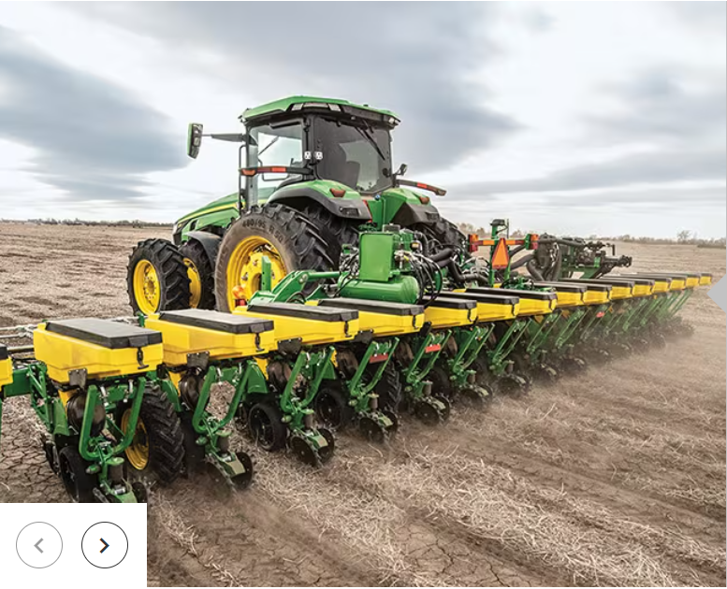
TRU – the quantity of ‘stuff’
Our example relates the quantity of a ‘shipped item instance’ transferred into a ‘container’.
16 Traceable Resource Units

Slide 5
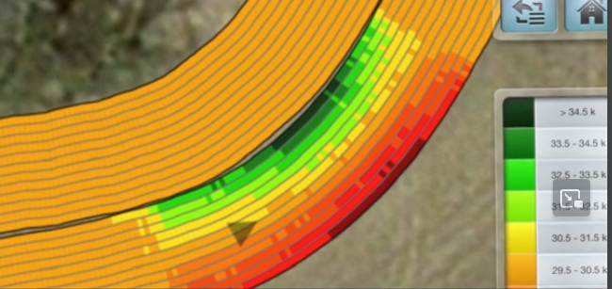
As-Planted TRU Challenges
Planters with electric meters can vary rate for turn compensation.
  A flat per acre rate can result in different rates per row/swath
How to capture container empty/level
  Use as-applied/rate
  Sensors
  Manual
Swath elements, machine configuration really impact how swath/coverage area is determined
Likely not real important to know VRT, other than total qty per area
Section control (1/2 width, per row, etc) impacts area of the field receiving any product

Slide 6
Critical Tracking Event
An occurrence where information is captured representing history relevant to a product’s genealogy. This includes occurrences to product or material, as well as occurrences involving equipment with which product or material came into contact.
CTEs are bounded by time, and usually by space. CTEs often document a change in state.
The GS1 definition was too narrowly scoped, and needed to expand to field operations.
[GS1] CTEs are activities in the supply chain that should be documented by the capture of key information for each event in order to accurately trace product movement up or down the supply chain. The IFT report defined CTEs as “those instances where-in product is moved between premises, is transformed, or is determined to be a point where data capture is necessary for effective tracing.”1 Typically, these events involve a product’s transformation, transportation, or depletion.

Slide 7
Critical Tracking Event types
Transfer Event (not in GS1)
  Movement of a quantity of material from source to target container; most often involves a device resource such as an auger
Transport Event
  Movement of material from one geographical location to another location
Transformation Event
  an event where the type or one or more characteristics of a portion of material/product is changed or where the identities of inputs are changed in a way that is difficult to reverse
Observation Event
  an event where some measurement or other observation is noted and recorded that relates (directly or indirectly) to material or equipment
Custody Change Event
  an event that changes the party responsible for a subject from the source custodian to the target custodian
Ownership Change Event
  an event that changes the party with title to the subject from the source party to the target party
Maintenance Event (not in GS1)
  an event typically “resetting” important characteristics of a resource
Identification Event (not in GS1)
  An event where a new identifier is minted and related to other identifiers from different sources (partners/platforms/agencies)

Slide 8
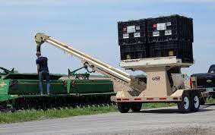
Critical Tracking Events
CTE Type = Transfer Event

Slide 9
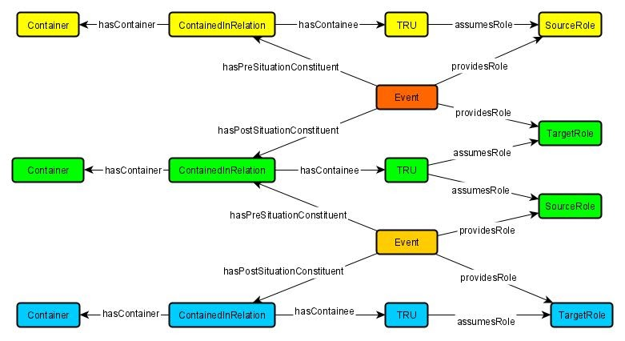
Modeling Critical Tracking Events
Events are central
  Yet many share similar structure
  Connect Containers to TRUs
  Chained events provide traceability

Slide 10
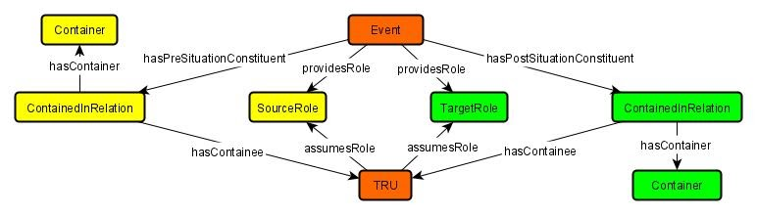
Example: Transfer Event
Transfer Events speak to the movement of a quantity of material from (one or many) containers to (one or many) containers
  A “ContainedInRelation” node in the graph allows us to track which containers were used, in what manner, and what they held

Slide 11
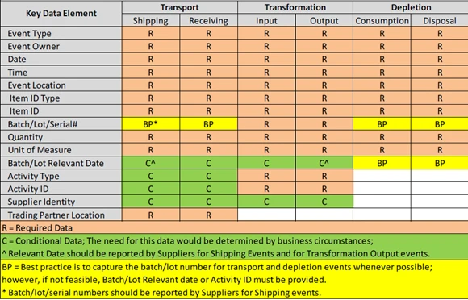
Key Data Element
Key Data Elements (KDEs) are data elements associated with each critical tracking event and provide:
  Essential information about time and place of the event, the party reporting the event, and the identification of the product involved; and
  Related essential information about the transformation, transportation, or depletion from the supply chain of a traceable product.
In short, the KDEs associated with each Critical Tracking Event should answer the five W’s and H (5WH principle from Zachman Framework):
  Who performed the activity
  What product was involved
  When was it done
  Where was it done
  Why the event reported
  How the activity was performed (devices, equipment).

Slide 12
Container Conceptual Evolution
A field is a container (form CART days)
  CART had a large focus on how to identify containers
    Beacons, Android Things, Proximity Sensing, …
The source and target TRU may be of greater significance than the source and target containers
Dealing with remainders TRU may not fully transfer from one container to the next in a transfer CTE
How to relate all the identifiers scoped within different systems
  Related Identifiers now in API

Slide 13
Meeting Business Needs/Value
Product Recall
Consumer Demand
Manufacturer need for product efficacy
Emerging Climate Smart Commodities

Slide 14
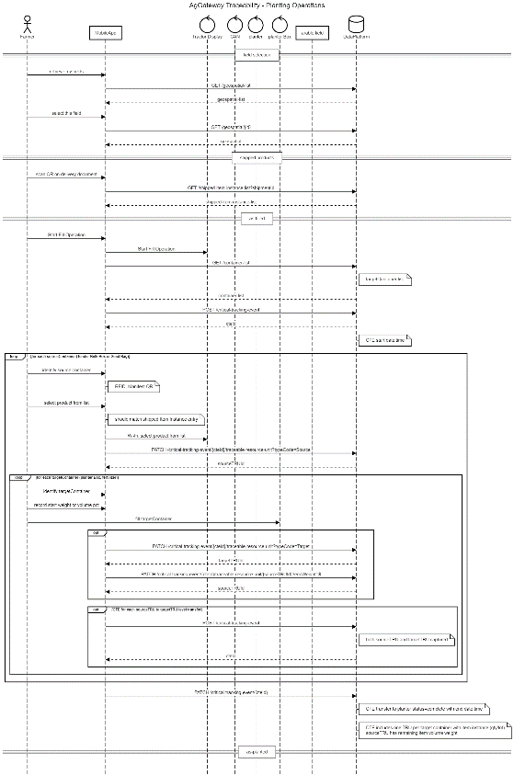
Seeding API Sequence Diagram
https://github.com/AgGateway/TraceabilityAPI/blob/main/documentation/AgGateway%20Traceability%20-%20Planting%20Operations.png
Exposes opportunities for innovation

Slide 15
Open API Specification

Slide 16
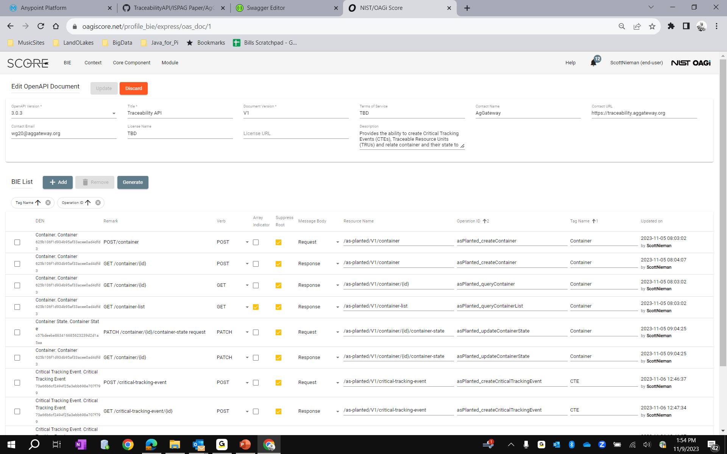

Slide 17
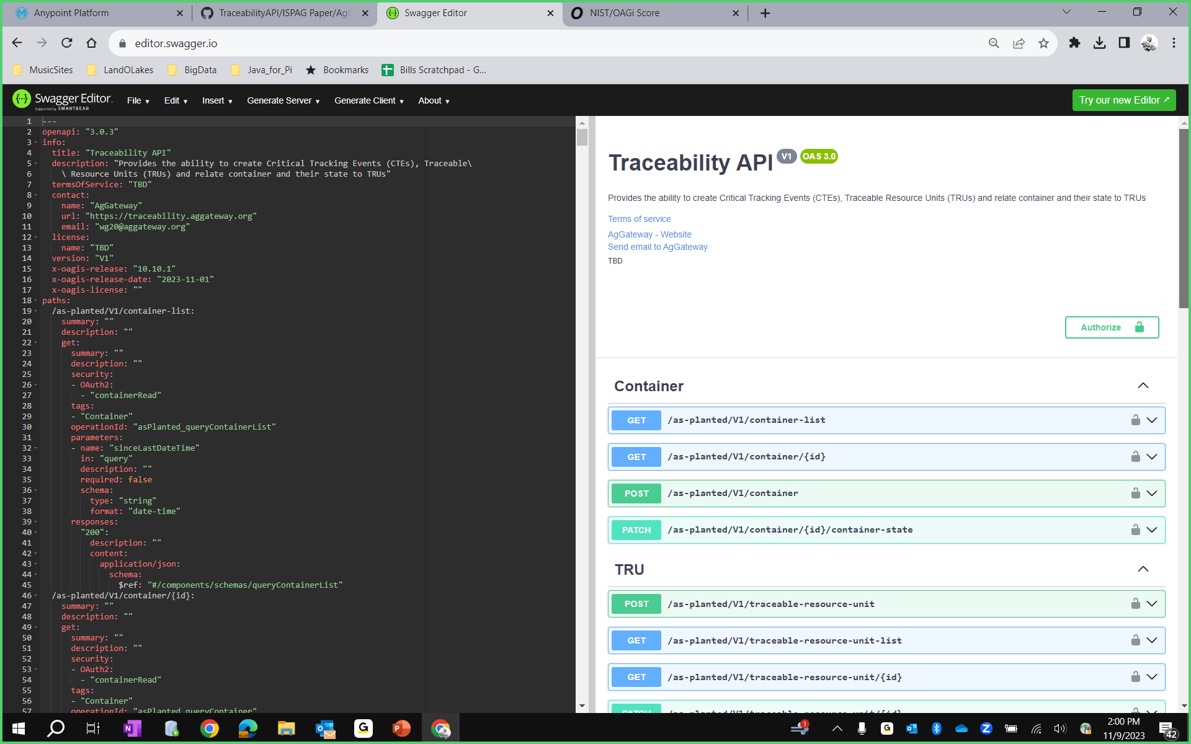

Slide 18
Background/Refence Slides

Slide 19
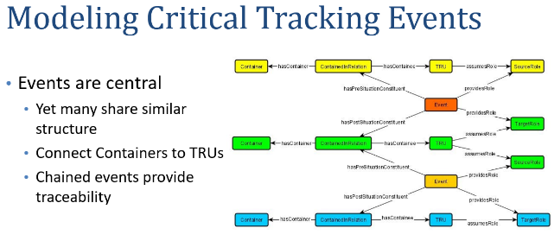

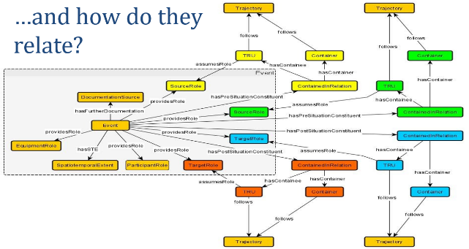

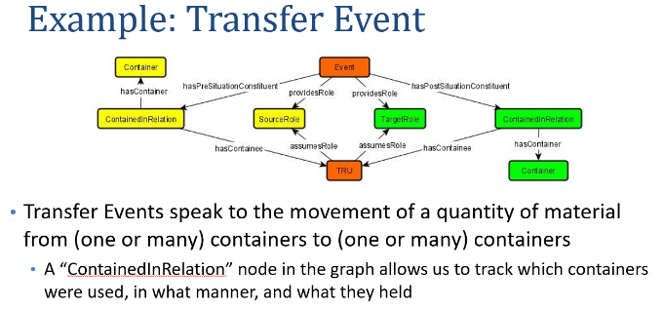
Remember…

Slide 20


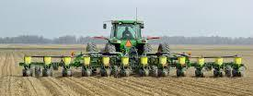

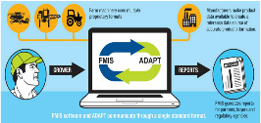
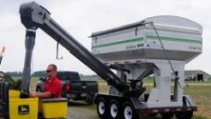
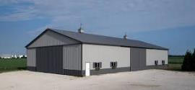
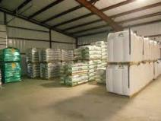
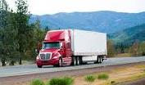
THE PROCESS
Accurate/Standardized Planting Data
Order
Data
Pick Ticket
Delivery Document

Slide 21
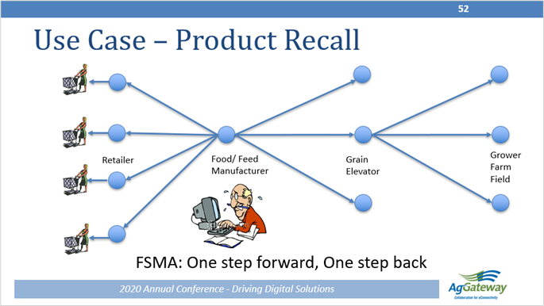
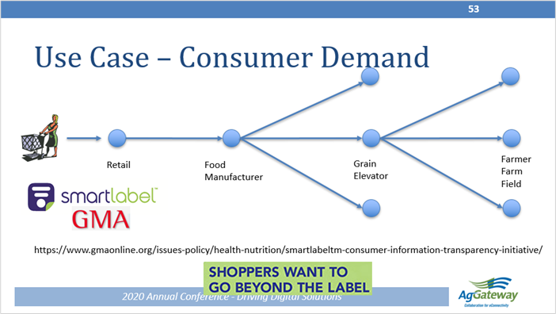
Define and Address Key Use Cases

Slide 22
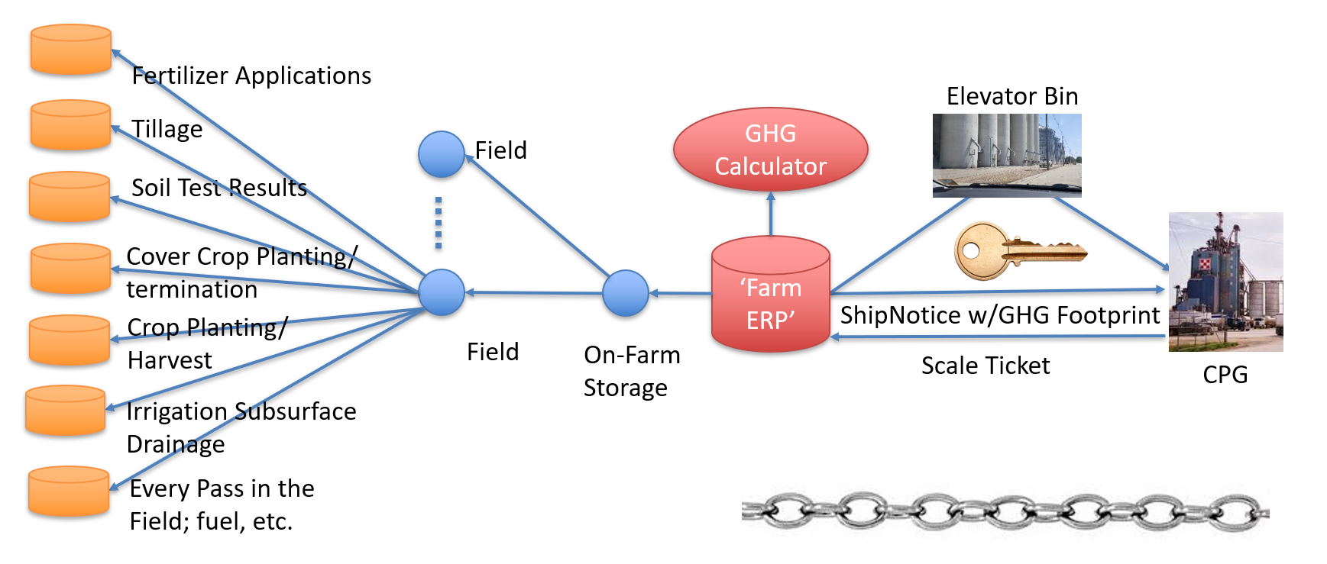
Climate-SMART commodity

Slide 23
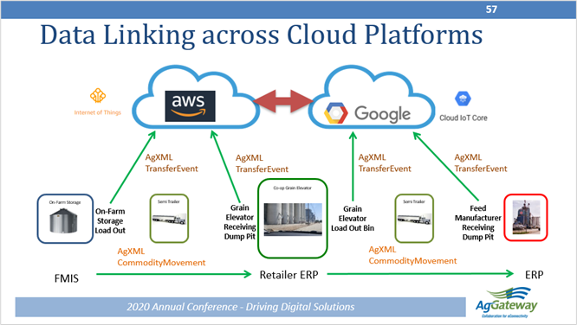
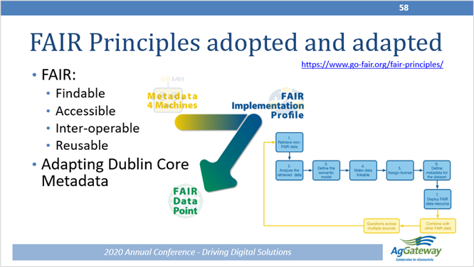
Define Metadata that links the Data

Slide 24
Data elements available in the test dataset

Slide 25
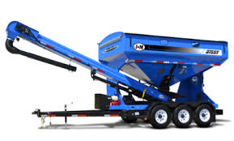
Background
  Accurate documentation of the application of seed products is critical to today's agronomic service providers and growers.
The most important attributes of any application are:
    Application seeding rates,
    Application location,
    Product identification.

Slide 26
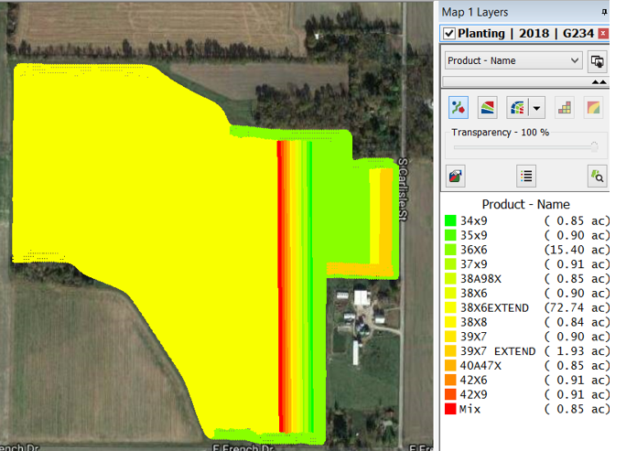
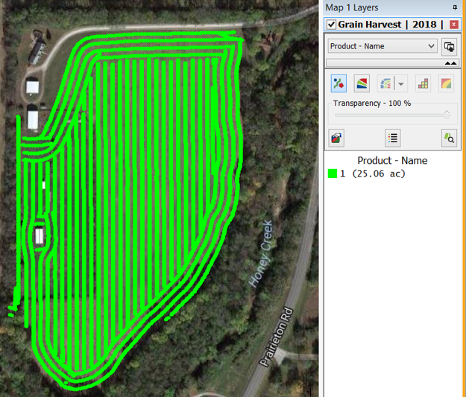
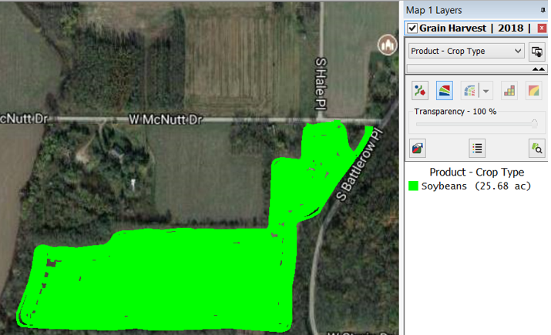
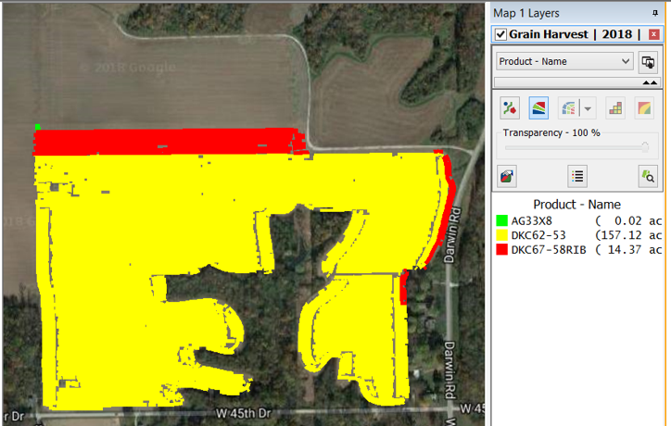
The Problem

Slide 27
Keys to Success
User/Operator
  Document all Critical Tracking Events (CTE) per standards
Software Application
  Follow Traceable Resource Unit (TRU) management rules/guidelines (TBD - in progress)
  Maintain system referential integrity
    Containers/vehicles
    CTE
    TRU
    ?

Slide 28
Event chain: feed production and delivery
Location
Processor
Coop or Dist. Center
Container
Type
Bin
Output
bin
Packaging
area
Storage
area
Truck
Storage
area
Originating
Container
Custody & Ownership Change
Custody Change
TRU
TRU
Transformation
Transfer
TRU
Transport
TRU
TRU
Transformation
Storage Bin 2
Transfer
Transfer
TRU
Produces
Produces
Produces
Produces
Produces
Storage bin 5
TRU
Batch record
Production record
Inventory update
Packing list
Bill of lading
Receiving ticket
Storage bin 8
Business Activity
Package
Store
Load
Ship
Receive
Formulate
Notes:
From ppt: Thoughts on visualizing tracking data

Slide 29


Supply Chain / Traceability Value Chain
Technology
Providers
Seed
Manufacturer
Seed
Retailer
Grain
Producers
Grain
Elevator
Ingredient
Manufacturer
Food
Manufacturer
Food
Retailer
Consumer
Traceability
People increasingly want to know where their food is coming from
Millennial age group driving this need
Most businesses are either reacting or resisting
Progressive business are being proactive; providing more information

Slide 30
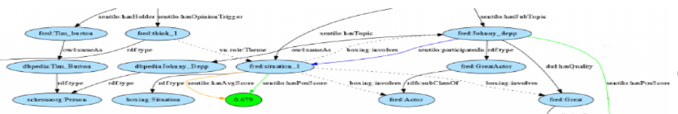
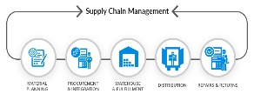
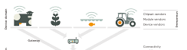


“Supply Chain” to “Fork” Traceability
Traceability Models
NIST/K-State, T-State, AgGateway : ATLAS?
RDF Models
Sematic standards
Controlled vocabularies
CTE interoperability standards
Dataset Repositories
WG09
Repository requirements
Metadata standards
CTE interoperability standards & guidelines
Semantic Interoperability Layer
metadata
metadata
metadata
metadata
Layer 3
Layer 3
Layer 3
Layer 3
Layer 2
Layer 2
Layer 2
Layer 2
Layer 1
Layer 1
Layer 1
Layer 1
Process Datasets
Data requirements
Define data standards
Collection process/workflow
In-process CTE
Crop Input Supply Chain
Field Operations
Transport
Processing
OAGi, X12, UN/EDIFACT
ISO11783, SPADE
ISO 11783, AgXML, OAGi…
OAGi …

Slide 31
Traceability Building Blocks
Opportunity for
Innovation
POC
Back Office Design
ADAPT Data Elements
Modify Existing Standards
Define ADAPT Traceability Data Elements
ISO 11783
AgXML
Standards
Community
Work
31

