Slide 1

WG04, WG11 Ag Lab Data (Modus)
AgGateway Annual Meeting 14 Nov 2023

Slide 2
Session Agenda
Modus Summary
Recap on changes since MYM
  Unit of Measure simplification
  Additional Methods, corrections
  Entry status alignment with WG00
Schema status, timeline
  Aligning Modus 1, Modus Slim, UN/CEFACT- LOR
Plan for other matrix e.g. manure, water, botanicals
Promotion and implementation planning

Slide 3
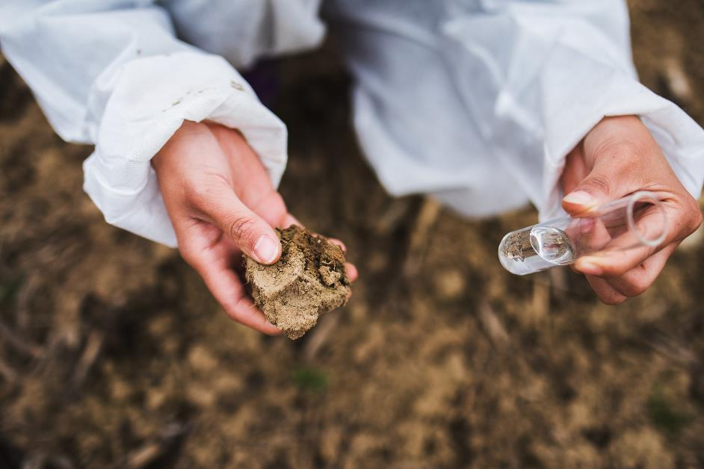
Why Soil Testing?
Most common data layer used by farm management information systems (FMIS) and other ag software
Sustainability, traceability, carbon and soil-health focused efforts will make soil testing mandatory
Only 30% of row crop land is using variable-rate technology (VRT) applications based on a soil test
We cannot afford the error associated with using “the wrong equation”
Not attempting to standardize test methods, just data generated

Slide 4
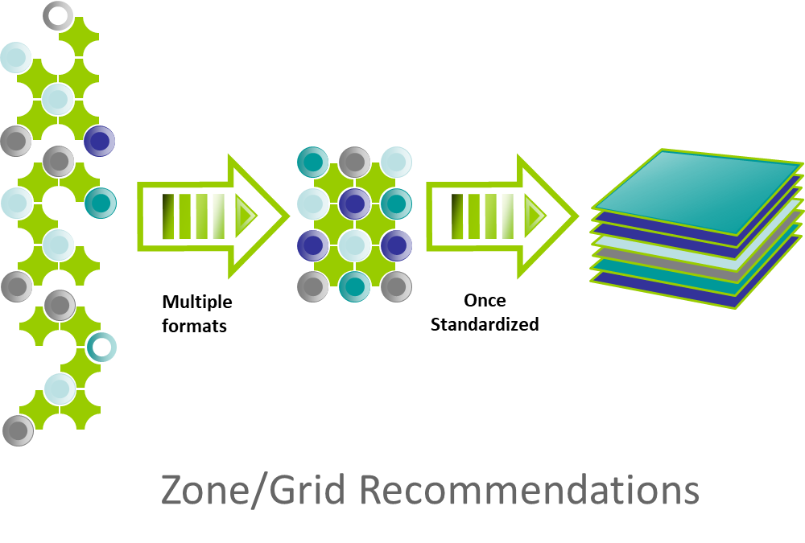
Laboratories are faced with using more than 70 data formats

Slide 5
Modus Agronomic Lab Testing Standard
State in 2018:
  Most adopted format within the lab industry
  Strong for its Controlled Vocabulary
  XML format
  Existing Schema: Soil, Plant, Water, Manure, Nematodes
Needed to:
  Become a true “Open Source” product with a clear license
  (“rules of engagement”)
  Set up a process for future maintenance and progress
  Evolve to other serialization formats like JSON
  Clean up the vocabularies, create version 2, engage the certification organizations
Moved to
AgGateway

Slide 6

Two AgGateway Working Groups
WG04 Lab Test Data
  Key Deliverables:
    Modus as Open-Source Standard
    Controlled Vocabularies
      (with Agrisemantics subcommittee)
    Updated schema XML, JSON, API
WG11 Integração Dados Laboratório Solos
  Key Deliverables:
    Documentation of specific requirements for a soil testing data standard in Brazil
    Regionally customized version of the WG04 BPMN
    Customization of the Modus standard for tropical soil analysis
    Survey of labs to identify current methods and datasets
This Photo by Unknown Author is licensed under CC BY

Slide 7
New Method Codes & Corrections Since MYM
VAST Aggregate stability method
CO2 reparation UoM, and analyte to Carbon Mineralization Potential to align with Soil Health Institute terminology
Cornell Carbon Mineralization Potential method
Harmonized deionized water extraction descriptions
Erroneous codes, duplicated code for different methods, incorrect use of P instead of K for potassium in code
Removed time from several reagent/formulation values
UoM question from one lab addressed in later slides

Slide 8

“Modus 2” Soil List Changes
UoM 1-8

Slide 9
Simplified UoM
Agreed upon one UoM per dimension for all codes
Implementing UoM codes similar to ADAPT structure
Remove Units that require outside information e.g. lb/ac
Modus | Modus 2 | Description
% | prcnt | Percent
cm/hr | cm1hr-1 | Distance per Hour
cmol/kg | mol1kg-1 | Centimole per Mass
Description | description | List, e.g.
dS/m | dS1m-1 | Deci-siemens/meter
g | g | Mass
g/cm3 | g1[cm3]-1 | Mass per Volume
g/kg | g1kg-1 | Mass per Mass
lb/ac/day | lb1ac-1day-1 | Mass per Area Per Day
meq/L | meq1l-1 | Milliequivalents per Volume
mg/m2 | mg1[m2]-1 | Mass pr Area (Proprietary)
mg/L | mg1kg-1 | Mass pr Mass
nmol/h/mg | nmol1hr-1mg-1 | Nanomole per Hour per Mass
None | count | Count
Ratio | ratio | Ratio
S.U. |  | pH, Standard Units
tons/ac | ton1ac-1 | Mass per Area (Legacy)

Slide 10
Code Status Alignment to WG00
Valid
Invalid
Retired
Superseded
Candidate
Expanded code states to better manage changes
Retired status for multiple “Modus 1” entries
  Not enough info to identify method, meant for people to submit an update request if actively using

Slide 11
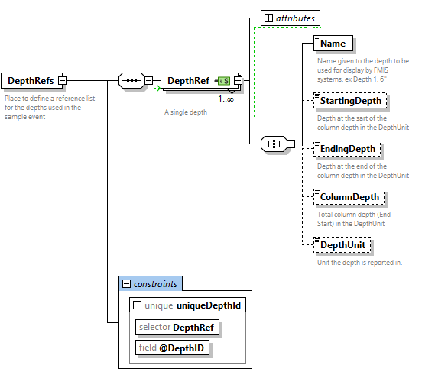
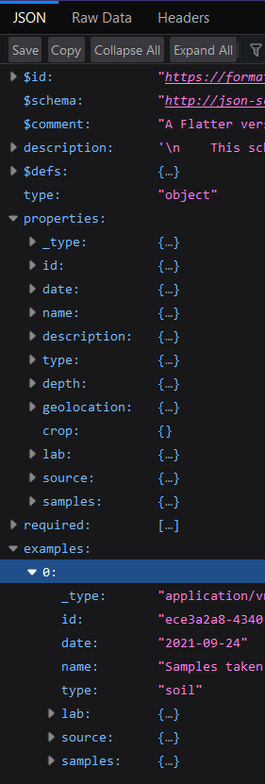
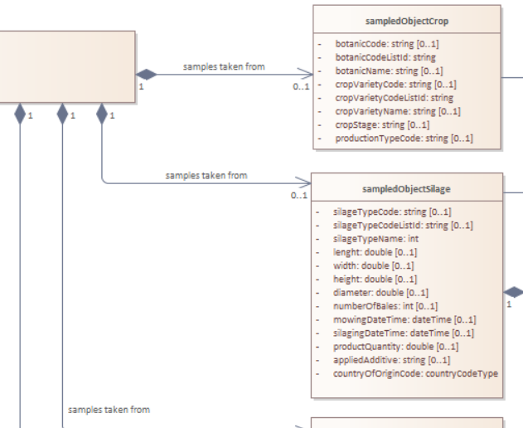
Schema
If we are going to break it, break it good
  Flatten
  One “file”
  Support different sampling methodologies
  Capture better metadata
  Try to align with other organizations/standards on a global standard

Slide 12
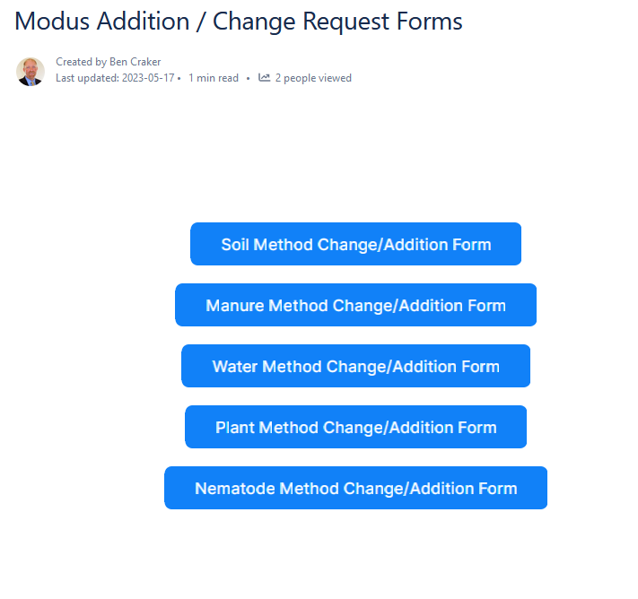
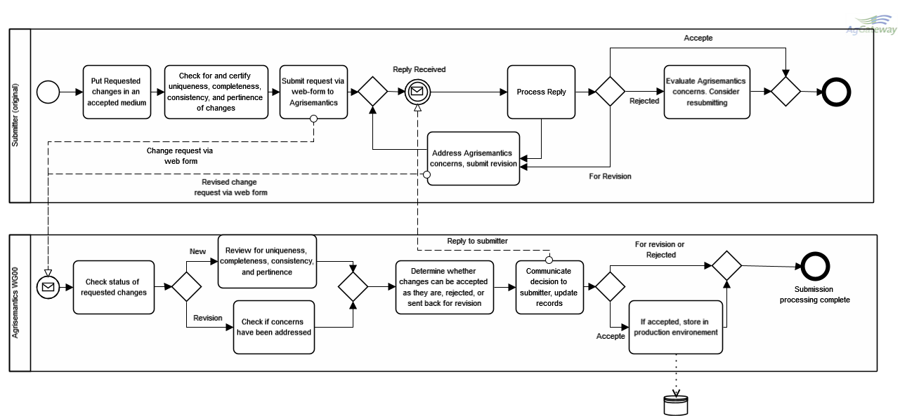
Change Request Process

Slide 13
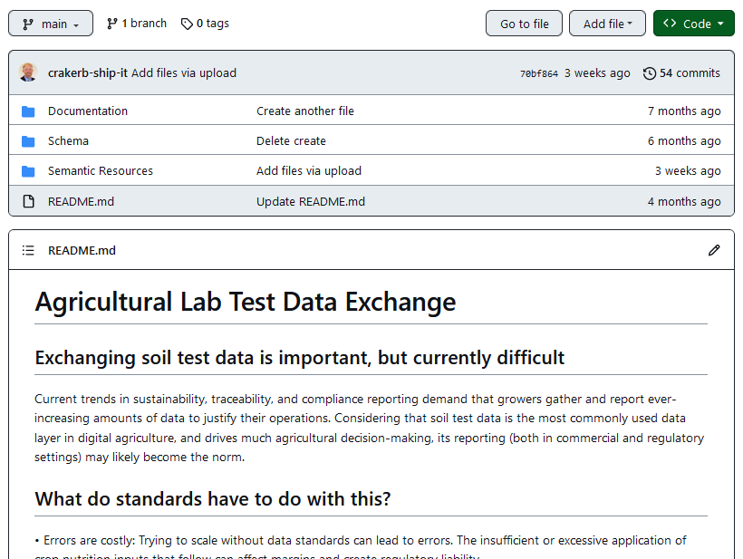
Resources Moving to GitHub
https://github.com/AgGateway/Modus
BitBucket Repo scheduled to be shut down early Dec.

Slide 14
Next Steps
v2.0 Soil methods list
v2.0 Schema
v2.0 Manure methods list
v2.0 Botanical methods list
v2.0 Water methods list
v2.0 Nematode methods list
v2.0 Microbiology methods list
v2.0 Feed methods list
v2.0 Compost methods list

