Slide 1
WG00 Agrisemantics PoC
Subtitle goes here

Slide 2
Agenda
Recap of the Semantic Interoperability Problem
Crop Definition Model
Semantic Resource Status
Swagger UI PoC
Agrisemantics Policy and Procedure Recommendation
ISO TC on Data-Driven Agrifood Systems alignment
Next steps, WG00 wind down

Slide 3
Semantic Problem: “What resource was used?”
Sends
How do systems communicate what product should be used, and was actually used, in a given operation?
Has
, , , represent the same product!
What gets recorded in the example?
Already has
?
?
?
Already has
Sends or
Notes:
Tweak because Crop is a little different. Resource? Product?

Slide 4
Granularity Problem
Seed Bag Label Detail
Hybrid
Treatment
Lot
…
Work Record Detail
Crop
Crop year (Maybe)
Hybrid (Maybe)
Intended Use (Maybe)
CP Jug Label Detail
Use restrictions dependent on
Crop
Development stage
Intended use
Timing re work record history

Slide 5
CropDefinition PoC
Objectives
Create PoC semantic infrastructure initially focused on a crop list.
Laying groundwork for infrastructure to enhance semantic interoperability within the agricultural industry.
Requirements for the crop list infrastructure will be driven from past work.
The group will also recommend future policies and procedures
Deliverables
Proof of concept semantic type registry for the ag industry
CropDefinitions and CropRelationships
Recommended policies and procedures for semantic resource management by AgGateway
Discussion: Does publication imply endorsement?
Notes:
Link to charter: https://aggateway.atlassian.net/l/cp/NCdwzDSf

Slide 6
Crop Definition Model

Slide 7
Semantic Infrastructure PoC
https://cropdefinition.org

Slide 8
Agrisemantics Policy & Procedure
Recommendation to form Agrisemantics Committee within Digital Resource Center
Standing committee similar to Standards and Guidelines to manage AgGateway Semantic Resources following ISO 19135
Purpose: Maintain infrastructure to provide the industry with controlled vocabularies, data type registries and other tools seeking to enable the communication and preservation of the meaning of digital agriculture data as it is exchanged among different actors in agriculture.

Slide 9
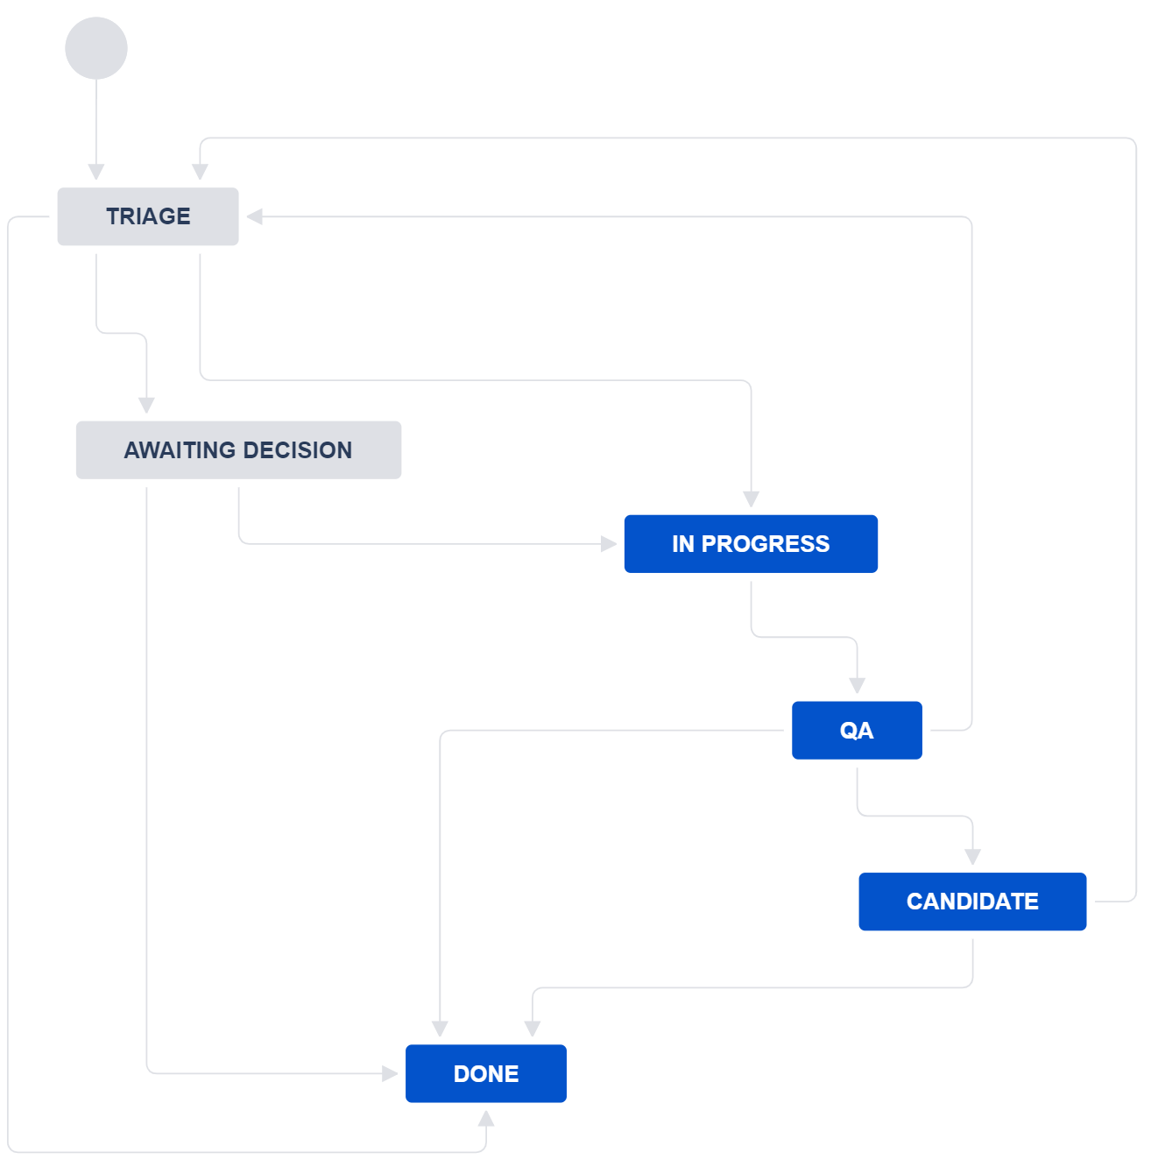
Submission Process
Create
Candidate challenged
QA failed
Accepted at triage
Clone of Glossary workflow
4 questions:
Uniqueness
Consistency
Completeness
Relevance
Have basic submission instrument (e.g. SmartSheet form)
Trusted, bypass decision
Approved for entry
Rejected
at triage
Data entry
Not approved for entry
Trusted bypass QA
QA passed
Candidate period passed

Slide 10
Entry States
valid: The semantic resource is actively being used for new and existing semantic resources
invalid: The semantic resource should not be used, because it is in error or otherwise unsuitable for use. It is kept in the infrastructure for forensic / reference purposes.
retired: The semantic resource should not be used to support new data. It was valid in the past, and retained to support historic data. It is not automatically assumed to have been replaced by a new, valid entry.
superseded: The semantic resource should not be used to support new data, because there is a new item that should be used instead. The item in question was valid in the past, and is retained in order to support historic data. It is assumed to have been replaced by a new, valid entry, which it will reference.
candidate: A state allowing a public comment period for new entries that aren't automatically approved, exists in this status for approximately 30 days before either being officially added or removed if issues arise.

Slide 11
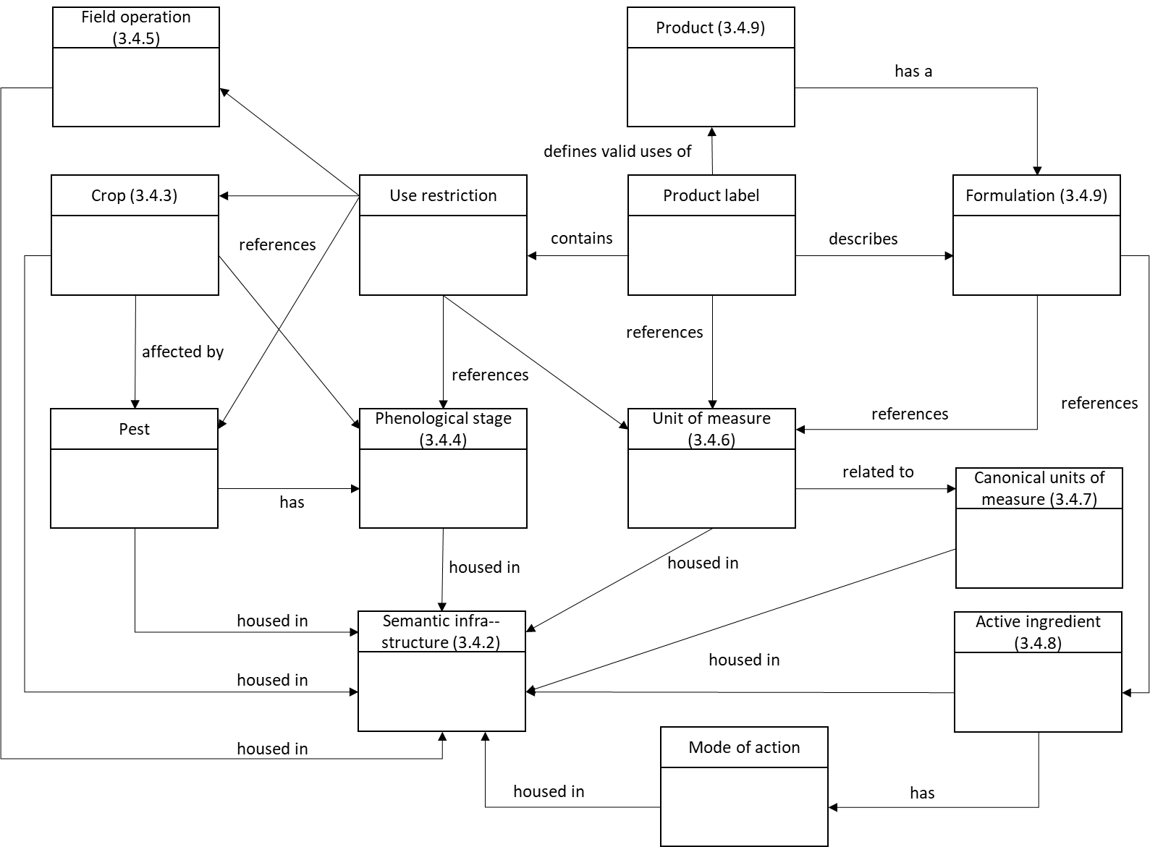
ISO Context
From ISO SAG-SF Report

Slide 12
Next Steps
WG00 complete
Semantic resource management tool analysis/recommendation
Infrastructure PoC → Production
Alternative hosting e.g. GitHub repo
Common controlled vocabulary needs identified by multiple WG’s
Identify or create vocabularies, populate infrastructure
Update/Enhance ContextItem.org?
Update/Enhance AgGlossary.org?
Align/support other glossaries e.g. University Precision Ag Program Glossaries
…

