Slide 1
PAIL
ISO 7673
ASABE/ANSI S632

Slide 2
Agenda
How we got here
  The problem
  History of PAIL
  3-part structure
ISO context: SAG-SF, where the three parts fit
  Part 1: Precursor to ADAPT
  Part 2: O&M as key to many things
  Part 3: Irrigation data management
Why this matters to YOU
Communication, reconvening & implementation effort

Slide 3
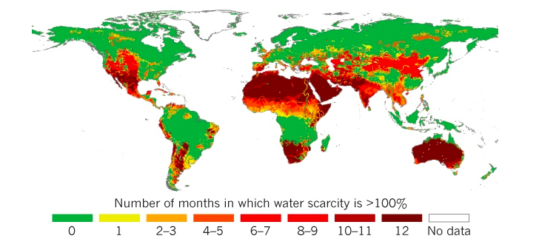
Water Scarcity Impacts 4 Billion People
Agriculture accounts for 70 percent of the freshwater
taken out of rivers, lakes, and aquifers.

Slide 4

Methods used in deciding when to irrigate
SIS: Scientific Irrigation Scheduling
Non-SIS: perception-based methods

Slide 5


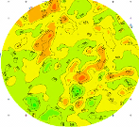
Integrated Decision Support Solution
INPUTS
Iterative Feedback Loop
OUTPUTS
On-Farm information
DYNAMIC
Weather
Optimal Irrigation management
Telemetry
Moisture sensors
Pumping +
distribution system
Uniform Fields
Decision support
static Data
Soil maps
Yield maps
VRI Fields
Online advisory system
Crop type, ET, weather integration, irrigation scheduling, etc.
FIXED
data output
Reports, trends, analysis, etc.
Risk management
Notes:
Review our concept of an integrated system
With an integrated decision support solution in place, all the tools and technologies “talk” to each other and offer growers the opportunity to rely on the data, not the consultants or people in the fields, to choose the right prescription for their fields. This allows growers to reduce their energy consumption or extend it further, improve yield and improve profitability. The problem is a lack of interoperability: the many pieces of this system have been unable to talk to each other.

Slide 6

The Problem: A Lack of Interoperability
Equipment from different sensor OEMs produce data in different formats, with different data encoding conventions, vocabularies, units of measure, etc.
“Pieces of irrigation equipment don’t talk with one another”.
The problem worsens if they are running a mixed fleet of equipment.
Advisors spend valuable extra time
trying to analyze data and interpret it to help growers be more productive.
Hypothesis: Standardizing data inputs and outputs can solve this problem.
Notes:
Dan:

Slide 7
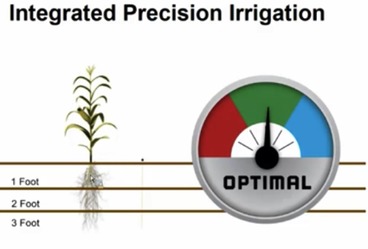
AgGateway’s PAIL: Goal & Objective
Goal: promote sustainable irrigation practices by facilitating integration of disparate data sources and management systems
Objective: provide an industry-wide format that will enable the exchange and use of data from irrigation management systems.
Notes:
The purpose of the PAIL project is to provide an industry-wide format that will enable the exchange and use of data from irrigation management systems. The data are currently stored in a variety of proprietary formats; the PAIL project seeks to develop a common language that can enable integration of these disparate sources of water management information.

Slide 8
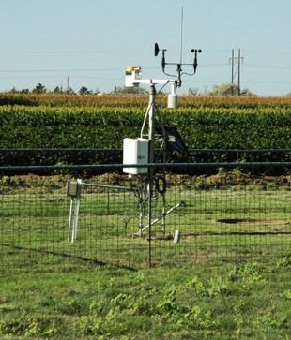
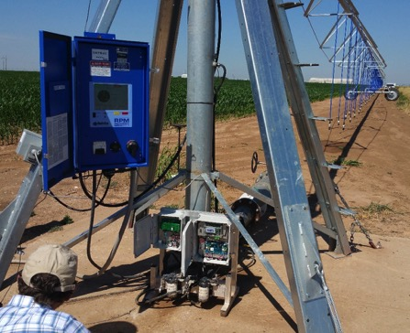
Scope
Observations
Operations

Slide 9
Part 1: Core Concepts
The group agreed on a level of abstraction that is closer to the business processes than to the hardware.
Supports Grower-Farm-Field-Cropzone
  Cropzone is a specific, well-defined concept, mappable to an ISO11783 PFD.
Standardized way of expressing space and time
  Includes radial and cartesian/polygon representations of space.
  Timescopes are analogous to ASP / TIM elements of 11783-10.
Standardizing codes for units of measure, but enables different sources.
ContextItem: capturing geopolitical-context-dependent data
Compatibility with AgGateway’s ADAPT

Slide 10
Field Operations Interoperability
Modern growers need to keep increasingly detailed and timely records of field operations (planting, irrigation, spraying, fertilization, harvest, etc.)
Motivations:
  Keeping their business profitable
  Regulatory pressure, and
  Supply-chain interest in traceability and sustainability.
Growers and their partners use multiple "documents" to exchange field operations information as part of their business processes.
Lack of common formats and shared meanings are huge problems
  The effort necessary to make the simplest of comparisons or exchanges with partners makes the documentation burden not scalable or sustainable by the grower.

Slide 11
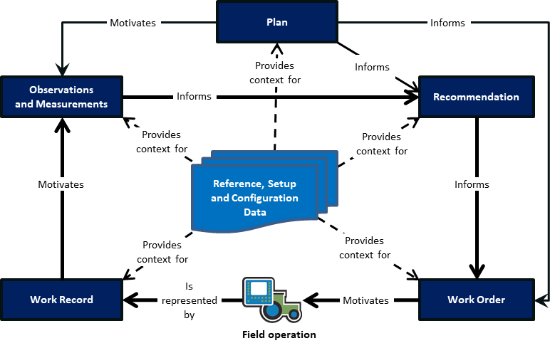
Core Documents and their Relationships

Slide 12
Part 2: Observations
Observations (e.g., scouting, soil water content, instrument data) have richer semantics than the DDI-mediated system of 11783-10.
ISO 19156 provides an abstract model that can represent the different aspects and rich semantics of an observation.
Part 2 is a realization of ISO 19156
in agriculture, meant to comply
with the abstract test suite
presented in 19156.
It seeks to represent data as
key-value pairs, with a
machine-readable set of definitions
behind the scenes.
Right-sized, application-specific level of detail.

Slide 13
Observations and Measurements
Observations & Measurements (“OM”) provide critical raw material for principled decision-making in field operations.
There are multiple attributes of an observation or measurement that need to be kept track of in order to allow the value to mean the same to sender and receiver.

Slide 14
Observations are everywhere in ag
Irrigation
  Soil water measurements
  Weather and climate data
Crop Nutrition
  Manure lab tests
  Soil test data
Post-Harvest
  Grain quality certificates
  Weight certificates (and scale tickets)
Logistics
  Asset management (grain dryers, grain bins, scales)
Crop Protection
  Diseases, insects, phenology, etc.
Crop simulation and other data-intensive applications.

Slide 15
Observation Codes vs Code Components
In their simplest form, observations can be interpreted as key-value pairs, where the key is an “observation code” that represents the meaning of the observation (e.g., feature of interest, observed property, method of observation, etc.)
  Example: liquid precipitation in a rain gauge, with tipping-bucket events signaling (0.1 mm).
In practice, it is not always optimal to embed all the meaning into the code, it instead being preferable to encode other things separately
  Example: a depth below ground parameter for volumetric soil water content observations.

Slide 16
Code structure
Sequence of code components
  We can sequence code components and enforce place value.
Each component has some attributes:
  ComponentType i.e., type (aggregation, property, feature, etc.)
  Selector: Value of a controlled vocabulary associated with this ComponentType (e.g., “Average”, “Median”, “Air”, “Soil”).
  Value: Numeric (or other) value of a parameter (e.g., “15”)
  Value type: Is this a number? A date? A string?
  UoM: Unit of measure for a parameter

Slide 17
Central ideas
Boil things down to a key-value pair
  (e.g., [key]: [value]), or (“http://omcodes.org/def/AT2315m : 72.4”)
  where the key communicates the meaning of the observation.
  This is equivalent to defining a data type.
Develop semantic infrastructure (e.g., an API or data-type registry) that can dispense machine-readable descriptions of the data types, searchable by their codes.
  Like ISO 11783-11’s data dictionary, but with 2023 aspirations

Slide 18

Core Documents and their Relationships
Motivates
Plan
Informs
Part 2
(based on
ISO 19156)
Provides
context for
Informs
Observations
and Measurements
Recommendation
Informs
Provides
context for
Provides
context for
Reference, Setup
and Configuration
Data
Motivates
Informs
Provides
context for
Provides
context for
Work Record
Is
represented
by
Work Order
Motivates
Field operation
Part 3 (aligned with ISO 11783)

Slide 19
Part 3: Operations
Corner arm (opens/closes in motion)
Non-irrigation field operations have an international standard (ISO 11783-10) for machine-to-FMIS communication; it does not fit irrigation well.
Also, ISO 11783’s assumption of a common electrical / communications infrastructure (e.g., ISOBUS) is not valid in the irrigation segment.
This led to the need for an irrigation-specific operations data model and serialization format that can naturally fit the different geometry and organization of irrigation systems.
This approach enables different levels of abstraction, ranging from specifying an irrigation amount on a field to a particular section of a specific machine.
End of primary, possible endgun
Local center of rotation (“bender”, primary before this point remains stationary during motion)
Pivot
center

Slide 20
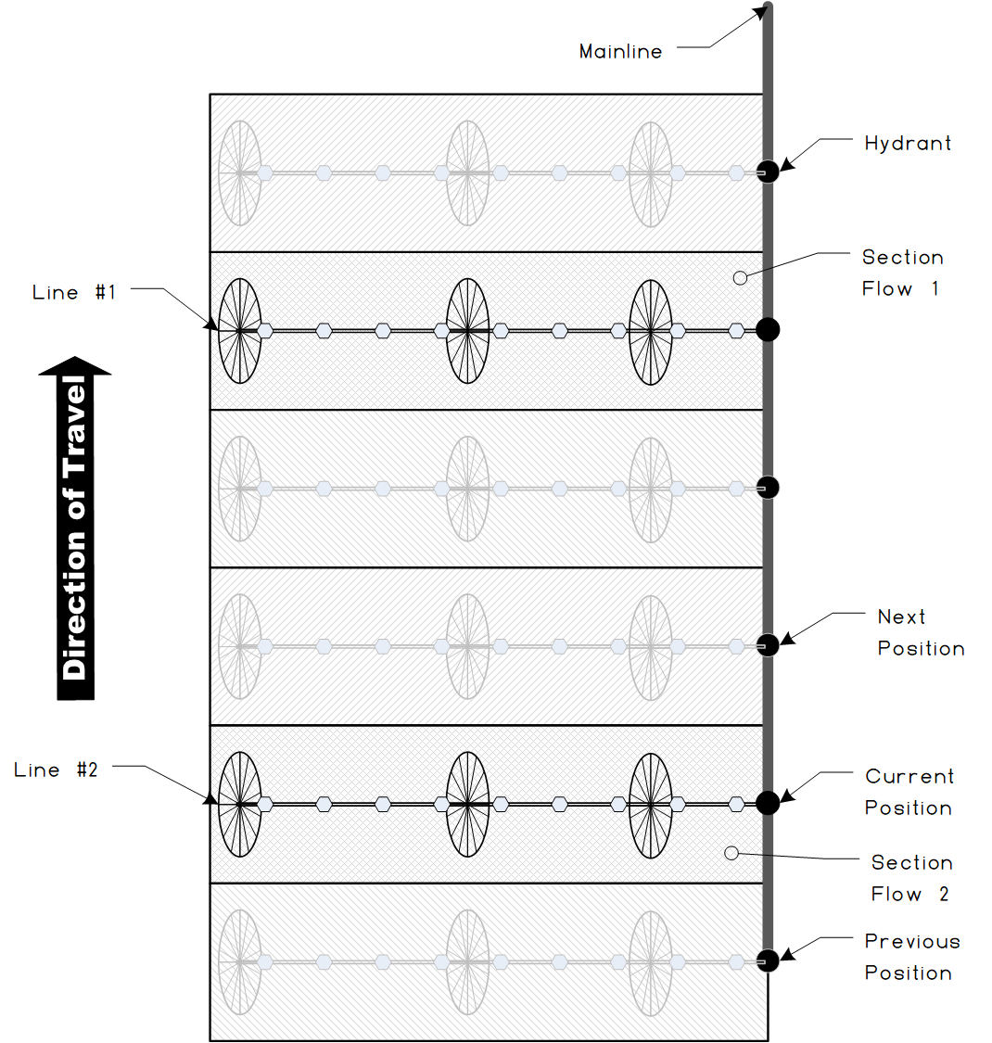
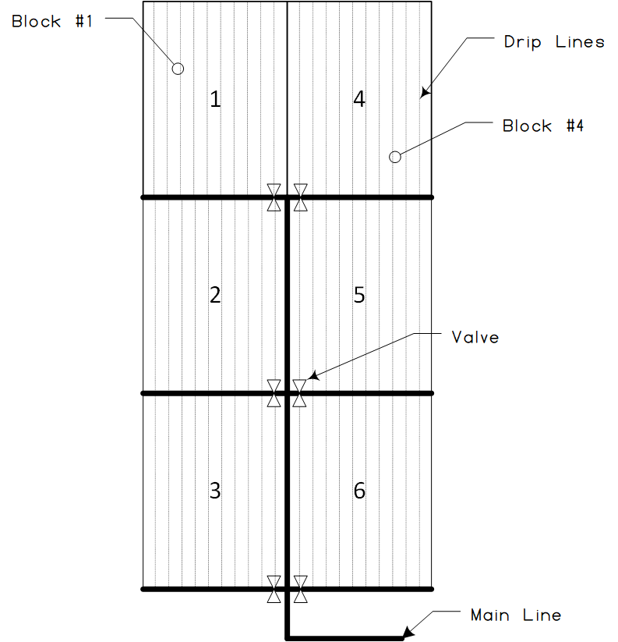
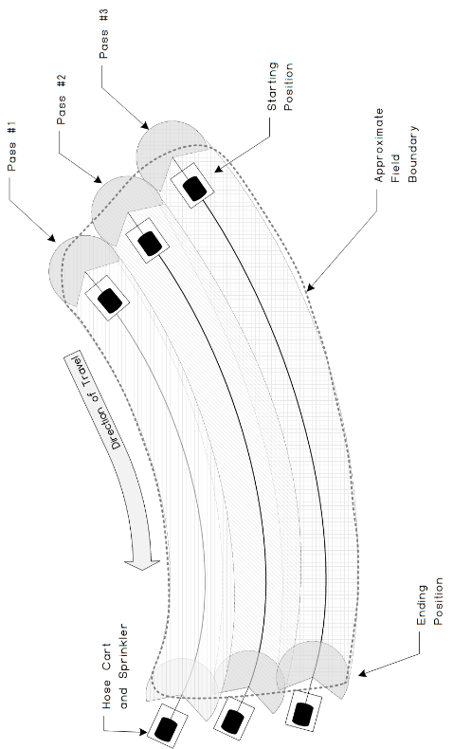
Irrigation System Examples
Drip
Wheel Line
Traveler

Slide 21
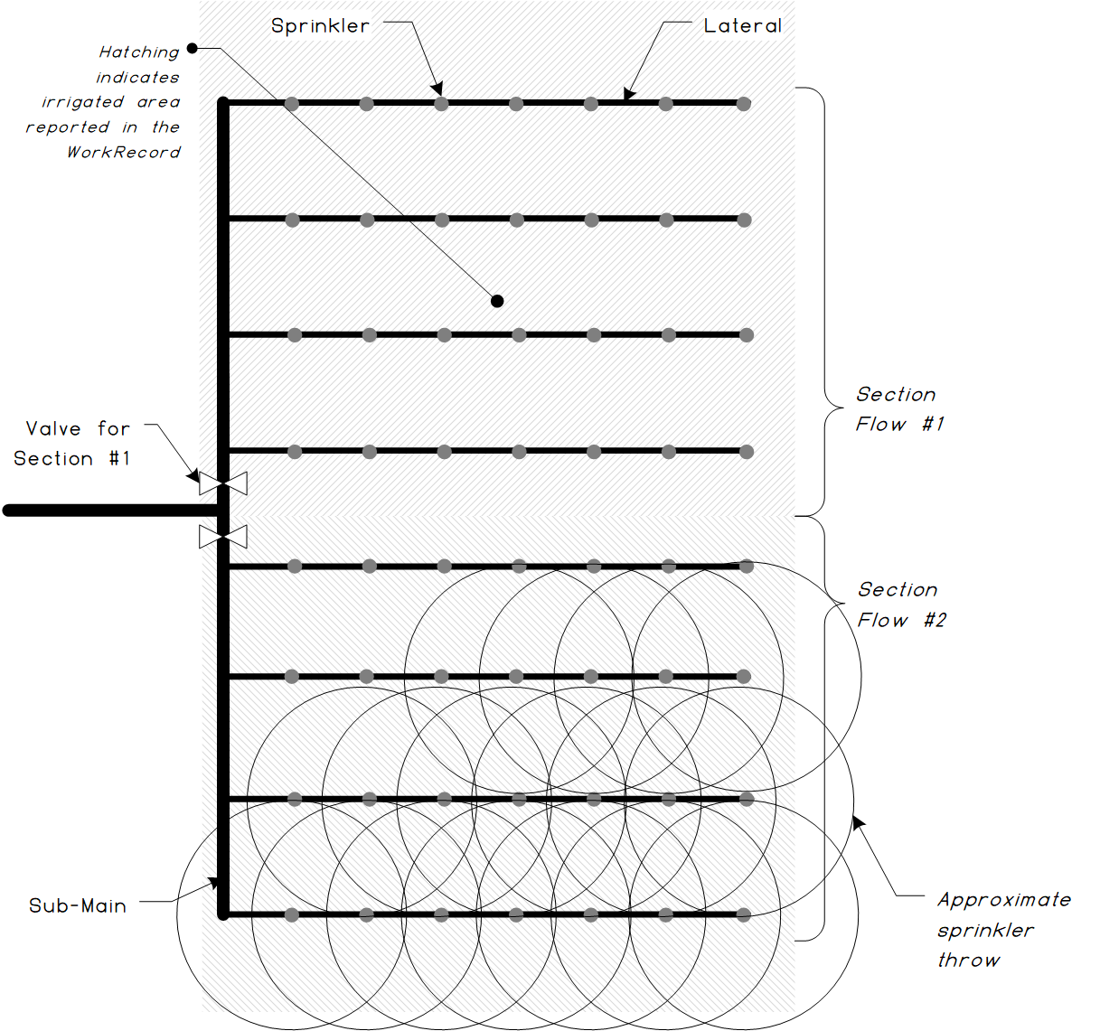
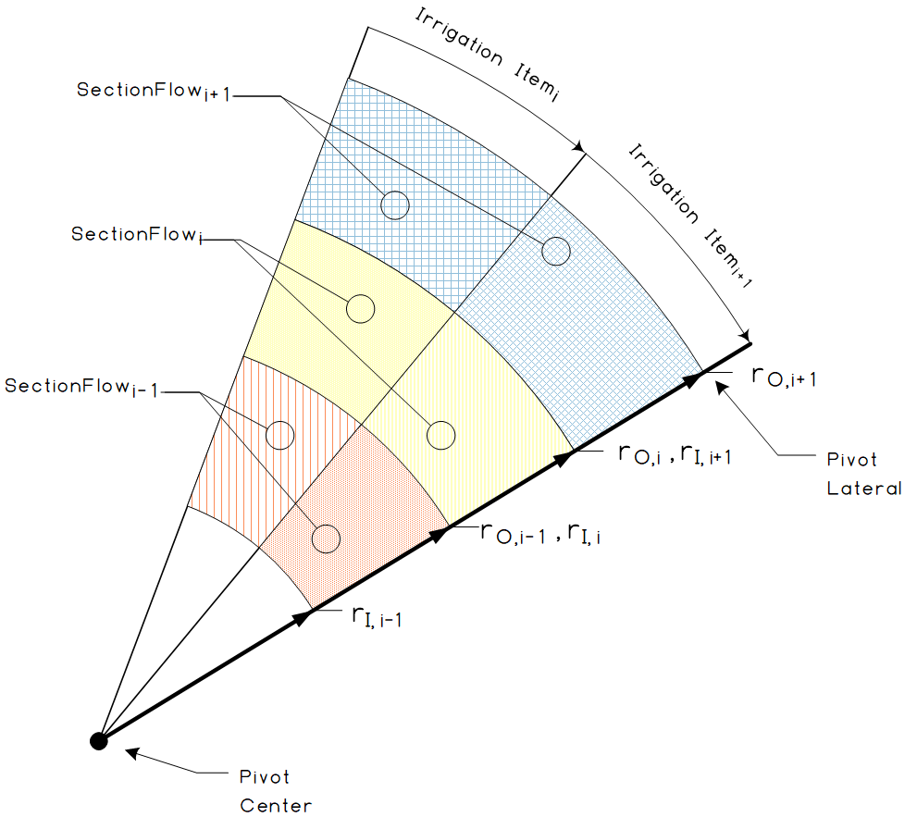
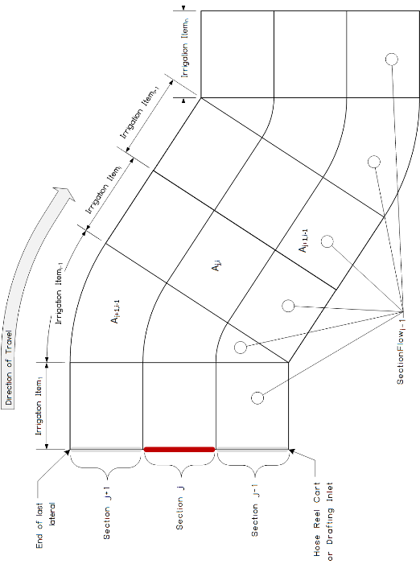
Irrigation System Examples
Solid Set
Linear Move
Pivot Sections

Slide 22
Why this matters to YOU

Slide 23


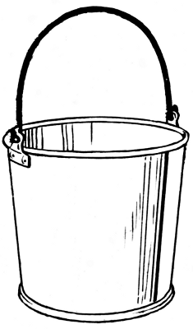




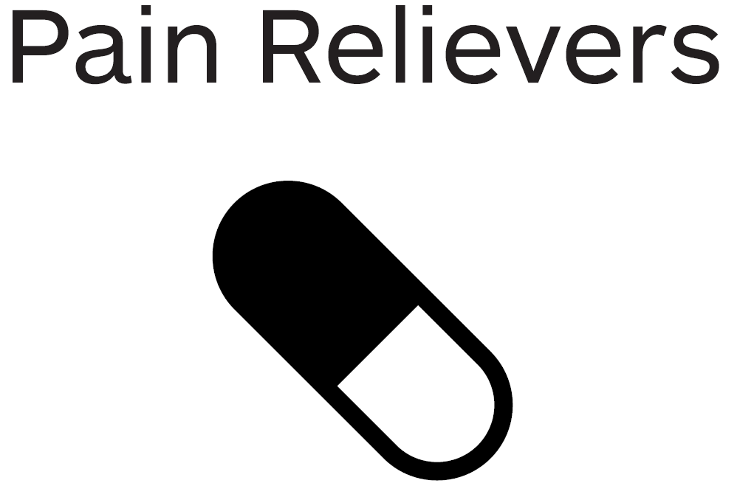
Irrigation Equipment or Services Company?
PAIL has something for YOU!
By connecting our data with other providers we can add new value to customers.
Grow our business with new, integrated solutions.
PAIL
Invest in future opportunities.
Save R&D and Support time and dollars.
Provide irrigation scheduling recommendations and work orders.
Standard data formats for observations in agriculture.
Standard data formats for irrigation operations.
Customers do not need to learn multiple data systems.
Our growers are complaining that our equipment doesn’t play well with others.
Collect and send relevant observations and measurements.
No need to re-write application-specific code when that app changes.
Different companies and orgs have many ways to describe weather data.
To find out more about how your company can take advantage of PAIL, contact the PAIL Team at pail.feedback@aggateway.org

Slide 24

Seed Company?
PAIL has something for YOU!
0
It’s SIMPLE and you can link to more complex resources (e.g. trait ontology).
Specifying field boundaries is easy and consistent.
PAIL
Farm and field boundaries can be described once and then referenced.
We all mean the same thing when describing soil and seed properties.
Conduct seed variety Trials.
Reference,
Set Up and Configuration Data
Framework for observation codes
Alignment on how properties are observed and measured.
CSV files and XML files are killing you!
Ensure customers use seeds correctly (Stewardship).
Standard data formats
Multiple teams are involved and they each use different terminology.
To find out more about how your company can take advantage of PAIL, contact the PAIL Team at pail.feedback@aggateway.org

Slide 25

FMIS Company?
PAIL has something for YOU!
We do not have to reference every single point of data every time.
Growers value how we protect their data and recommend us.
PAIL
We know who authorized the work orders and work records.
Keep it simple and not have to include every nuanced geo-political difference.
Use data only as authorized by the grower.
Compound-
Identifiers and UniqueIds.
Work Order and Work Record Documents.
If another FMIS uses a different way to identify data objects, we can still use the same documents.
Every little change due to some local requirement to the same object – Aghh!!
Share a document with other FMIS companies.
For most items, we can use standard data formats
Multiple teams are involved and they each use different terminology.
To find out more about how your company can take advantage of PAIL, contact the PAIL Team at pail.feedback@aggateway.org

Slide 26
Crop Protection Company?
PAIL has something for YOU!
Specify the meaning of what is being measured, and how it is measured.
Easier and more consistent reporting.
PAIL
Unambiguous results across different teams.
Fewer unnecessary regulations.
Conducting field trials under different conditions & w different teams.
Nascent code component.
Product Reference Data; Work Order Core Document.
Grower can specify who has authorization to apply product.
Customers do not always have latest info on product use.
Help ensure proper use of crop protection products.
Customers can be directed to manufacturer’s url for up-to-date info.
Unauthorized application of products.

Slide 27
Getting the band back together

Slide 28
How to drive engagement
Materials to make implementation easy
  JSON Schema
  XML Schema?
  Implementation notes
ROI with / without standards
Everyone talks about interoperability; we have a standard here…
Promotion, events, conferences, trade shows, publications?
  Irrigation Today
  ICPA?
  Meister Media Precision Ag
    Tech Hub
  Commodity Classic
  UNL/Extension

