Slide 1
Field Boundaries: GNSS Accuracy
WG24 Kick Off

Slide 2
Session Agenda
Quick Recap: WG17 Field Boundary: Terms and Definitions
Review WG24 Scope, Deliverables, and Timeline
Breakdown project goals, milestones, and formulate plan for WG meeting cadence
Review logistics, wiki page, resources or materials needed
Other Field Boundary Needs/Future WG’s

Slide 3
WG17 Field Boundary: Terms and Definitions Recap
We defined the term 'Field':
A named and farmer-accepted physical space where production agriculture takes place. This can be used to partition and identify data.

Slide 4
WG17 Field Boundary: Terms and Definitions Recap
We defined the term 'Field Boundary':
A geometry that identifies the geo-spatial coordinates of a field. The boundary can be used to define the area for a particular operation, a particular crop or crops, or for legal purposes. A field can have different boundaries that may vary in geometry based on their specific use but is always either a polygon or multi-polygon.

Slide 5
WG17 Field Boundary: Terms and Definitions Recap
Field Boundary Use Case Work
Custom Application
Insurance
Soil Testing
Sustainability and Carbon Reporting
Identified and defined common terms
All work tracked and housed in Wiki

Slide 6
In Scope
Identify and define how GNSS positioning data (both terrestrial and space-based), correction signals, and types, are associated with Field Boundaries.
Identify and define other relevant associated data and/or classifications
Out of Scope:
Definition of field boundary file format

Slide 7
Deliverables
Implementation guideline for GNSS receiver manufacturers
Metadata needs for boundary definition(optional and required)
Controlled vocabulary needs
ADAPT Recommendations to support GNSS Implementation Guidelines
Potential recommendations to other standards orgs (e.g. NMEA)
Review and update Field Boundary Definition (WG17) Use Cases and Boundary Types/Classifications as needed

Slide 8
Field Boundary Interoperability Needs
Field Identifier
Boundary Accuracy
Buffer zone creation/sharing
…

Slide 9
Definitions
Accuracy vs. Precision
Boundary accuracy hard to determine
Was the boundary driven/drawn correctly?
Positioning precision can be measured
Was the boundary driven with a high accuracy GNSS position?

Slide 10
WG Planning
High-level goal: Understand what a boundary is suitable to be used for
Need to know:
Definition method, driven, drawn, recognized (imagery)
Driven – GNSS position accuracy
Creation date/age
Etc...

Slide 11
PRELIMINARY WORK

Slide 12
WG Cadence, Timeline
Meet weekly, bi-weekly, 1 hour, 3 hours at a time?
Preferred day/time – Doodle?
Goal to complete deliverables by April

Slide 13
Current Library of Materials
https://aggateway.atlassian.net/l/cp/XJeJ1ZX1
WG17 Deliverables
Boundary Use Classifications/Types
Field Boundary Terms & Definitions
Field Boundary Use Cases
What else would be helpful for the effort

Slide 14
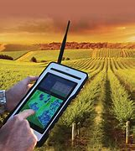
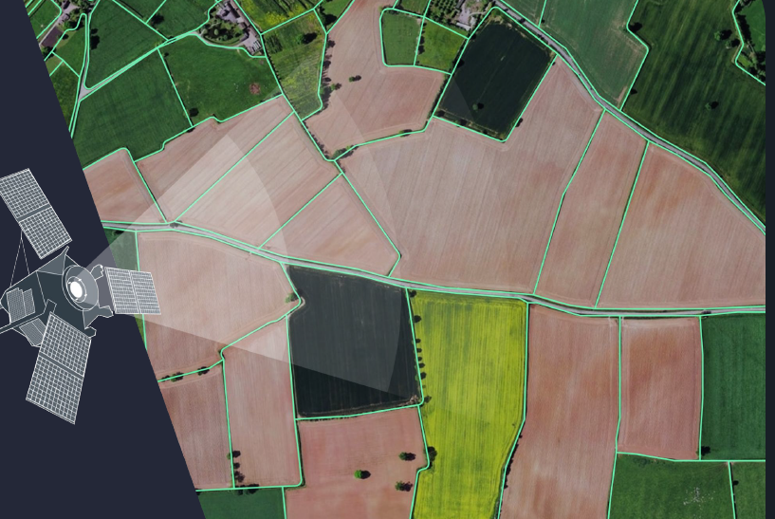
Correction Signals, Definition Method
Webinar Overview of (RTK) Correction Signals: https://youtu.be/Jh2DBRmz88Q
Mobile base, CORS, Surveyed Base, SBAS
Driven, vs. drawn, vs imagery derived boundaries

Slide 15
Field Boundary Future Needs

