Slide 1

Portfolio Management Center Update

Slide 2
Agenda
2023 Year in Review
Gaps, the big picture, how to drive implementation
New Working Groups for 2024

Slide 3
PMC Groups
Found within Portfolio Management Center
Advisory Groups
Strategic in nature, providing longer term guidance in a subject area
Working Groups
Shorter in duration, delivering defined digital resources
Member organizations affirmatively join a Working Groups via Join Form
Company participation must be confirmed by AgGateway primary contact per IP policy

Slide 4




AgGateway Digital Resource Development
Affirmatively Join the
Working Group
Meet Ups
Working Group Charter
Working Group
Works

Slide 5




2023 Working Groups Status
WG22
WG23
WG25
WG24
WG12
WG15
WG18
WG20
WG19
WG04
WG16
WG00
WG13
WG17
WG11
WG21
Input manufacturer
Input distribution/retail
Farm
Field operations
Processor
Complete, Ready for Implementation
WG13 Closed Loop Spray
WG15 Scale Ticket
WG16 Crop Protection Product Guidelines
WG17 Field Boundaries: Terms & Definitions
WG18 Crop Nutrition 3rd Party Product Management
WG19 ADAPT Serialization
WG22 Booking & Prepay Reporting
Wrapping Up
WG00 Agrisemantic Infrastructure PoC
WG04 Ag Lab Data (Modus)
WG11 LATAM Soil Data
WG20 Traceability API
Active or Starting Up
WG12 PAIL
WG21 European Reporting ADAPT Mapping
WG23 Weather and Forecast Data API
WG24 Field Boundary: GNSS Accuracy
WG25 Dairy Feeding Data Standards Assessment

Slide 6
Meeting Industry Needs

Slide 7

Use Case #1: Product Performance
Input manufacturer
Input distribution/retail
Farm
Field operations
Processor
Product Created
Lot, Batch assigned
CN/CP/Seed ShipNotice, GTIN
Mix Ticket,
In-Field Product ID
Work Order, Work Record, ADAPT
PAIL (ISO7673-2) Observations and Measurements
Agrisemantics and Dataset Metadata

Slide 8

Use Case #2: Climate Smart Commodity Verification
Input manufacturer
Input distribution/retail
Farm
Field operations
Processor
Field Boundary, Modus
ADAPT,
Traceability API
Scale Ticket
PAIL (ISO7673-2) Observations and Measurements
Agrisemantics and Dataset Metadata

Slide 9
Everything, Everywhere, All at Once
Input manufacturer
Input distribution/retail
Farm
Field operations
Processor
Product Created
Lot, Batch assigned
CN/CP/Seed ShipNotice, GTIN
Mix Ticket
In-Field Product ID
ADAPT,
Traceability API
Bulk Delivery
Scale Ticket
PAIL (ISO7673-2) Observations and Measurements
Agrisemantics and Dataset Metadata

Slide 10

Pressures on Agriculture
Sustainability
  Mandated Scope 3 reporting
  Other industry’s net zero commitments
Regulatory
  EU Deforestation legislation
  CP/CN application records
Traceability
  Where did my food come from
    Gluten, GMO, Organic, Hormones, Free Range, …
  Blending/tracking requirements and limitaitons

Slide 11
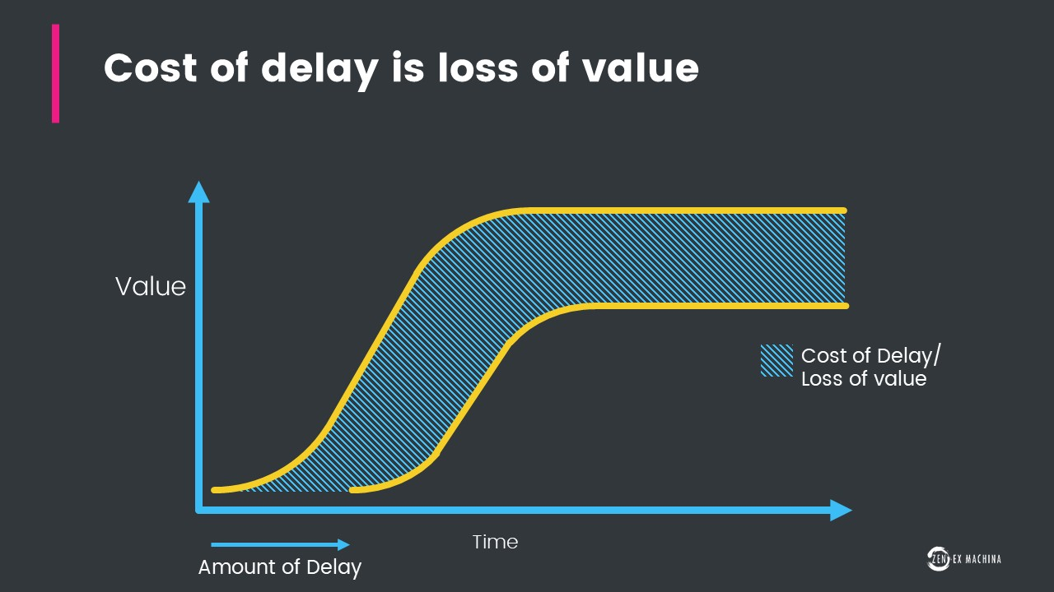
When to Implement AgGateway Digital Resources
Telecom agrees to standards before anyone develops anything e.g. 4G, 5G, 6G
  Interoperability is a fundamental requirement
How much time and effort is wasted connecting to everyone’s “Standard” proprietary interface?

Slide 12
2024 Potential Working Groups
Agrisemantics:
  Semantic resource management tool analysis/recommendation
  Common controlled vocabularies identified by multiple WG’s
  Dataset Metadata controlled vocabularies
Data permissioning and stewardship
  Update the data privacy whitepaper with the latest views pertaining to data access permissioning and stewardship
ASN (Advanced Ship Notice): Farmer to elevator/processor
Scale head to ERP interface
ShippedItemInstance gap check for crop protection, crop nutrition
Animal Agriculture
  Poultry
  Swine
  Beef
AI/ML Training metadata tagging
Equipment Parts Inventory Exchange
Farm store inventory EDI Implementation Guidelines
Drone application work order/work record
ADAPT Standard plugin for ADAPT Toolkit
AgGlossary 2.0
Modus, other matrix: water, manure, nematodes, feed, …

