Slide 1
Embracing A Data-Driven Future
AgGateway 2023 Review
Brent Kemp, President and CEO

Slide 2
2023 Progress and Accomplishments
17 new members
3 new working groups
1 new advisory group
11 new resources submitted to Standards and Guidelines
~400,000 ADAPT component downloads
24 meet ups
9 industry meetings and presentations
1 Podcast appearance
9 AGIIS Enhancements

Slide 3
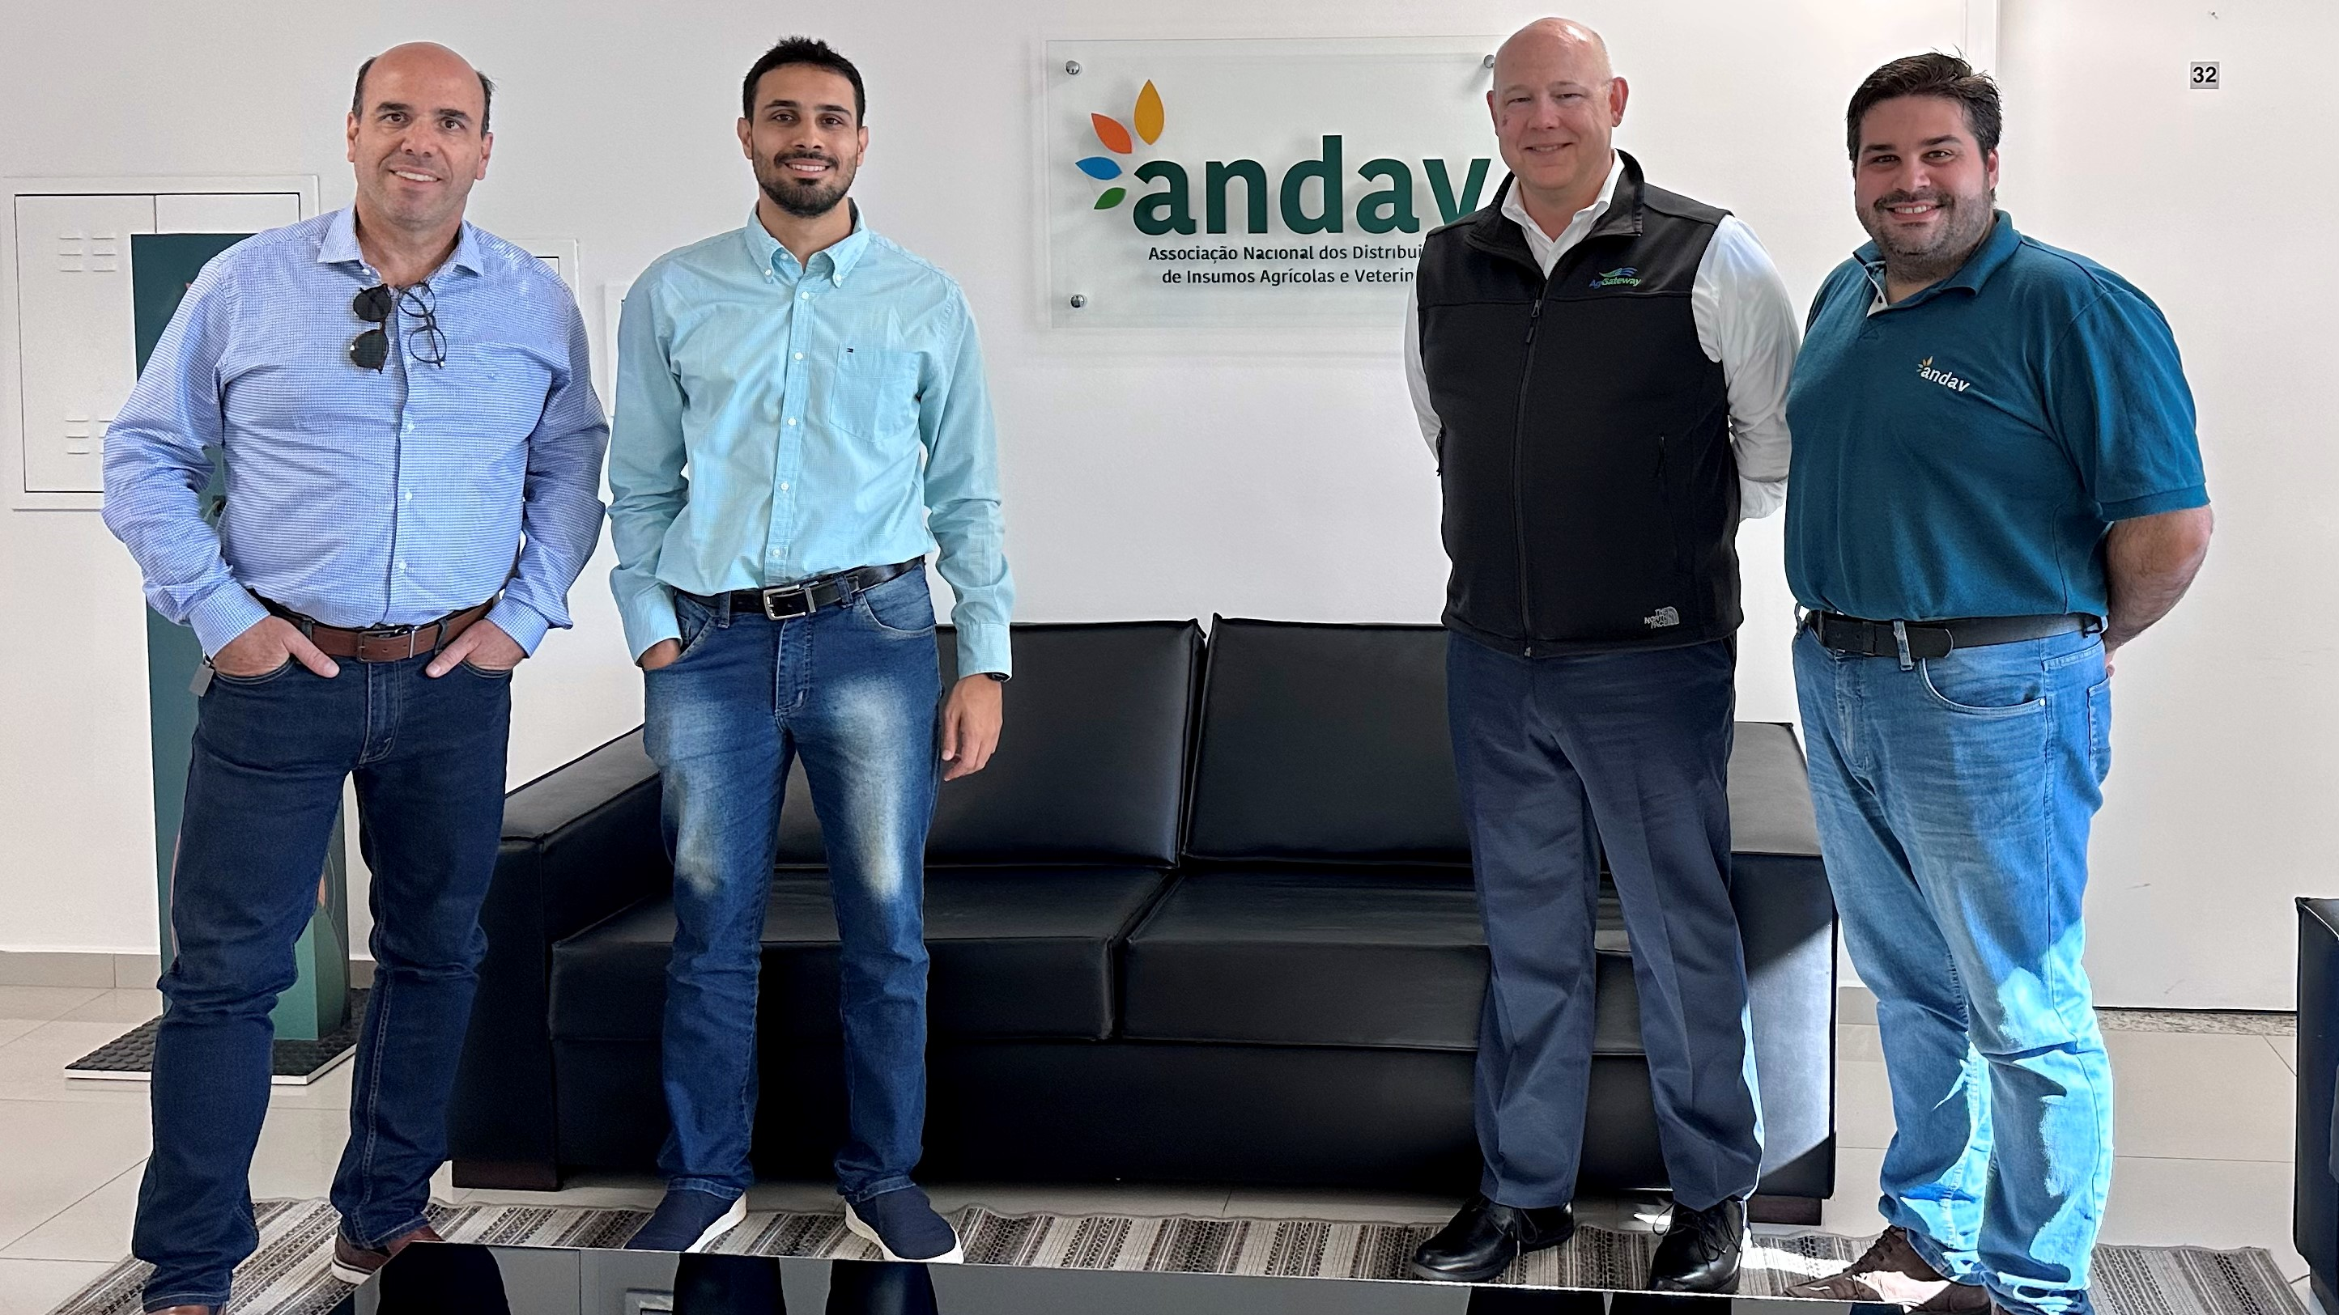
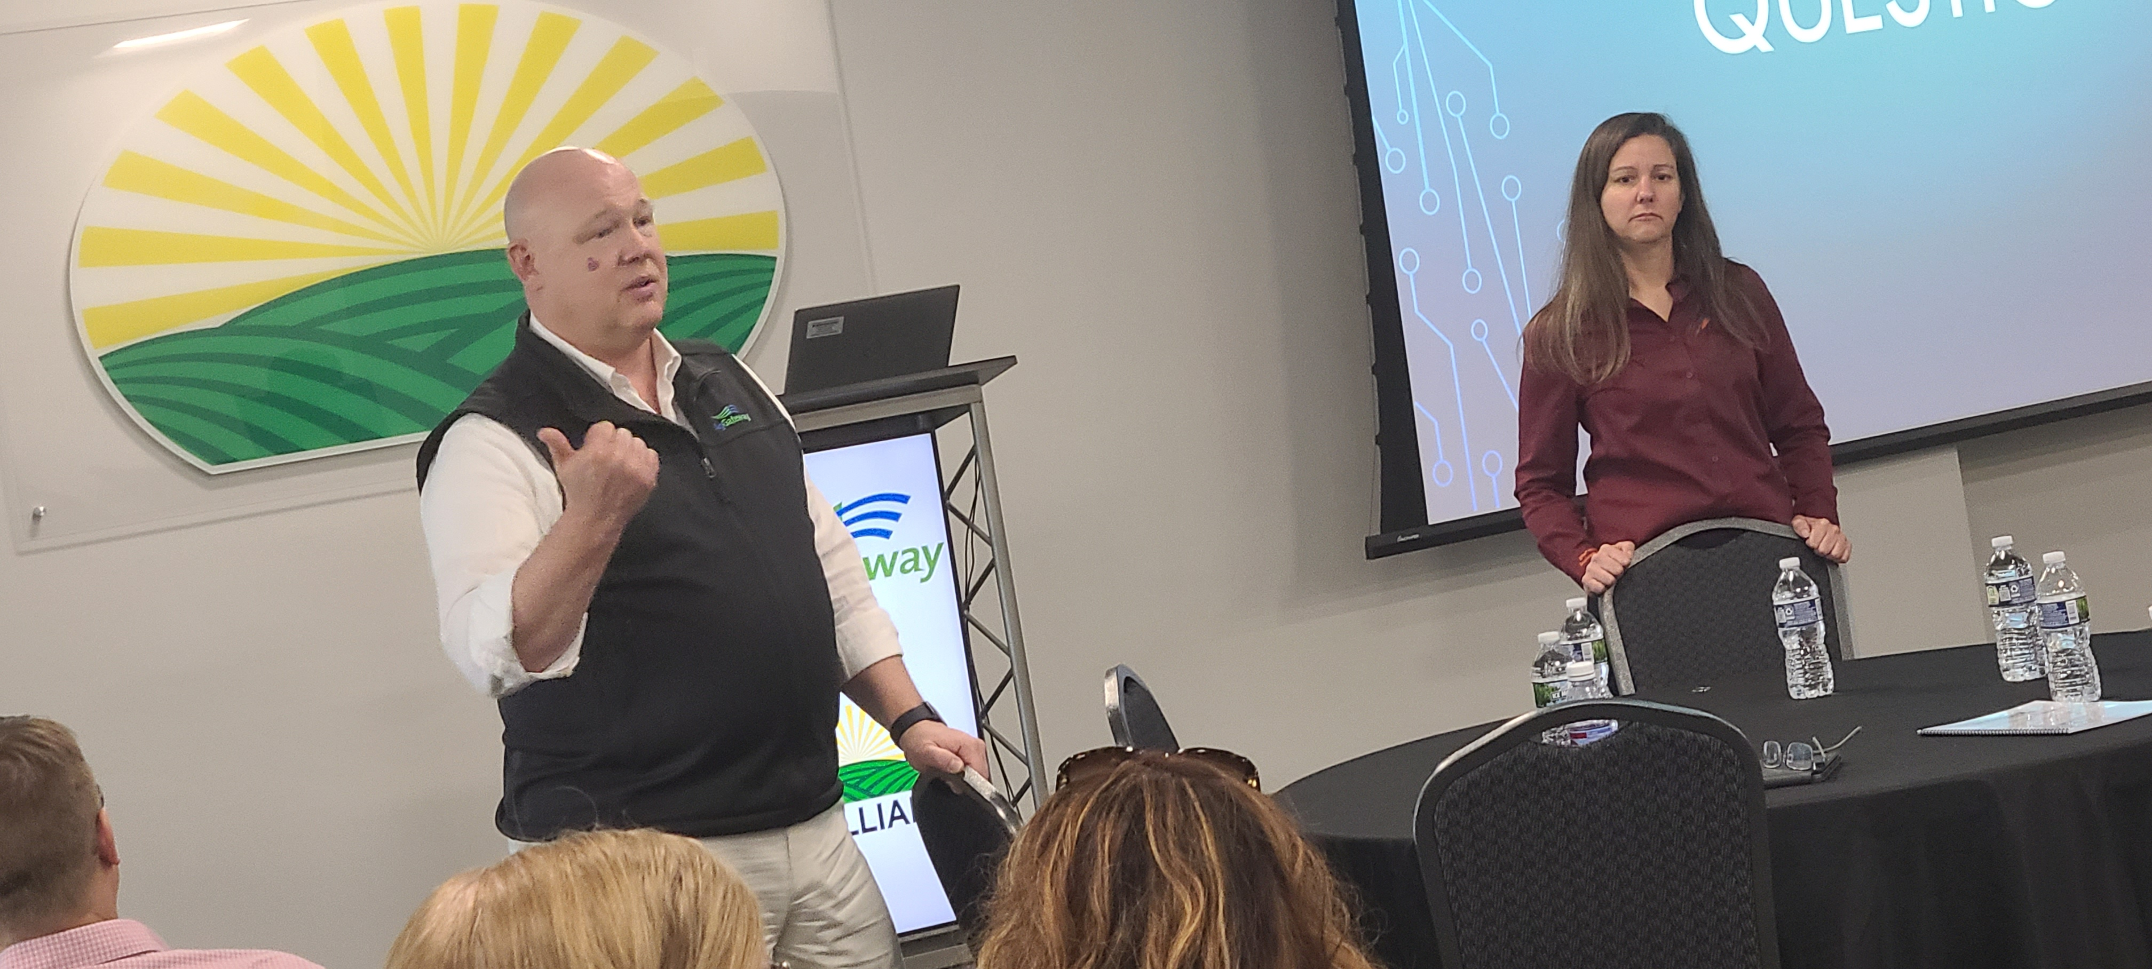
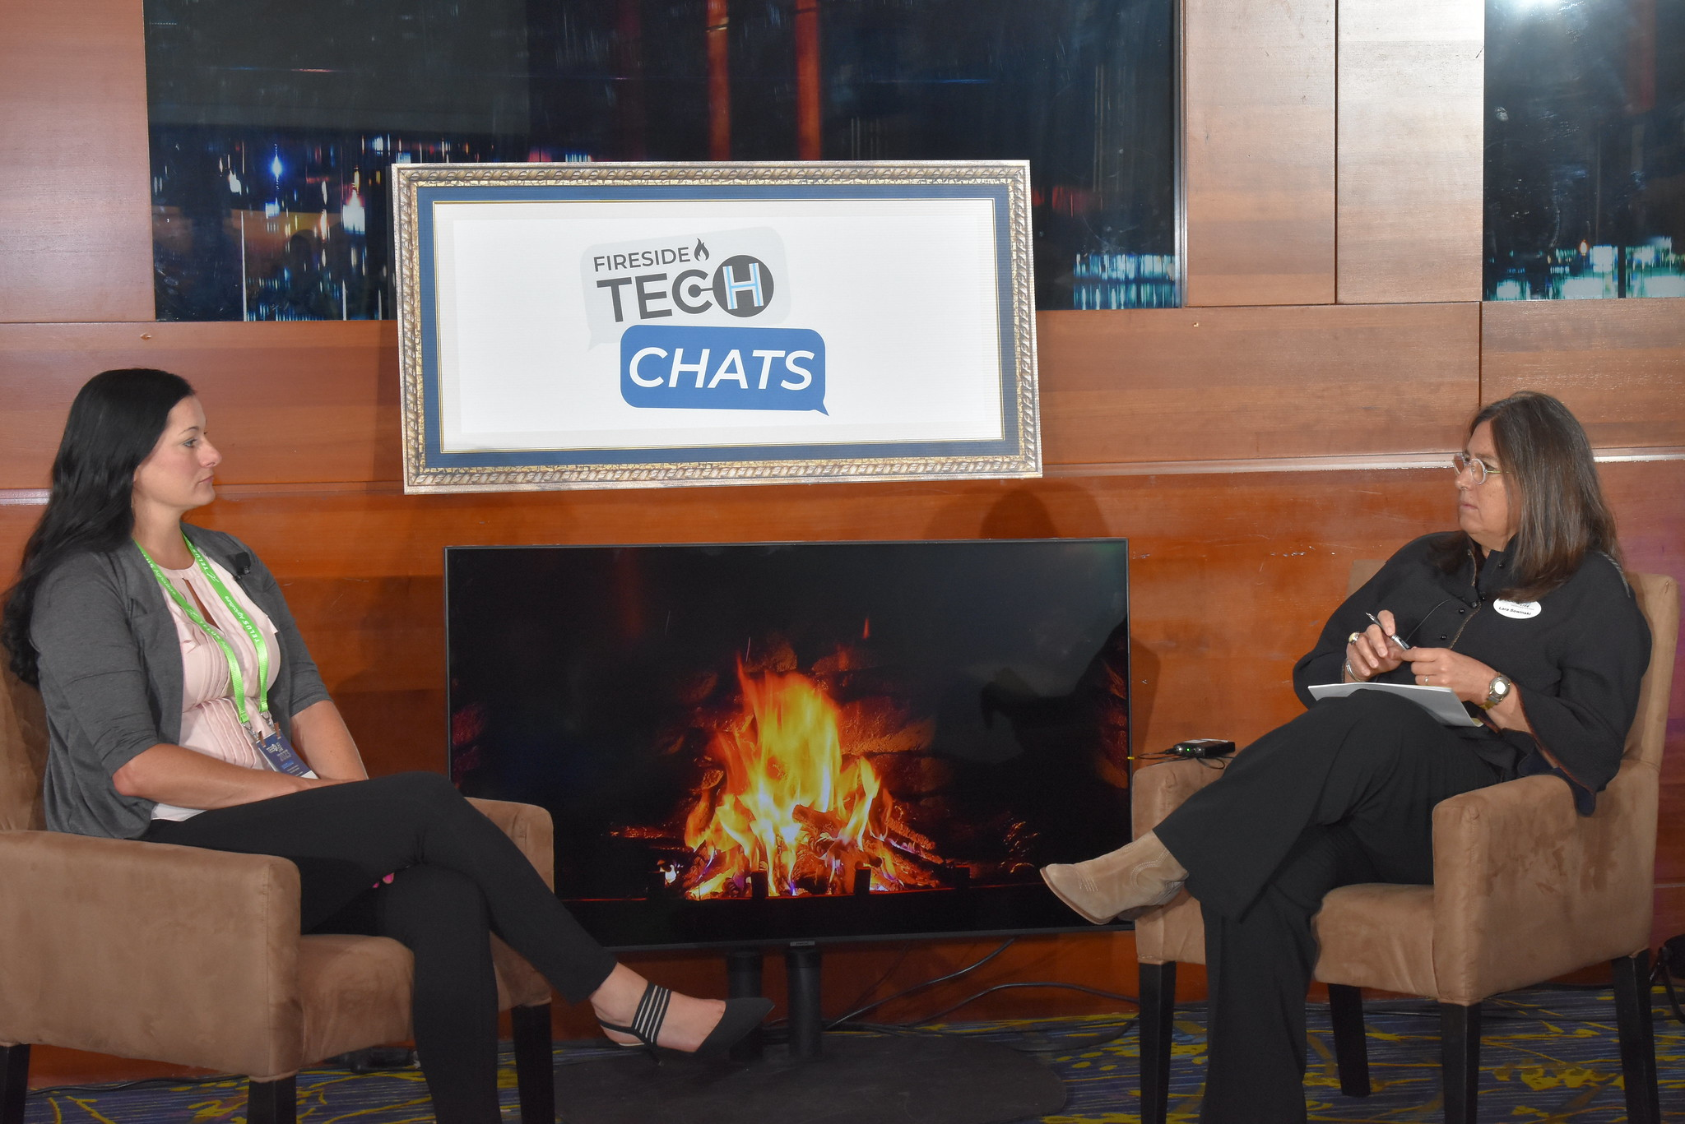
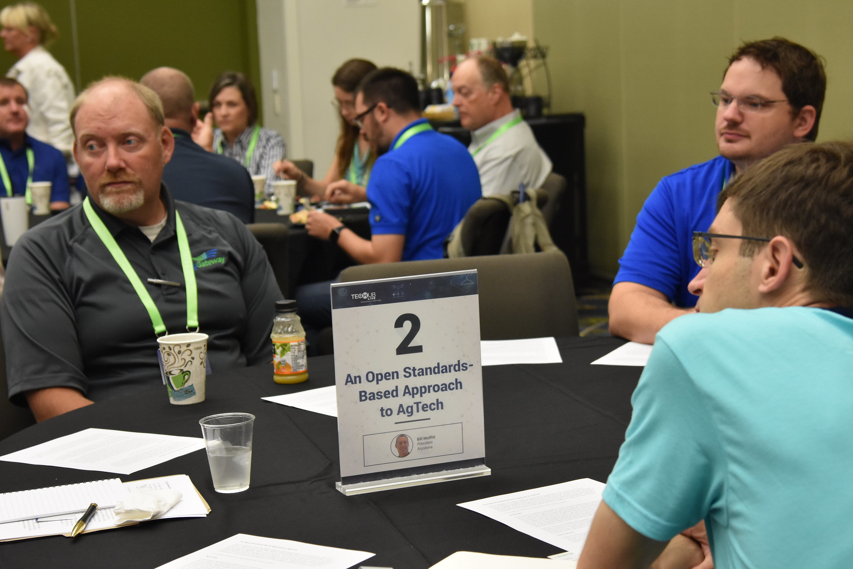

Slide 4
2024 Roadmap
Increased industry presence
State association meetings
Attendance at international events
Partnership with other associations
Digital Resource development
AGIIS Entity Rules revisions
Animal production data linking
Weather and climate data
Field data definitions
Evaluation of existing messages for new implementations

Slide 5
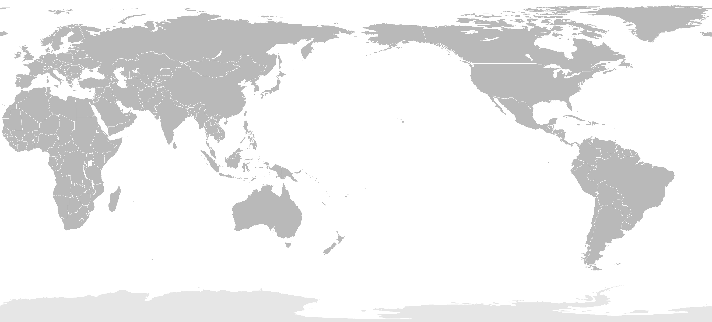

Slide 6
A Data-Driven Future Requires …
Interoperability
Agreed upon and implemented reference data and connections
Context-aware messages and processes
Collaboration on the basics

Slide 7
