Slide 1
Agrisemantics Committee

Slide 2
Purpose of Agrisemantics Committee
Develop, implement and maintain infrastructure to provide the industry with semantic resources such as controlled vocabularies, data type registries and other tools seeking to enable the communication and preservation of the meaning of digital agriculture data as it is exchanged among industry stakeholders (growers, advisors, retailers, manufacturers, etc.).

Slide 3
What are Semantic Resources?
ContextItemDefinitions
These are machine-actionable data type definitions that can be used to convey information specific to a given country, state, or other jurisdiction.
Examples include US EPA numbers, FSA Farm and Tract numbers, Public Land Survey System data; German Bundessortenamt codes, cadastral codes, and so forth,
Representations
These are machine-actionable data-type definitions used within the ADAPT system to represent machine-logged data and other variables.
Observations and Measurement Codes
These are machine-actionable codes to enable accurately expressing what is being measured or observed in observations processes like crop scouting, field instrumentation, laboratory testing, and so forth,
Examples include mean daily air temperature, volumetric soil water content, and the Modus laboratory test method codes.
Other controlled vocabularies and semantic resources
CropDefinitions: This is an example of a complex data type definition

Slide 4
Why would I want to do this? What’s in it for me?
Sharing semantic resources in general, and data type definitions (including enumerated ones like code lists) in particular, makes it easier to interoperate with other companies.
If you produce data, it makes it easier for others to consume your data.
If you consume data, it makes it easier for other companies to send you data in ways that you can consume frictionlessly.
Idea: Add example of how the definitions can help not fly blind

Slide 5
How is this different from S&G?
A precursor of this Committee was the Controlled Vocabularies Working Group within Standards & Guidelines.
Over time it seemed reasonable to spin it off as its own entity, because there are significant differences among the two.
 | Standards & Guidelines | Agrisemantics
Deal with controlled vocabularies, DTDs? | Occasional | YES
Deal with machine-actionable infrastructure? | NO | YES
Expectation of agility | Low / Medium | Medium / High
Availability of SMEs | Not specifically | Yes, by design

Slide 6
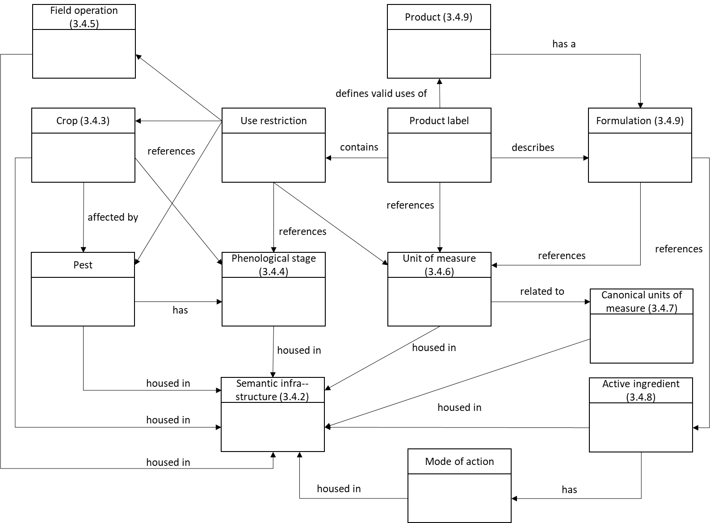
What would we work on?
From ISO SAG-SF Report

Slide 7
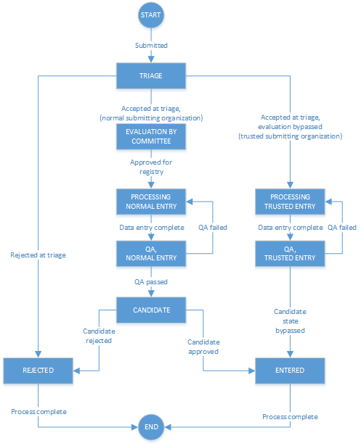
How Would it Work? Process?
See "ISO 19135 Requirements" in wiki*
There's a simple process in place for managing the lifecycle of semantic resources (see diagram).
Once stored in the database, the semantic resources have states (Valid, Invalid, Superseded, etc.) as per ISO 19135.
* https://aggateway.atlassian.net/wiki/spaces/PMC/pages/3591503978/ISO+19135+Requirements+Draft

