Slide 1
Ag Industry Identification System 301 Education Session - Products
Chris Crutchfield – AGIIS Product Manager

Slide 2
Purpose
To inform users of the most efficient method to manage, navigate, input and access product information to and from the Ag Industry Identification System. This session will highlight best practices and provide tips for a successful user experience.

Slide 3
Overview
Profile Management
GTIN Components
Product Search
Adding Products
Extracts
Services
Resources
Questions and Answers
Notes:
not consistent

Slide 4
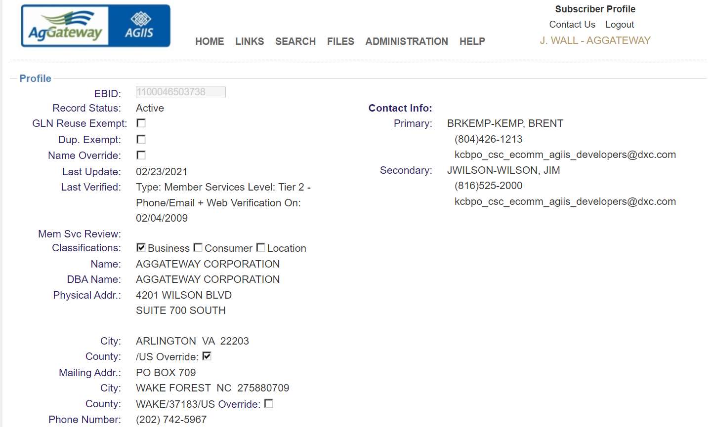
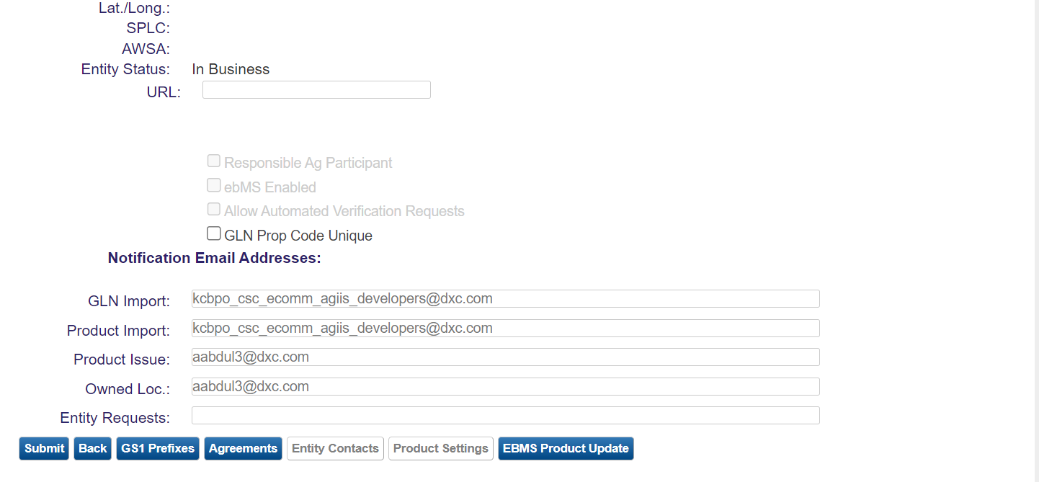
Profile Management
Subscriber Profile
Contacts
Email Notifications
GS1 Prefixes
Product Settings

Slide 5
Product Settings Administration>My Subscriber Profile>Product Settings

Slide 6
Mass Product Deactivation/Delete

Slide 7
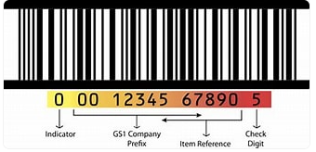
GS1 Company Prefix
A GS1 Company Prefix is a number composed of 4-12 digits that is unique to each member of GS1 and identifies the owner of a brand.
It is the building block for every barcode and other information keys that are used to track products and communicate in electronic business messages.
Foundation of the GTIN

Slide 8
Global Trade Item Number (GTIN)
A GS1 number used to give products and packaging a globally unique identity – Applied to the package configuration level AGIIS. GTIN is 14 digits in length.
Indicator Digit + GS1 Company Prefix + Package Size ID + Check Digit
01100011123459 - 14 Digits
Indicator Digit - 1 Digit
Company GS1 Prefix - Variable Length
Package Size ID = (GS1 prefix + Package Size ID must = 12 digits)
8-digit company prefix requires 4-digit package size ID
7-digit company prefix requires 5-digit package size ID
Check Digit = 1-Digit

Slide 9
INDICATOR DIGIT
First digit of the GTIN
Formerly known as package level indicator
0 – Smallest Salable Unit
1 – Not previously defined
2 – Mutually agreed upon (e.g. To identify a container less than intermediate and above smallest consumer unit.)
3 – Interim Package
4 – Mutually agreed upon (e.g. To identify a container smaller than standard shipping container and greater than intermediate.)
5 – Standard Shipping Container
6 – Not previously defined
7 – Standard Pallet
8 – Repack
9 – Non-Standard/Bulk
Used to differentiate various groupings of the saleable package
Manufacturers can now assign their own definition to the indicator digit but must apply consistently across product lines
Manufacturers encouraged to update their hierarchy on wiki - https://aggateway.atlassian.net/wiki/x/CYDSzg

Slide 10
Package Size ID (Item Reference Number)
Product XYZ
Product XYZ
Product XYZ
12345
67890
Same Product – Different Package Sizes

Slide 11
Check Digit Calculator

Slide 12
Indicator Digit | GTIN Hierarchy
3 | Interim Package
5 | Shipping Container
0 | Lowest Saleable Unit
ABC Company
GS1 Prefix 1100011
Product
Product XYZ
Package Size
12345
Package Configurations
12345
31100011123450
51100011123454
01100011123459

Slide 13
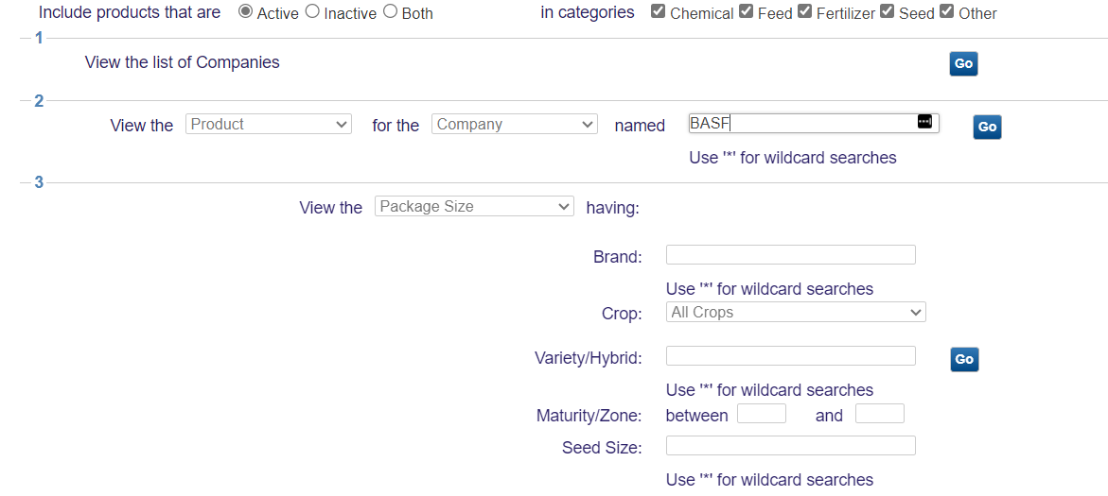
Product Search
Product Status
Product Categories
Seven Search Methods
List of Companies
Specific Search Criteria (“View the” “For the” “Named”)
Seed Specific Search
Prop Code
GTIN
Reporting Identifier – Pkg Config Level
Product Identifier – Product Level/Pkg Config
Preferred Product View (3-Level or Flat/GTIN)

Slide 14
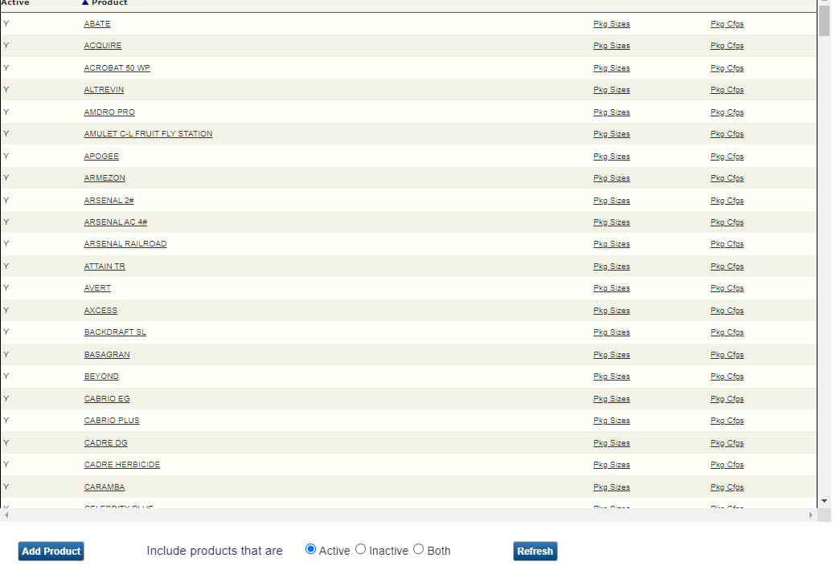

Slide 15
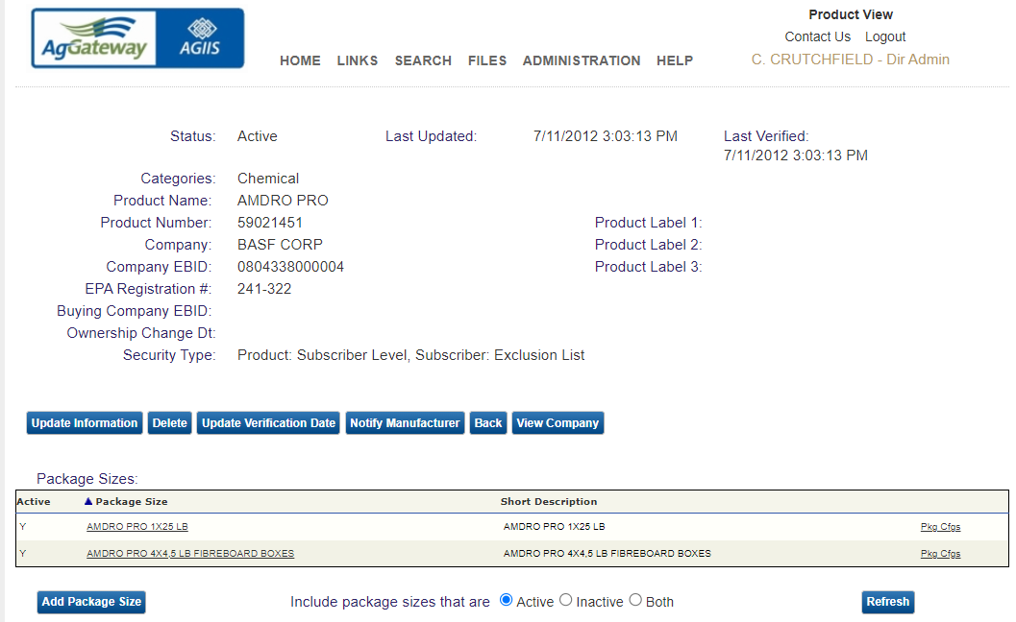

Slide 16
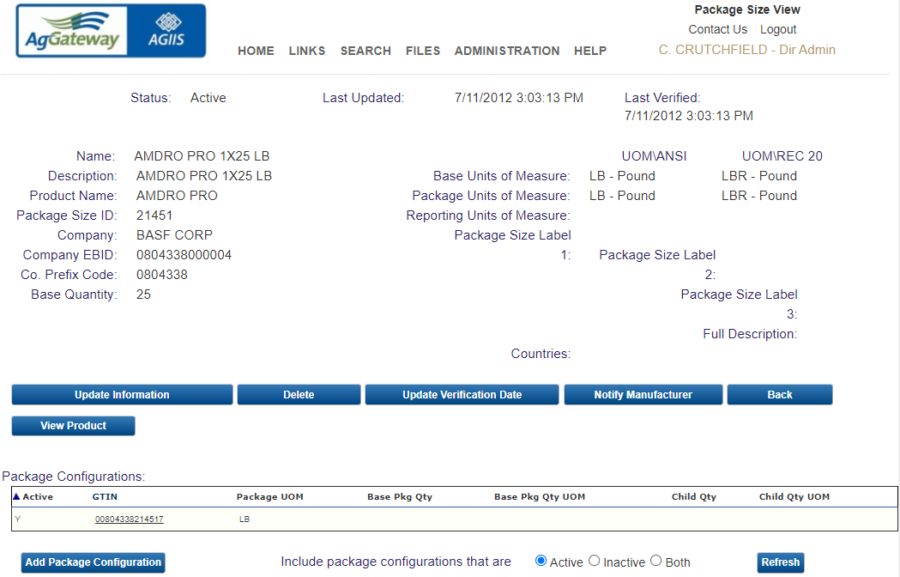

Slide 17
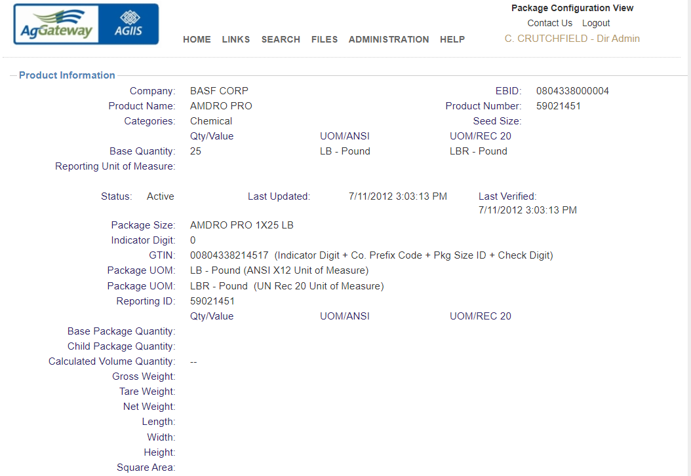

Slide 18
Product Best Practices
Understand “Key” Data Elements before loading data
Product data should be consistent
Product data should be complete
Established an automated update process
Verify Products at least once a year
When assigning GTIN’s use GLN calculator to ensure check digit is calculated correctly

Slide 19
Adding Products
Set-up/Review Subscriber Profile in AGIIS
Find out your organization's Subscriber Administrator
Add GS1 Prefixes or confirm your prefix is in AGIIS
Set-up Product Notifications
Fill-out or update Product Settings
Determine GTIN hierarchy that will be used for indicator digit that will be applied consistently across product lines. Update GTIN hierarchy on AgGateway wiki page so it can be shared with trading partners.
Create GTIN’s Using GTIN Check Digit Calculator
Add Product via AGIIS web interface
Create a Product Extract via format of choice
Use Extract as a template for creating bulk load
Submit to AGIIS FTP site to be loaded
Keep products updated and verified
Notes:
If you have questions regarding these steps call Member Services

Slide 20
Product Extracts – Files>Schedule Extracts>Add Product/License Extract

Slide 21
Extract Retrieval – Files>Download Files

Slide 22
CSV – Flat Product GTIN

Slide 23
3-Level CSV

Slide 24
3-Level Fixed Length Text

Slide 25
Product Assistance
Member Services
866-251-8618 or Member.Services@AgGateway.org
Links menu
Product 3-Level (CSV)
GTIN 1-Level (CSV)
Product Import XML
Product Extract XML
XML Schema Documentation
Web Service Schema
Product Tutorials

Slide 26
Thank you!

