Slide 1
Ag Industry Identification System
201 Education Session - Entities
Chris Crutchfield, AGIIS Product Manager

Slide 2
Purpose
To inform users of the most efficient method to manage, navigate, input and access information to and from the Ag Industry Identification System. This session will highlight best practices and provide tips for a successful user experience.

Slide 3

Overview
Profile Management
Entity Search
Adding/Updating Entities
GLN Types – AGIIS Assigned/Subscriber Owned
Extracts
Services
Resources
Questions and Answers
Notes:
not consistent

Slide 4
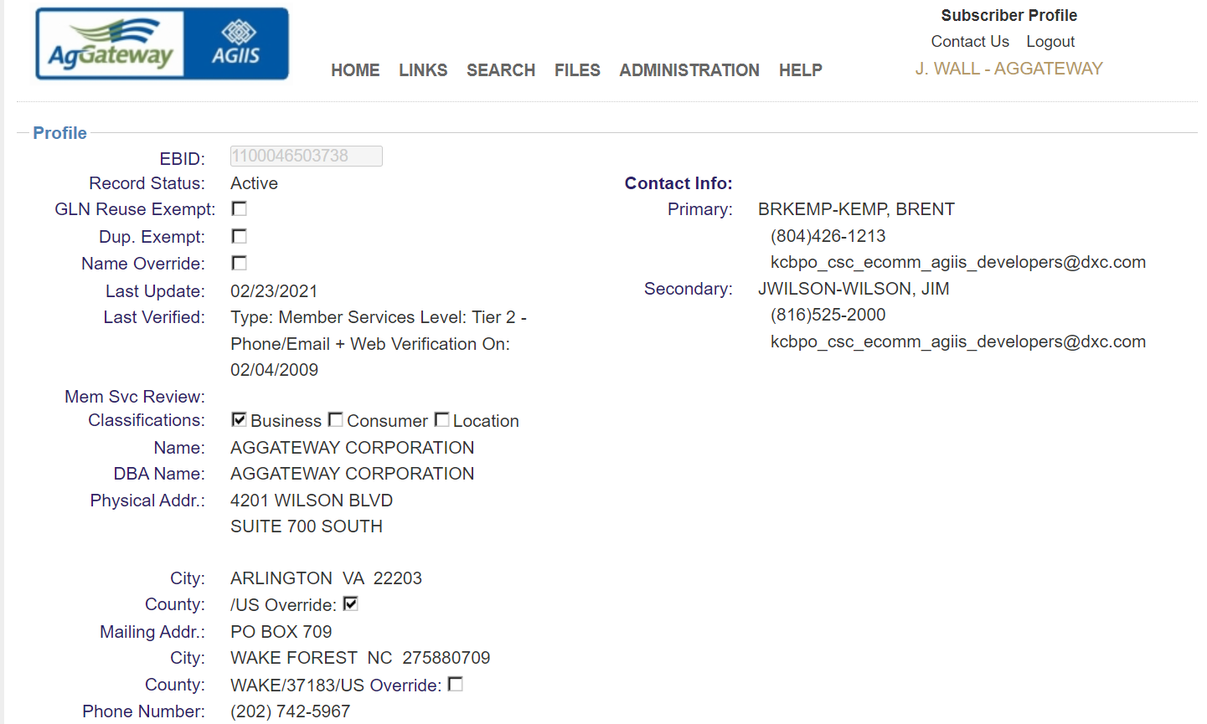
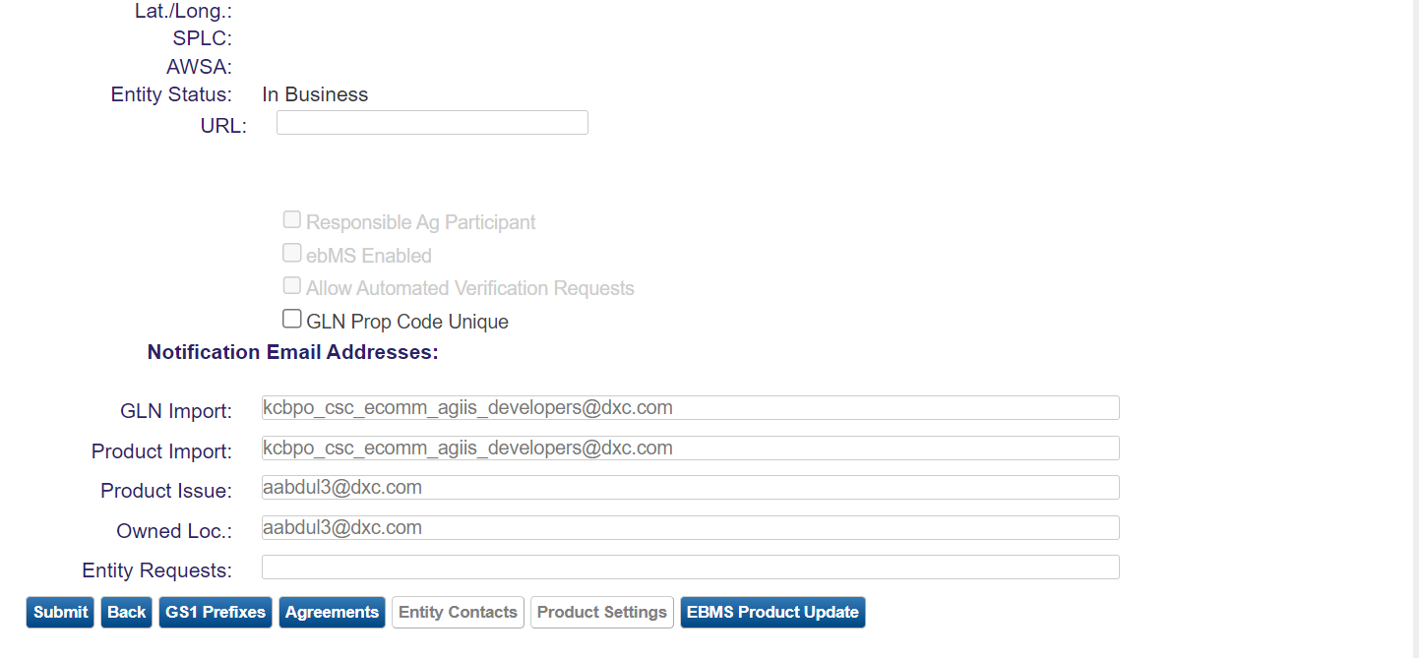
Profile Management
Subscriber Profile
  Contacts
  Email Notifications
  GS1 Prefixes
  Product Settings

Slide 5
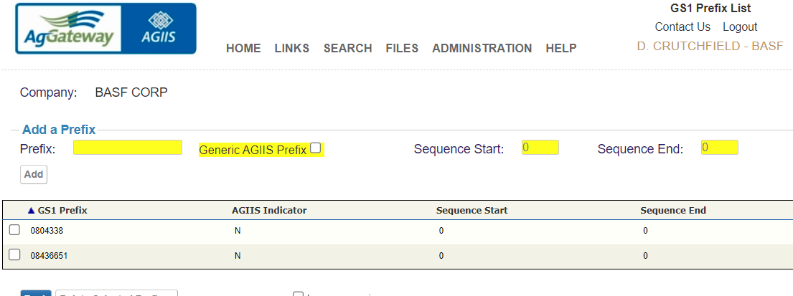
Subscriber Profile – GS1 Prefix

Slide 6
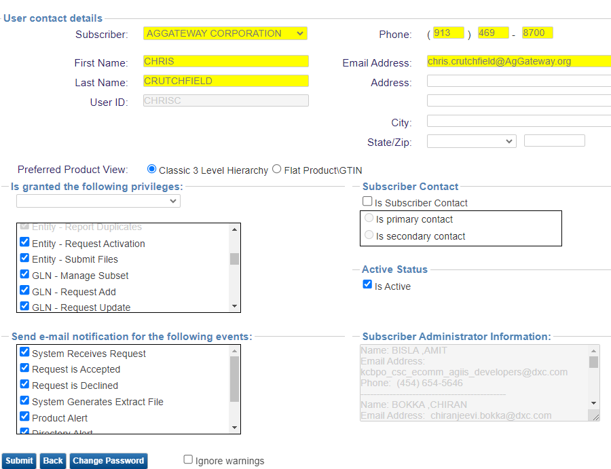
User Profile
  Email
  Password
  Product View
  Privileges
  Email Notifications
  Subscriber Administrator Information

Slide 7
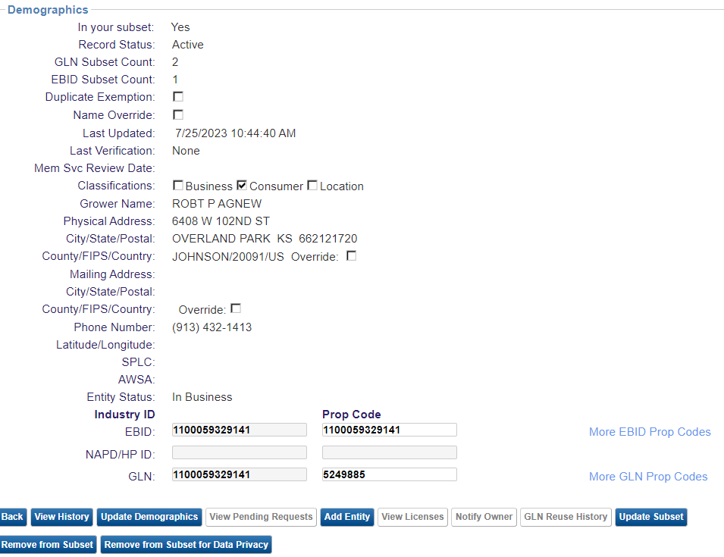
What is an Entity?
An entity is a unique combination of name and location conducting business within the agriculture industry. Each entity is identified in AGIIS with a 13-digit GLN and possibly a 13-digit EBID.

Slide 8
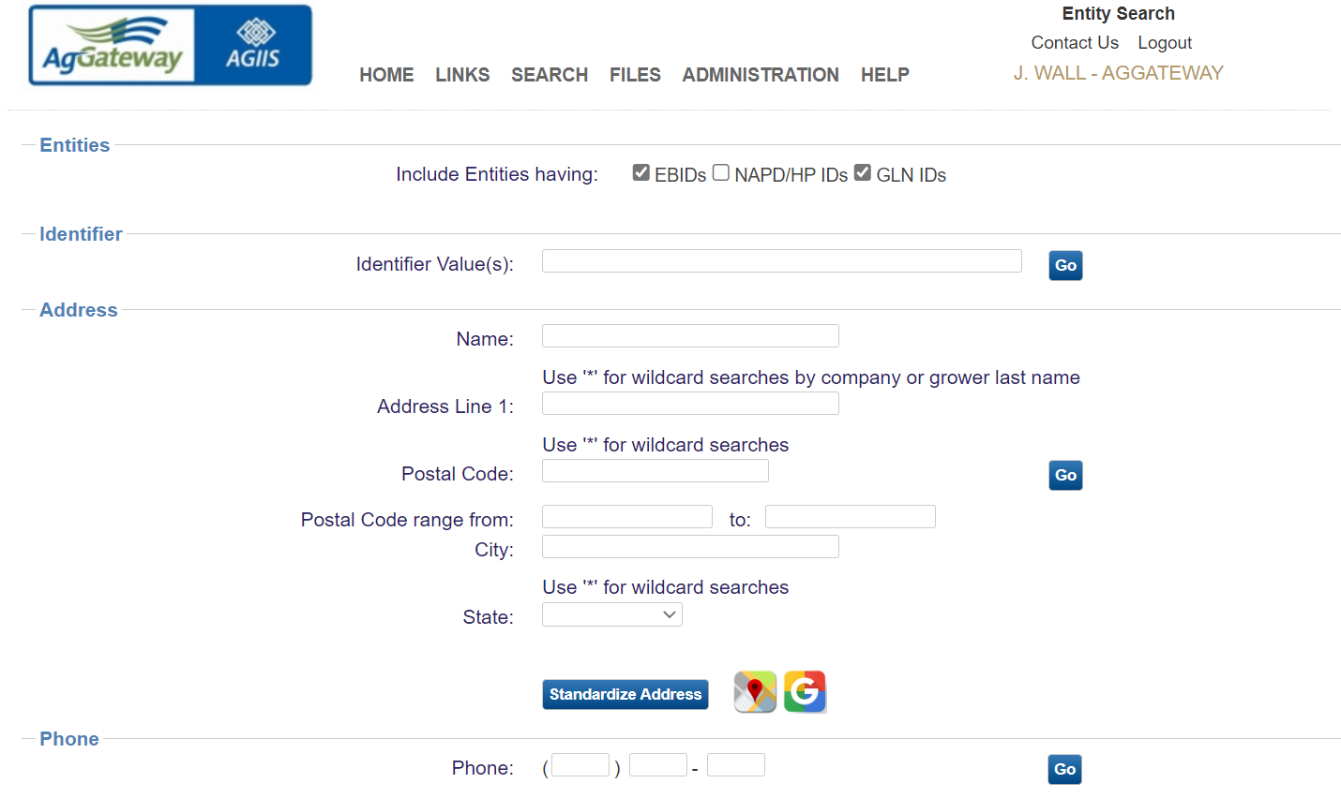
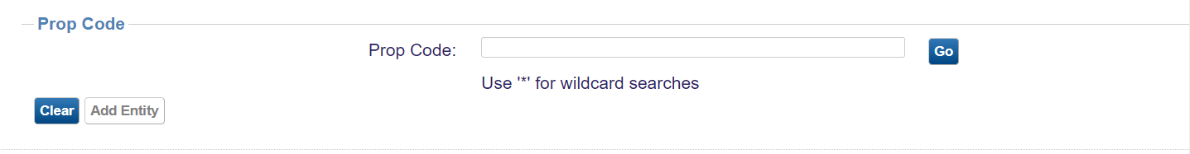
Entity Search
Identifier Type Selection
  GLN
  NAPD
  EBID
Four Search Methods
  Identifier
  Name/Address/Postal Code/City/State
  Phone
  Prop Code

Slide 9
Entity Best Practices
Establish Standards when sending data to AGIIS
  Name field – last, first, middle, (Avoid submitting substandard data such as cash sales, non-exempt, COD)
  Address Line 1 & Line 2 – Need a valid complete address
  City, State, Zip Code – Appropriate field sizes, valid
  Phone number - (913) 469-8700 (field size, what can be entered). When asking for verification please provide valid phone information
  Utilize data hygiene tools and standards within internal systems
Establish an internal identifier to industry Identifier x-ref
Only send entities to AGIIS that need a unique identifier
Share unique identifiers with new trading partners
Utilize GS1 Prefix for owned entities
Review Substandard Data
Notes:
These are a few best practices and we take a closer look at these best practices during our entity follow-up session.

Slide 10
Entity Best Practices - Continued
Establish an Entity Update Process
Update Extracts
  Provide changes to entities in your subset
  CSV or XML File Formats – Daily, Weekly, Monthly schedules available
  Determine which internal data fields should be synchronized with AGIIS
  Determine which AGIIS field can be applied automatically, and which need to be reviewed manually
Notes:
These are a few best practices and we take a closer look at these best practices during our entity follow-up session.

Slide 11
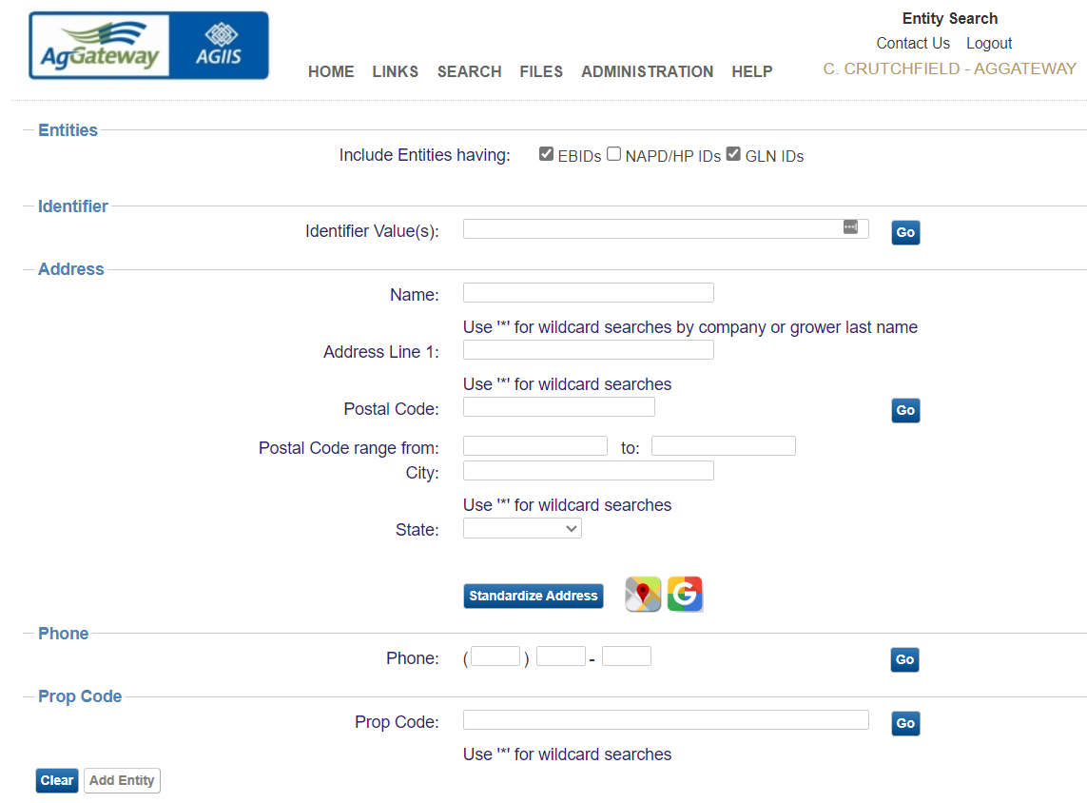
Adding Entities
Search Required First
Helps Prevent Duplicates

Slide 12
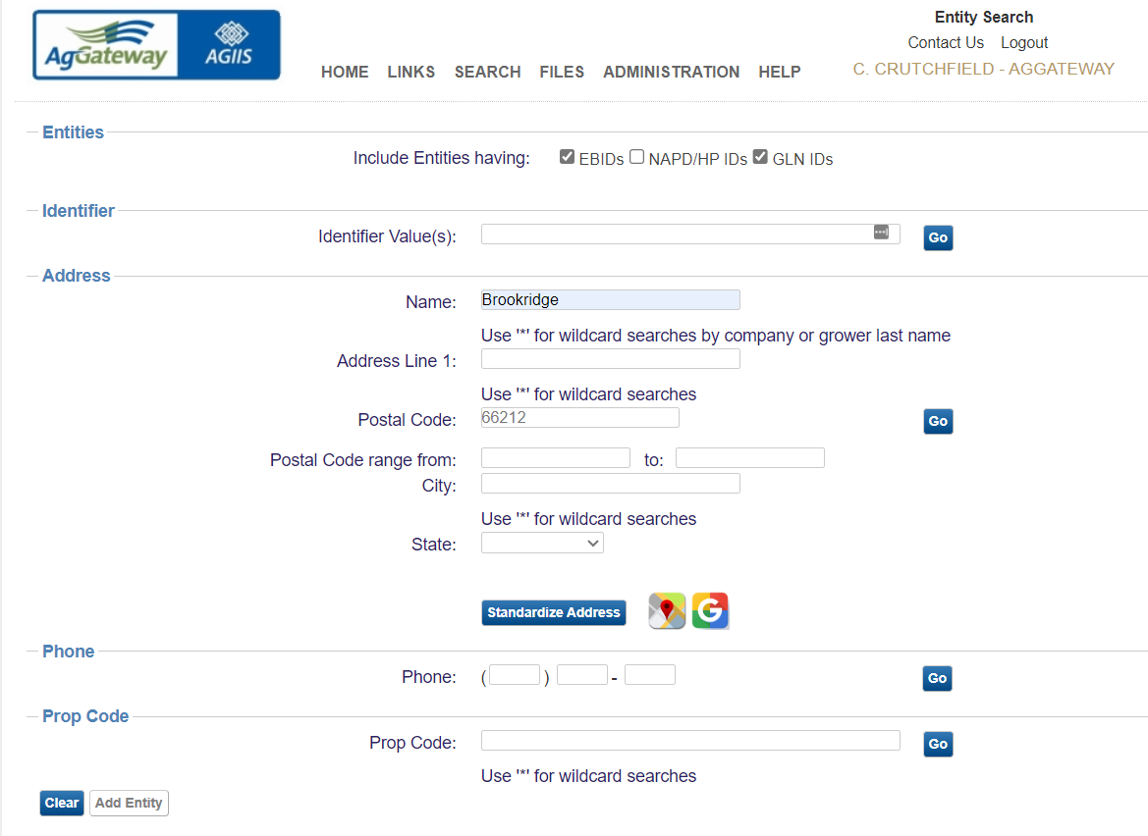

Slide 13
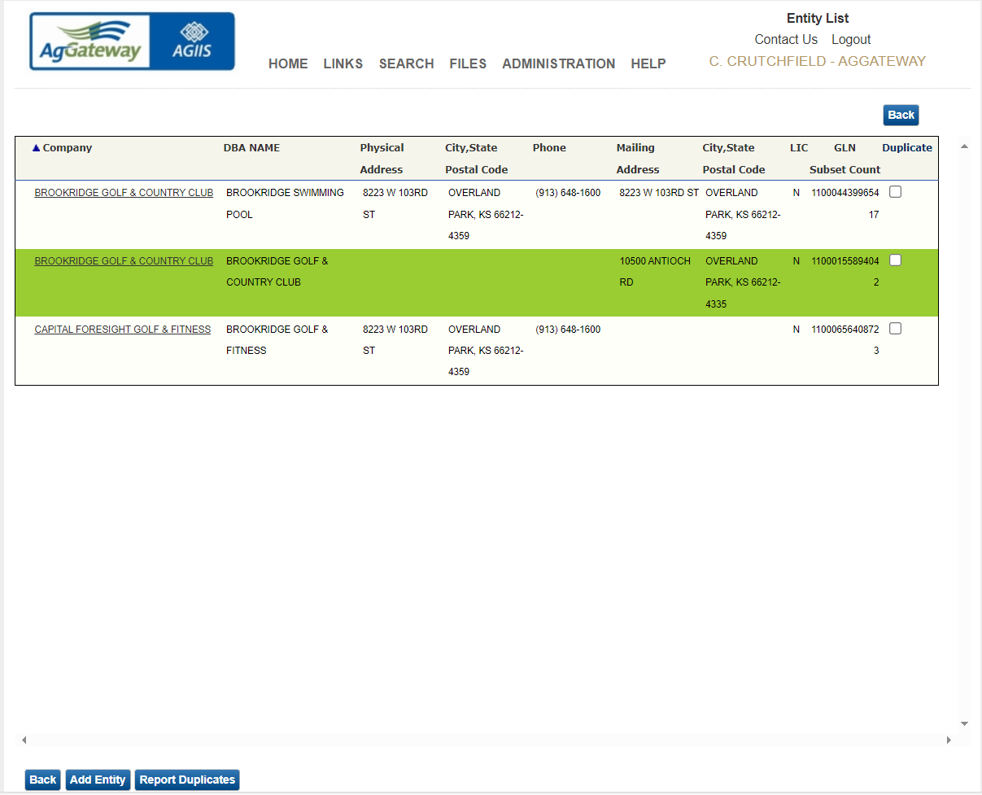

Slide 14
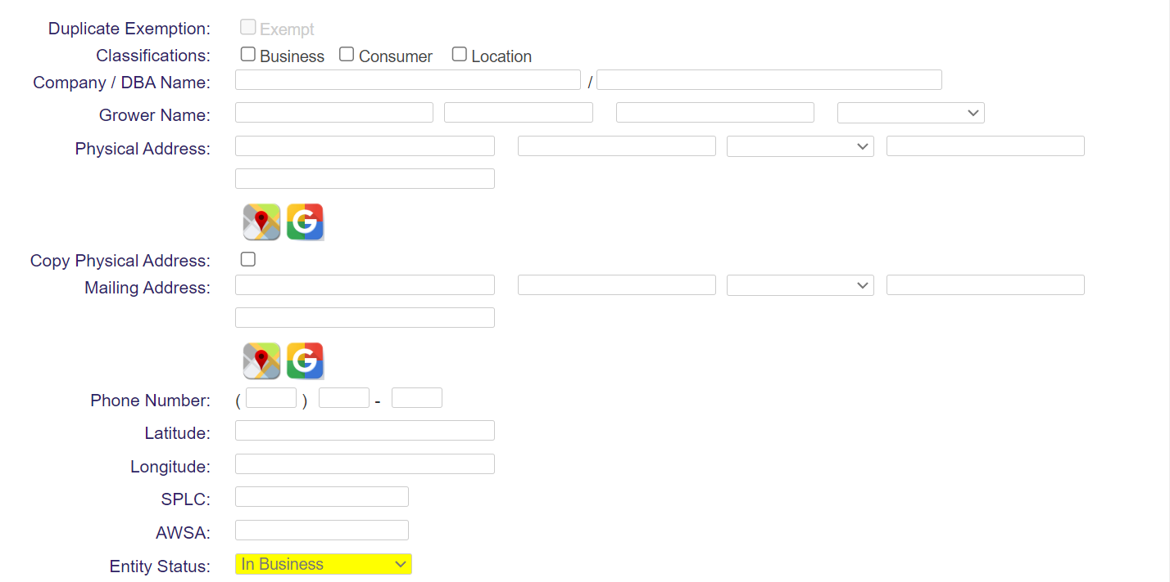
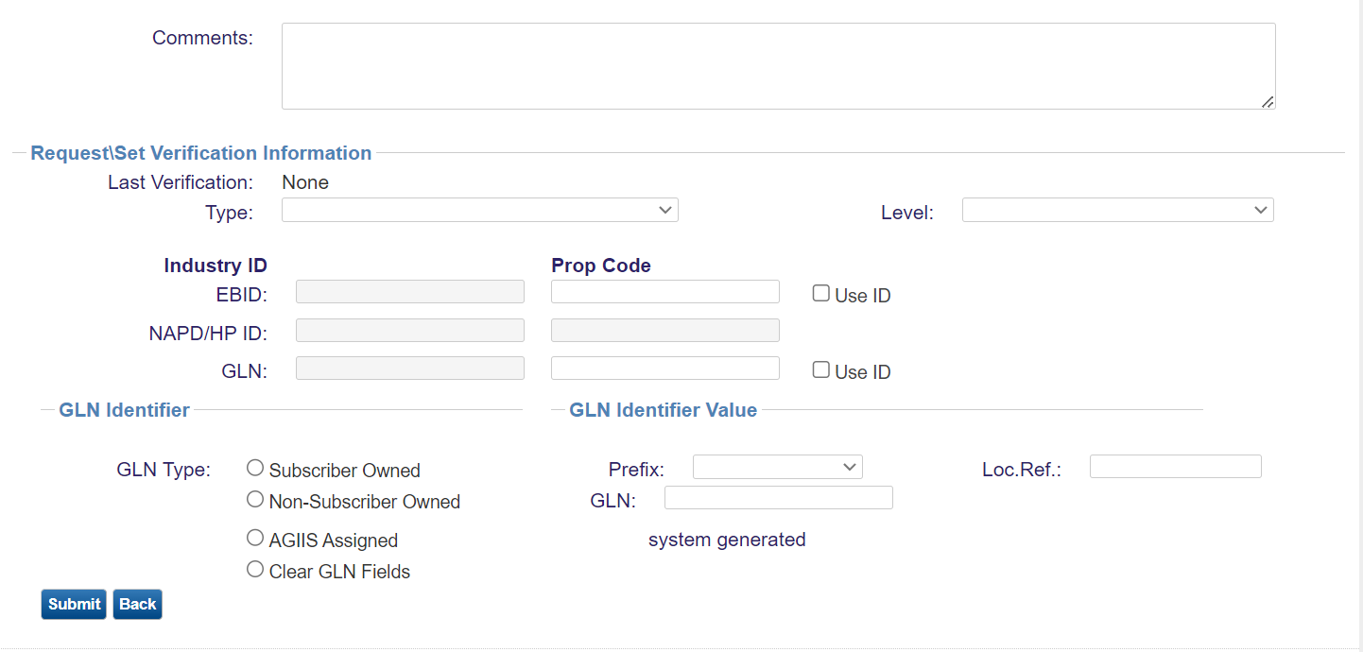
Adding Entities
Required Fields
  Classification
  Business Name/Grower Name
  Address
  GLN Type
  Prop Code
Verification
  Member Services
  Subscriber
  Self
Identifier Assignment
  Subscriber Owned
  AGIIS Assigned
  Non-Subscriber Owned

Slide 15
Subscriber Owned GLN
Company GS1 Prefix + Location Reference Number + Check Digit
Company GS1 Prefix + Location Reference Number = 12 digits
Company GS1 Prefix Assigned by GS1
Location Reference Number – Assigned by Subscriber
Check Digit – Calculated by GLN Check Digit Calculator
Prevents Updates by Another Subscriber
Address | GS1 Prefix | Location Ref # | Check Digit | GLN
123 Main Overland Park KS 66212 | 1100011 | 00001 | 9 | 1100011000019
456 Elm Lenexa KS 66215 | 1100011 | 00002 | 6 | 1100011000026
9112 Westbrooke Overland Park KS 66214 | 1100011 | 00003 | 3 | 1100011000033

Slide 16
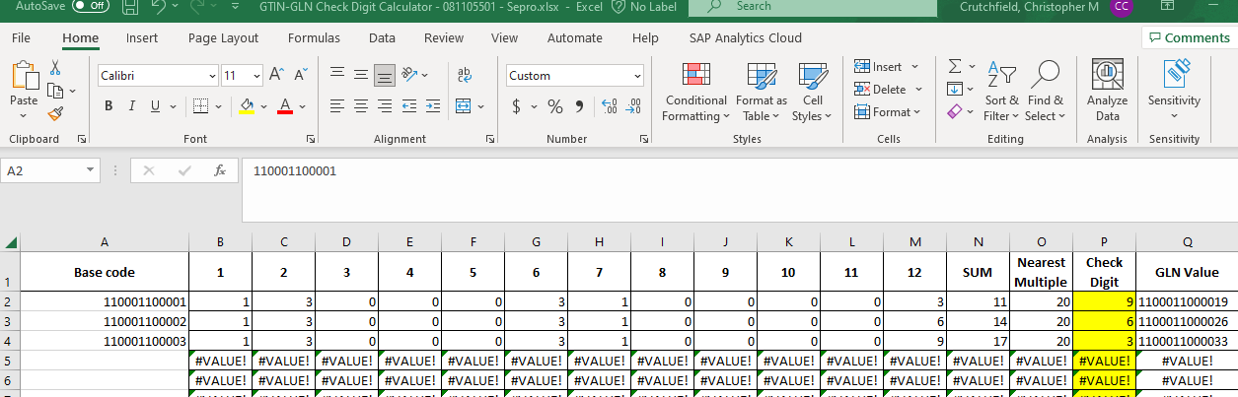
GLN Check Digit Calculator

Slide 17
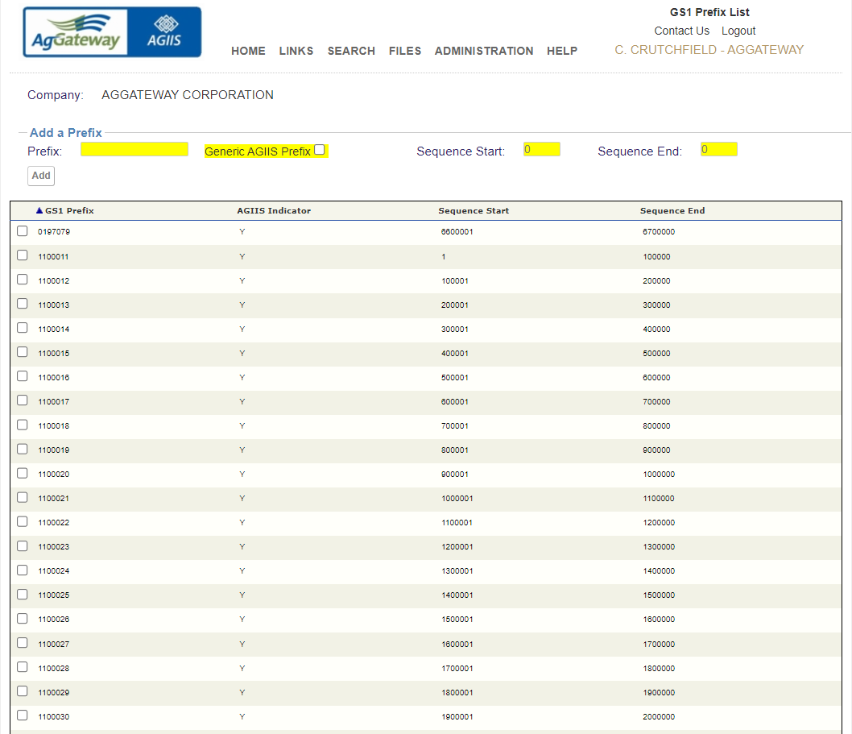
AGIIS Assigned GLN
AgGateway Purchases GS1 Prefixes As Needed

Slide 18
Directory Requests
Duplicate Detection
Name/Address Override
Entity Status Change (Reactivation, Out of Business, Replaced or Bought Out)
Existing Pending Request for the Entity
Member Services Verification Requested
Disputes
Comments

Slide 19
Bulk Add/Update/Inquiry
CSV File Format
LINKS MENU>GLN BULK>SUBMISSION TEXT>FULL FEATURED CSV TEXT SUBMISSION LAYOUT

Slide 20
Web Services
AGIIS Subscribers utilize Web Services to streamline workflow by:
  Reducing or eliminating manual interaction with applications (AGIIS System)
  Eliminating the need to “learn” another application
  Providing an automated interface with your application(s)
  Automating repetitive manual tasks
AGIIS Offers:
  REST Services
  SOAP Based Services
Notes:
AGIIS Subscribers (excluding subscribers with only search/view privileges) can include any entity record in their subset.
The SOAP approach is highly structured and uses XML data format. REST is more flexible and allows applications to exchange data in multiple formats

Slide 21
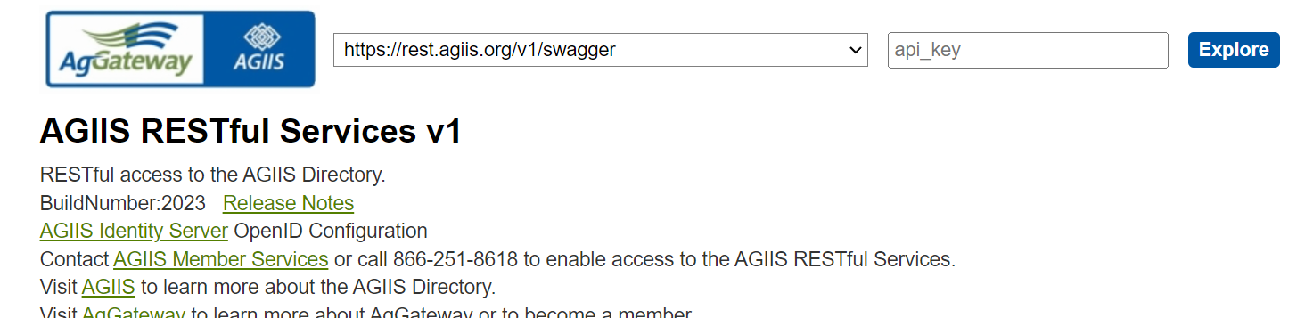
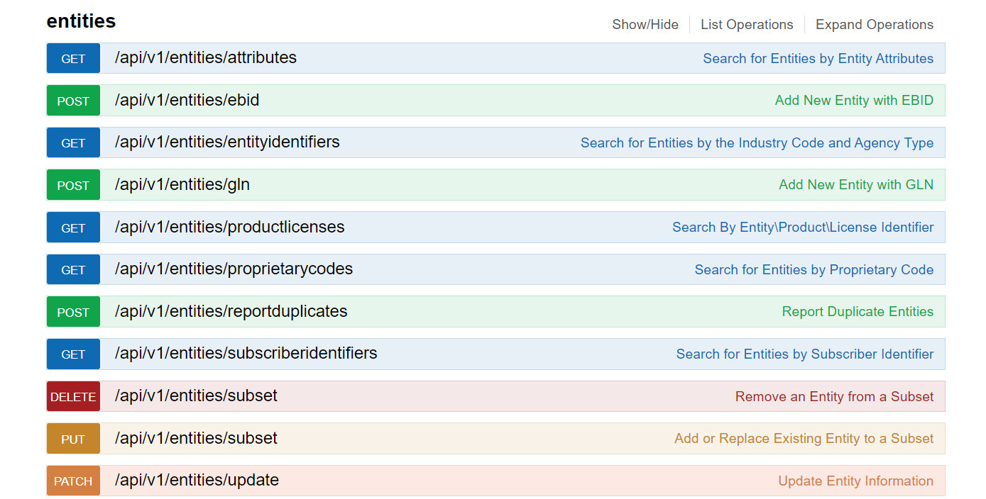
Service Recommendations
Entity Look-Up
  Demographic Look-up
  Identifier Look-up
Add Entity to Subset
Update Entity Demographics
Add Entity to AGIIS
Search for Product by Identifier
Search for Product by Attribute
For more information:
AGIIS RESTful Services
Web Services Overview (agiis.org)

Slide 22
Entity Extracts
Entity Update Extract – Ongoing Maintenance
  Provides changes to entities in your subset
  Frequency – Daily, Weekly and Monthly
  Multiple Formats available
Subset Extracts
  Report containing all entities in your subset including GLN and associated demographics
  Frequency – On Demand
  Multiple Formats available
Notes:
AGIIS Subscribers (excluding subscribers with only search/view privileges) can include any entity record in their subset.

Slide 23
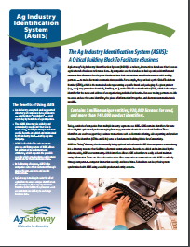
Available Resources
AgGateway Newsletter
AgGateway Website
White Papers
  AGIIS Duplicate Prevention
  AGIIS Entity Synchronization
  AGIIS Product Synchronization
  AGIIS Fact Sheet
Release Notes
  Detailed information regarding new enhancements
  Released each time an enhancement occurs
Page level help
  Provides detail of every field on the page
  Provides tips and tricks on how to navigate the page
  Provides details and examples of what needs to be populated in fields
  Hover help is used on fields to aid users
Tutorials
  Tutorials are located under “Help” on the Menu Bar
  Covers – General overview, Entities, Products, Admin

Slide 24
Resources - Continued
Subscriber Training
  Website Tour for Subscriber administrators and users
  Web Meetings
    Product loads
    Entity bulk loads
    Extracts
    Web Service implementation
    Review of existing functionality
    Maintaining Subscriber profiles and users
Conference Training
  Annual
  MYM
Member Services
  866-251-8618 or Member.Services@AgGateway.org
Notes:
Current (Dec 2021 – Feb 2022)
Dec – 5,882
Jan – 6,558
Feb – 4,983
Previous (Dec 2020 – Feb 2021)
Dec – 6,173
Jan – 5,225
Feb – 5,778

Slide 25
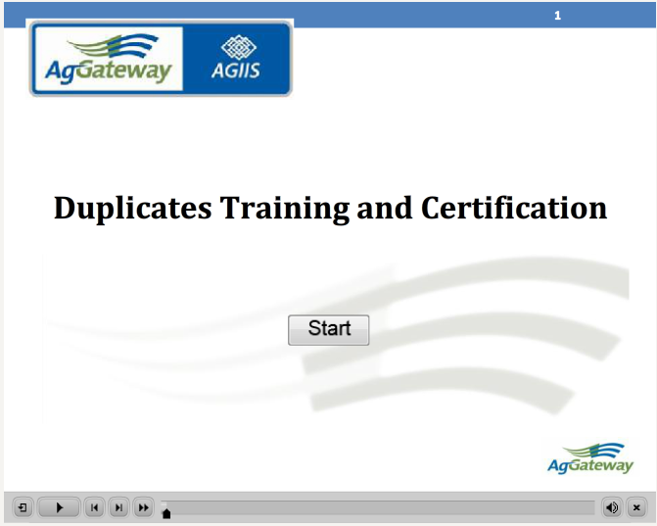
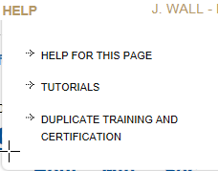
Resources - Continued
Online Duplicate Training and Certification
  Educates users on AGIIS Business rules
  Informs users on how to identify and report a duplicate
  Certify users to report duplicates

Slide 26
Questions?
What questions do you have?
  Member.Services@AgGateway.org
  +1 (866) 251-8618

Slide 27
Thank you!

