Slide 1
ADAPT
ADAPT Toolkit
ADAPT Standard
WG19 ADAPT Serialization
ADAPT Technical and Business Teams

Slide 2
Agenda
ADAPT Toolkit Status Update
ADAPT Standard
ADAPT Serialization WG Recommendation

Slide 3
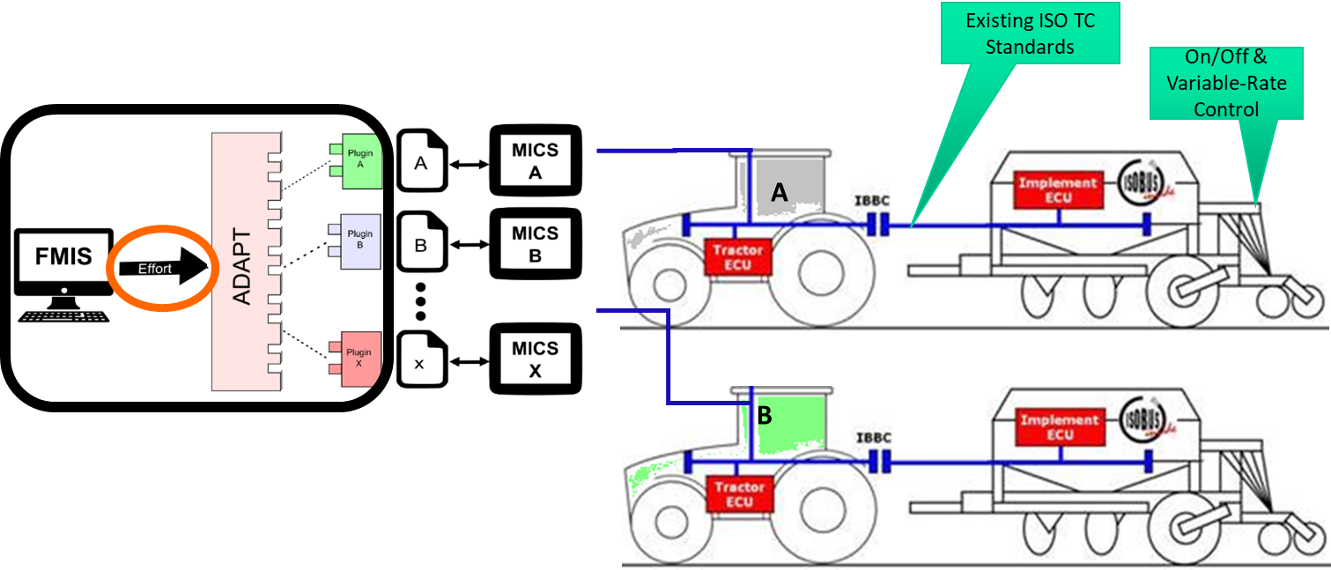
ADAPT Framework Update

Slide 4
Over 400,000 Downloads
9 Nov 2023

Slide 5
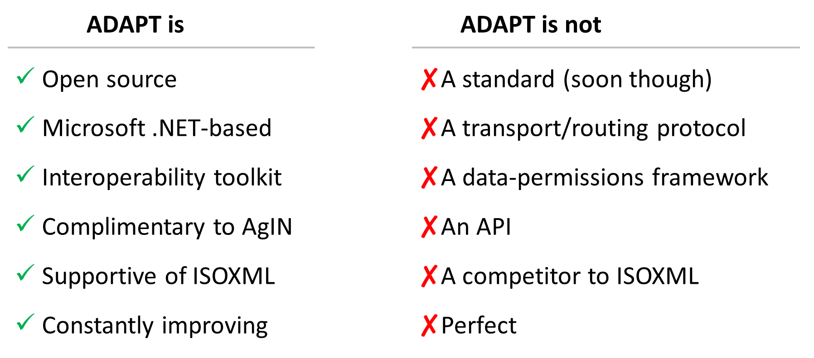
What the ADAPT Framework is and is not today

Slide 6
ADAPT Standard

Slide 7
ADAPT past, present, and future
2014
2022-05
2022-11
2023+
//
//
Begin ADAPT framework and plugin development
Begin ADAPT Standard development
Kick off ADAPT Serialization WG
Release ADAPT Standard v1
Publish ADAPT Serialization specification
Other*
*Other
ADAPT Standard development and maintenance
ADAPT Framework and plugin development and maintenance
Explore seamless interoperability among ADAPT Data Model, ADAPT Plugins, and ADAPT Standard
Consider process for ADAPT Standard → ISO Standard

Slide 8
AgGateway’s approach to developing the ADAPT Standard
Completely open activity. AgGateway membership is not required.
Using a GitHub project for issue management.
Using Score model development tool developed by AgGateway member NIST and AgGateway partner OAGi
Wednesday 10AM central meetings to discuss/resolve open questions and direct the model.
Significant participation from 12+ AgGateway member companies

Slide 9
ADAPT Standard Principles
Data Transfer: The purpose of the ADAPT Standard is to facilitate data transfer between systems.
Field-Centric: The ADAPT Standard is a data representation for agricultural information centered on the field/production space.
No Flexibility in How to Model. The ADAPT Standard seeks to avoid the data consumer needing to handle conditionality for multiple data producers.
Flexibility in What is Modeled. The ADAPT Standard will allow serialization of subsets of the data model.
No Software Dependencies. The ADAPT Standard is an open format and not platform dependent. All data authorization, encryption, etc. is external to the standard itself.
Burden on Data Producer: It presumes that the data producer has sufficient interest in the consumer being able to correctly interpret the data to put forward the effort to accurately transform data into the model.

Slide 10
V1.0: Field Operation/Machinery Data
Logic to be handled by the data producer
GNSS receiver, vehicle and implement offsets
Working widths
Flow delays
Available (post-)/calibration
Data from farm implements with a boom traveling over a field must be rendered as polygons

Slide 12
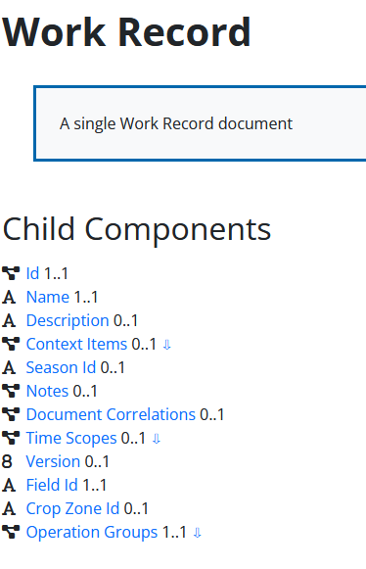
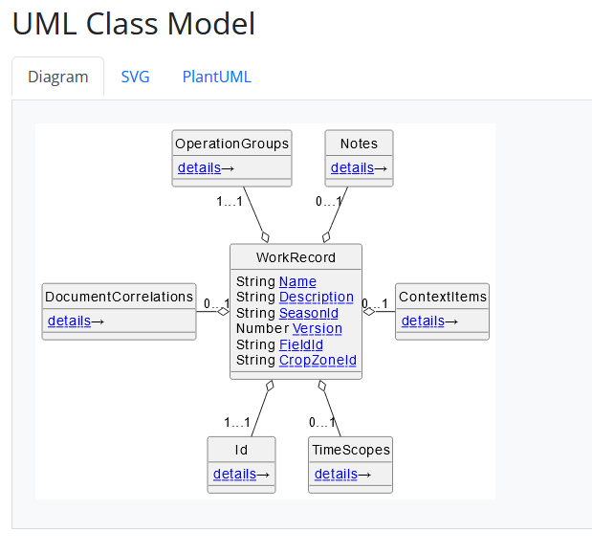
ADAPT Standard Documentation
https://ADAPTStandard.org

Slide 13
Up Next
Formal Standards body submission?
Irrigation Operations
Field Observations and Measurements
Regulatory compliance use cases
Sustainability reporting use cases
Livestock?
Specialty Crops?
{ Ideas welcome }

Slide 14
WG19 ADAPT Serialization

Slide 15
WG19 ADAPT Serialization Recommendations
WKT for simple geometries within ADAPT objects
GeoParquet for high density vector data
Instead of expecting consumers to implement complex or OEM specific calculations, coverage polygons are calculated and included in the data model.
GeoTiff for high density raster data
Raster data should be explicit; unknown values should be represented as NaN, while only known values should be represented as a value (0, 1, 2, etc.)

Slide 16
Other Serialization Tools Considered
Github Issue Discussions:
Replacing the ADAPT Raster geodata Model with GeoTiff #109
Replacing the ADAPT Vector geodata Model with WKT #110

Slide 17
Other Serialization Tools Considered
GeoJSON
Larger file sizes
Cannot be streamed
Protobuf
No native QGIS support
GeoPackage
Required full package download to read any data
FlatGeoBuf
No advantage found over GeoParquet
Attributes assigned in JSON, GeoTiff/GeoParquet columns map back to JSON (not supported in other tools?)
One attribute will be band index (GeoTiff), column index (GeoParquet)
Column index is the key between variable ID and data in the file

