Slide 1
WELCOME
Day 2 General Session

Slide 2
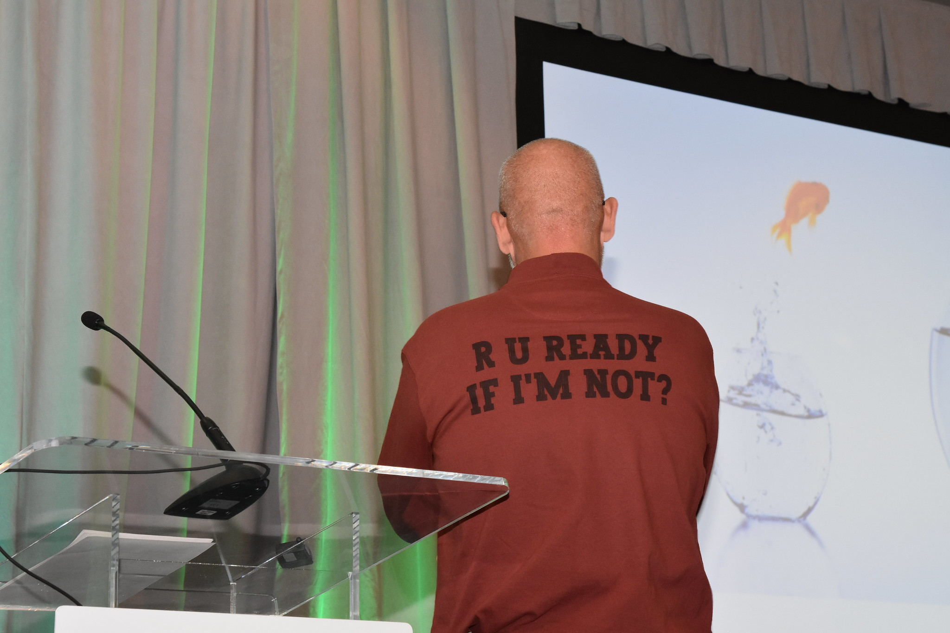
R U Ready … to Bid on Jeremy’s Shirt??

Slide 3
Submit your most generous bid to Member Services at
member.services@aggateway.org
Proceeds Benefit the Lymphoma and Leukemia Society

Slide 4
2023 Financial Report

Slide 5
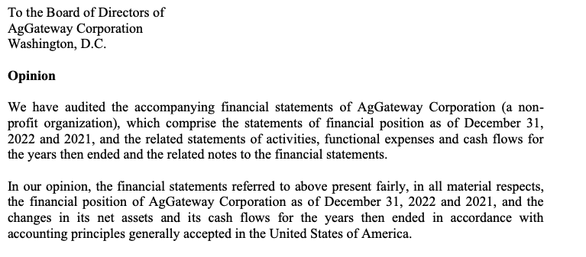
2022 Audit
Notes:
The annual audit was completed as of 31 March 2023. JM&M, Certified Public Accountants, reports that AgGateway’s books are fairly represented and did not identify any deficiencies or material weaknesses in our internal controls within the scope of their work for us.
Final reports will be distributed to board members for review upon filing of AgGateway’s 990, anticipated this month.

Slide 6
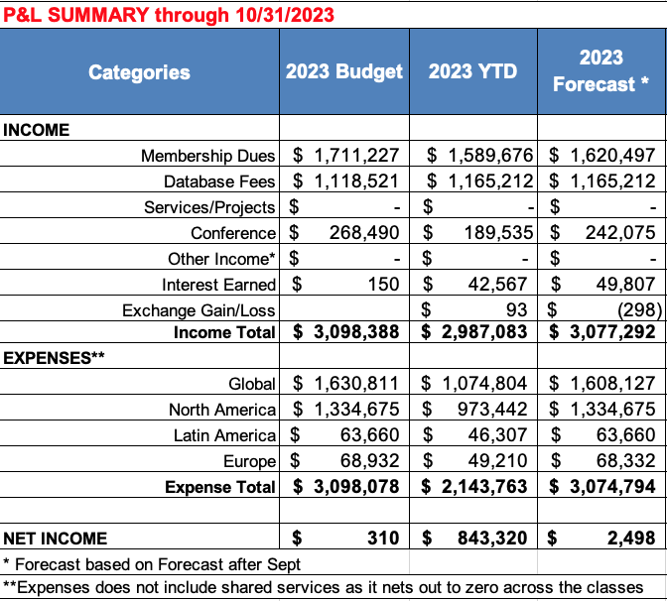
2023 Year to Date Financial Summary
Key Points:
  Membership dues loss compensated for by increased AGIIS subscriptions and favorable interest on retained earnings
  Expenses tracking largely to expectation
  Careful expense management may see a slightly higher net savings than forecast

Slide 7
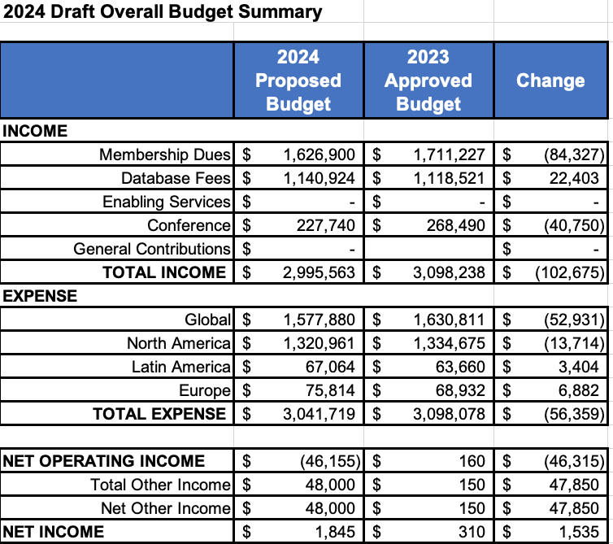
2024 Final Budget Summary
Notes:
All numbers finalized as of 20 October 2023

Slide 8
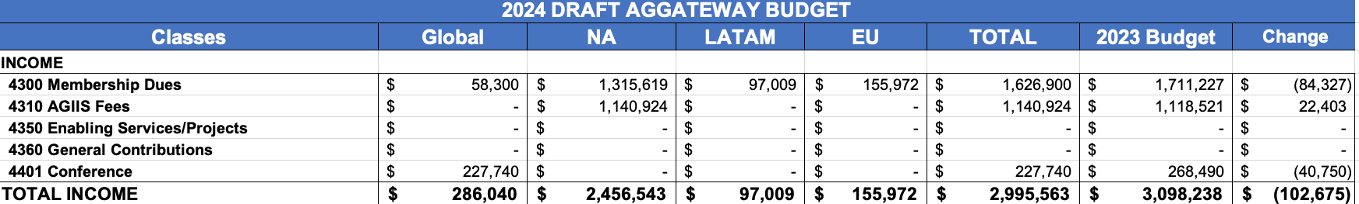
2024 Final Budget Detail - Income

Slide 9
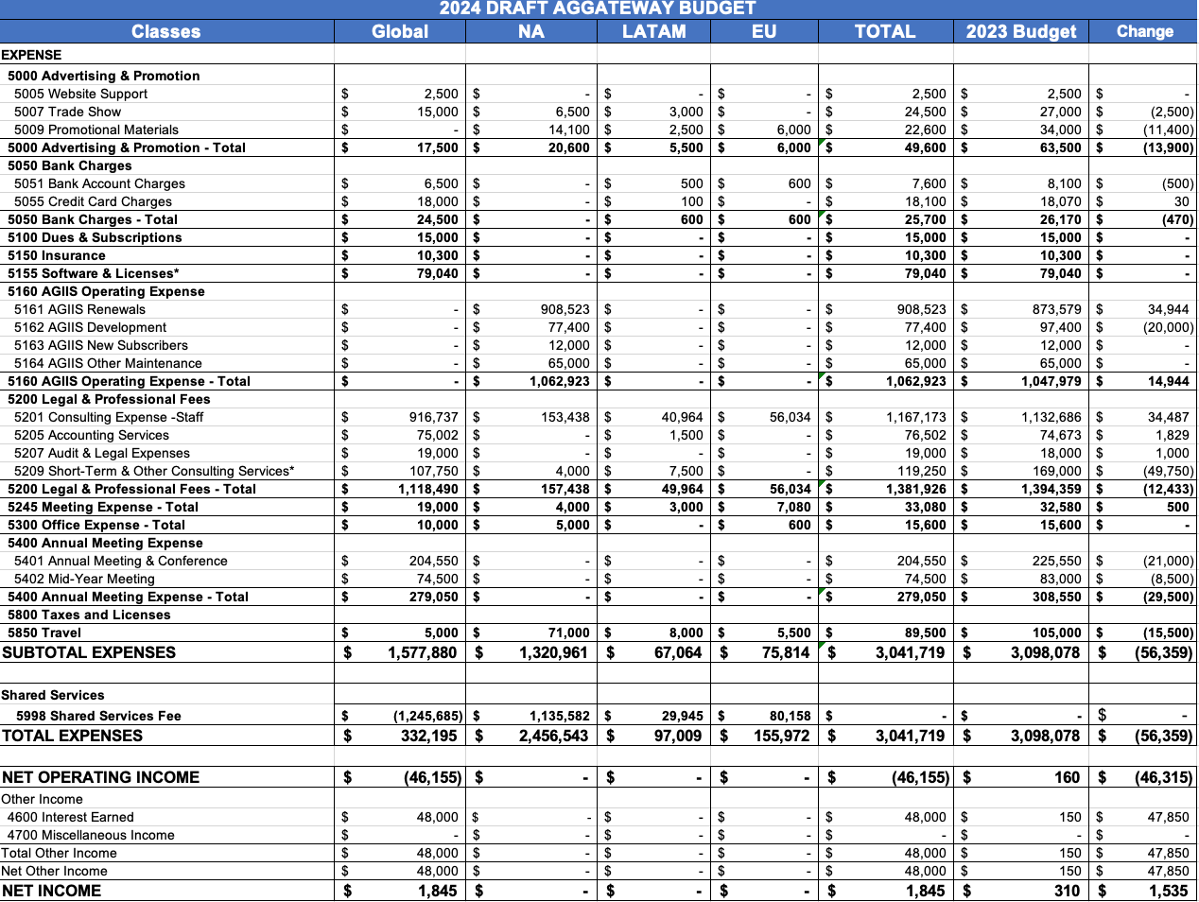
2024 Final Budget Detail - Expense

Slide 10
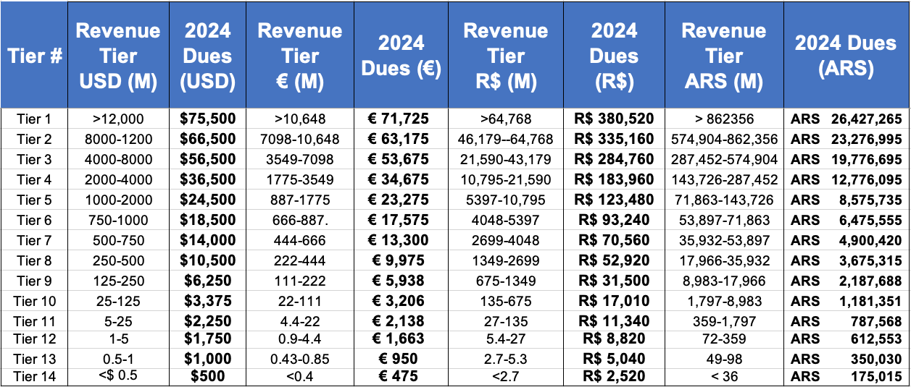
Approved 2024 Membership Dues
Notes:
Currency conversion as of 19 October:
$1 USD =
€ 0.95
R$ 5.0
ARS 350.03

Slide 11
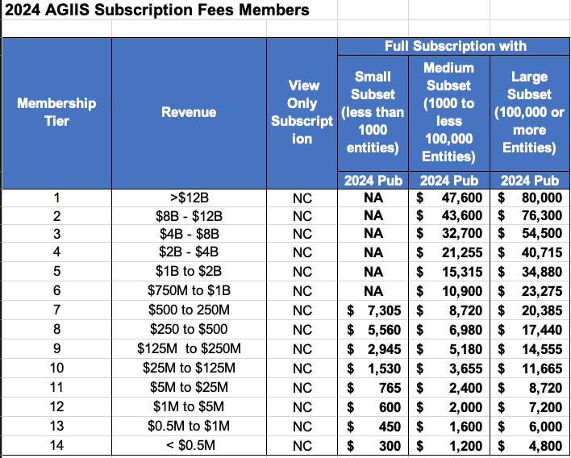
Approved 2024 Members’ AGIIS Fees

Slide 12
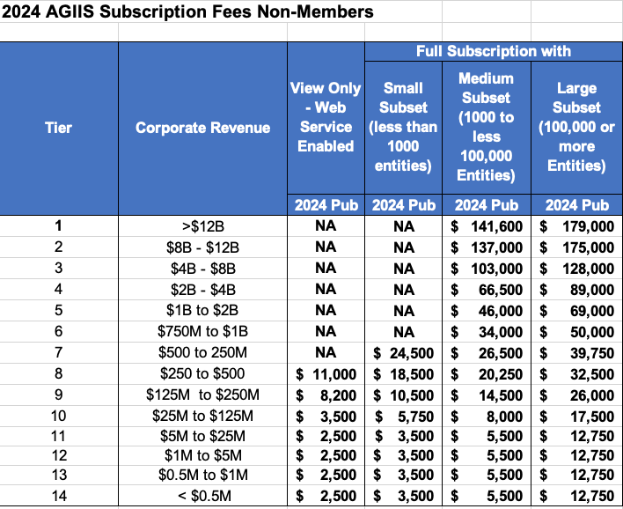
2024 Approved Non-Member AGIIS Fees

Slide 13


2023 Awards Presentation

Slide 14
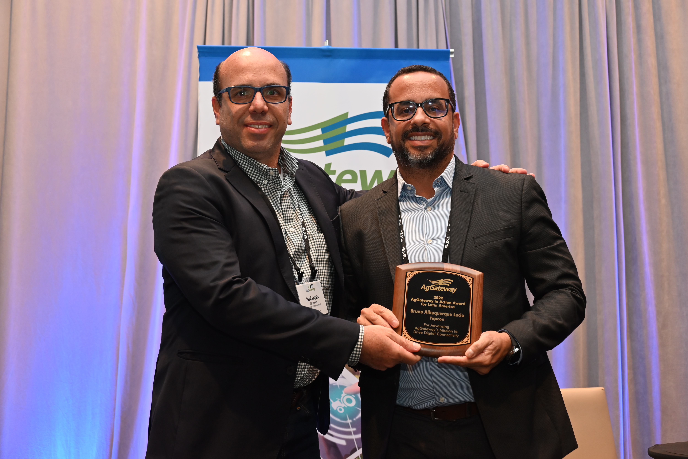
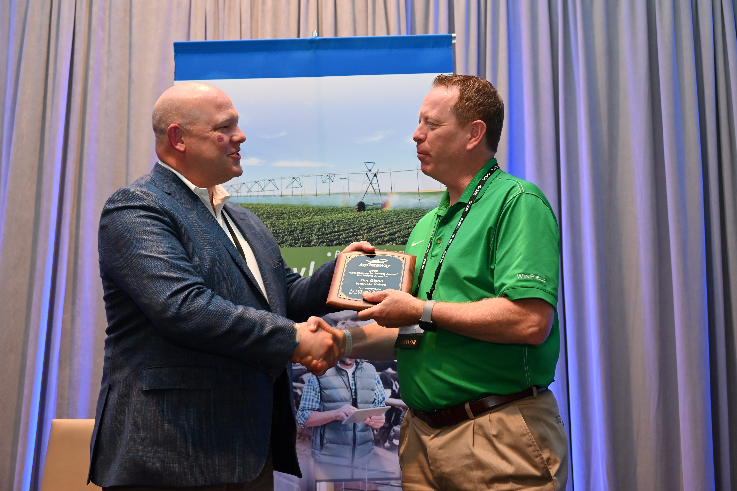
AgGateway In Action Awards

Slide 15
AgGateway in Action Awards
Chosen from nominations by regional boards
Must Demonstrate:
Dedication to the mission to promote and enable the transition to digital agriculture.
Leadership in moving eConnectivity goals and activities forward
Ability to promote collaboration among AgGateway teams.
Participation in AgGateway projects for at least 2 years, and active participation and leadership in at least two activities

Slide 16
2023
Europe &
Latin America
Recipients

Slide 17
AgGateway In Action Awards
Udo Kaempf, BASF
Guilherme Panas, Jacto

Slide 18
2023
North America
Recipient

Slide 19
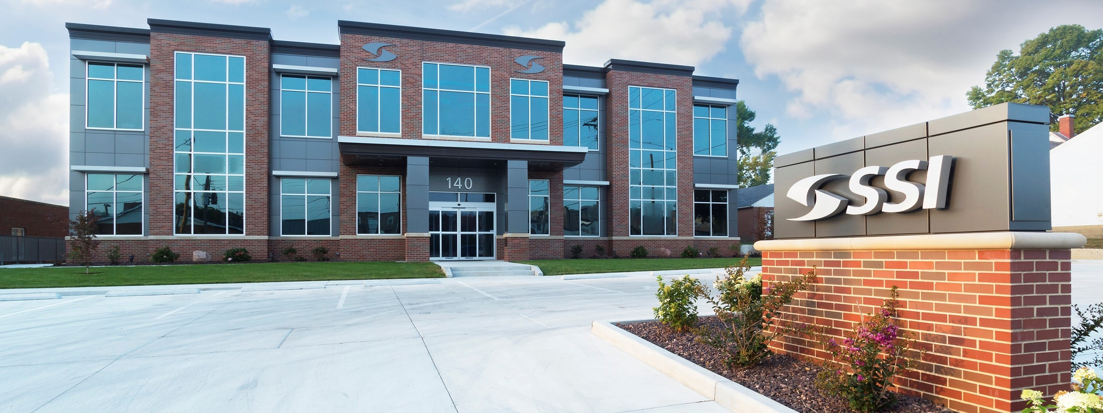
AgGateway In Action | North America
Software Solutions Integrated

Slide 20

Ron Storms Leadership Award

Slide 21
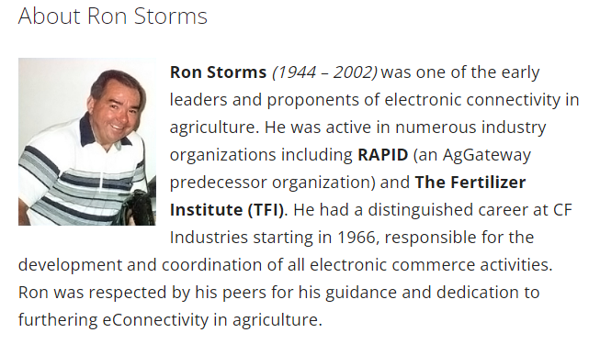

Slide 22
Ron Storms Leadership Award
Dedication to the mission to promote and enable the transition to digital agriculture.
Leadership in moving eConnectivity goals and activities forward
Ability to promote collaboration among AgGateway teams.
Participation in AgGateway councils, committees, projects, task forces and/or working groups for at least 2 years, and active participation and leadership in at least 2 different activities

Slide 23
2023
Ron Storms Leadership Award
Recipient

Slide 24
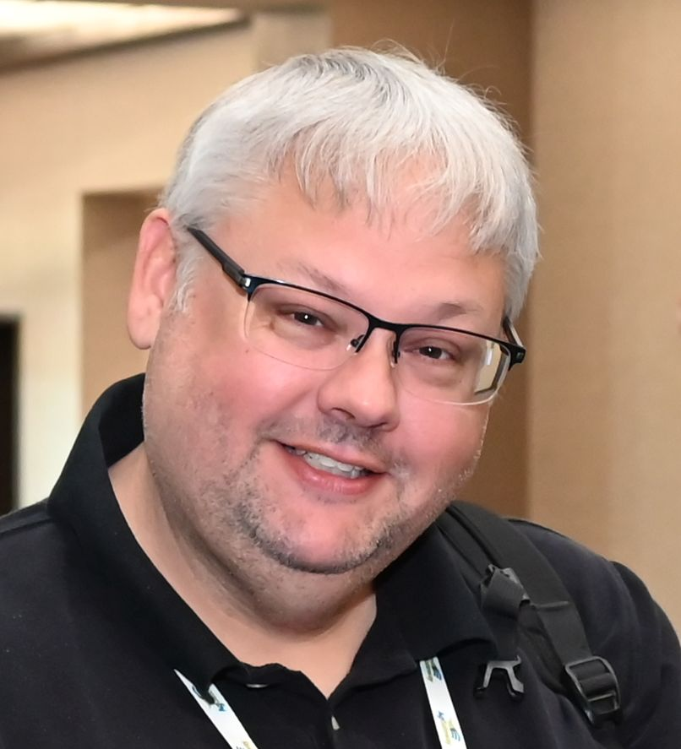
Ron Storms Leadership Award
Stuart Rhea
Syngenta

Slide 25
2023
Ron Farrell
Attitude Award

Slide 26
Video to play on cue
https://vimeo.com/883913514/2f85e5c6b2

Slide 27
Thank You!

Slide 28
Presentation and
Keynote Introduction
Scott Cogdill, Proagrica

Slide 29
Insights on Cybersecurity: Threats, Prevention, and Recovery

Slide 30
Introduction to Cybersecurity Infrastructure Security Agency (CISA)
& The need for Cyber Security
November 2, 2023
Giovanni Williams| Cybersecurity Advisor
Cybersecurity Infrastructure Security Agency Region 4
Alabama | Florida | Georgia | Kentucky | Mississippi | North Carolina | South Carolina | Tennessee
Notes:
Change Presenter’s Name and Date in Slide Master view.

Slide 31
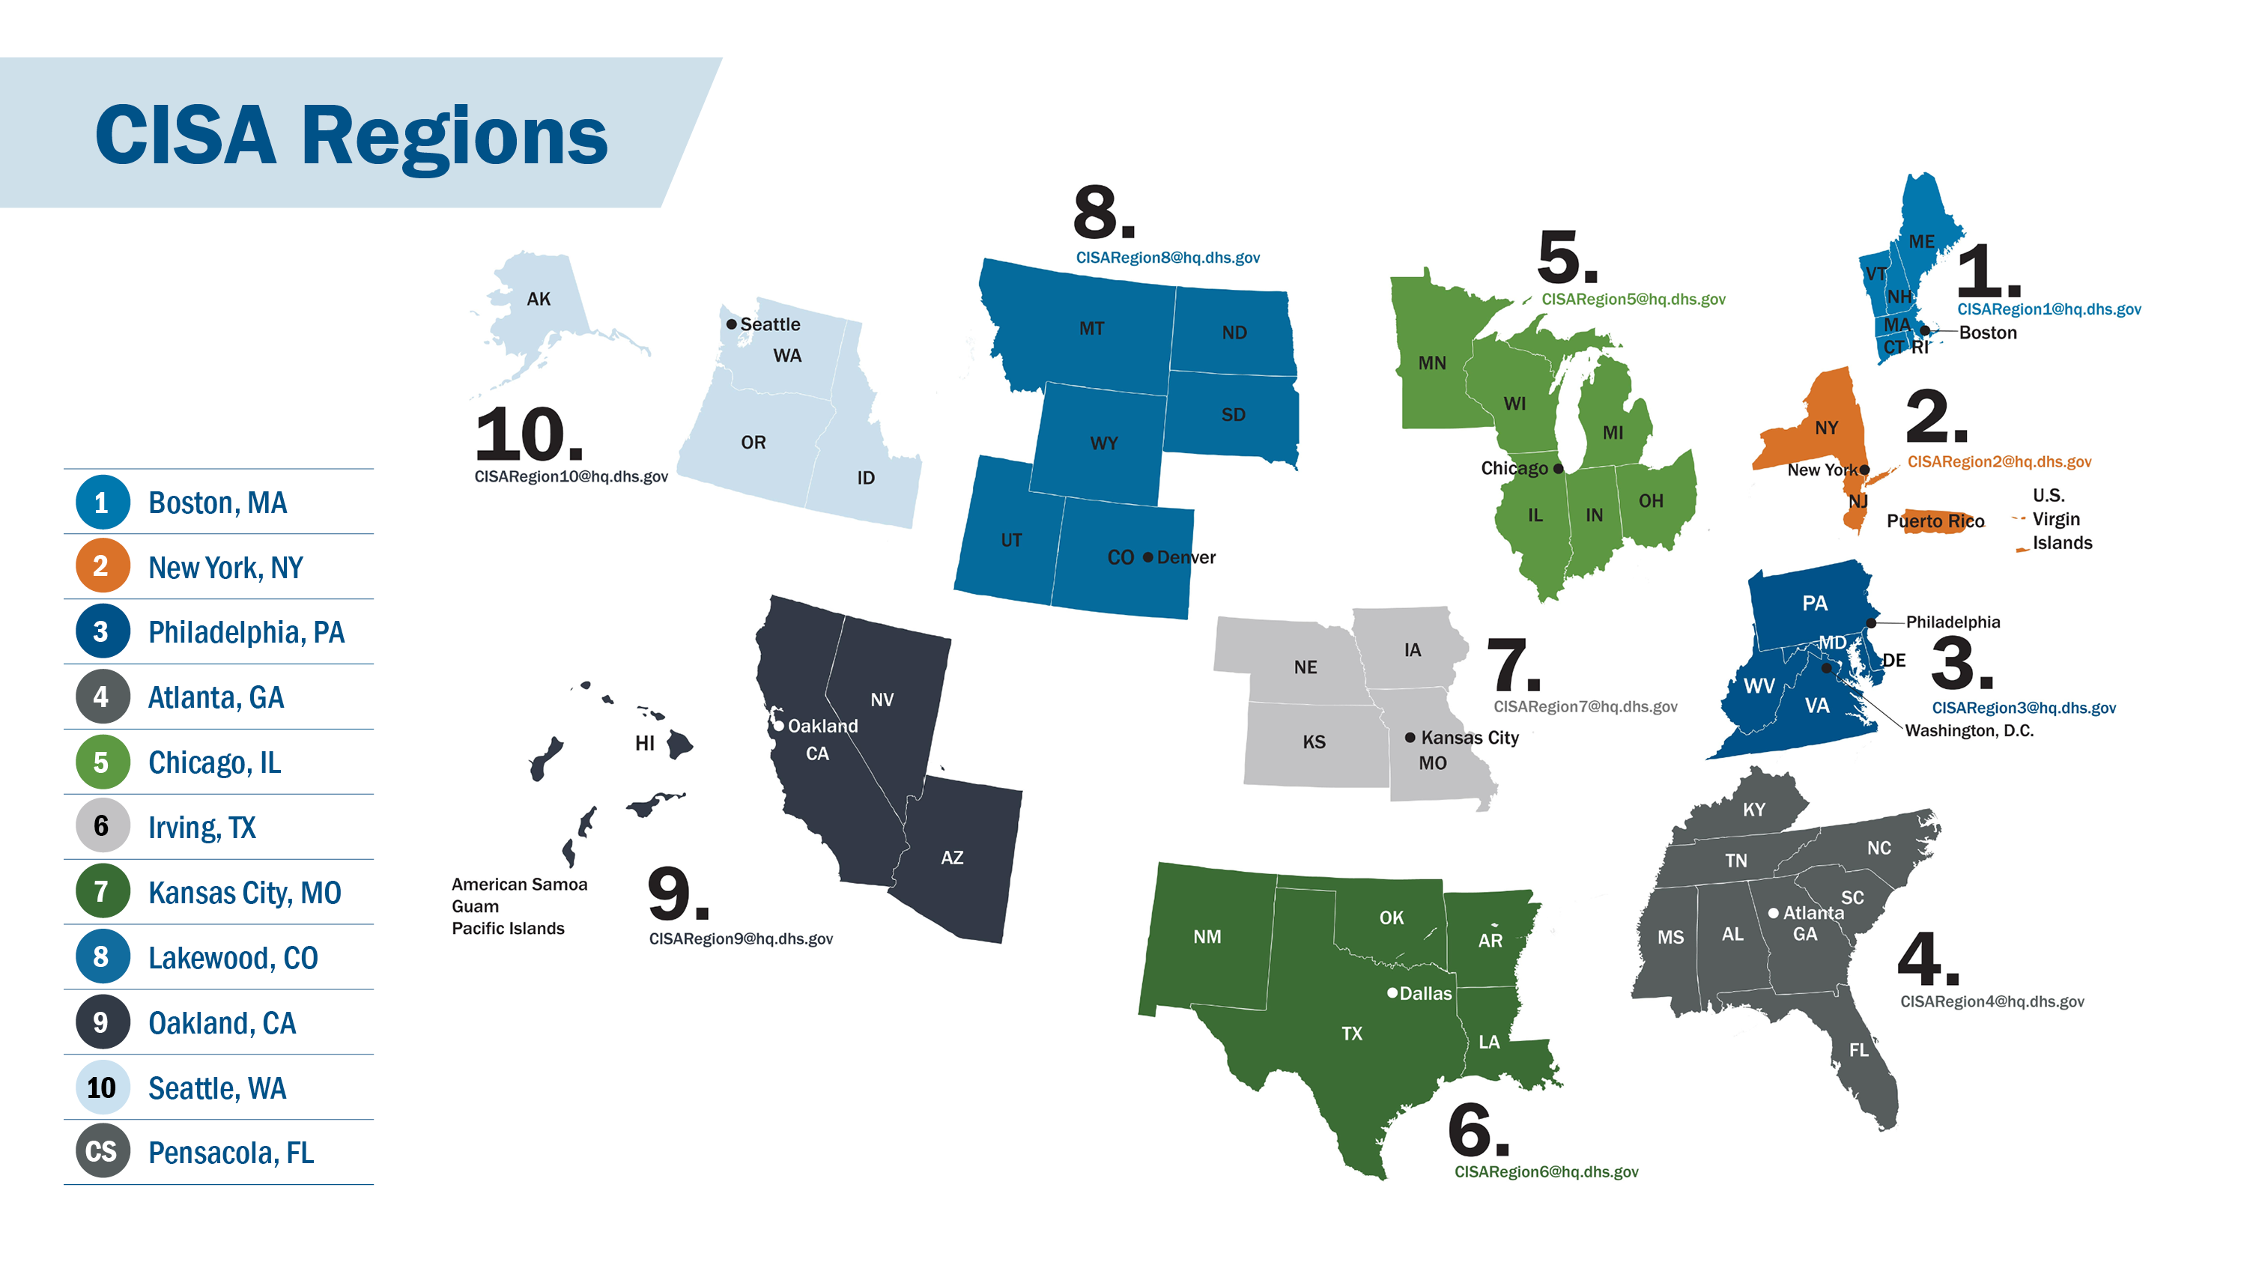

Slide 32
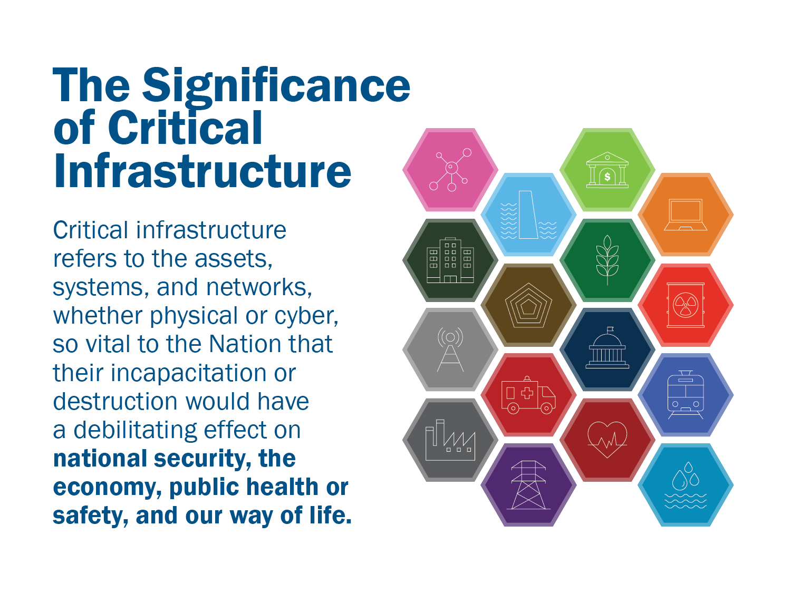

Slide 33
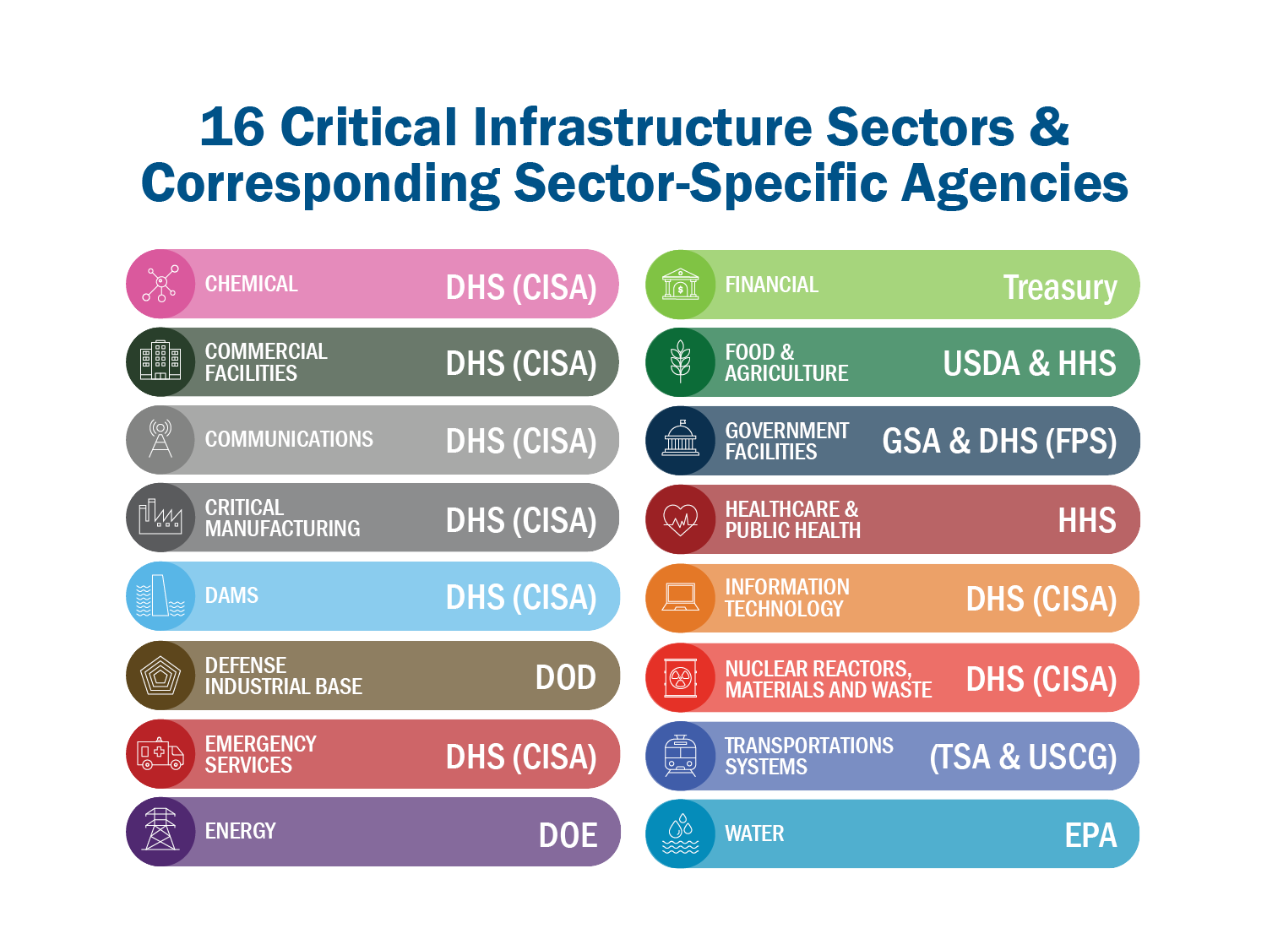

Slide 34
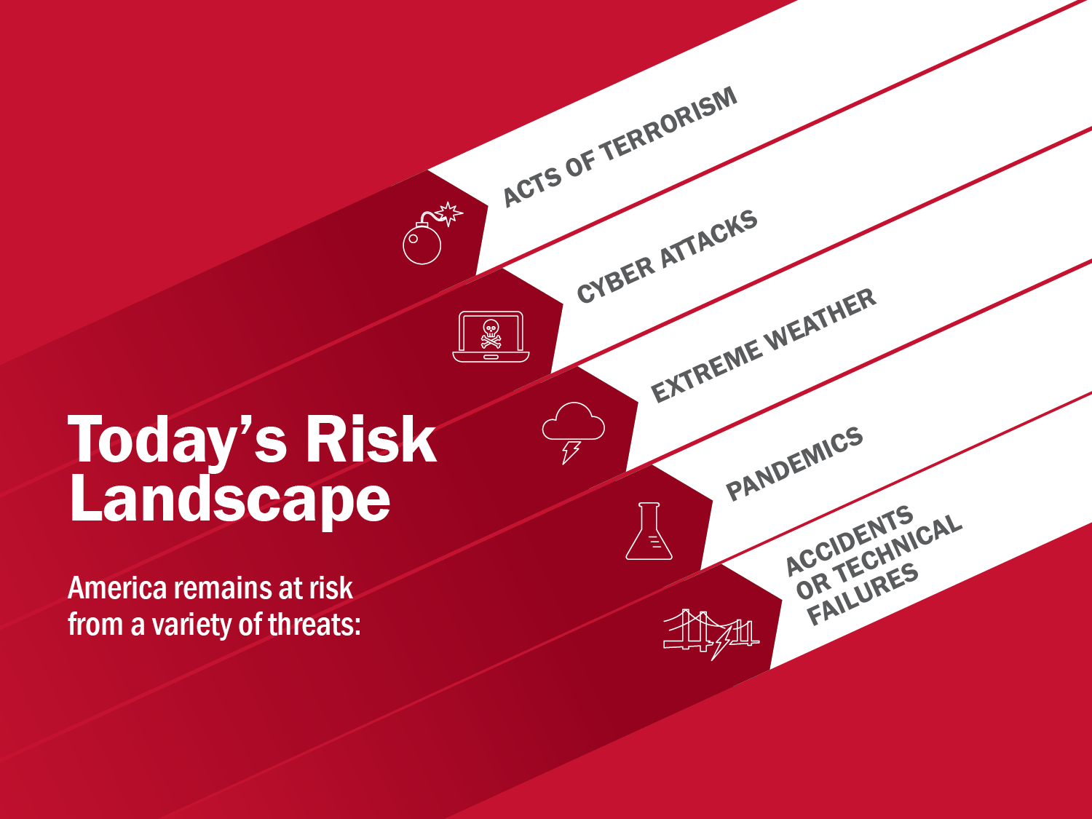

Slide 35
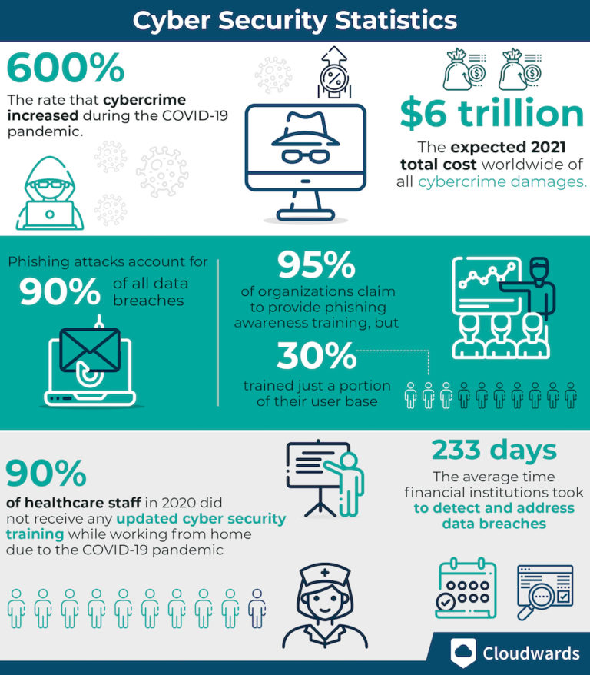

Slide 36
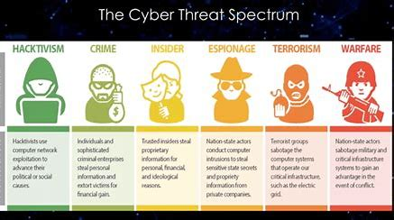
Who's after your data
Notes:
mandatory faceless hacker in a hoodie

Slide 37
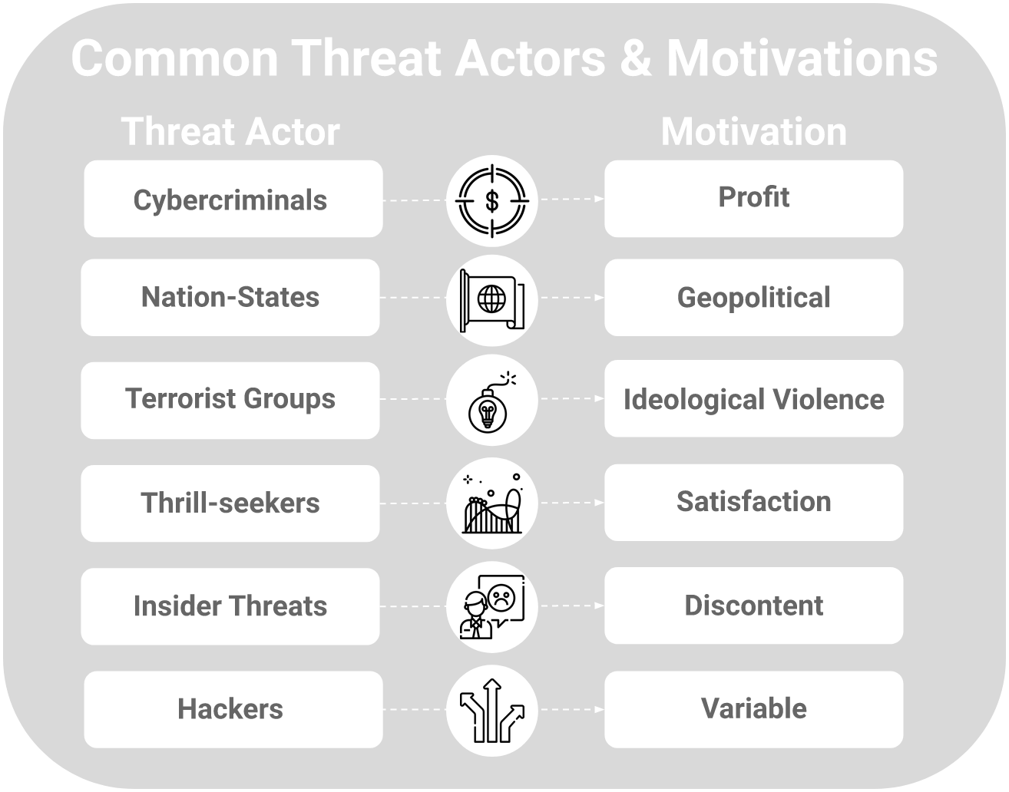
Why they want your data
Notes:
mandatory faceless hacker in a hoodie

Slide 38
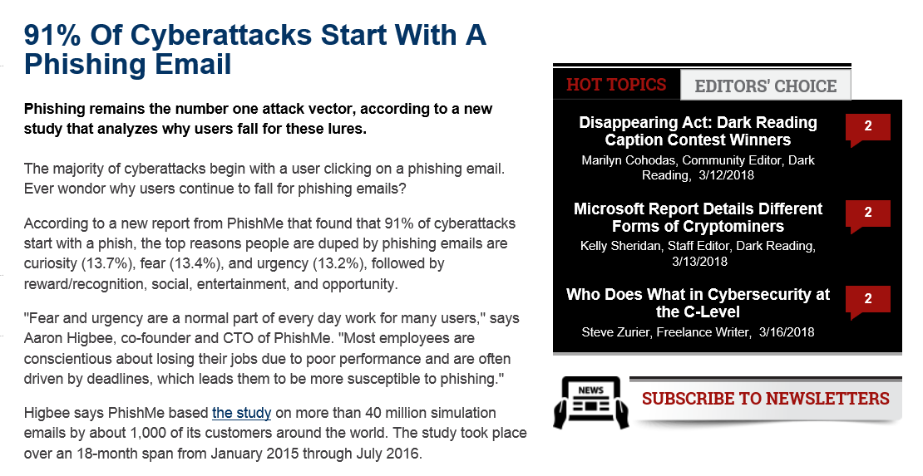
Sophistication is not always important
https://www.darkreading.com/endpoint/91--of-cyberattacks-start-with-a-phishing-email/d/d-id/1327704

Slide 39
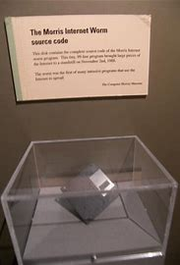
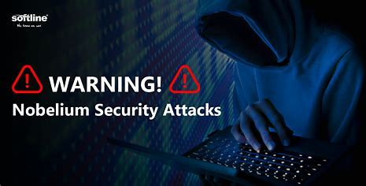
Sophisticated Attack Examples
Notes:
mandatory faceless hacker in a hoodie

Slide 40

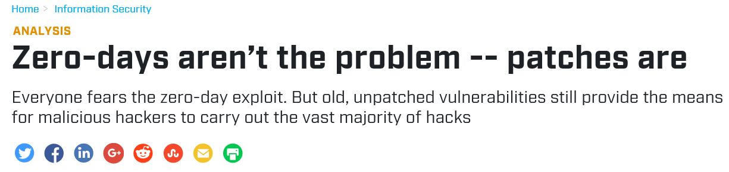
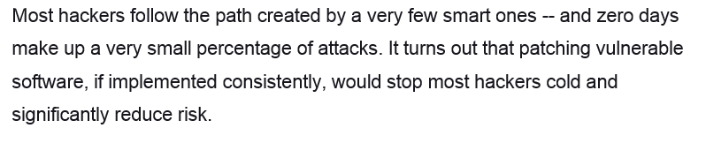
Updates Updates Updates
https://www.csoonline.com/article/3075830/data-protection/zero-days-arent-the-problem-patches-are.html
…

Slide 41


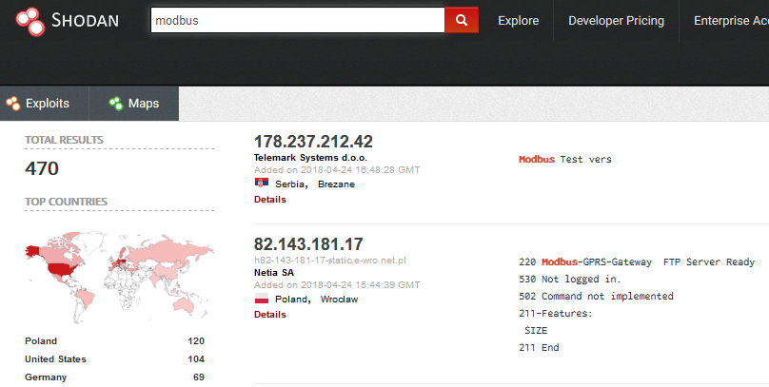
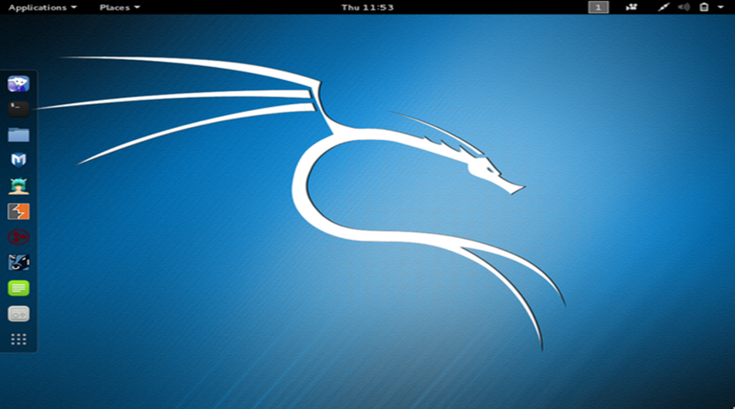




With Tools Aimed Directly At You

Slide 42




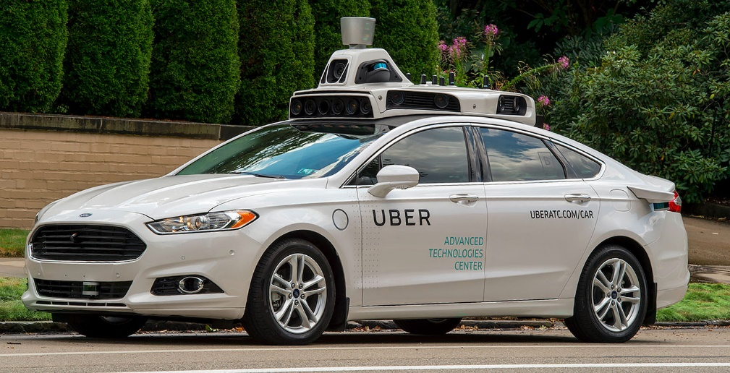

Against an Expanding Attack Surface

Slide 43




Future Technology

Slide 44


Final Technology

Slide 45
Risk Management Strategies
Preparedness (Prevention, Protection)
Mitigation
Response
Recovery
Notes:
Prevention
Avoid, prevent or stop a threat
Protection
Capabilities necessary to secure against acts all hazards
Mitigation
Capabilities necessary to reduce the loss of life and property by lessening the impact
Response
Capabilities necessary to save lives, protect property and the environment, and meet basic human needs after an incident has occurred
Recovery
Assist facility and company affected by an incident to recover effectively.

Slide 46

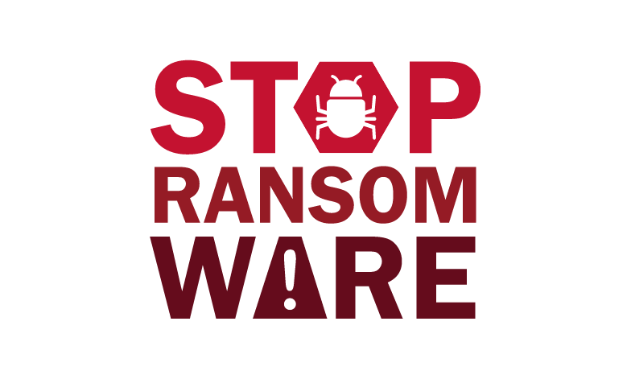
CISA Resources
CISA provides more than 40 cybersecurity tools and resources for public and private sector stakeholders,
Visit: https://www.cisa.gov

Slide 47
Cybersecurity Advisor Program
In support of the CISA mission, Cybersecurity Advisors:
  Assess: Evaluate critical infrastructure cyber risk.
  Promote: Encourage best practices and risk mitigation strategies.
  Build: Initiate, develop capacity, and support cyber communities-of-interest and working groups.
  Educate: Inform and raise awareness.
  Listen: Collect stakeholder requirements.
  Coordinate: Bring together incident support and lessons learned.

Slide 48
Protective Security Advisors
Protective Security Advisors (PSA) have five mission areas that directly support the protection of critical infrastructure:
  Plan, coordinate, and conduct security surveys and assessments
  Plan and conduct outreach activities
  Support National Special Security Events (NSSEs) and Special Event Activity Rating (SEAR) events
  Respond to incidents
  Coordinate and support improvised explosive device awareness and risk mitigation training

Slide 49
Sampling of Cybersecurity Offerings
Preparedness Activities
  Information / Threat Indicator Sharing
  Cybersecurity Training and Awareness
  Cyber Exercises and “Playbooks”
  National Cyber Awareness System
  Known Exploited Vulnerability Catalog
  Information Products and Recommended Practices
  Cybersecurity Evaluations
    Cyber Resilience Reviews (CRR™)
    Cyber Infrastructure Surveys
    Phishing Campaign Assessment
    Vulnerability Scanning
    Risk and Vulnerability Assessments (aka “Pen” Tests)
    External Dependency Management Reviews
    Cyber Security Evaluation Tool (CSET™)
    Validated Architecture Design Review (VADR)
Response Assistance
  Remote / On-Site Assistance
  Malware Analysis
  Hunt and Incident Response Teams
  Incident Coordination
Cybersecurity Advisors
  Assessments
  Working group collaboration
  Best Practices private-public
  Incident assistance coordination
Protective Security Advisors
  Assessments
  Incident liaisons between government and private sector
  Support for National Special Security Events

Slide 50
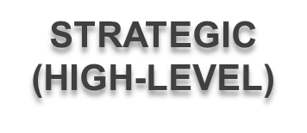

Range of Cybersecurity Assessments
Cyber Resilience Review (CRR)
External Dependencies Management (EDM)
Cyber Infrastructure Survey (CIS)
Phishing Campaign Assessment (PCA)
Cyber Tabletop Exercises (CTTX)
Vulnerability Scanning Service (VSS)
Web Application Scanning (WAS)
Remote Penetration Test (RPT)
Risk & Vulnerability Assessment (RVA)
Red Team Assessment (RTA)
TECHNICAL
(LOW-LEVEL)

Slide 51
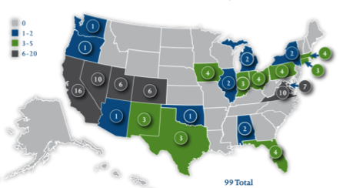
Cyber Exercises and Planning
CISA’s National Cyber Exercise and Planning Program develops, conducts, and evaluates cyber exercises and planning activities for state, local, tribal and territorial governments and public and private sector critical infrastructure organizations.
Cyber Storm Exercise –CISA’s flagship national-level biennial exercise
Exercise Planning and Conduct
Cyber Exercise Consulting and Subject Expertise Support
Cyber Planning Support
Off-the-Shelf Resources

Slide 52
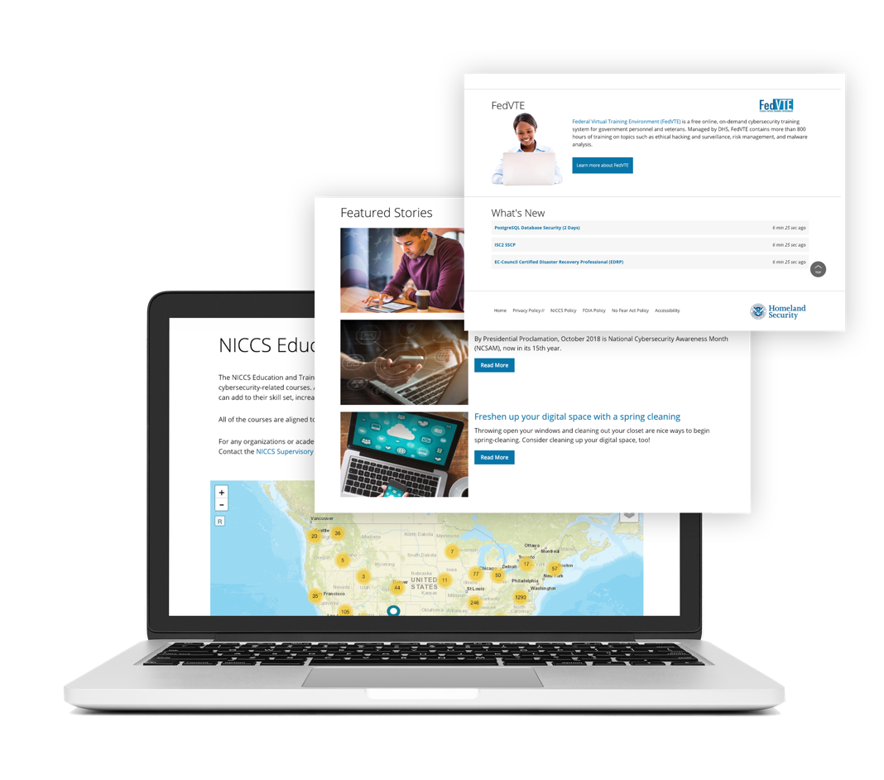
Cybersecurity Training Resources
CISA offers easily accessible education and awareness resources through the National Initiative for Cybersecurity Careers and Studies (NICCS) website.
The NICCS website includes:
Searchable Training Catalog with 4,400 plus cyber-related courses offered by nationwide cybersecurity educators
Interactive National Cybersecurity Workforce Framework
Cybersecurity Program information: FedVTE, Scholarships for Service, Centers for Academic Excellence, and Cyber Competitions
Tools and resources for cyber managers
Upcoming cybersecurity events list
For more information, visit Cybersecurity Training & Exercises | CISA

Slide 53
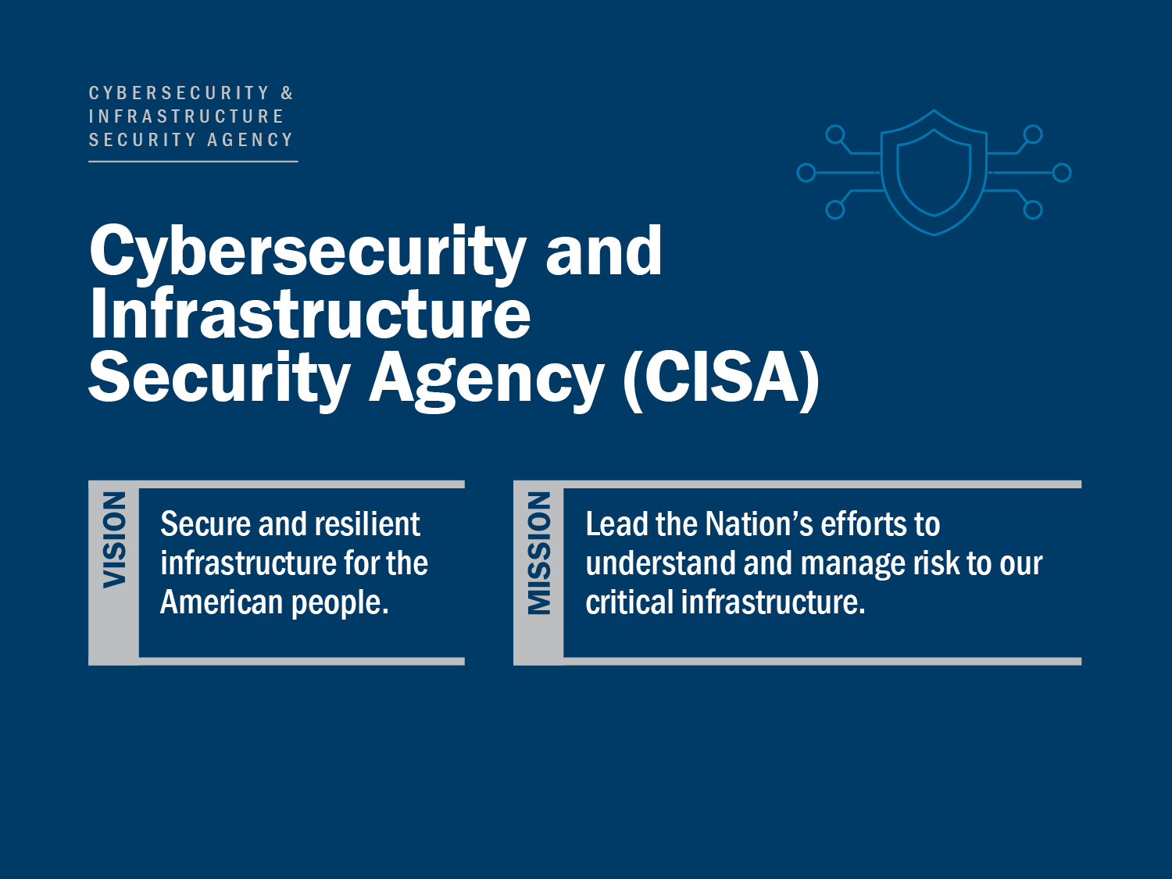
Questions? Next Steps?
Contact your local Cybersecurity Advisor!
Artie Crawford
Cybersecurity State Coordinator, Region 4
Alabama | Florida | Georgia | Kentucky | Mississippi | North Carolina | South Carolina | Tennessee
Cybersecurity and Infrastructure Security Agency
771.202.2624
james.crawford@cisa.dhs.gov

Slide 54


Slide 55
FBI Strategy
Our Priorities:
Protect the U.S. from terrorist attack
Protect the U.S. against foreign intelligence, espionage, and cyber
operations
Combat significant cyber criminal activity
Combat public corruption at all levels
Protect civil rights
Combat transnational criminal enterprises
Combat significant white-collar crime
Combat significant violent crime
Notes:
The mission of the FBI is to protect the American people and uphold the Constitution of the United States.
Our mission priorities assist us to determine where to focus our efforts and resources in order to mitigate threats and move toward accomplishing our vision. The eight mission priorities outline how we protect the American people and uphold the Constitution of the United States.

Slide 56
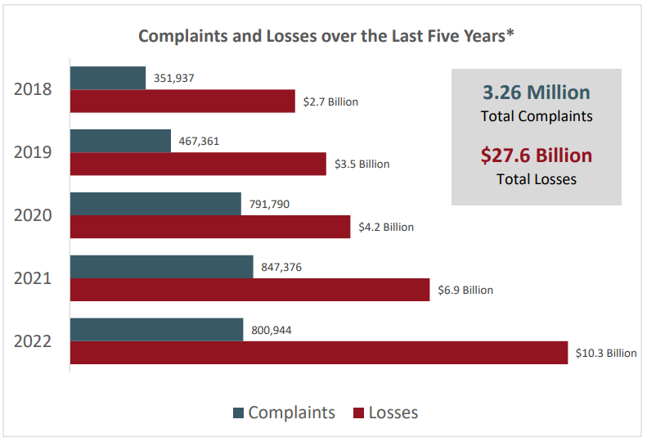
Cyber Crime Statistics
Notes:
Over the last five years, the IC3 has received an average of 652,000 complaints per year. These complaints address a wide array of Internet scams affecting victims across the globe. Over 2,000 complaints a day are reported to IC3.

Slide 57
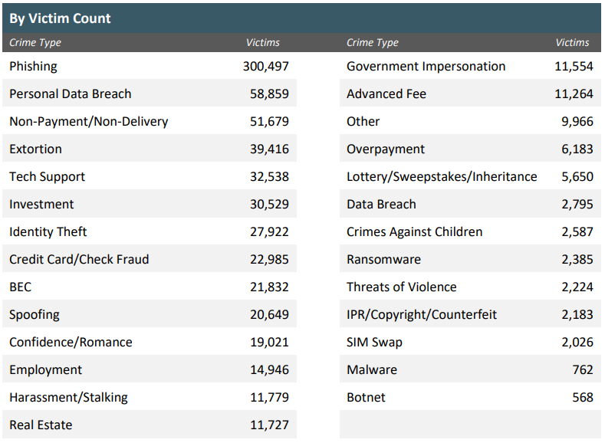
2022 Cyber Crime Statistics
Notes:
These are the ones that report. We know many go unreported.
Fear of FBI
Concern of Liability
Worry over Proprietary Information

Slide 58
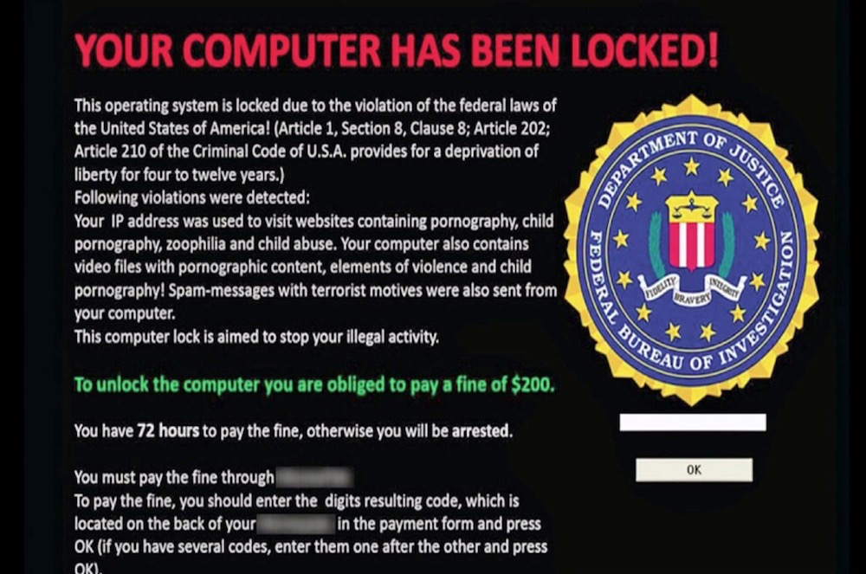
Ransomware
Notes:
Conti first observed in 2020 and it is thought to be led by a Russia-based cybercrime group that goes under the Wizard Spider pseudonym.
The group is using phishing attacks in order to install the TrickBot
Double extortion ransomware, also known as pay-now-or-get-breached refers to a growing ransomware strategy and the way it works is that the attackers initially exfiltrate large quantities of private information, then encrypt the victim’s files. Once the encryption process is complete the attackers will threaten to make the data publicly available unless they get paid.
Just four days after the official start of the Russia-Ukraine war, and in the wake of Conti’s announcement of its support for Russia, an insider leaked tens of thousands of internal chat logs to the public. Documents revealed the group’s size, its day-to-day activities, and how this cybercrime “company” was structured, showing that, in many ways, Conti operated as any normal business would.

Slide 59
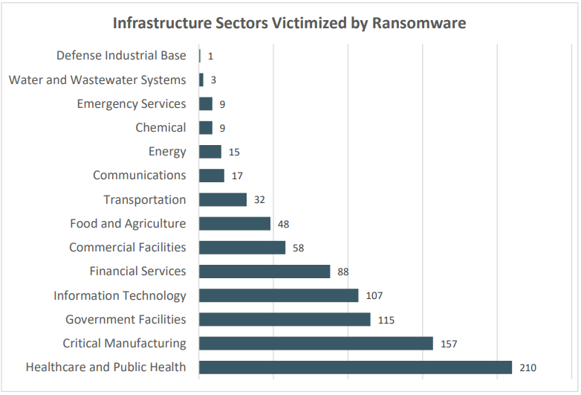
Ransomware
Notes:
The IC3 received 870 complaints that indicated organizations belonging to a critical infrastructure sector were victims of a ransomware attack.
Immediate Actions You Can Take Now to Protect Against Ransomware: • Update your operating system and software. • Implement user training and phishing exercises to raise awareness about the risks of suspicious links and attachments. • If you use Remote Desktop Protocol (RDP), secure and monitor it. • Make an offline backup of your data.

Slide 60
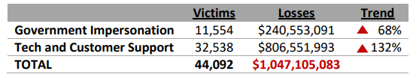
Call Centers
Illegal call centers defraud thousands of victims each year.
Two categories of fraud, Tech and Customer Support and Government Impersonation, are responsible for over $1 billion
in losses to victims.
Notes:
I`m a Government Agent…..
Norton/Geek Squad

Slide 61
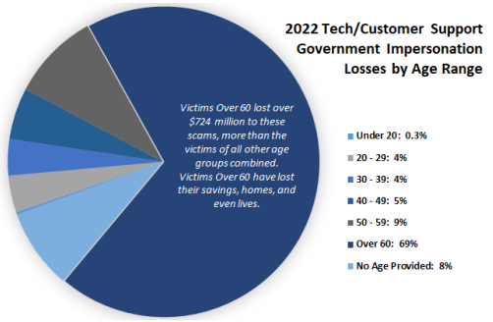
Elder Fraud
Call centers overwhelmingly target the elderly.
Almost half the victims report to be over 60 (46%), and experience 69% of the losses (over $724 million).
Notes:
Primarily East Asia Groups – Mule Networks
Gift Cards
Bitcoin
Cash

Slide 62
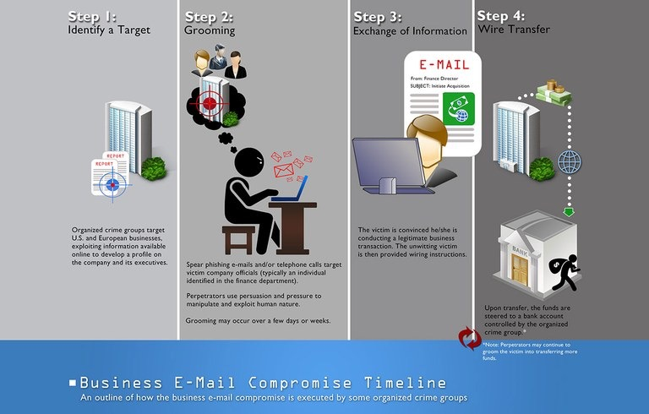
Business Email Compromise (BEC)
Notes:
Wire Transfers

Slide 63
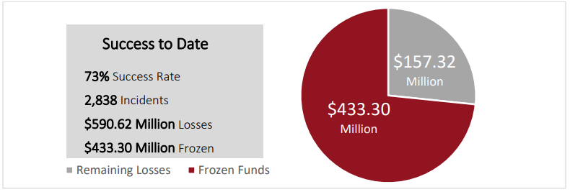
Recovery Asset Team
Notes:
In 2022, the IC3 received 21,832 BEC complaints with adjusted losses over $2.7 billion. BEC is a sophisticated scam targeting both businesses and individuals performing transfers of funds. The scam is frequently carried out when a subject compromises legitimate business email accounts through social engineering or computer intrusion techniques to conduct unauthorized transfers of funds.

Slide 64

Romance Scams
Presses you to leave the dating site to communicate e-mail or instant messaging
Professes instant feelings of love
Sends you a photograph that looks like something from a glamour magazine
Claims to be from the U.S. and is traveling or working overseas
Makes plans to visit you, but is then unable to do so because of a tragic event
Asks for money for a variety of reasons: travel, emergencies, official documents, losses from a financial setback
Cryptocurrency investing
Notes:
An individual believes they are in a relationship (family, friendly, or romantic) and are tricked into sending money, personal and financial information, or items of value to the perpetrator or to launder money or items to assist the perpetrator. This includes the Grandparent’s Scheme and any scheme in which the perpetrator preys on the complainant’s “heartstrings.”
Toby Keith
Jimmy Johnson
Fake/Spoofed Crypto Websites

Slide 65

Extortion - Account Takeover
Notes:
Sextortion can start on any site, app, messaging platform, or game where people meet and communicate. In some cases, the first contact from the criminal will be a threat. The person may claim to already have a revealing picture or video of a child that will be shared if the victim does not send more pictures. More often, however, this crime starts when young people believe they are communicating with someone their own age who is interested in a relationship or with someone who is offering something of value.
After the criminals have one or more videos or pictures, they threaten to publish that content, or they threaten violence, to get the victim to produce more images. The shame, fear, and confusion children feel when they are caught in this cycle often prevents them from asking for help or reporting the abuse. Caregivers and young people should understand how the crime occurs and openly discuss online safety.

Slide 66

Basic Cyber Security
Strong Passwords
E-mail Attachments & Internet Download Modules
Anti-Virus Programs
Install and Maintain a Firewall
Remove Unused Software & User Accounts
Physical Access Controls
Backups
Software Updates
Network Security with Access Control
Limit Access to Sensitive and Confidential Data
Security Risk Management (Disaster Recovery & Contingency)
Technical Expertise when Necessary
Notes:
The Norton Top 10 Riskiest Online Cities Report Reveals Who’s Most Vulnerable to Cybercrime
19. Nashville-Davidson, Tenn.

Slide 67
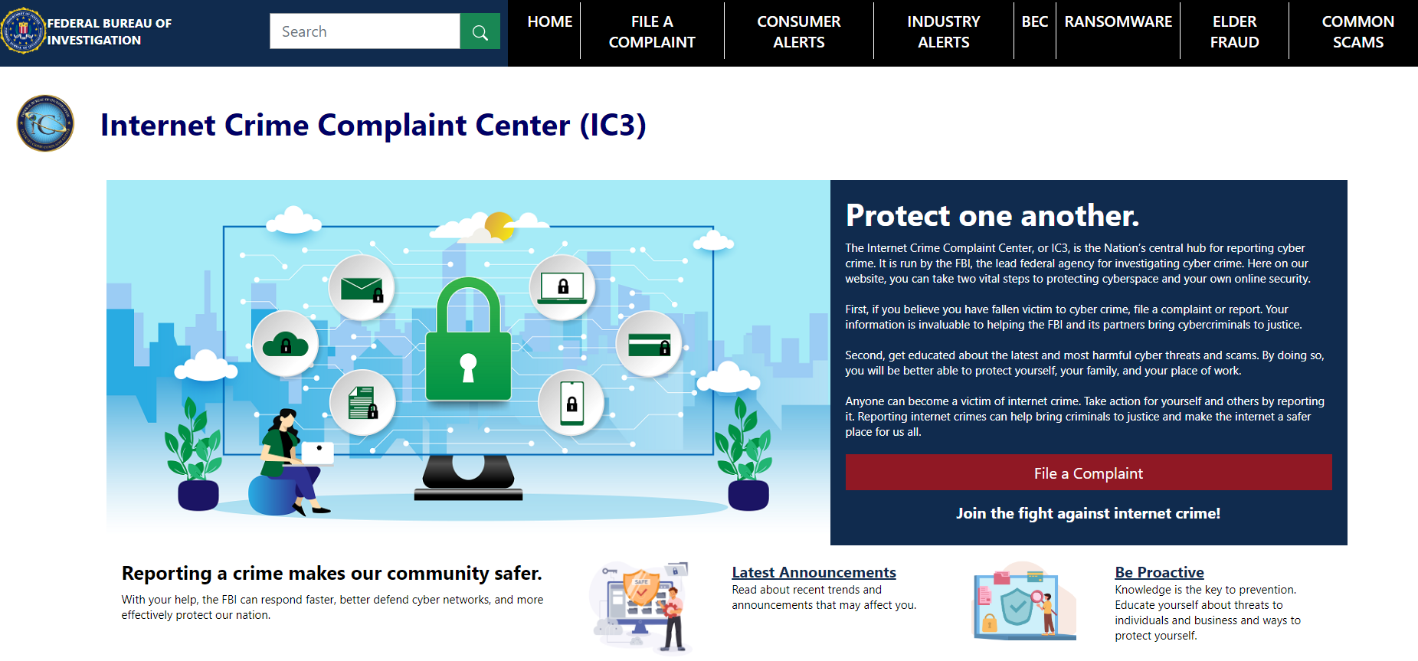
Internet Crime Complaint Center
Notes:
-Refers complaints from individuals to FBI, when patterns are seen a referral is made, -we do not have the resources to investigate every complaint

Slide 68
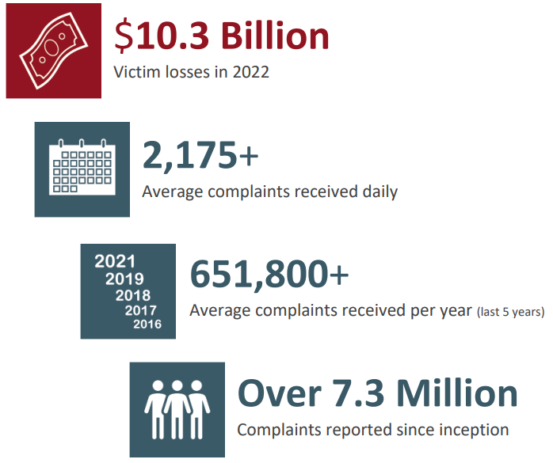
Summary

Slide 69
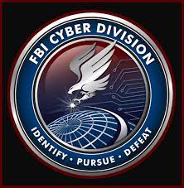
SA Derek Rousseau
Memphis Division / NVRA
Cyber Squad

