Slide 1
WELCOME
Opening General Session
Monday, November 13

Slide 2
Thank You | Titanium Sponsor

Slide 3
Thank You | Platinum Sponsor

Slide 4
Thank You | Gold Sponsors

Slide 5
Thank You | Silver Sponsors

Slide 6
Thank You | Conference Sponsors

Slide 7
Sponsor
Monday Opening Keynote Address
Notes:
Very Special Thank you to the sponsors of the Gateway to Ag Careers program … the AgCIO Roundtable… and a warm welcome to all eight student representatives … could I please ask you all to stand and be recognized? Also sponsoring today’s keynote address coming up shortly.

Slide 8
This Afternoon’s Agenda
General Session 12:30 – 2:30 PM
Welcome and Association Overview – Brent Kemp
Election Report
Passing the Gavel – New Board Chair
President’s Award
Keynote Address – Brooks Hamilton
Closing Presentation – Jeremy Wilson
Adjourn to Break
Afternoon Sessions 3:30 – 5:00 PM
First Time Attendee Meet and Greet 5:00 - 5:30 PM
All Attendee Reception 5:30 – 7:00 PM

Slide 9
Looking Ahead
2024 Mid-Year Meeting
June 9-13 | Altoona, IA
2024 Annual Conference
November 10-13 | Austin, TX
2025 Annual Conference
November 2-6 | Clearwater Beach, FL

Slide 10
Embracing A Data-Driven Future
AgGateway 2023 Review
Brent Kemp, President and CEO

Slide 11
2023 Progress and Accomplishments
17 new members
3 new working groups
1 new advisory group
11 new resources submitted to Standards and Guidelines
~400,000 ADAPT component downloads
24 meet ups
9 industry meetings and presentations
1 Podcast appearance
9 AGIIS Enhancements

Slide 12
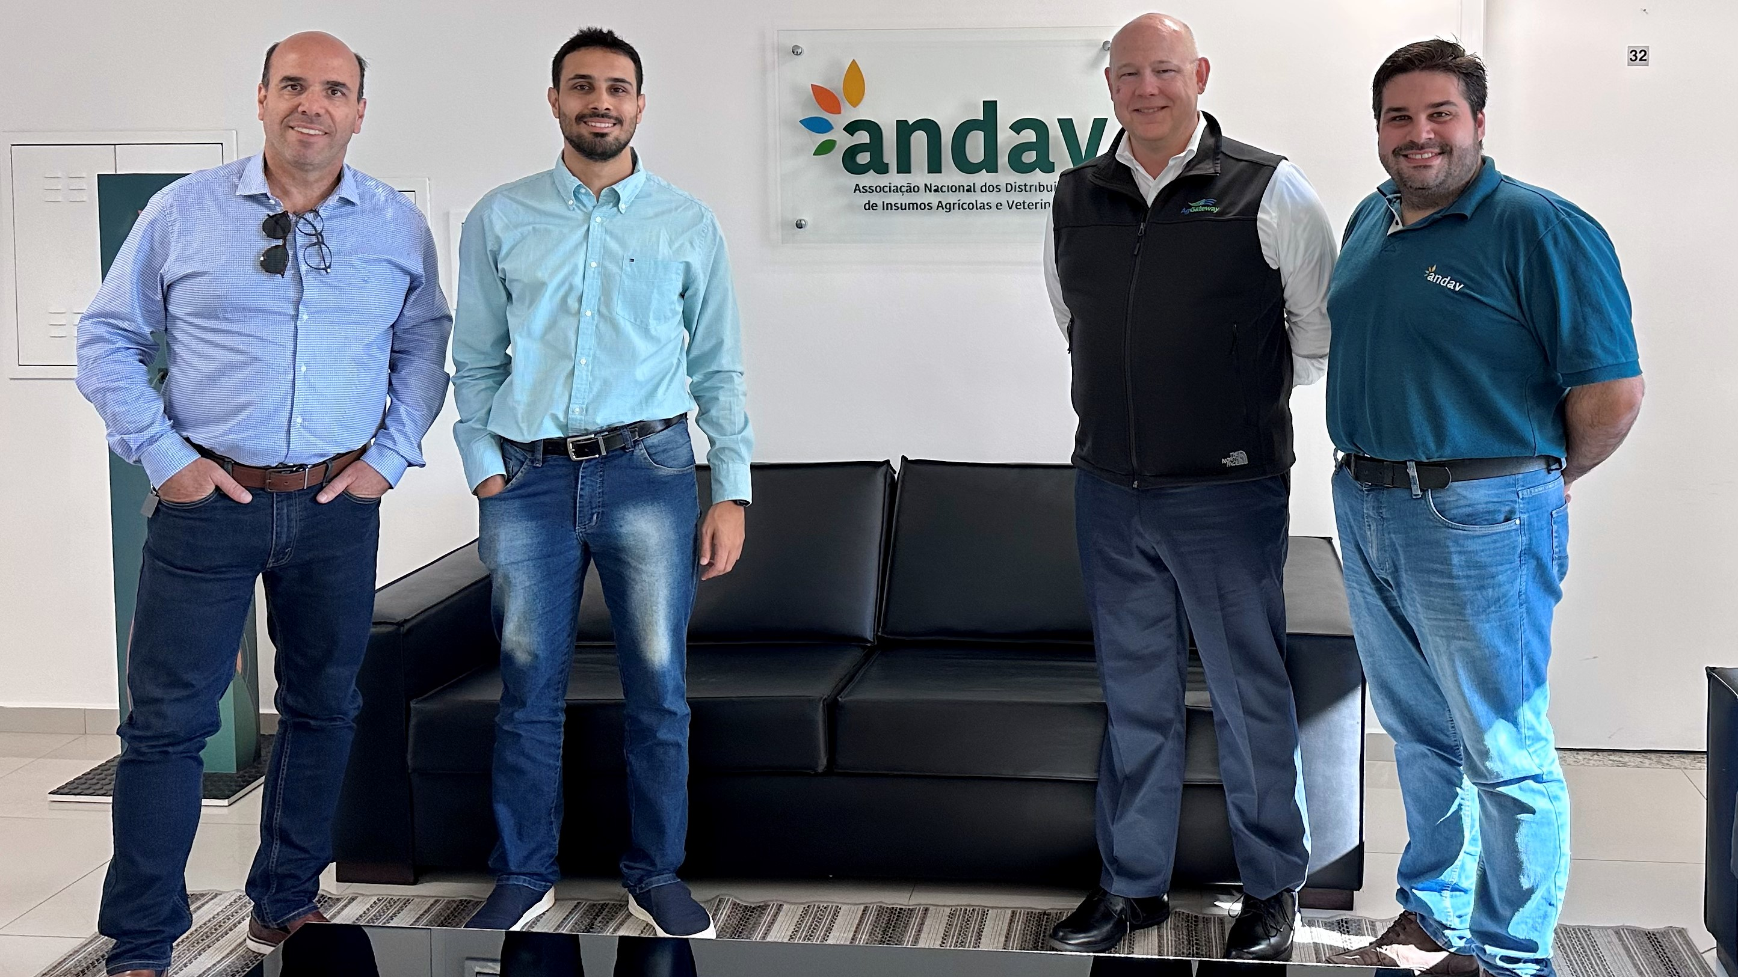
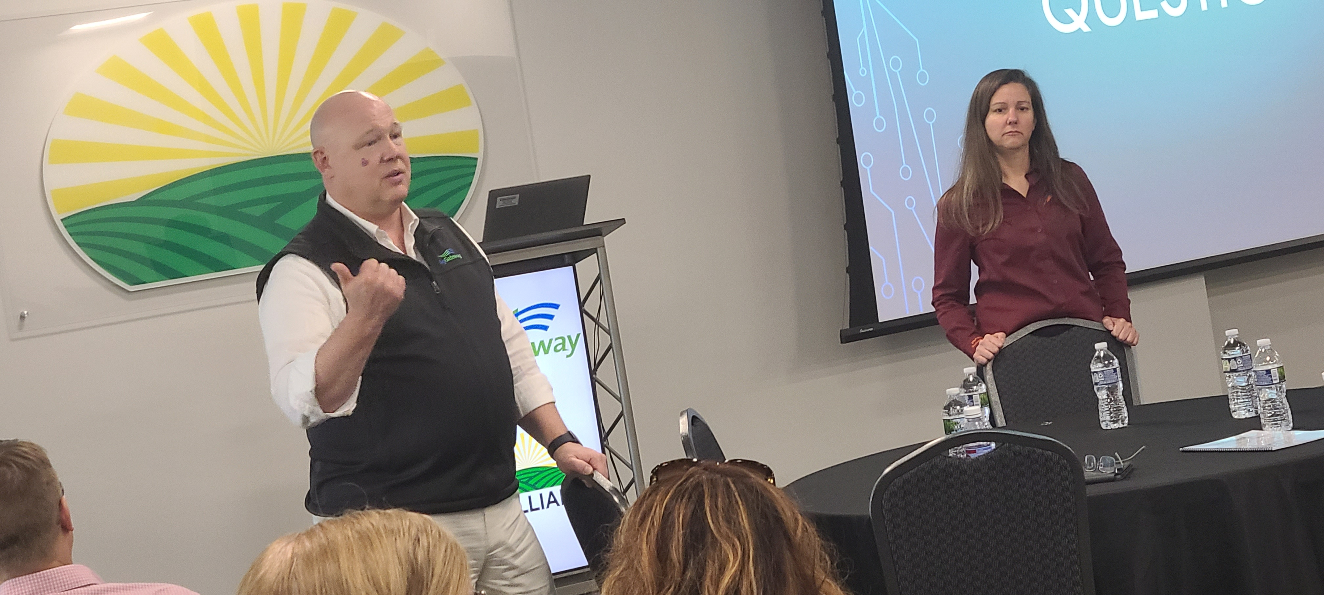
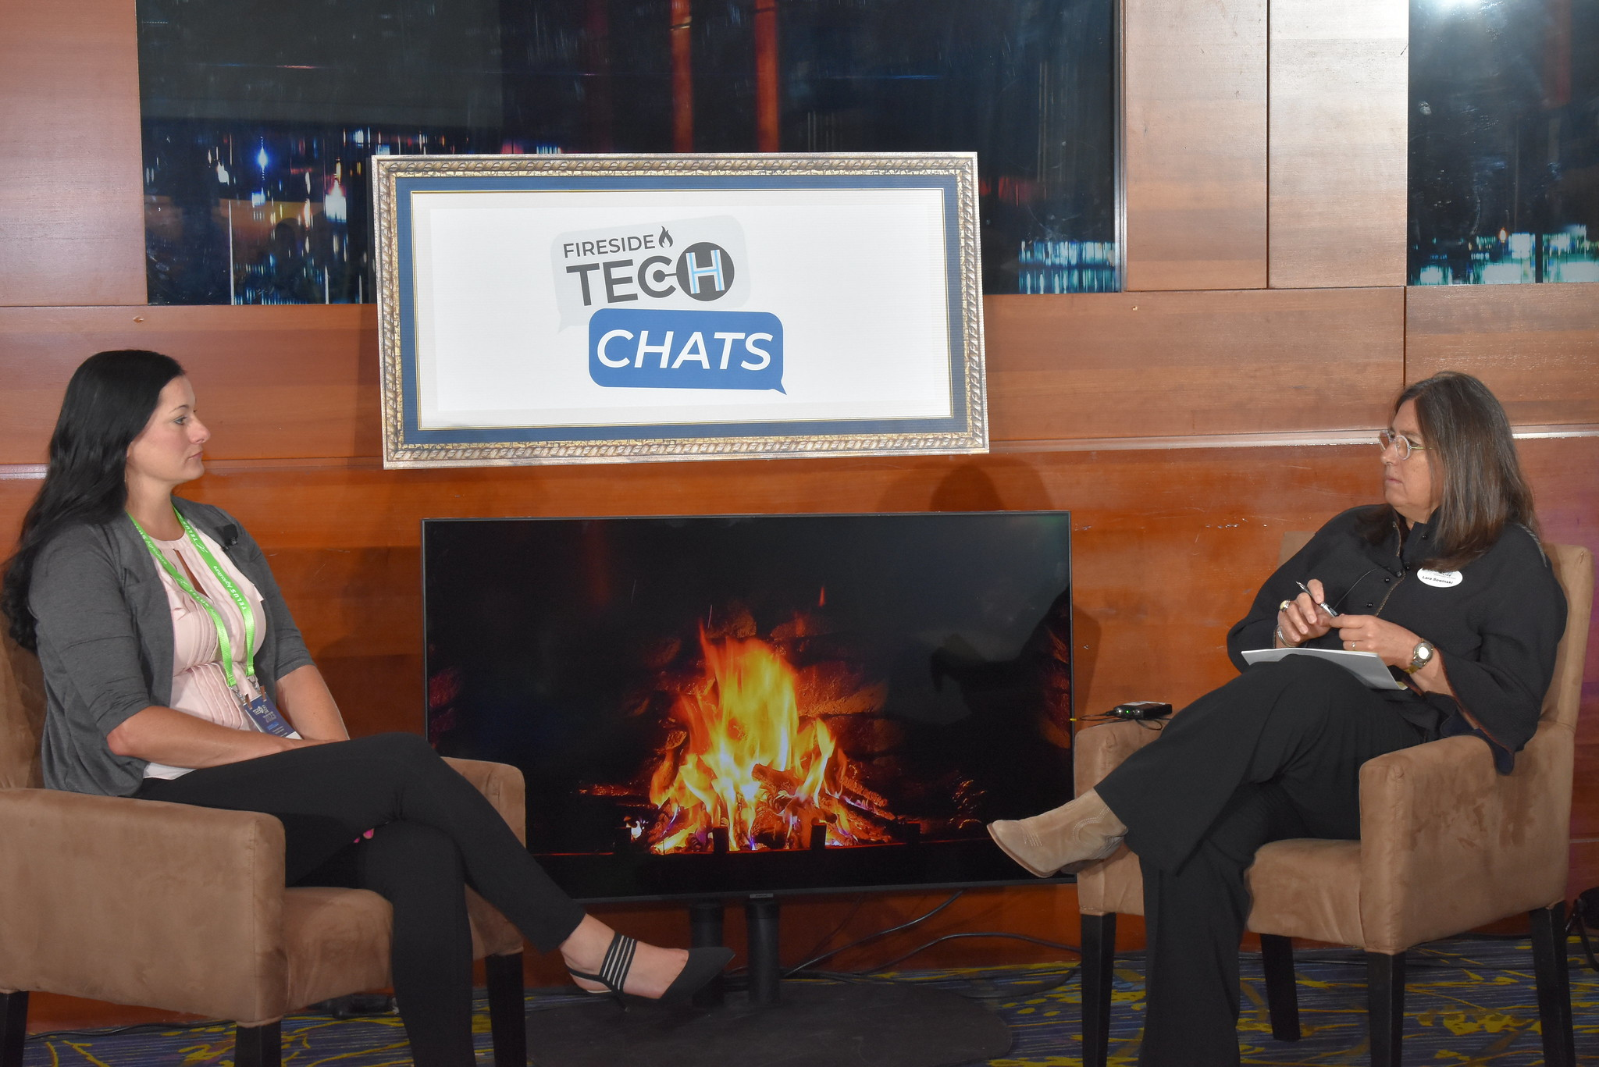
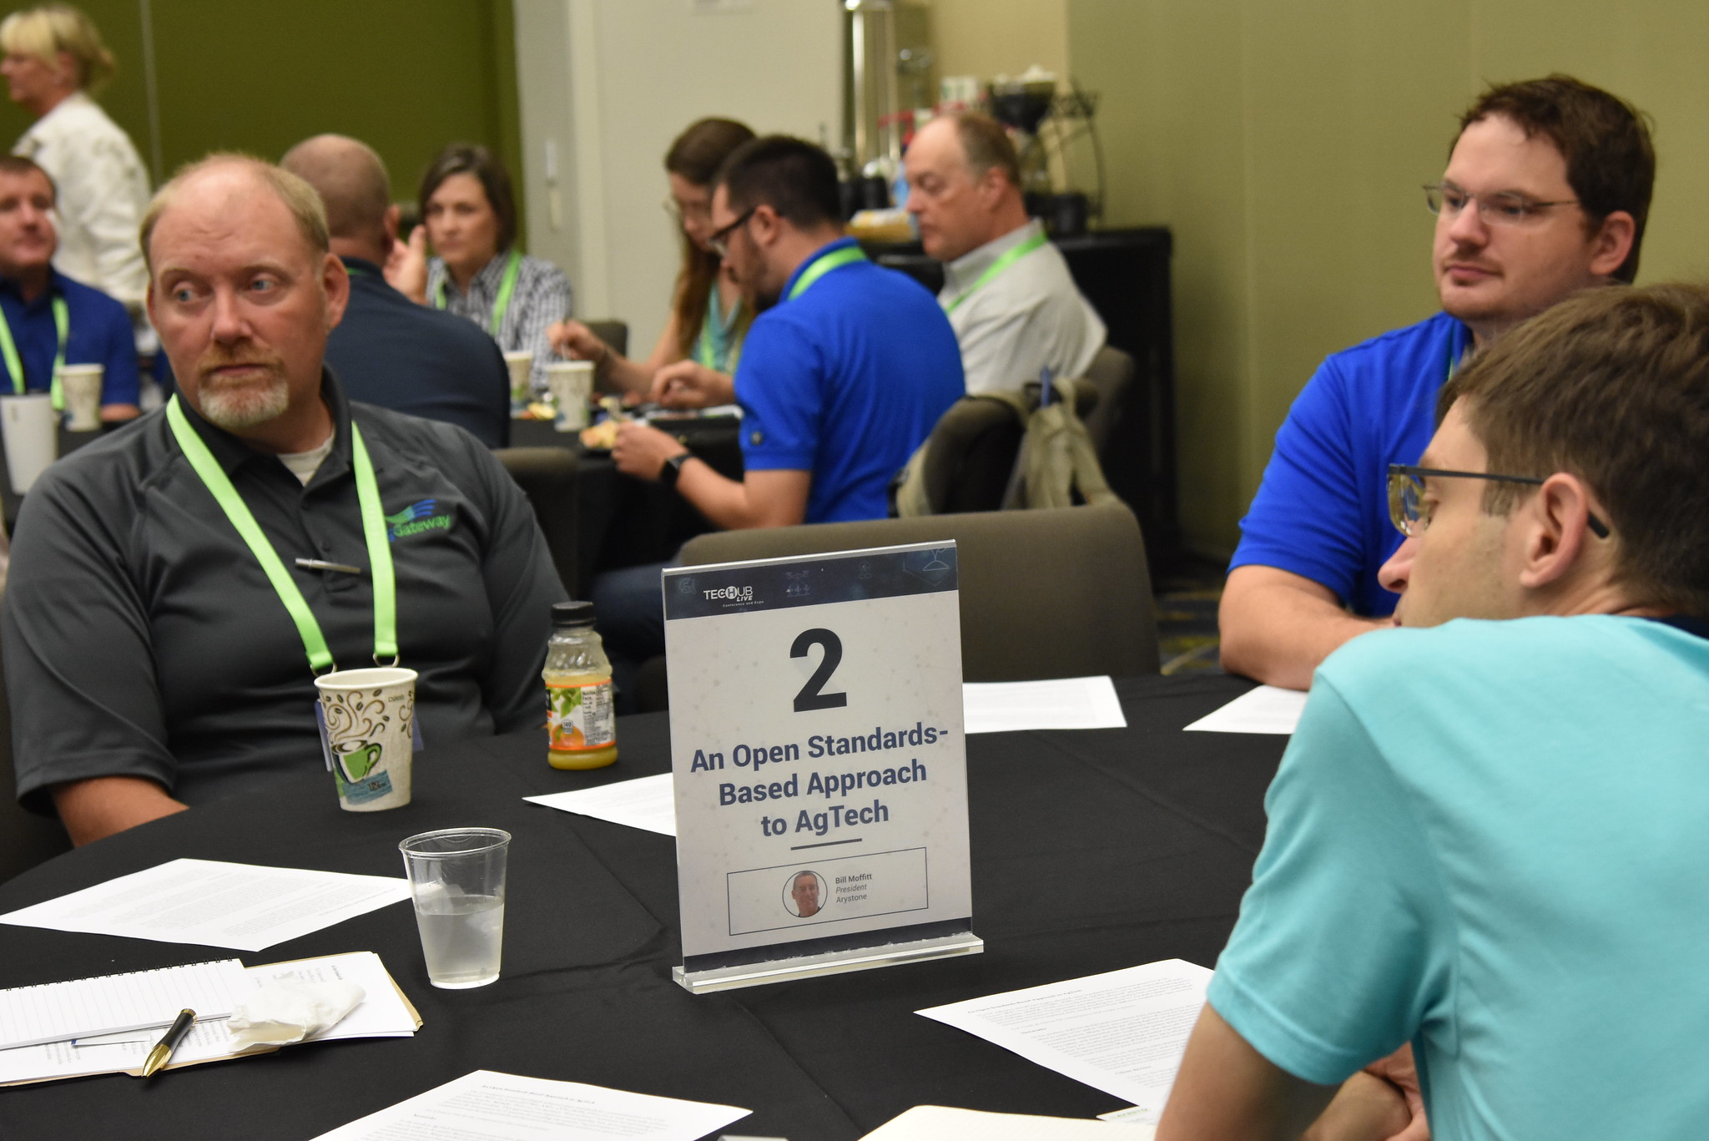

Slide 13
2024 Roadmap
Increased industry presence
State association meetings
Attendance at international events
Partnership with other associations
Digital Resource development
AGIIS Entity Rules revisions
Animal production data linking
Weather and climate data
Field data definitions
Evaluation of existing messages for new implementations

Slide 15
A Data-Driven Future Requires …
Interoperability
Agreed upon and implemented reference data and connections
Context-aware messages and processes
Collaboration on the basics

Slide 16
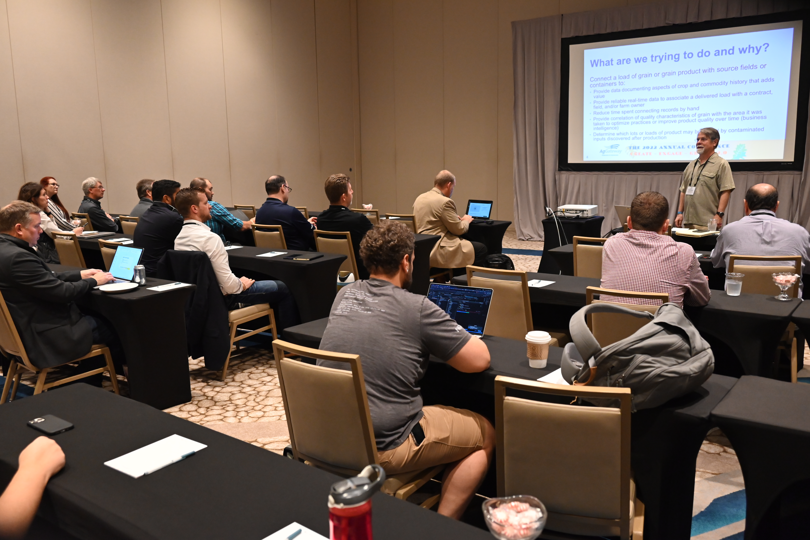
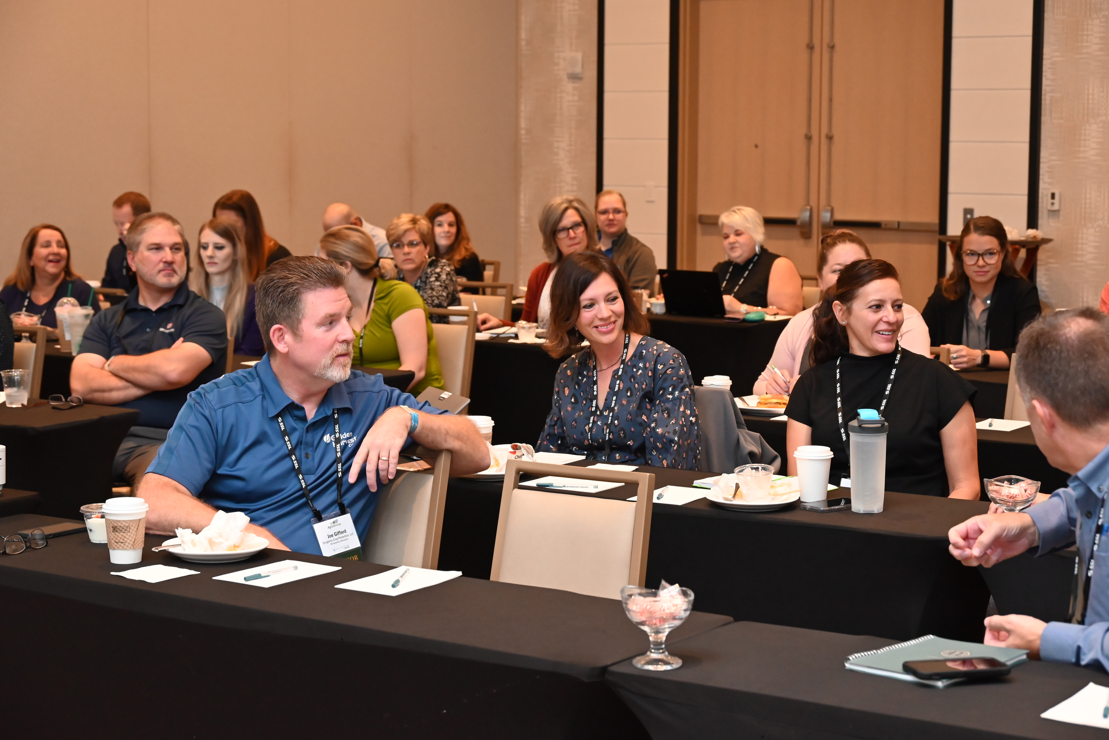
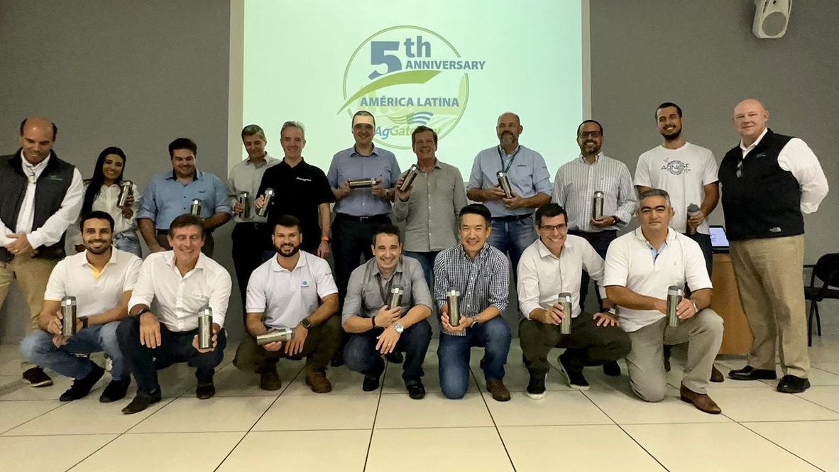

Slide 17
2023 Elections Report
AgGateway Board of Directors
Regional Steering Committees

Slide 18
2023 Election Process
Call for nominations – 11 September 2023
Ballots Released – 6 October 2023
Board of Directors
Regional Steering Committees
Response Results – 23 October 2023
31% response for Board
66% response for América Latina Steering Committee
Transition year for Europe Steering Committee
20% response for North America Steering Committee

Slide 19
Current Board Membership
Adriano Becker, CNH
Scott Charbo, Nutrien
Bernd Kalfass, Topcon
Karen Oerter, WinField United
Guilherme Panes, Jacto
Ryan Risdal, Proagrica
Felipe Santos, John Deere
Fritz Schuster, Lexagri
Feroz Sheikh, Syngenta

Slide 20
2024-2025 Directors
Re-Elected
Ryan Risdal, Proagrica
(At Large)
Felipe Santos, John Deere (América Latina)
Karen Oerter, WinField United (North America)
Joining
Robbie Weathers, Corteva (At Large)
Patricia Perez, Lexagri (Europe)

Slide 21
Regional Steering Committee Members – Election Results
América Latina
Marcela Guidi, John Deere
Europe
Oliver Rahner, DKE Agrirouter
North America
Mike Kuhn, Nutrien
Julie Mathey, GROWMARK
Scott Nieman, Land O’Lakes

Slide 22
Passing The Gavel
Notes:
22

Slide 23
2023 President’s Awards

Slide 24
President’s Award
The President’s Award recognizes individuals that have gone above and beyond in the support of AgGateway and its mission to develop the resources and relationships that drive digital connectivity.

Slide 25
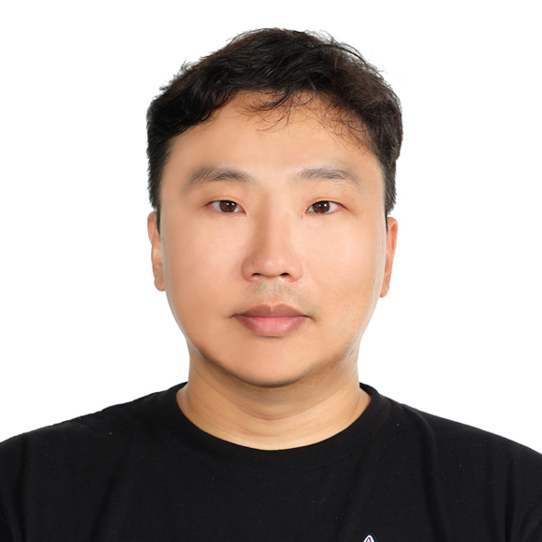
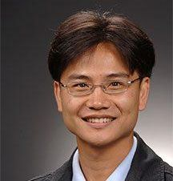
2023 President’s Award Recipients
Evan Wallace
Hakju Oh
Boonserm Kulvatunyou
National Institute of Standards and Technology

Slide 26
Keynote Presentation

Slide 27
Seismic Changes How the AI Revolution will Reshape the Industrial Fabric (and What You Can Do About It)

Slide 28
A Tale in Three Parts
Act 1
This is Real
Act 2
This is Now
Act 3
This is How
Notes:
Audience Advisory: Geeky Content

Slide 29
Buckle Up!

Slide 30
A Tale in Three Parts
Act 1
This is Real
Act 2
This is Now
Act 3
This is How
Notes:
Audience Advisory: Geeky Content

Slide 31
ChatGPT has spread like wildfire
November 30th 2022 to Today

Slide 32
Major AI Investments
In 2023 alone, large technology companies have invested $15.6 Billion in other AI companies.
1/2014
Google $500 Million Acquisition of DeepMind
9/23
Amazon invests $4 Billion in Anthropic.
7/21
Microsoft invests $2 Billion in OpenAI
1/23
Microsoft invests $10 Billion in OpenAI
2/23
Google invests $300 Million in Anthopic. Anthropic’s chatbot is Claude.
3/23
Microsoft & Others
invested $1.3 Billion in Inflection AI
4/23
PwC announces $1 Billion investment in AI
Microsoft’s “hold my beer” moment
Microsoft
Amazon
Google
Other

Slide 33
AI Enhanced Productivity
Study of AI productivity by Harvard, Warwick, and MIT universities
76 Boston Consulting Group (BCG) Consultants in the study
18 different realistic task samples
Consultants using ChatGPT-4 substantially outperformed the control group – typically by 40%
Notes:
On every dimension. Every way we measured performance.

Slide 34
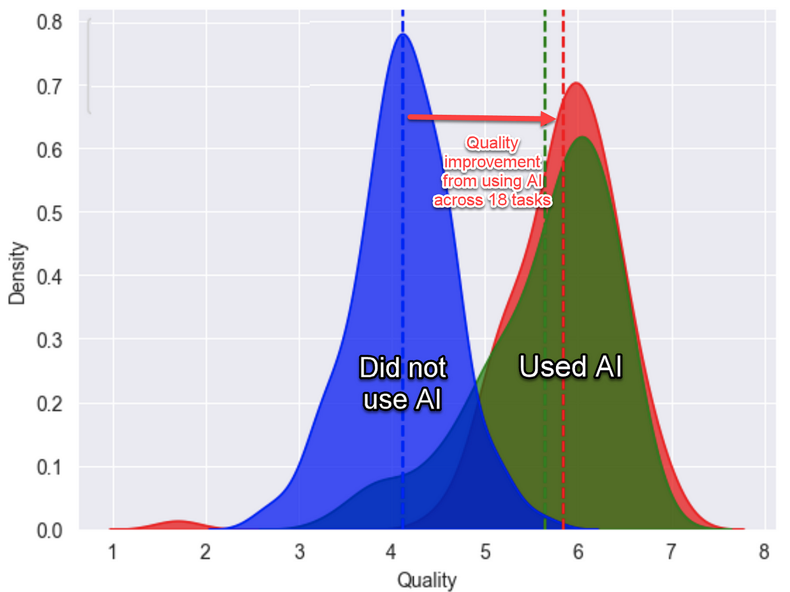
Results for Consultants using AI
Output. Finished 12% more tasks
Speed. Completed tasks 25% more quickly
Quality. Produced 40% higher quality results
No ChatGPT
ChatGPT + Training
ChatGPT + No Training

Slide 35
As models scale up, they become more capable
Real Smart
Model Capability
Not Smart
Model Scale: Model Size, Compute Time, and Data
Notes:
mo’ parameters, mo’ money

Slide 36
As models scale up, they become more capable
Real Smart
Human Range
Model Capability
LSAT
US Bar Exam
MCAT
September
2023
Coding
GRE
AP Physics
GPT-4 tests at 80th percentile (that’s good)
Not Smart
Model Scale: Model Size, Compute Time, and Data
Notes:
mo’ parameters, mo’ money
Language models are nipping at human-level capabilities

Slide 37
As models scale up, they become more capable
No upper bound for capabilities has been established
Real Smart
Human Range
Model Capability
September
2023
Not Smart
Model Scale: Model Size, Compute Time, and Data
Notes:
mo’ parameters, mo’ money

Slide 38
How did they train the model to pass those tests? They didn’t.

Slide 39
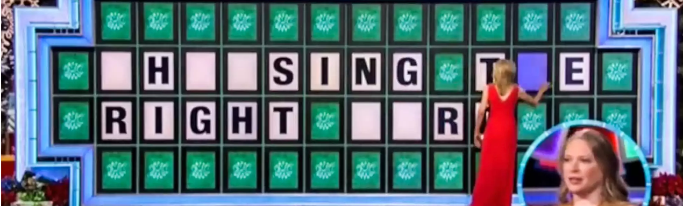
Only trained to guess the next token
“I couldn’t see in the dark room because the light was ___.”
Note: Instead of words, researchers use tokens so account for punctuation, spaces, and symbols.

Slide 40
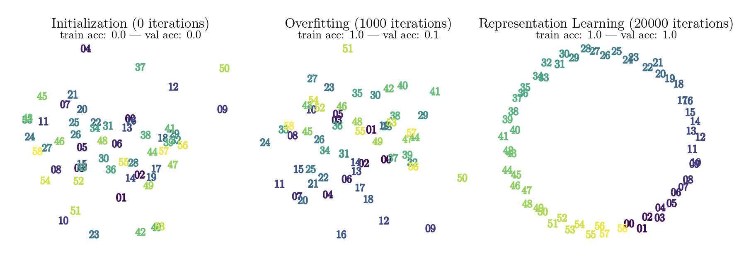
From Learning Sequences to Learning Relationships
0 Iterations
1,000 Iterations
20,000 Iterations
Notes:
In addition, statistical physics has been identified as a powerful tool in studying generalization in neural networks. Our work connects a low-level understanding of models with their high-level performance.
In a recent work, researchers at Anthropic, connect a sudden decrease in loss during training with the emergence of induction heads within their models.

Slide 41
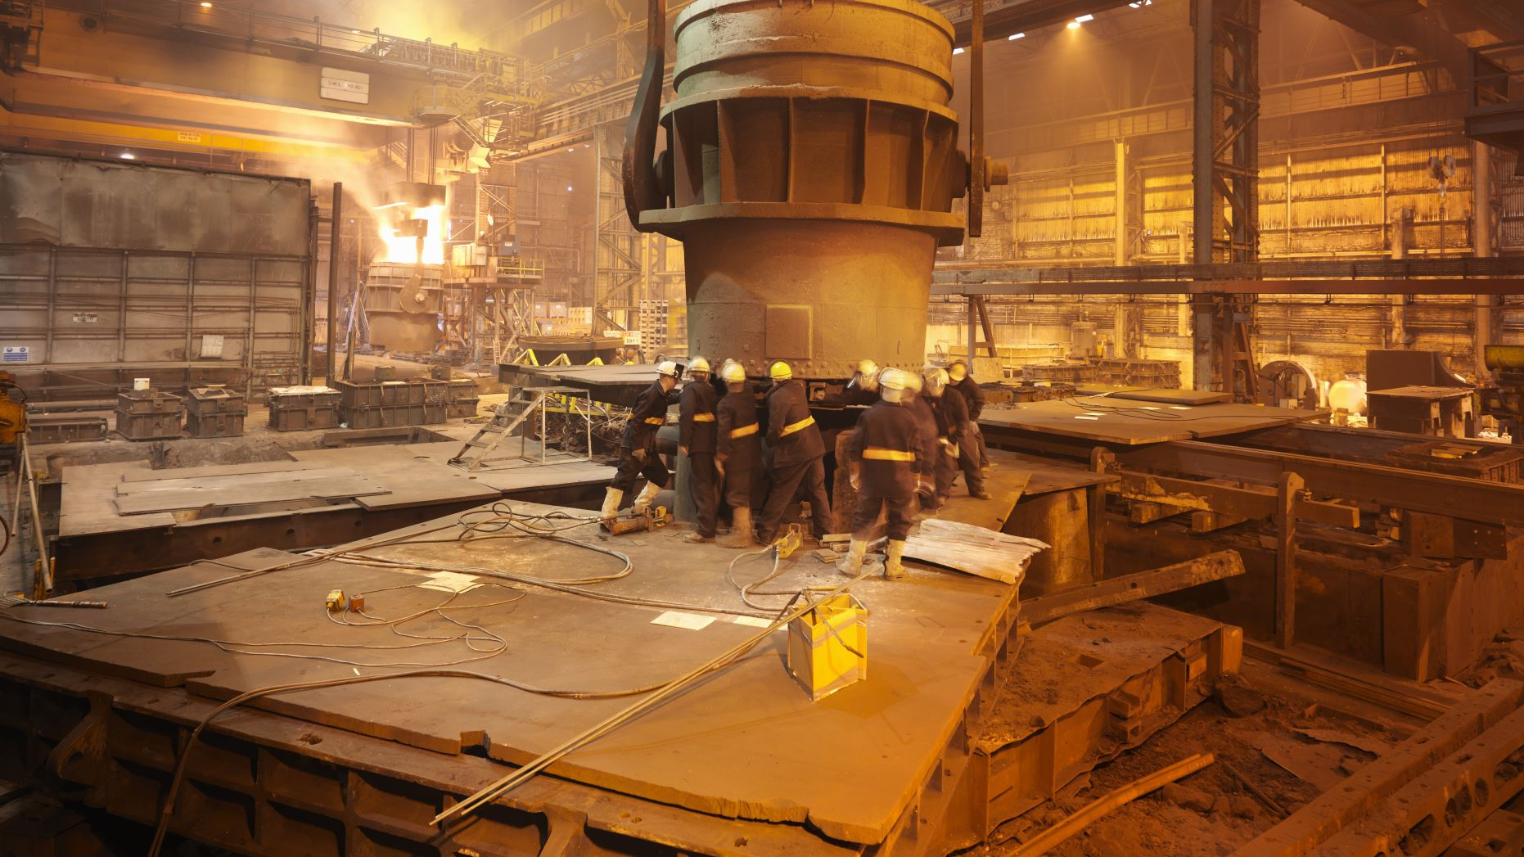
Tech companies increased models to enormous sizes…

Slide 42
…researchers encountered surprises

Slide 43
Emergent Behavior
“Emergent behavior is the unplanned emergence of new, coherent structures, patterns, and properties during the process of self-organization in complex entities.”
Corning, 2002

Slide 44
8 Billion Parameters
Google researchers made astounding discoveries while constructing the PaLM Large Language Model (540B)
Documented in Google’s paper Scaling Language Modeling with Pathways
Notes:
The downstream capability set is composed of core abilities such as:
Question answering
Basic arithmetic
Language understandingThese capabilities of synthesis begin to emerge when models have approximately 3.5 billion parameters.

Slide 45
62 Billion Parameters
Documented in Google’s paper Scaling Language Modeling with Pathways
Notes:
its capability set expands to include: language translation, common sense reasoning, programming code completion, and summarization. Take a hard look at these. This isn’t just an area of knowledge but a synthesis of language, culture, and reasoning.

Slide 46
175 Billion Parameters
GPT3
From OpenAI’s paper: Language Models are Few Shot Learners
Notes:
its capability set expands to include: language translation, common sense reasoning, programming code completion, and summarization. Take a hard look at these. This isn’t just an area of knowledge but a synthesis of language, culture, and reasoning.

Slide 47
540 Billion Parameters
Documented in Google’s paper Scaling Language Modeling with Pathways
Notes:
On the way to 540 billion parameters, it develops an additional set of abilities: proverb usage and understanding, advanced reading comprehension, perform logical inference chain reasoning, recognize patterns, create dialogue, explain jokes, and understand physics.

Slide 48
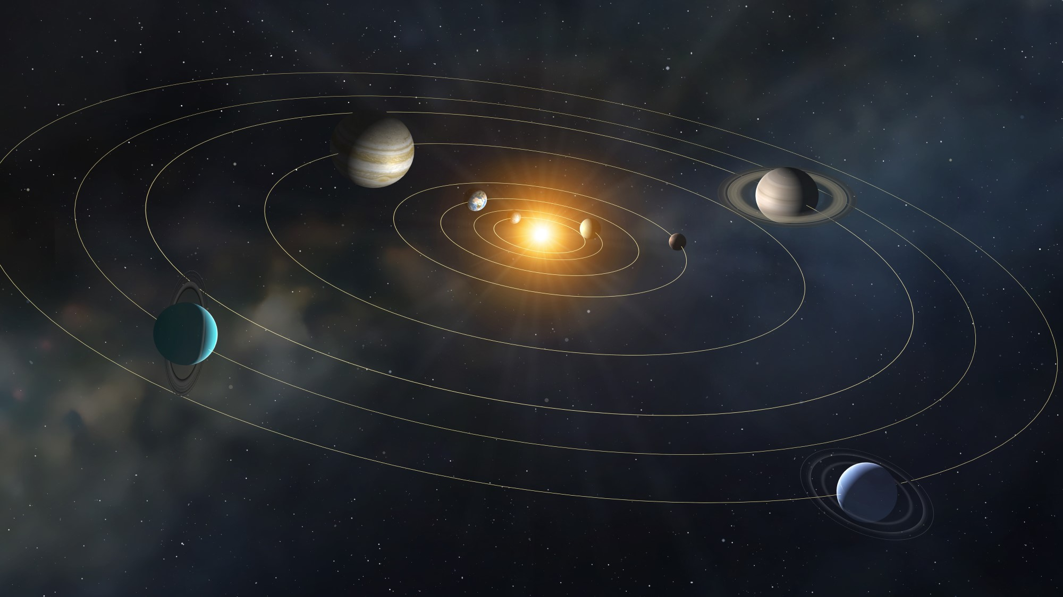
Two Historic Events
Intelligent Artifacts
We have arranged minerals to think.
These intelligent artifacts can be built to become more intelligent, without end in sight.
Discovery of the Laws of Intelligence
Intelligence is having its Newtonian Physics moment.
The laws of intelligence are emerging from the noise.

Slide 49
A Tale in Three Parts
Act 1
This is Real
Act 2
This is Now
Act 3
This is How
Notes:
Audience Advisory: Geeky Content

Slide 50
New Technology Adoption Has Accelerated over Time
Years until 25% population adoption
A.I.
2023

Slide 51
Smartphone Revolution: Initial Products were “Production Prototypes”
The smartphone technology revolution progressed rapidly over 15 years
Notes:
We are 15 years into the smartphone rollout.

Slide 52
AI Success Does Not Depend upon Major Infrastructure Investments
Infrastructure | Apple iPhone | OpenAI ChatGPT
Release Cadence | Annually | Monthly
Supply Chain | Thousands of hardware suppliers | Data – Widely available GPU chips – Limited availability
Distribution Channel | Physically deliver billions of smartphones into the hands of its worldwide customer base | Internet connection
Hardware | Proprietary, cutting-edge, vertically-integrated hardware | Commodity servers
Software for End Users | Built an app ecosystem | Utilize existing API’s and web pages of other companies’ apps

Slide 53
The Critical Breakthroughs are Complete
Algorithm
Transformer Model architecture (2017)
Compute at Scale
PaLM (2019)
Highly Capable Model
GPT3 (2020)
Data Sources
The Pile (2021)
Interface
ChatGPT’s Reinforcement Learning with Human Feedback (2022)

Slide 54
The Future is Multi-Modal
Constant stream of consistently more capable models
11/22
Microsoft Released GitHub CoPilot
Q4 2023
Microsoft to release Copilot for Office 365
2/23
Meta released Llama 1
7/23
Meta released Llama 2
Q4 2023
Google to release Gemini across Google products Q4 ’23
11/22
OpenAI releases ChatGPT 3.5
9/22
OpenAI releases Dalle-2
3/23
Google releases Bard chatbot
5/20
OpenAI releases GPT3
10/23
OpenAI to enable web searching, images, and speech
9/23
OpenAI releases Dalle-3
Language Models
Image Models
Software Code Models
Multiple Modes

Slide 55
Mutually Reinforcing Acceleration
Models
Data
Compute
Applications

Slide 56
Text
Images
Sound
Financial market Data
Earth & Space Observation
Genetics & Proteins
Data
Compute Budget
Training Time
User Interfaces
Process
Incorporation
Early stages
Notes:
Large networks are being trained for other domains

Slide 57
The Ferris wheel of change starts slowly… …but doesn’t stay that way

Slide 58
Where in the workforce will this impact hit?
Act II

Slide 59
Each Role is Composed of Multiple Tasks & Each Task has Various Levels of Potential Automation
Task Category | Description | Customer Service Rep | Potential Cost Savings
Automate | Task can be fully automated | Transcribe the call, summarize main points, score outcome | 80% to 99%
Augment but not automate | Productivity, efficiency, and accuracy improved but will continue to be performed by person. | Suggest potential fixes to the problem. Provide context about the customer. | 5% to 50%
No Automation | Tasks will continue to be performed by a person. | Defuse an angry customer | N/A

Slide 60
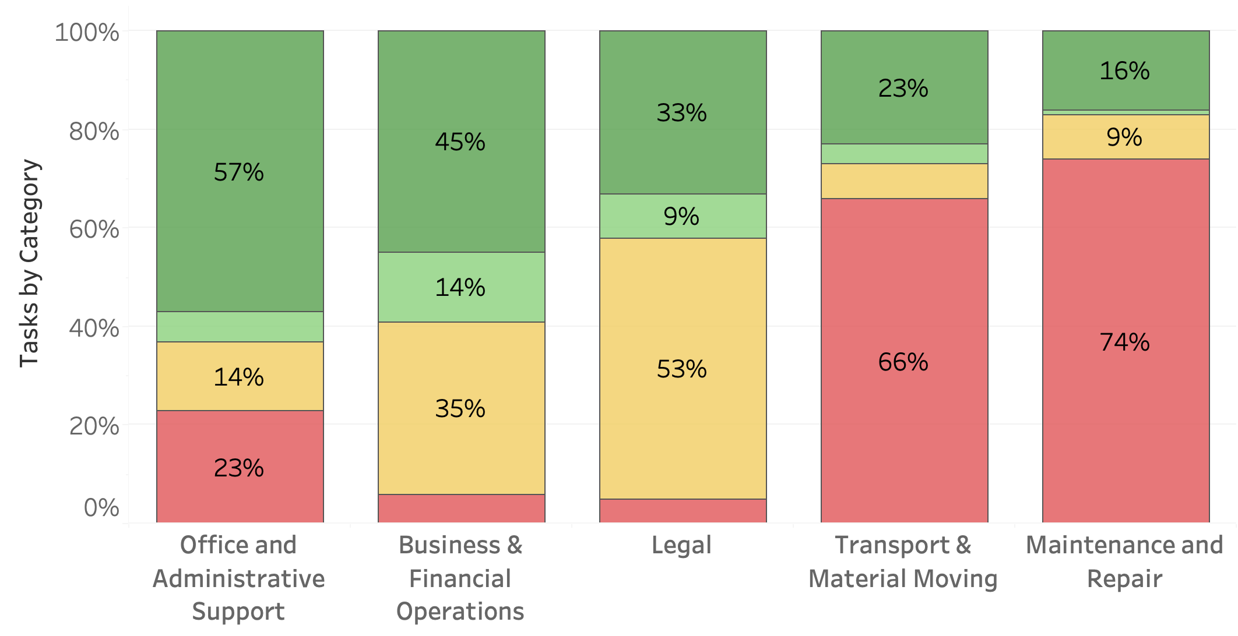
Potential AI Impact will Differ by Role
Source: Accenture Research based on analysis of Occupational Information Network, US Dept Labor, US Bureau of Labor Statistics

Slide 61
A Tale in Three Parts
Act 1
This is Real
Act 2
This is Now
Act 3
This is How
Notes:
Audience Advisory: Geeky Content

Slide 62
Plan for Approaching AI
Phase 1
Q4 ’23 – Q1 ‘24
Get Started
Tertiary functions
Phase 2
Q1 – Q2 2024
Augment Existing Processes + Build Capability
Secondary functions
Phase 3
Q3 2024+
Bigger Bets / Re-envision
Core functions & processes

Slide 63
Phase 1: Embrace, Educate, and Expand
Embrace
Educate
Expand
Objective: Engage with the teams already using generative AI to normalize and proliferate the use.
Notes:
Tasks that people are likely already performing with AI or dislike doing as part of their job.

Slide 64
Phase 1: Embrace
Generative AI is in use – Find it
Best Practices working groups
Rules of the Road working groups
Educate Leadership
Marketing, Sales, IT, Support
Tools, prompts, custom instructions, plug-ins
Privacy, security, when to use, when not to use it
Useful
Job Satisfaction
Customer Sat.

Slide 65
Phase 1: Educate
Execs: Explain what it is, what it may be used for, and the risks of not starting to plan for it.
Legal: The AI policy should not be “No use of any kind, for any purpose.”
IT: AI foundation models, large technology vendor landscape, researching available tools
Budget: Set aside resources in 2024 to allow for research, education, innovation, and experimentation

Slide 66
Phase 1: Expand
Formalize usage
Expand usage
Explore vendors
Claim victory
Train teams on usage, best practices, & expectations
Full group uses it, expand to others
Best tools for task, user mgmt., payment
Celebrate people enjoying their jobs more

Slide 67
Phase 1: Example Use Cases
Marketing
HR
Write job descriptions
Website content
Social Media content
IT Org
Draft policies
Testing
General Corporate
Draft emails (non-sensitive)
Generate form templates
Blog posts
Documentation
Sales
Call transcription
Call summarization

Slide 68
Phase 2 : Build the Organizational Capability
Build the capability
Exercise the capability
Sense the market
Communicate the plan

Slide 69
Phase 2: Build Organizational Capability for AI Projects
Build the team’s leadership roles
Build the team’s technical roles
Re-envision and redesign processes
Notes:
Build the Team: Technical Roles
Roles: Data Engineering, Data Science, ML Ops, etc.
Decide what should be grown in-house, hired, or retained externally
Identify specialized firms to help flex and augment needed staff roles
Build the Team: Non-Technical Roles
Project Management: Familiar with AI implementation and in-production processes, not only traditional software
Change Management: Highly important, hard to effectively outsource
Create the Processes
Challenge (and invigorate!) your functional teams to describe how their process would work with AI tools
Maximize shared expertise, policy, processes, data, data pipelines, tools, etc.
Ranges from prompt libraries to Center of Excellent

Slide 70
Phase 2: Exercise the Capability

Slide 71
Differing Sophistication of AI-Powered Tools
Direct Use / Out of the Box
ChatGPT (marketing copy, emails, analysis, etc.)
Adobe Firefly (create images from text)
Configured Solutions
ProtonAI (Sales opportunity identification)
PROS / Vendavo / PFX / Zilliant Price Optimization (Pricing)
Action IQ (Customer Management)
Minor Configuration
WrangleWorks (Excel plug-in used to manage the spreadsheet hell your teams live in)
Spellbook (Word plug-in that reviews and updates Legal docs)
Notes:
Identify more sophisticated projects
Medium risk profile / High ROI
Opportunity to delight customers and invigorate team\

Slide 72
Phase 2: Example Use Cases
Supply Chain / Pricing
eCommerce
Product titles
Matching product ID’s from vendors
Sales
Opportunity identification
Draft policies
General Corporate
Draft emails (non-sensitive)
Convert emailed PDF order to Excel
Product descriptions
Product attributes (for searching)
Vendor cost updates
Cross-sell / up-sell analysis
Personalized outreach
Customer Support
Call summary
Call scoring
Ticket creation
Call transcription
Analysis & summary across tickets for trends
Price guidance to sales
Demand forecasting

Slide 73
Communicate the Plan
Employees
Customers
Suppliers

Slide 74
Phase 3
Ground
Envision
Rock n’ Roll
Adapt
Notes:
Ask what is organizational inertia vs. getting the job done

Slide 75
Phase 3: Ground in Your Company Identity
Purpose
values
differentiation

Slide 76
Envision: Rules of Thumb
Over time, 100% of cognitive tasks will be able to be performed by A.I.
Headquarters (decision factories) and industries with highly skilled knowledge workers will be areas of significant transformation
Any role acting like a machine in a knowledge process is better performed by a machine i.e. A.I.
Person to Person interaction will be more valuable. Focus on the value of person-to-person interaction

Slide 77
Phase 3: Envision
Opportunities
Efficiency & Cost Savings
Solve New Problems
Risks
Competitive Challenges
Socio-Political

Slide 78
Phase 3: Envision
Among AI High Performers, twice as many see opportunity in creating new businesses and sources of revenue.
Source: McKinsey & Co.
Top objective for organizations’ planned generative AI activities

Slide 79
Rock n’ Roll

Slide 80
Success will go to those who can best Adapt
Vision
Creativity
Bravery

Slide 81
Building Organizational Capability for Rapid Change
Practice organizational change.
Build a true change management function, not paper tigers.
Identify and empower your bolder and more creative leaders.
Reduce the inertia of organizational bureaucracies.

Slide 82
Adapt to the Landscape
Each day will bring a new challenge and new opportunity
Notes:
We can only manifest a future we can describe

Slide 83
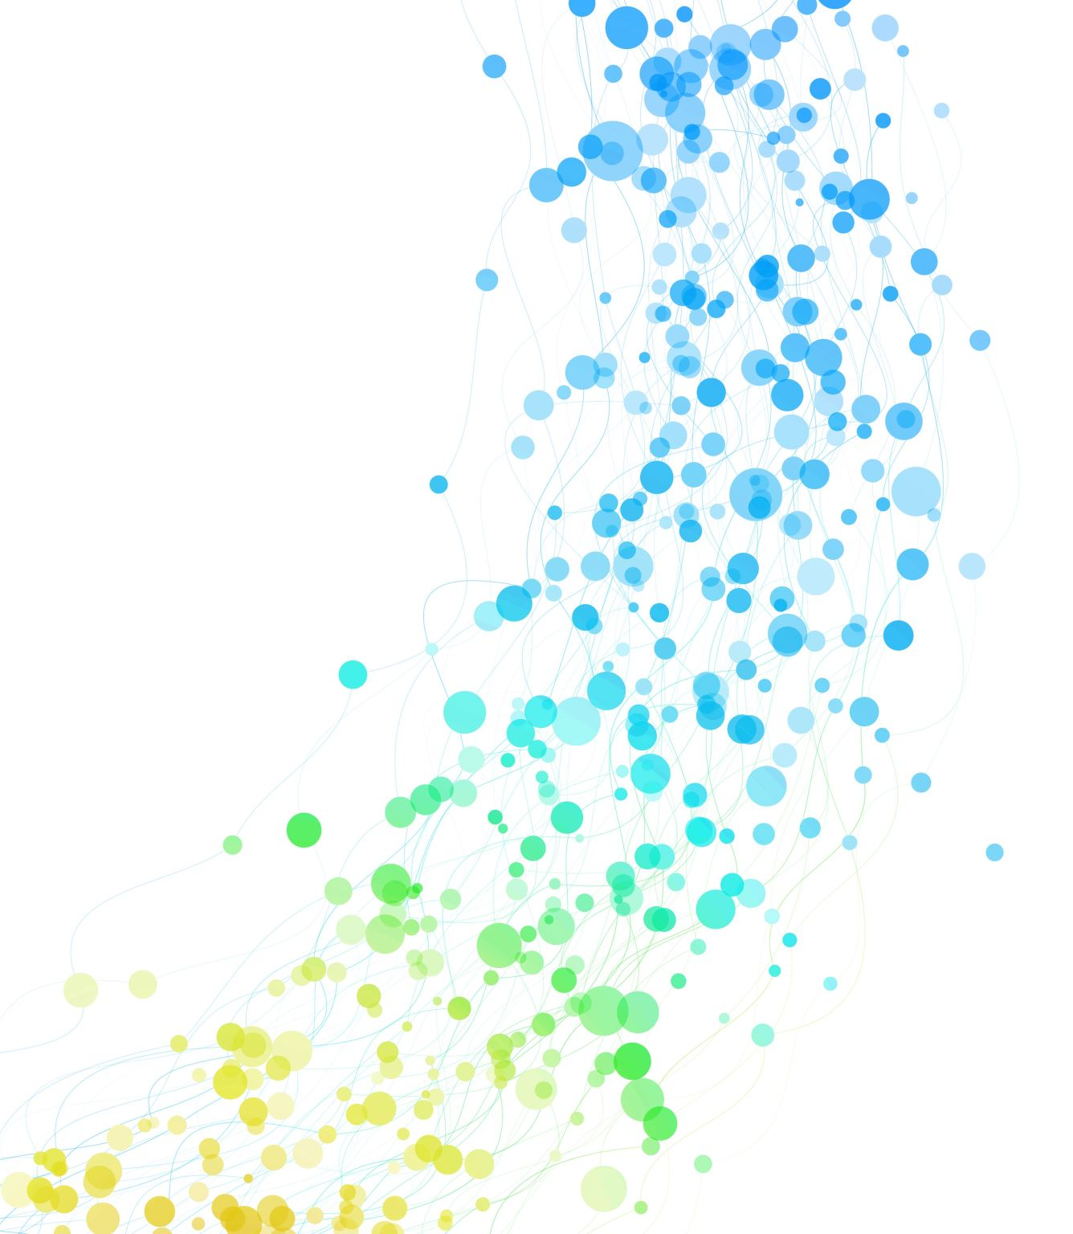
Thank You

Slide 84
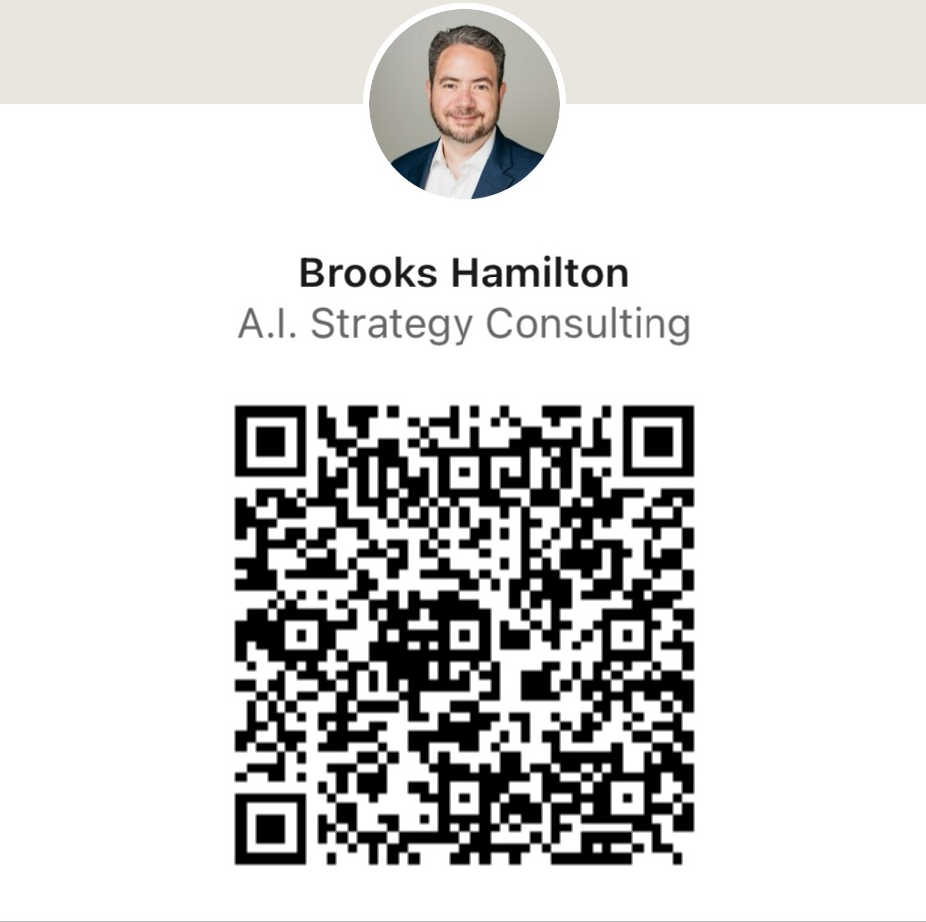
Hamilton AI Strategy Advisors
EMAIL
brooks.hamilton@strategyadvisors.ai
SITE
www.strategyadvisors.ai
PHONE
512.784.8049

Slide 85
I Could Be Wrong …
Jeremy W Wilson
EVP/COO North American Director

Slide 86
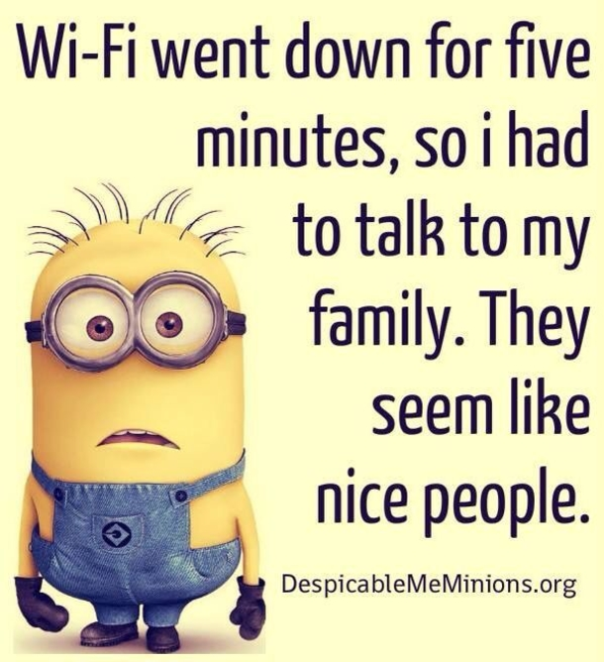

Slide 87
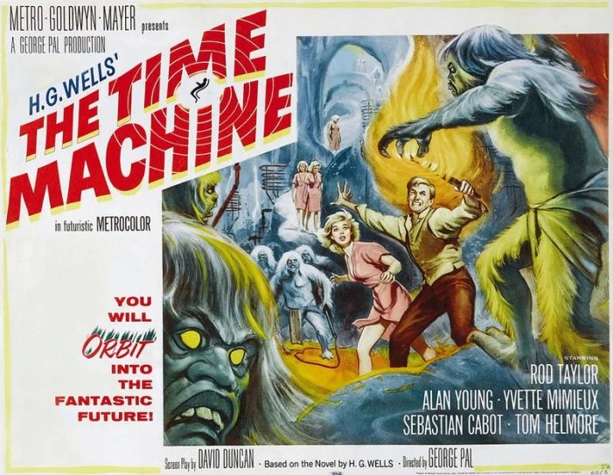
Let’s take a trip back in time

Slide 88
November 2011

Slide 89
November 2011

Slide 90
November 2013

Slide 91
November 2013

Slide 92
November 2013

Slide 93
November 2017

Slide 94
November 2017

Slide 95
November 2017

Slide 96
Something to Think About
Are consumers asking for information about our products?
Are “customers” needing more data to meet their demands?
How much data is in your systems that will need to be shared in the future?

Slide 97
Let’s think about the current Ag space
Industry is working to develop tools to facilitate data driven decision making while each trying to meet a “climate” initiative
“Climate” reporting tools will change the total volume of data collected by Growers
Are standards widely adopted to guarantee we are prepared to process and share the volume of data that these new tools will need to succeed?
How many software tools does a Service Provider have to use today to support the Grower?

Slide 98
Industry Successes
Data management solution for:
Management of soil N,P,K and pH
Hybrid/Variety selection tools
Planting Population
Water Management
Management Zone creation
Development of valuable machine control tools
Software to Software connection
Traceability within the specialty crop market
Talking about how we can help the Grower

Slide 99
Marginal successes … … or maybe failures?
Large scale data interoperability
Engaging the entire Ag Industry
Common definition of “Sustainable” and who pays
Defining Data Ethics

Slide 100
Work together as a team …
We can bring data interoperability to the entire Ag Sector
Competitors can spend more time developing tools and features to bring value to data
As an industry we can work to bring solutions that meets our customers needs and requests

Slide 101
Work Independently and …
Users will likely be operating with 6 or 7 different solutions based on what data each system can support today
Our industry spends millions on developing to each others' standards
Meeting our customers needs and requests will be delayed while we work to support multiple systems

Slide 102
Let others set the standards and …
Will you have a seat at the table to make the standards?
Industry will likely need to make changes to meet these new standards.
Will these organizations know and understand the capabilities of the current technology to capture their requested data?

Slide 104
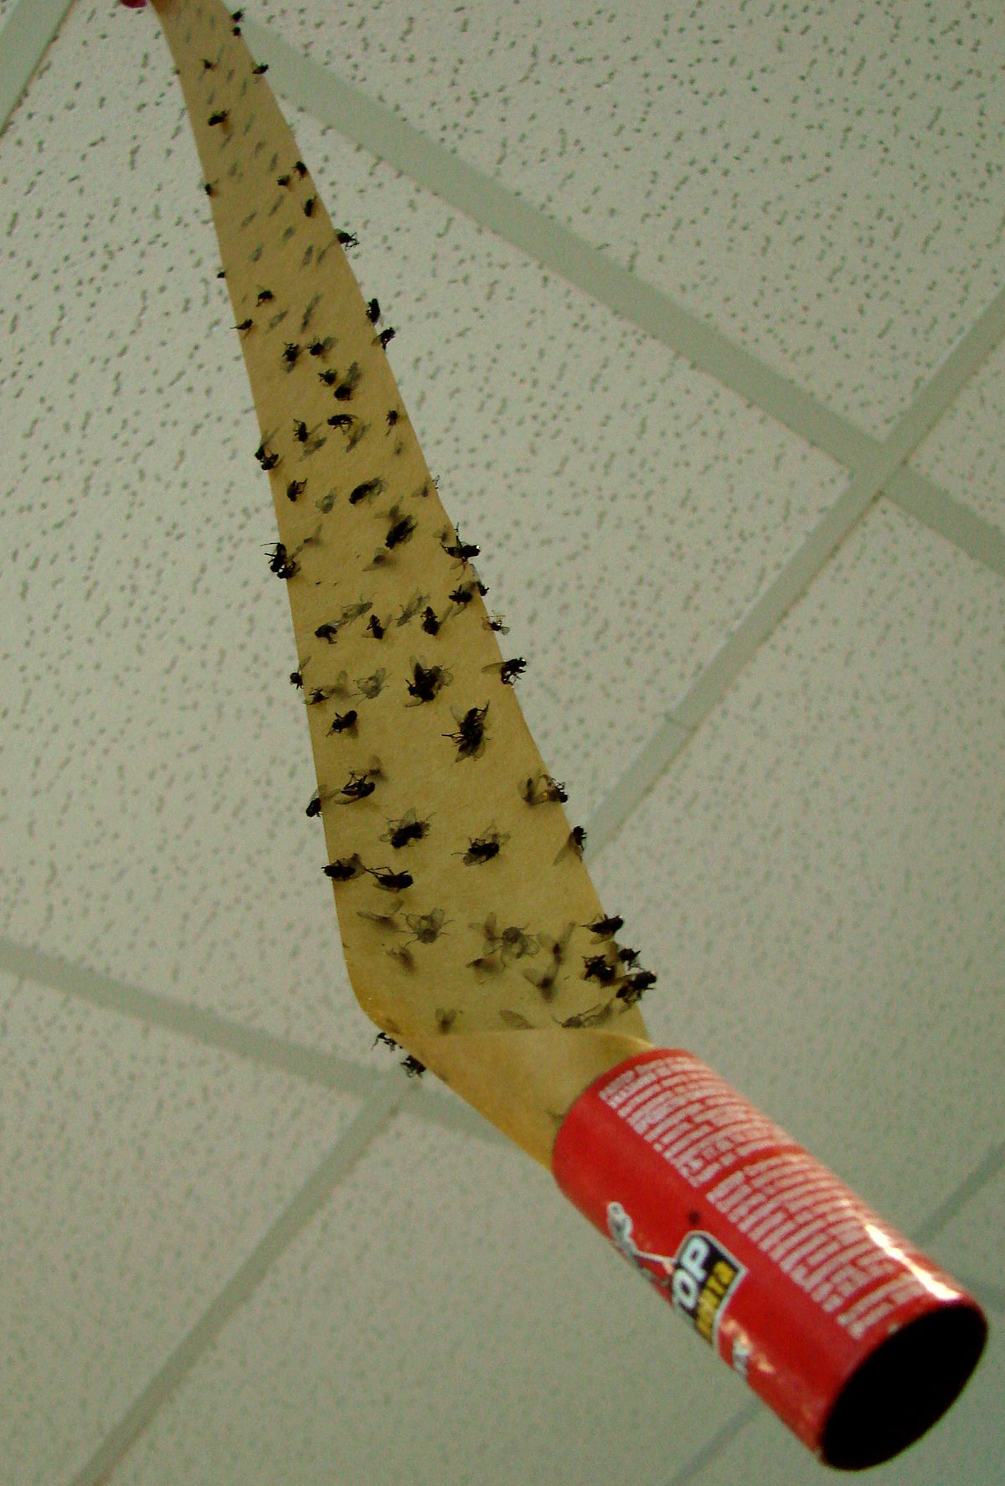
Growers say that …
We just want technology and software tools to work!
Technology must be easy to use!
It Must bring value to their operation!
“Brand Loyalty” and “Customer Stickiness”
are not the same thing

Slide 106
Summary
Bandwidth and connectivity to the farm will improve.
Energy efficiency, climate neutrality, low carbon fuel development, and/or sustainable systems are here to stay.
The value is moving from the farmer to others downstream from his or her commodities
Help growers move from selling commodities to selling a more valuable product to improve their profitability

Slide 107
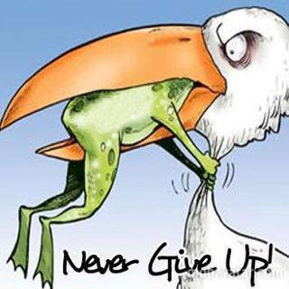

Slide 108
Thank you!

