Slide 1
AgGateway Essentials
Nikki Marshall – Member Services Program Manager
Leslie Hedges – Director of Member Relations
Notes:
.

Slide 2




Thank You to our Silver Sponsors!
Notes:
.

Slide 3
Topics For Today
Introductions
Antitrust Guidelines
Background on AgGateway “The Organization”
AgGateway’s Operating Structure
Working Groups and What We Are Working on Now
AgGateway Resources
Ways You Can Get Involved in AgGateway
Notes:
.

Slide 4
Anti-Trust Do’s and Don’ts
Don’t Discuss
Individual company prices, price changes, price differentials, mark-ups, discounts, allowance, credit terms or data that bear on price
Industry pricing policies
Industry production, capacity, or inventories
Plans concerning design, production, distribution, promotion or marketing
Matters relating to actual or potential customers or suppliers that might have the effect of excluding them from any market
Don’t discuss these matters during social gatherings incidental to meetings, even in jest
Do…
Adhere to prepared agendas for all meetings and object when meeting minutes don’t accurately reflect the matters that transpired
Understand the purpose and authority of the group
Consult with your company counsel on all antitrust questions relating to the activities, discussions or meetings of the group
Protest any discussions, meetings or activities that appear to violate the antitrust laws; disassociate yourself from any such discussions or activities and leave any meeting in which they continue
Notes:
In all of AgGateway’s operations and activities, it must avoid discussions or conduct that might violate applicable antitrust laws, or even appear to do so. To that end, AgGateway has established antitrust guidelines, which it has provided to each participant in this meeting. While it is your ultimate responsibility to ensure that your actions comply with applicable antitrust laws, your participation in this meeting is affirmation that you will abide by AgGateway’s guidelines.

Slide 5

What is
AgGateway?
Our Mission: To develop the resources and relationships that drive digital connectivity in global agriculture and related industries
AgGateway is a global, non-profit organization
whose members develop standards and other resources so that companies can rapidly access data
Notes:
.

Slide 6
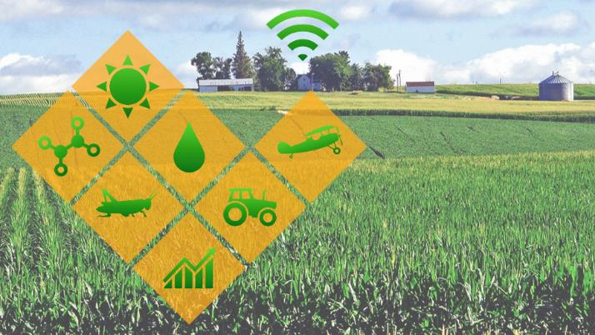
Why are we here?
Success in agriculture today requires:
Mastering the use and exchange of data
Maximizing efficiency and productivity
Tightening financial management of large-scale costs
Notes:
Success in Agriculture today requires mastering the Use and Exchange of data and being able to maximize efficiency and productivity while tightening the financial management of large-scale costs.
The ag industry faces many challenges.
The technology in the field and throughout the industry is getting more and more complex.
Consumers and regulators are demanding more and more visibility.
Companies face increasing regulatory and traceability requirements
Farmers are trying to make sense of the data they have.
Digital data exchange plays a key role in navigating many of these challenges.

Slide 7
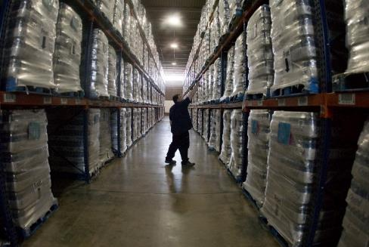

But…
Not all companies use up-to-date or common standards, which makes seamless connectivity impossible!
Notes:
.

Slide 8
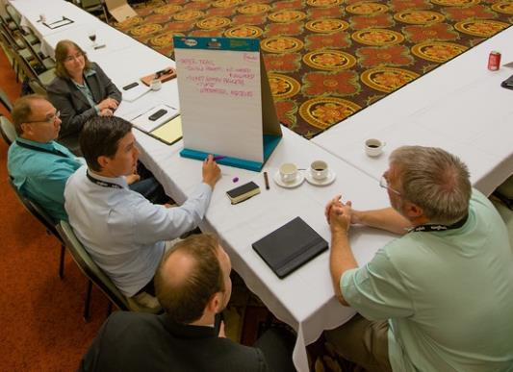
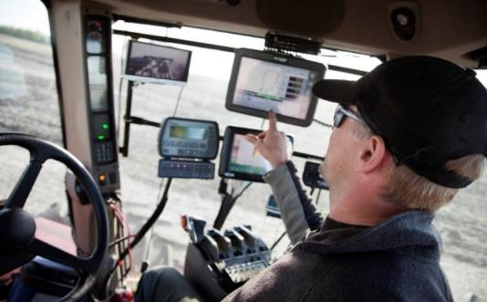
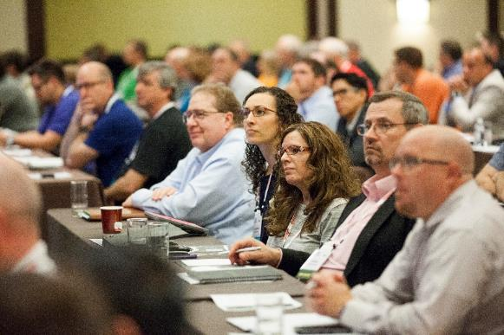

How do we do what we do?
AgGateway members identify business problems to address through working group activities.
Meet Ups bring organizations together to brainstorm, focus on business issues, and generate interest in developing solutions.
Working Groups develop digital resources that help companies identify, understand, consume or exchange data in consistent and agreed upon ways.
We do this work under defined antitrust guidelines and IP development policies and processes.
Notes:
How do we do what we do? Member companies, like yours, identify the priorities that we work on. This is usually done through what we call Meet Ups. Meets ups bring organizations together to brainstorm and generate interest in developing a solution to a common problem. If there is enough interest in tackling a problem, a Working Group is formed that brings AgGateway members together to develop a solution..
This solution is called digital resource. These resources can include standards, guidelines, communications tools, project management tools, implementation tools, and requirements.
All this work is done under our antitrust guidelines and according to our Intellectual Property policy. You must be a member in AgGateway to participate in a working group. That’s because membership provides the commitment to honor the policies and procedures set up for this type of collaborative work.

Slide 9







Collaboration for Industry-Wide
Global Solutions
…standards groups, govt agencies, trade associations…
Notes:
AgGateway teams, or working groups, don’t work in a void. We’re in conversation and work with standards groups, trade associations and government agencies, some of which you see listed here..
Why do we work with these organizations? Well, the solutions we develop need to be compatible and workable throughout the industry and across the globe. Also, there is not point in reinventing the wheel. If a standard already exists and it will meet our needs, we try to adopt it as is. If it doesn’t quite meet our needs, we may modify it, but if one doesn’t exist, then we work together to develop it.

Slide 10
What AgGateway Does and Does Not Do
(a data perspective)
Activity/Function | Reference Data | Transactional/ Operational Data
Document processes | yes | yes
Set standards | yes | yes
Develop implementation guidelines | yes | yes
Define APIs | yes | yes
Document data security use cases | yes | yes
Organize implementation projects | yes | yes
Collaborate with other organizations | yes | yes
Store data | yes | no
Process data | yes | no
Reference non-AgGateway data sources | yes | no
.
AgGateway does not collect, store, transform or analyze operational data
Notes:
What AgGateway Does and Does Not do. From a data perspective, you can see on this slide all the things that AgGateway does and does not do with Reference data compared to Transactional or Operational data. What is important to take away from this graphic is that AgGateway does not collect, store, transform, or analyze transactional or operational data. AgGateway is not a data hub.

Slide 11


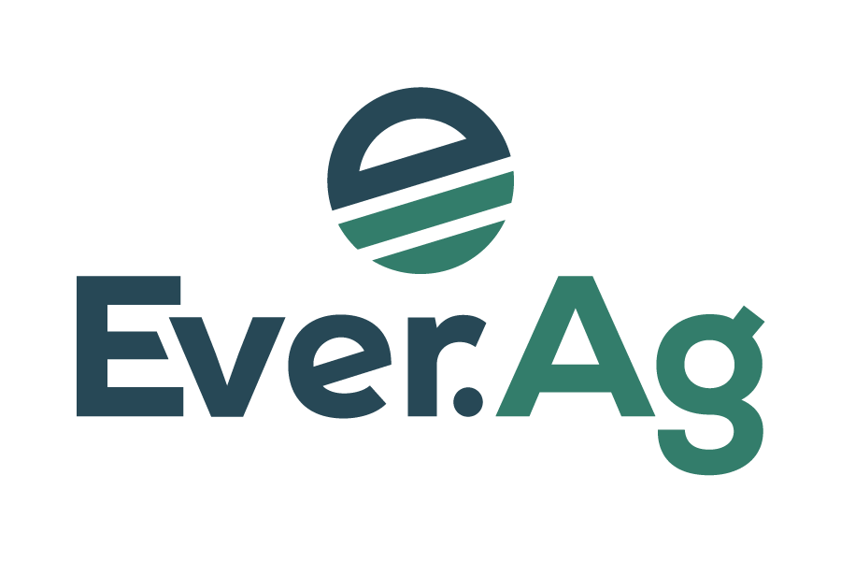












































Here are some of our members!
Notes:
Some of our members are shown on this slide …
As you can see, we have broad representation across the ag industry. Our members include Ag Retailers, Manufacturers (of seed, crop nutrition and crop protection products and equipment), Distributors, Grain & feed companies, Precision ag providers, Specialty chemical manufacturers, Software and data service providers, and a few growers. Our members range from well established firms to brand new start ups.

Slide 12
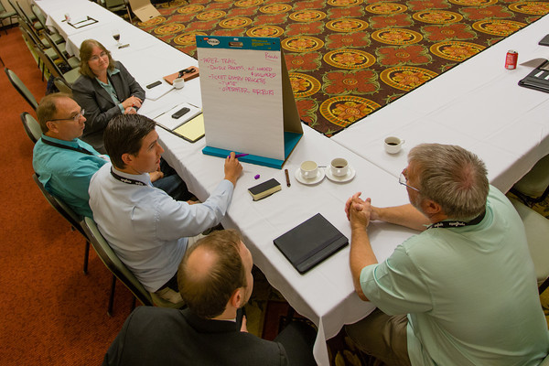
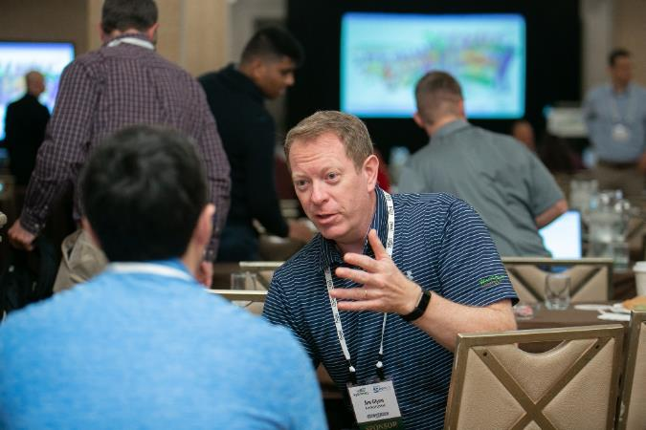
AgGateway is Member-Driven!
Notes:
Here at AgGateway, we are member-driven, which means that our members set the priorities and decide what we work on. Our members come together to collaborate on challenges they are facing and develop business solutions. In our working sessions you’ll find that members often volunteer up both their Business professionals and IT professionals.
We need to hear from both sides– from the managers of the business to identify the problems and propose a solution, and from the IT professionals to develop a solution.

Slide 13
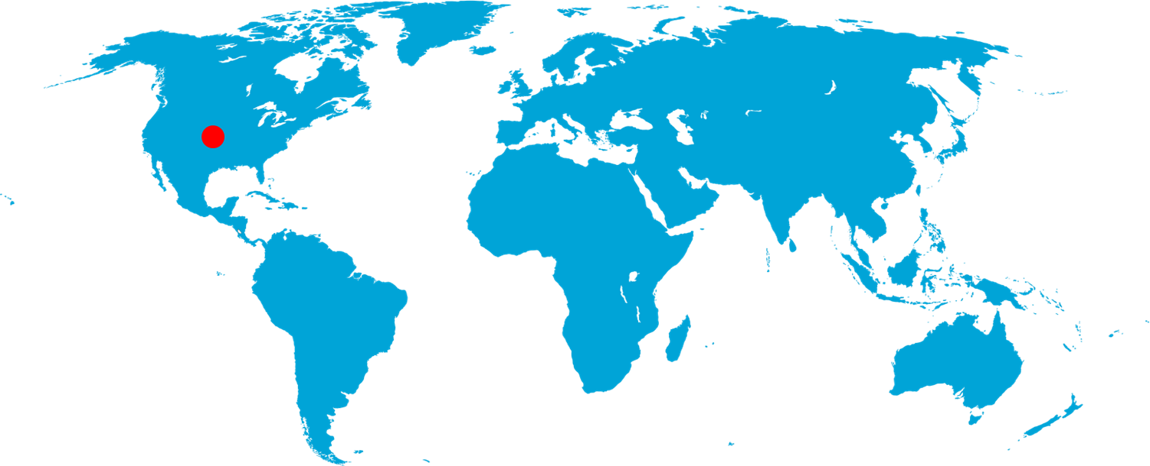
AgGateway Around the Globe
Notes:
Global in scope – We are now a global organization, which includes regional groups in North America, Europe and Latin America. We also have interest in Asia and Australia/New Zealand.

Slide 14
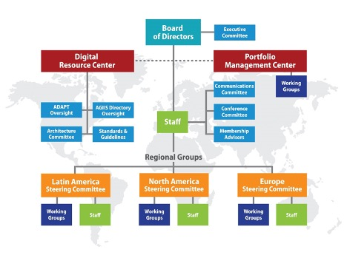
AgGateway Operating Structure
Notes:
AgGateway is composed of a Board of Directors, Regional Groups in Latin America, North America and Europe (each overseen by Regional Steering Committees,) a Digital Resource Center, a Portfolio Management Center, committees that support our digital resources or our organization.
The Board of Directors- The board consists of members which are elected by AgGateway membership (voting members or dues paying members), the President and Chief Executive Officer, and a Corporate Treasurer. Each AgGateway region votes for its representatives to the board.
Each Regional Group has a Regional Steering Committee made up of member volunteers to provide oversight and direction of the Working Group activities in that region.
The Digital Resource Center (DRC) provides oversight and support for all AgGateway digital resources published and/or requiring ongoing maintenance. It oversees compliance with AgGateway's patent policy and digital resource development process, which protects members from developing or distributing digital resources that infringe on their own intellectual property not available in a royalty-free manner.
Digital resources are produced within Working Groups "Digital resources" refers to any digital content developed with the intent of assisting companies with implementing electronic connectivity.. These resources can include standards, guidelines, communications tools, project management tools, implementation tools, and requirements.
The Portfolio Management Center (PMC) provides oversight and support of AgGateway Working Groups and coordinates closely with the Digital Resource Center. Confirm Working Group charters • Manage the commissioning of Working Groups, their work progress and financial reporting • Create tools and resources to help move work forward.
Also have various committees that support AgGateway and our resources.

Slide 15
AgGateway Staff
Brent Kemp– President/CEO
Jeremy Wilson– Executive VP/COO/North America Regional Director
Jim Wilson – Chief Technology Officer
Conny Graumans – Europe Regional Director
José Loyola – Latin America Regional Director
Paul Schrimpf– Marketing and Communications Director
Ben Craker– Portfolio Manager
Leslie Hedges – Director of Member Relations
Meri Kotlas – Web Media Support and Graphic Design Specialist
Chris Crutchfield – AGIIS Product Manager
Nikki Marshall – Member Services Program Manager
Kimberly Chauche – Administrative Assistant
Notes:
Here is a listing of all AgGateway staff. Everyone on here except for Chris Crutchfield, Nikki Marshall, and Kimberly Chauche are paid contractors with AgGateway. They are not full-time staff. Each are contracted for anywhere between 5 and 80% of their time. Chris, Nikki, and Kimberly work for DXC Technologies. DXC hosts and maintains the AGIIS Directory and provides member and subscriber support through Member Services.

Slide 16
AgGateway Working Groups
Notes:
Let’s talk about AgGateway Working Groups. The value you get from membership comes down to your participation in an AgGateway working group or implementing the digital resource that is developed in a Working Group!

Slide 17



From Idea to Working Group to Digital Resource
Meet Ups
Working Group
Works
Working Group Charter
Join the
Working Group
Official document
Goals, Objectives & Deliverables
Timeframe
Select Chair/Co-Chair
Companies/Orgs likely to join
Submitted and approved by AgGateway CEO and VP/COO.
Meet as scheduled
Offline work
Develop & test digital assets
Document
Submit for approval
Work is done under AGW Patent Policies and Antitrust Guidelines
Open to All with Interest in the Topic
Define the Problem
Set the Scope
Align on the goals and key deliverables
Express intertest in joining a working group
Call for Participation
Company/Org first becomes an AgGateway member
Then individuals MUST join the Working Group to participate by completing the form:
Join a Working Group
Notes:
Here we show AgGateway goes from an idea, to a Working group, and the development of a digital resource.
Meetups are open to anyone with interest in developing a solution to a common industry issue or pain point. The problem is defined, and a scope is set, and we make sure everyone is aligned on the goals, and key deliverables. We find out the level of interest to spin up a Working Group. If the level of interest in high, a Working Group charter is drafted. The charter identifies Goals, objectives and deliverable timeframes. The charter identifies a Working group chair and vice-chair to lead the working group. It also identifies companies that are likely to participate. Once drafted, the charter is submitted to the AgGateway CEO, and COO for approval.
We then send out a Call for Participation to join a working group. Companies that wish to participate must be an AgGateway member. Individuals from member organizations then complete a Working Group sign up form that is available on the AgGateway wiki.
The Working Group sets up a recurring meeting and gets to work. Some work is done within the meeting schedule, but work is also done outside of scheduled meetings. The digital resource is developed, tested and submitted for approval and finally it is published.

Slide 18
Delivering Member Value Quickly
Working Groups are the engines of value creation and engagement
Portfolio Management Center helps working groups get started, applies best practices, and communicates outcomes
Digital Resource Center manages and oversees the delivered resource on behalf of the membership
Portfolio Management Center
Digital Resource Center
Members form Working Group
Working Group Works
Proposed Digital Resource is Processed
Digital Resource is Maintained
Notes:
One of AgGateway’s priorities is to develop solutions (or digital resources) for members as quickly as possible. We want solutions developed in several weeks or few months and not have projects linger on without a digital resource being developed. This is one reason we have implemented a Portfolio Management Center to oversee all our working groups. The PMC helps working groups get started, develop a working group charter, navigate roadblocks, like resources for example, and helps apply best practices to ensure a successful project.
Many resources require ongoing management, so our Digital Resource Center is responsible for maintaining a digital resource once it is developed.

Slide 19




Active Working Groups
WG24
WG12
WG18
WG20
WG19
WG04
WG14
WG16
WG00
WG17
WG11
WG21
Input manufacturer
Input distribution/retail
Farm
Field operations
Processor
  WG00 Agrisemantic Infrastructure PoC
  WG04 Ag Lab Data (Modus)
  WG11 LATAM Soil Data
  WG12 PAIL
  WG14 Potato Provenance (on hold)
  WG16 Crop Protection Product Guidelines
  WG17 Field Boundary Terms & Definitions
  WG18 Crop Nutrition 3rd Party Warehouse Management
  WG19 ADAPT Serialization
  WG20 Traceability API
  WG21 European Reporting ADAPT Mapping
  WG24 Field Boundary: GNSS Accuracy
Notes:
.

Slide 20
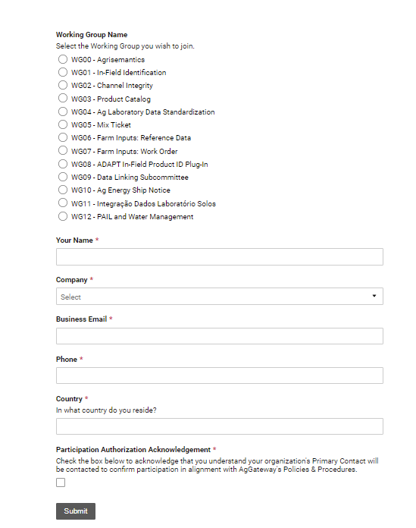
How do I join an existing Working Group?
Complete the short WORKING GROUP Sign-Up form.
Working Group Sign-Up (smartsheet.com)
Respond to a follow up email from Member Services to your primary contact.
Notes:
How do you join an existing Working Group? The sign-up form can be found on the AgGateway Wiki, under the Portfolio Management Center. Here is an example of the form.
Once this form is completed, Member Services receives a notification of your interest in joining the Working Group. Member Services will send your company’s primary contact an email for approval. This is done to ensure that your organization is aware of your participation and that you are participating according to AgGateways Intellectual Property Policies and Procedures. Once approval is received, you are included in the Working Groups meeting invitations.

Slide 21
Active & Completed Working Groups
WG05
WG06
WG12
WG
15
WG18
WG01
WG20
WG19
WG04
WG09
WG14
WG03
WG16
WG08
WG00
WG07
WG13
WG17
WG11
WG24
Input manufacturer
Input distribution/retail
Farm
Field operations
Processor
WG01 In-Field Product ID Seeding Pilot
  Seed list from retailer to farmer/planter controller (ShippedItemInstance)
WG03 Product Catalog
  Common information on products for ecommerce
WG05 Mix Ticket
  Work order/record from product mixing
WG06 Farm Inputs: Reference Data
WG07 Farm Inputs: Work Order, Work Record
WG08 In-Field Product ID ADAPT Plugin
WG09 Linked Data (DatasetMetadata)
WG13 Closed Loop Spray
WG15 Scale Ticket
Notes:
.

Slide 22
Where to find Completed WG Digital Resources
WG/Resource | Location
WG01 In-Field Product ID Seeding Pilot(ShippedItemInstance) | Private GitHub Repo (AgGateway members only) https://github.com/AgGateway/In-FieldProductID
WG03 Product Catalog | Private GitHub Repo (AgGateway members only) https://github.com/AgGateway/ProductCatalog
WG05 Mix Ticket | Public GitHub Repo https://github.com/AgGateway/Dispensing
WG06 Farm Inputs: Reference Data | AgGateway Confluence (Wiki) https://aggateway.atlassian.net/l/cp/zPjh3HqN
WG07 Farm Inputs: Work Order, Work Record | AgGateway Confluence (Wiki) https://aggateway.atlassian.net/l/cp/oGiWwmD5
WG08 In-Field Product ID ADAPT Plugin | Public GitHub Repo https://github.com/ADAPT/ShippedItemInstancePlugin
WG09 Linked Data (DatasetMetadata) | Private GitHub Repo (AgGateway members only) https://github.com/AgGateway/DatasetMetadata
WG13 Closed Loop Spray | AgGateway Confluence (Wiki) Final review & posting in process
Use this form to request access to private repo.
Notes:
.

Slide 23
AgGateway Resources
  AgGateway Website: AgGateway.org
    Accessible to the public
    News, meeting announcements, case studies, description of current work, calendar etc.
  AgGateway Wiki: AgGateway.atlassian.net/wiki/
    Most content for AgGateway members only
    Working documents, project dashboards, meeting agendas and minutes, some digital resources
  MyAgGateway: Member.AgGateway.org
    Access membership directory
    See participant lists for Committees and Working Groups
    Register for AgGateway meetings
    Purchase sponsorships
    Access past and current billing information
    Sign up to receive the AgGateway newsletter
    Maintain directory of your company volunteers
  Member Services – Member.Services@AgGateway.org or +1 (866) 251-8618
Notes:
Here are some other resources that are available for members.
The AGW Website- Contains Industry news, meeting announcements, descriptions of current work, a meeting calendar and much more.
The AGW Wiki – Mostly members only content – Working Group Documents, Project Dashboards, Meeting Agendas, Minutes and some of our published Digital Resources
MyAgGateway- Association Management System, - Where we maintain your company contact information. All member individuals have access. Can access Membership directory, see whos participating in Committees and Working Groups, Register for meetings, purchase sponsorships, Access Billing info and maintain a directory of your company volunteers.
Member Services-

Slide 24
Ways to get involved in AgGateway
Join a Working Group or Connect with Partners
  Help to Create a Project
Attend Committee Meetings
  Be Willing to Take a Leadership Role
Attend Face to Face Meetings
  Annual Conference in November – Nashville, TN
Ask for Mentor or Become a Mentee
Join the Member Advisory Panel
Notes:
How Can You Get Involved?
There are several ways for you to get involved in AgGateway:
Join or start a Working group or a connectivity initiative with your trading partners. . . you could even help create a project or new Working Group
Attend Committee Meetings and consider taking a leadership role; all of our Committees are listed on our website
Attend our face-to-face meetings in June & November.
Our face-to-face meetings are great opportunities to network with vendors, customers, and competitors
Ask for a Mentor:
We have current members who are willing to work with new members and walk along with them for 3-6 months to bring them up to speed on what AgGateway is, and how to get the best value out of your membership. Our meetings can be intimidating for some people, so having a mentor or someone from your company who has been around AgGateway for a while will help to decide what sessions you should attend. If your company is not new to AgGateway, you can probably find a mentor within your company. Either way, we can help you find someone to work with you!
Join the Member Advisory Panel which is a small subset of members; at this year’s Annual Conference the Member Advisory Panel will participate in a design thinking session focused on member engagement and communication.

Slide 25
What questions do you have?
Notes:
.

Slide 26
How We Collaborate – Wiki 101
Nikki Marshall – Member Services Program Manager
Notes:
.

Slide 27
Topics For Today
What is a Wiki?
Why AgGateway uses a wiki
How to access the AgGateway wiki
How to create your user account
Wiki homepage contents and security
Define a Space and a Page
How to find content
Creating and updating a page – The Editor
Page history
Managing your profile
Notes:
.

Slide 28
What is a Wiki?
Wikipedia Definition – A wiki is a website which allows collaborative modification of its content and structure directly from the web browser.
Merriam Webster Definition – A website that allows visitors to make changes, contributions, or corrections
Impress Your Friends- Wiki/Wiki/Web was the first wiki and was developed by software engineer, Ward Cunningham in 1994. The term “Wiki” was named by Cunningham and is derived from a Hawaiian term meaning “Quick” or “Fast”
Notes:
.

Slide 29
Benefits of the Wiki
Atlassian’s Confluence or the Wiki, allows you to create, organize, discuss and document work with your team
All work is centralized
Allows for collaboration
Real Time Updates
Notes:
.

Slide 30
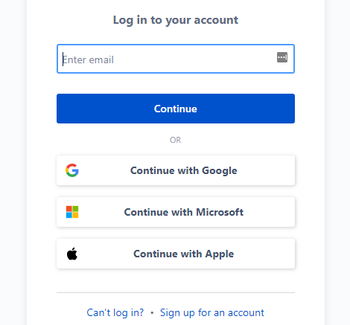
How do I get access?
https://aggateway.atlassian.net/login
Self Register - Click on “Sign Up for an Account”
OR
Contact Member Services
Notes:
HOW TO GET ACCESS
To get access to the wiki, go to https://aggateway.atlassian.net/login and click “Sign Up for an Account”. Once registered, you will have immediate access to the public content on the wiki. Member Services will receive a notification that you have signed up and we will give you membership access.
Some spaces are restricted at an individual or group level. To get access to spaces that are restricted to certain groups, contact the groups council chair or vice chair, or a project lead to request access. This person will send the request to Member Services so that we can update your user profile with access to the space.
Login

Slide 31
Spaces and Pages
Spaces – Containers for pages with related content
  Site Spaces – These are areas where you can create content and collaborate with other users
  Personal Spaces – You can create your own personal space. Your space can be kept private, or you can open it up for others to view and edit
Pages – Allow you to create content and store it in a space
Notes:
Spaces are containers for pages and blog posts with related content. Each space that is created is automatically created with a home page – this is the first page you will see when navigating to a space. There are two types of spaces, Site Spaces and Personal Spaces.
Site Spaces – These are areas where you can create content and collaborate with other users. The links here on the AgGateway home page will take you to a site space. Only AgGateway Staff, primarily Jim Wilson or Marilyn Hunter, along with Member Services, can create a Space.
Then there are personal spaces.
Personal Spaces – You can also create your own personal space to store personal documents, links, etc. for personal use. Your space can be kept private, or you can open it up for others to view and edit. Later in this demonstration I will show you where you can create your own personal space.
Pages on the other hand allow you to create content and store it in a space so that it can be shared.

Slide 32
Permissions
Spaces Are Created by Site Administrators (Usually AgGateway Staff
Most Spaces are accessible by AgGateway Members
  Exceptions include Staff, Regional Steering and Executive Committees
Upon Initial Sign-Up, Member Services is notified by email
  Use Company Email Address – This helps verify membership and ensures member access privileges.
Make sure you are logged In!
Notes:
.

Slide 33
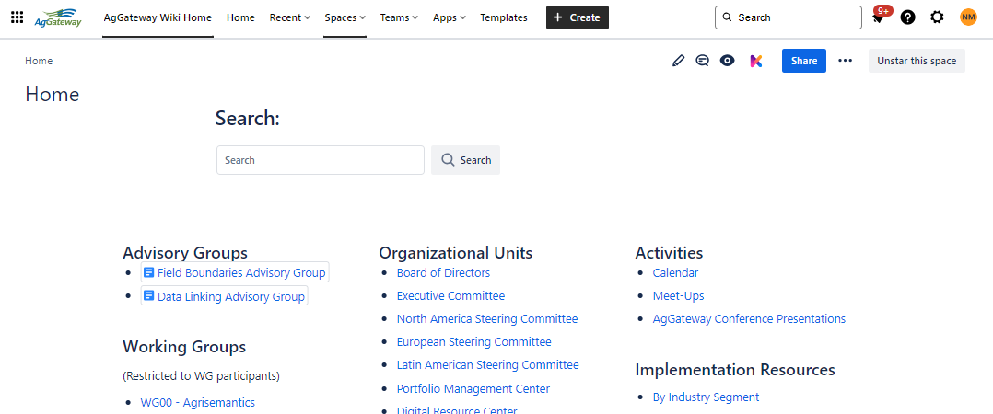
How can I tell if I am logged in?
Notes:
.

Slide 34
Wiki Home
Working Groups
Organizational Units
Activities
Implementation Resources
Other Resources
Notes:
.

Slide 35
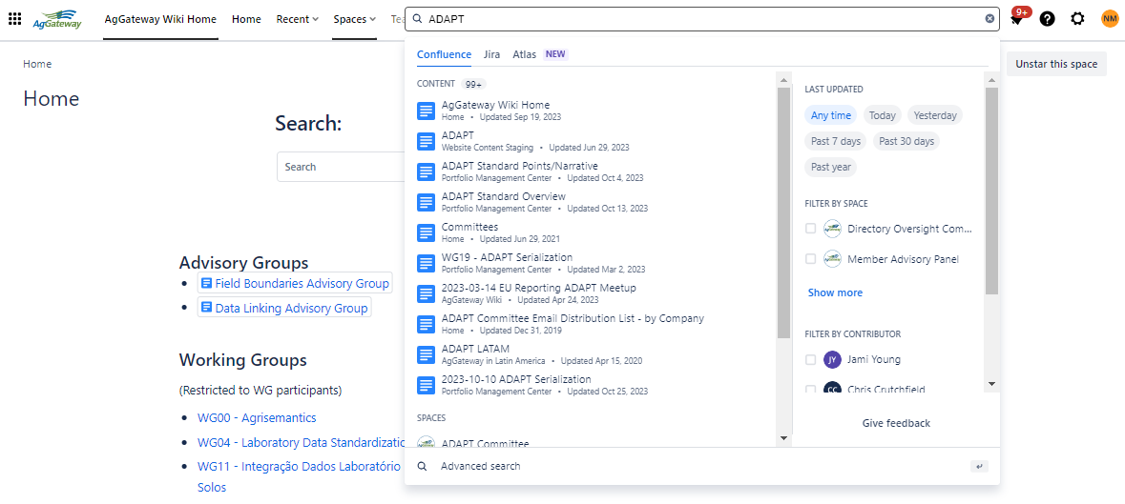
Searching for Content
Notes:
.

Slide 36
The Editor
  Name the page
  Page Layout (column setup)
  Files and Images
  Links to Other Wiki Pages
  Symbols
  Emoticons
  Horizontal Rule
  Task List
  @User mention
  Macros
  Keyboard Shortcuts
  Adding a Table
    Inserting and deleting columns and rows
Notes:
Navigate to MS Home and create a new page. Show how pages become Parent/Child

Slide 37
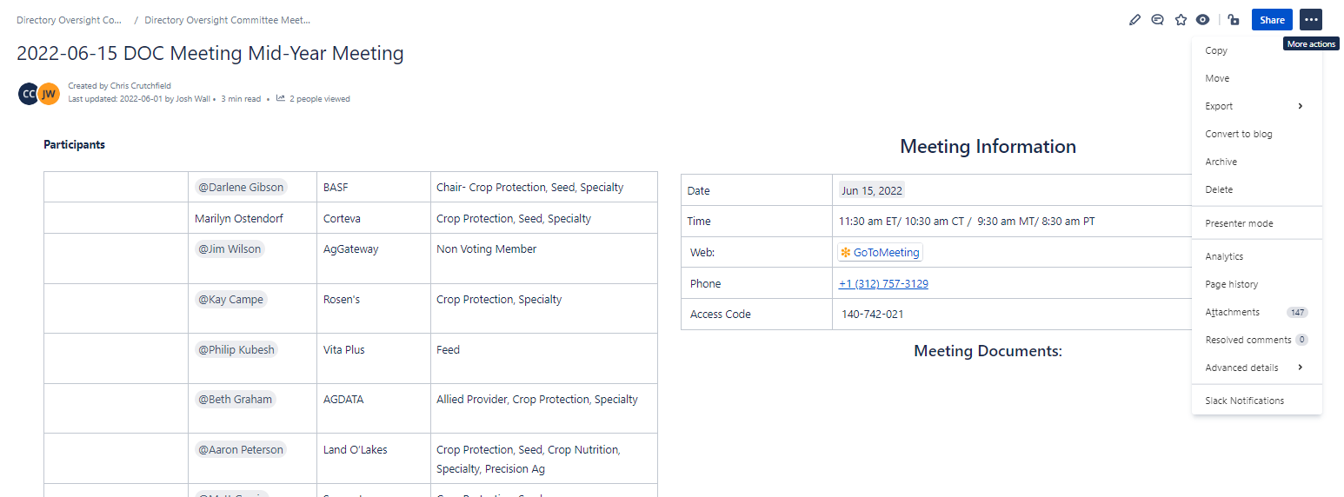
Copying Pages
Notes:
.

Slide 38
Page History
View changes made to a page
Restore a previous version
Compare versions
Notes:
.

Slide 39
Managing Your Profile
If you need to update your password, click on initials, top right- hand corner.
You can also view any tasks that have been assigned to you, or those that you have assigned others.
This is also where you can create your own personal space, by clicking on Personal Space under your profile.
Manage Watches
Notes:
.

Slide 40
What questions do you have?
Notes:
.

Slide 41
Introduction to MyAgGateway
Leslie Hedges – Director of Member Relations
Notes:
.

Slide 42
Topics For Today
Benefits to AgGateway members
Summary of how to get started
Live demo
Q&A
Notes:
.

Slide 43

Vision is to create…
Intuitive solution that improves staff efficiency
Provides members an easy-to-use interface
Configurable for AgGateway structure
Ability to manage Committees and Working Groups
Integrated to AgGateway website and other AgGateway systems
Notes:
.

Slide 44
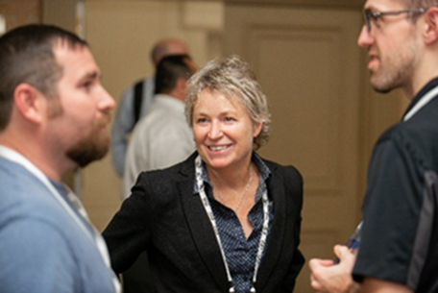
Making it easier: Networking
Access membership directory
See participant list for Committees and Working Groups
Access volunteer history for you and your company colleagues
Notes:
AgGateway has a new Member Management System, which makes a few things much easier for our members to navigate.
AgGateway members can now:
Access a Membership Directory; the ability to look up contact information for other members,
Look up lists of committee and working group members
Track your AgGateway volunteer history, and that of your company

Slide 45

Making it easier: Communication
Sign up to receive AgGateway newsletter
Maintain list of your company volunteers
View which members of your organization are involved in which AgGateway activities
Opt in/opt out to be listed in Member Directory
Notes:
Review and adjust AgGateway email lists you’re on
Update your AgGateway company roster – who is getting communications

Slide 46

Making it easier…
Register for AgGateway meetings
Purchase sponsorships
Track and manage dues and fees invoices
Access past and current billing information
Notes:
Register for AgGateway meetings
Purchase sponsorships
Track and manage your AgGateway dues and fees invoices,
…with the ability to see your accounting history (IF you are the Primary Contact for your Org)

Slide 47
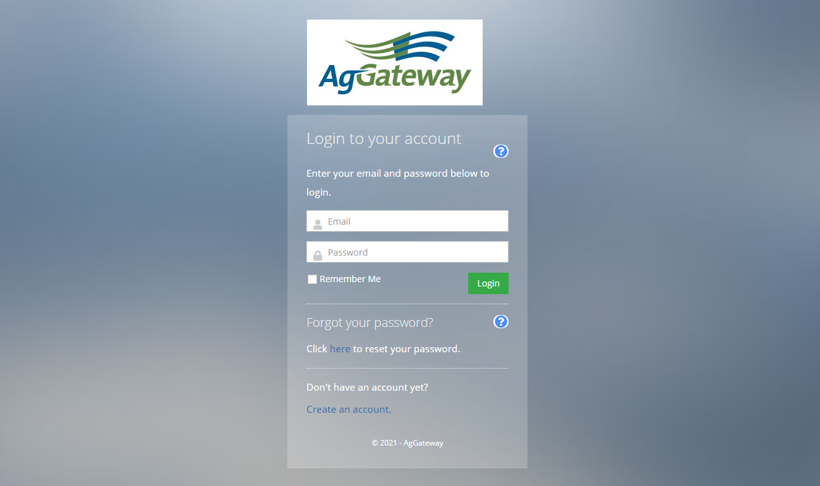
Getting Started
https://member.aggateway.org/account/login
Notes:
This is the URL for MyAgGateway

Slide 48
Create User Profile
Upload your headshot
Verify your information is correct
If you are the primary contact for your organization, verify your organization’s information is correct
Notes:
.

Slide 49
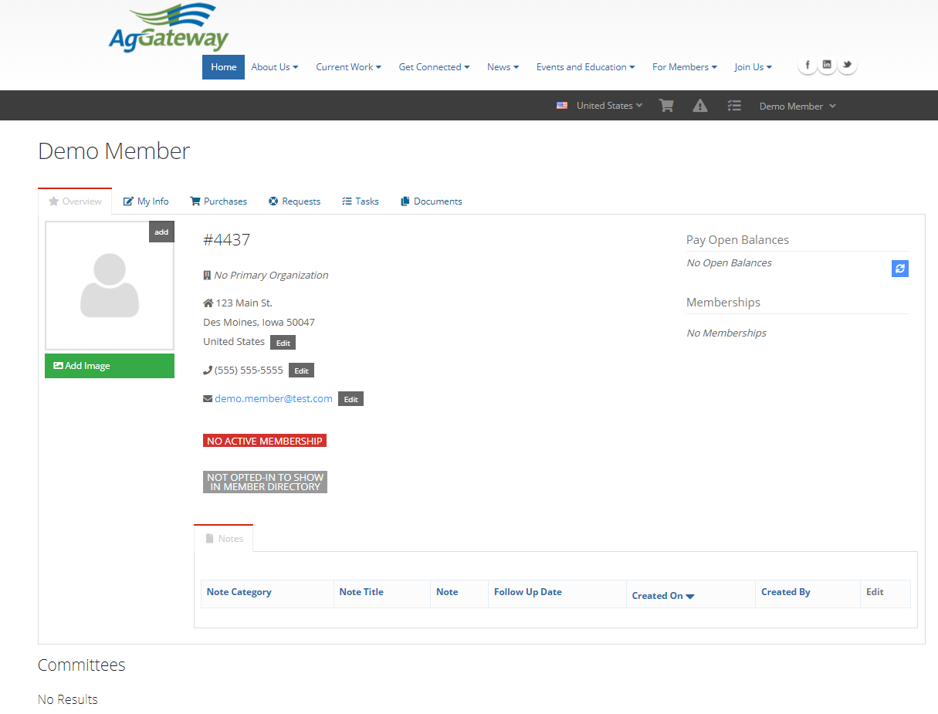

Member Profile Page
If member has open invoice it is reflected here
Membership type and expiration date listed here
Member’s Committees and Working Groups listed here
Notes:
This is a sample member profile page

Slide 50
Live Demo
https://member.aggateway.org/account/login
Notes:
.

Slide 51
Member Feedback Welcome!
Please contact Member Services at:
Member.Services@AgGateway.org or +1 866.251.8618
with suggestions.
Notes:
.

Slide 52
Thank you!
Questions or information about AgGateway?
Contact Member Services
+1.866.251.8618
member.services@aggateway.org
Website: www.AgGateway.org
Notes:
.

