Slide 1
Communications Committee
Mid-Year Meeting
June 12, 2016
3:30 pm – 5:20 pm

Slide 2
Please Sign In
This Photo by Unknown Author is licensed under CC BY-SA

Slide 3
Communications Committee
Mid-Year Meeting
June 12, 2016
3:30 pm – 5:20 pm

Slide 4
Agenda
Roll
Anti-Trust Guidelines
Minutes Taker
Committee Goals
Marketing Plan
Social Media Calendar & Training
Newsletters
Council & Working Group Updates
Next Meeting

Slide 5
Attendees
Name
Company
Role/Title
Years involved with AgGateway
Main goal to get accomplished this week

Slide 6
Anti-Trust
While some activities among competitors are both legal and beneficial to the industry, group activities of competitors are inherently suspect under the antitrust laws. Agreements or combinations between or among competitors need not be formal to raise questions under antitrust laws, but may include any kind of understanding, formal or informal, secretive or public, under which each of the participants can reasonably expect that another will follow a particular course of action.
Each of you is responsible to see that topics, which may give an appearance of an agreement that would violate the antitrust laws, are not discussed at your meetings. It is the responsibility of each participant in the first instance to avoid raising improper subjects for discussion. This reminder has been prepared to assure that participants in meetings are aware of this obligation. A copy of the Antitrust Guidelines must be provided at every meeting to its participants. If meeting is via telephone, an electronic form must be sent to its participants prior to the conference call.
http://s3.amazonaws.com/aggateway_public/AgGateway_Antitrust_Guidelines.pdf

Slide 7
Committee Goals
Operations
Get a Vice-Chair (Complete)
Fill all Council/Working Group/Committee Liaisons
Increase membership size of Communications Committee (Semi-Complete)
Job Description and Expectations for positions within the Committee (Member, Article Writer, Social Media)
Social Media
Increase interaction with social media platforms, especially LinkedIn Group and Twitter
Pre-load and semi-live tweet at relevant trade shows
Newsletter:
Leadership Profile in each newsletter
New Member Profile in each newsletter
Each Council have at least two significant update article
Each Committee have at least 1 significant update article
Get publication of AgGateway related articles within company internal newsletters
Publish Case Studies

Slide 8
Marketing Plan
Updates for the next few months
Trade shows
“C-Suite Communications Kits” project

Slide 9
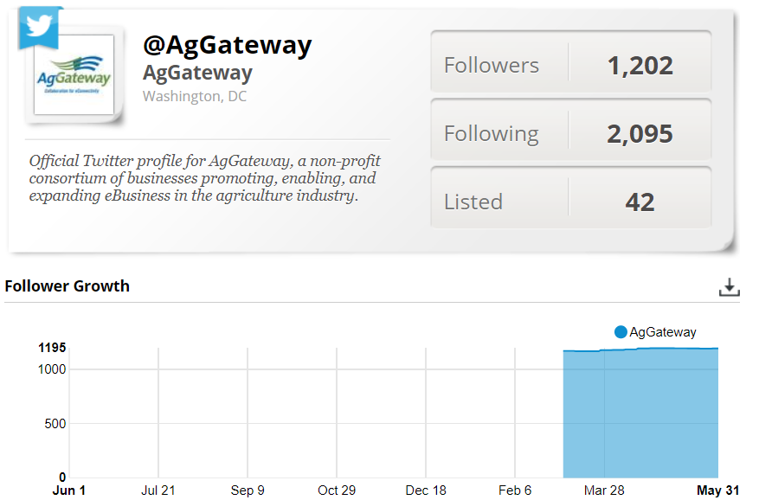
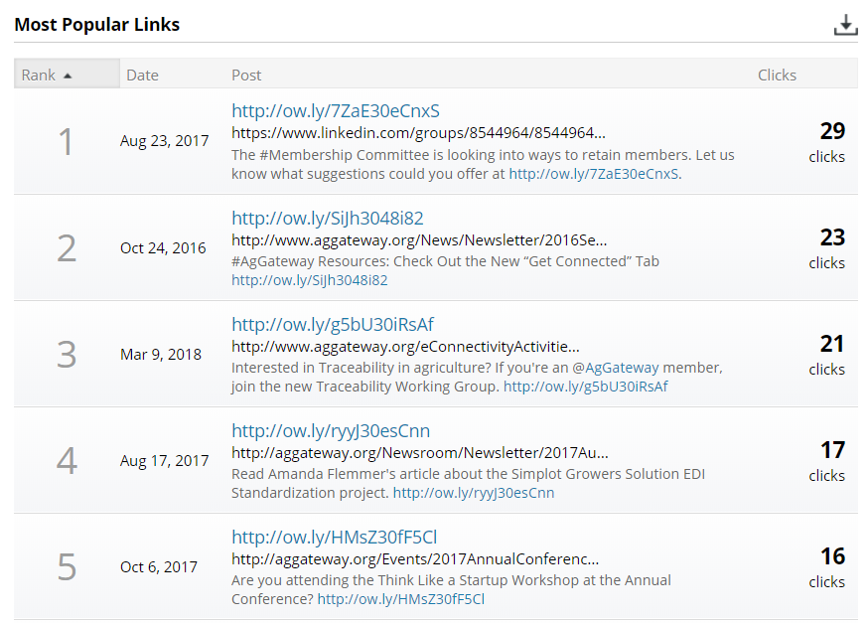
Social Media: Twitter Stats

Slide 10
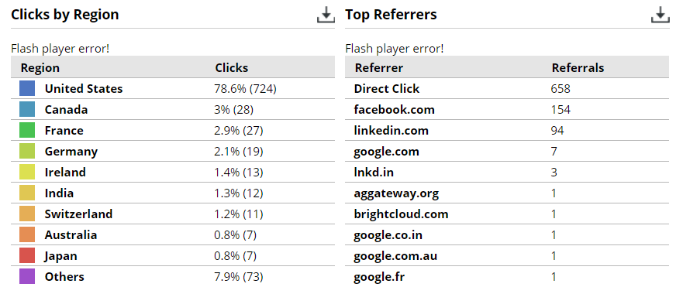
Social Media: Link Clicks

Slide 11
Newsletter: (Due June 15)
New Member Article: Evin Ellis
AgGateway in the News: Susan Ruland
Leadership Profile: J. Nolfo
AIDC Working Group: Jody Costa
AGIIS: Chris Crutchfield / Josh Wall
Council Updates: J. Nolfo
Monthly LinkedIn Group Discussion: J. Nolfo
Leadership Remarks from MYM - Susan Ruland
Quick Connect Session - Natasha Lilly
Mid Year Meeting Wrap Up -

Slide 12
Newsletter: (Due July 15)
New Member Article: Evin Ellis
AgGateway in the News: Susan Ruland
Leadership Profile: J. Nolfo
AIDC Working Group: Jody Costa
AGIIS: Chris Crutchfield / Josh Wall
Council Updates: J. Nolfo
Monthly LinkedIn Group Discussion: J. Nolfo

Slide 13
Council, Committee & Working Group Updates
Councils:
Seed Council: Natasha Lilly
Ag Retail Council: Natasha Lilly
Crop Nutrition Council: OPEN
Specialty Chemical Council: J. Nolfo
Crop Protection Council: Eileen Licitra
Precision Ag Council:
SPADE Task Force
SPADE Communications Task Force
Allied Providers Council: Eileen Licitra
Grain & Feed Council: Natasha Lilly
Committees and Working Groups:
Conference Committee: OPEN
Membership Committee: Nick Reichel

Slide 14
Next Meeting
July 5 @ 2:00 ET
Do we want to move?

