Slide 1
WG20 Traceability API
Annual Conference 2022 Kick Off & Working Session

Slide 2
API track
Leverage prior work
  CART
  KSU / TSU ontology research
  Dataset Metadata
  Years of discussion
Model TRU, CTE and related components in Score
Use components to build OpenAPI definition
Enable service providers share datasets using Dataset Metadata integration from which CTEs and TRUs can be elicited using processing algorithms

Slide 3
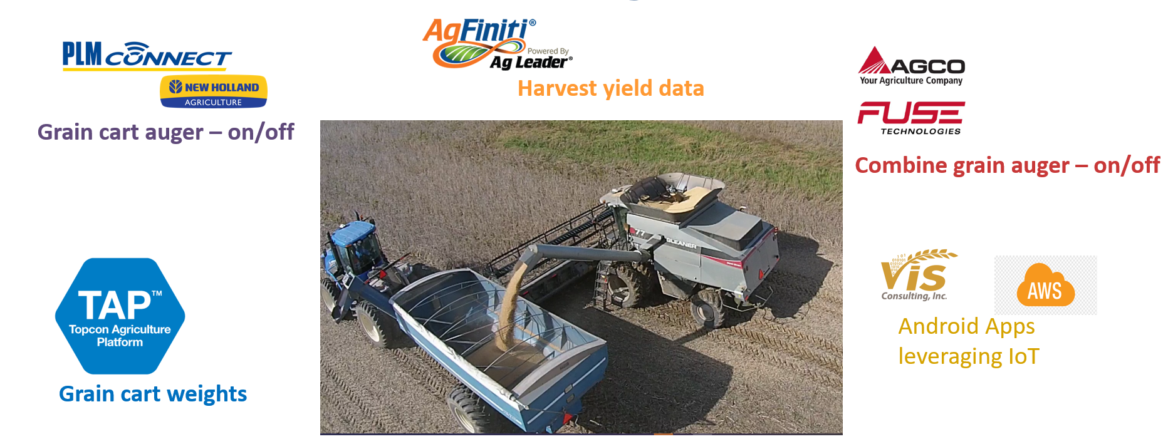


Dataset metadata driven integration
Traceability API ideas for client:
GET /tru-list?kde.id=$&kde.type
GET /cte-list?kde.id=$&kde.type
API Client
Traceability Repo
(discovered
CTEs, TRUs)
Notes:
The OEM Platform alone is not enough to solve the transfer event discovery, that all datasets and event messages needed to be merged together to truly identify the transfer event. With integration via the recently released Dataset Metadata, data can be more easily shared to traceability repositories where TRU and CTE discovery can take place, and an API can be provided for future root cause analysis.

Slide 4
Agenda
Project Overview
  Background
  Key concepts
Review Charter
Working Session
  Review input models and SCORE components
Next meetings and work plans

Slide 5
WG20 Traceability API Project Overview
Nov 2022 Kick Off

Slide 6
What are we trying to do and why?
Connect a load of grain or grain product with source fields or containers to:
Provide data documenting aspects of crop and commodity history that adds value
Provide reliable real-time data to associate a delivered load with a contract, field, and/or farm owner
Reduce time spent connecting records by hand
Provide correlation of quality characteristics of grain with the area it was taken to optimize practices or improve product quality over time (business intelligence)
Determine which lots or loads of product may be tainted by contaminated inputs discovered after production

Slide 7
Challenges
tracking bulk (loose) material as it is mixed and moved
  WG20 will address this with data models and practices
many different repositories for related data, each having only a part of the picture
  Dataset metadata from Data Linking WG supports discovery and retrieval
incomplete data and costs of filling those gaps
  WG20 or a follow on WG will provide guidelines for data required for specific use cases

Slide 8
Past Work
CART (Commodity Automation for Rail and Truck)
Traceability WG
In-Field Identification
Seeding and harvest PoCs
  (the latest to be presented at Tuesday’s 2pm Data Linking Subcommittee session)

Slide 9
Key concepts for the Traceability API
Traceable Resource Unit
Critical Tracking Event
Key Data Elements

Slide 10
Traceable Resource Unit
A collection of material, discrete product(s), or packaged product(s) treated as a unit for some period for tracking.
Abbreviation: TRU
Examples: The grain contained in a truck during delivery to a grain elevator from a farm. The collection of material in a storage bin between transfers.
From Ameri, Wallace, et al traceability paper for JCISE:
  Traceable Resource Units (TRU)s are collections of materials with some shared history for which an agent may have a need to retrieve information. The shared history might include similar production, movements, or storage history.

Slide 11
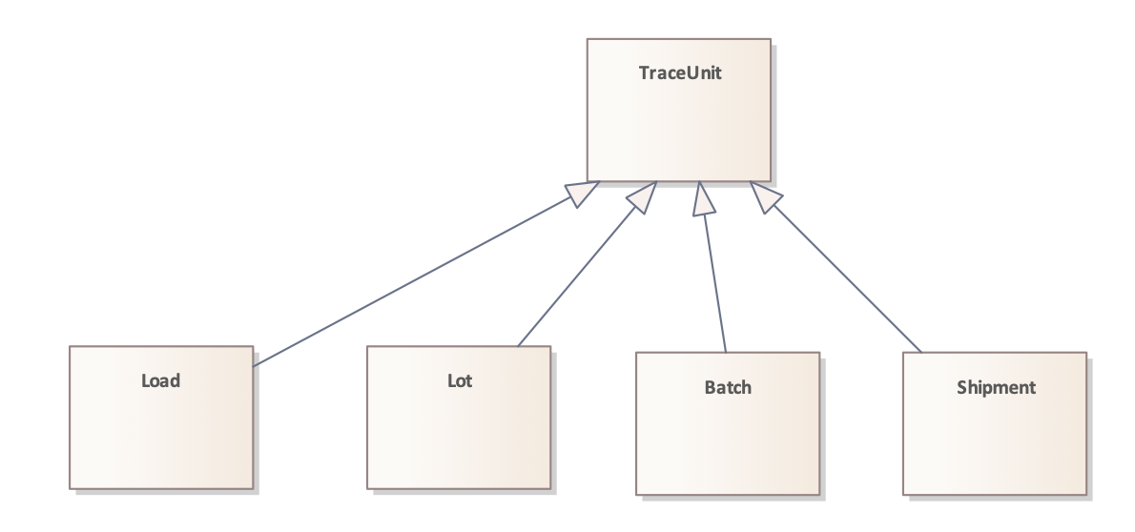
Traceable Resource Unit (continued)

Slide 12
Critical Tracking Event
An occurrence where information is captured representing history relevant to a product’s genealogy. This includes occurrences to product or material, as well as occurrences involving equipment with which product or material came into contact.
CTEs are bounded by time, and usually by space. CTEs often document a change in state.
[GS1] CTEs are activities in the supply chain that should be documented by the capture of key information for each event in order to accurately trace product movement up or down the supply chain. The IFT report defined CTEs as “those instances where-in product is moved between premises, is transformed, or is determined to be a point where data capture is necessary for effective tracing.”1 Typically, these events involve a product’s transformation, transportation, or depletion.

Slide 13
Critical Tracking Event types
Transfer Event
  Movement of material from source to target container
Transport Event
  Movement of material from one site (geographical location) to another
Transformation Event
  an event where the type or one or more characteristics of a portion of material/product is changed or where the identities of inputs are changed in a way that is difficult to reverse
Observation Event
  an event where some measurement or other observation is noted and recorded that relates (directly or indirectly) to material or equipment
Custody Change Event
  an event that changes the party responsible for a subject from the source custodian to the target custodian
Ownership Change Event
  an event that changes the party with title to the subject from the source party to the target party
Maintenance Event
  an event typically “resetting” important characteristics of a resource

Slide 14
Key Data Elements
Data that should be captured for a Critical Tracking Event to answer questions such as Who, What, Where, and When regarding the event.

Slide 15
WG20 Charter Review
Confirm, scope, deliverables, timeline etc.
https://aggateway.atlassian.net/wiki/spaces/PMC/pages/3476554217/Charter+WG20+-+Traceability+Component+Modeling

Slide 16
Walk through NIST models
Evan Wallace, NIST

Slide 17
Work on CTE and TRU components in SCORE
Scott Nieman, Land O’ Lakes

Slide 18
Next Meetings
Day, Time, Cadence, etc.

Slide 19
Thank you

