Slide 1
WG17 Field Boundary Use Cases & Definitions
Annual Conference 2022 Update & Working Session

Slide 2
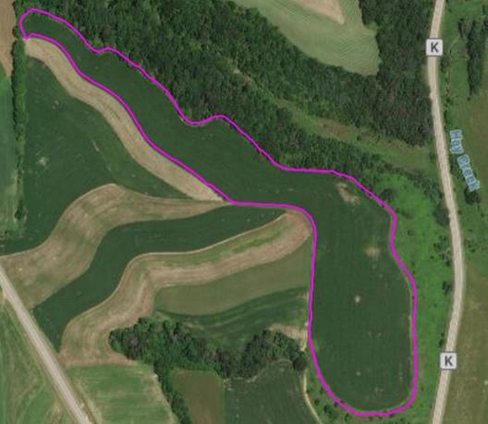
Agenda
Project Overview
Progress to date/Status
Confirm WG Leadership
Working Session
  Review Completed User Stories
  Work on remaining User Stories
  Review Identified terms, AgGlossary
Next meetings and work plans

Slide 3
WG17 Field Boundary Use Cases & Definitions Project Overview
Nov 2022 Update

Slide 4
WG15 Status And Background
Value of Field Boundary Definition & Use Cases:
An unambiguous, core definition of a field and field boundary that can serve as the basis for different business use cases, can reduce effort and confusion across the value chain
Preserving the meaning of that core definition, while adding relative meaning for different use cases
Enable farmers to share their field data without having to learn a multitude of terms and meanings
Assist in traceability efforts
To-date, 8 of 15 Use Cases identified in charter captured or consolidated
Initial terms identified with draft definitions

Slide 5

WG Lead(s)
Chair position Open
Responsibilities

Slide 6
Working Session
Review Use Cases
Review Terms

Slide 7
Use Cases Status, Schedule and Links
https://aggateway.atlassian.net/l/cp/8n45m8J8
Not started yet:
  In-Season Imagery
  Ground Based Autonomous Vehicle
  Aerial Autonomous Vehicle
  Crop Insurance Claim
  Sustainability/Carbon Reporting
  Multi-cropping Splitting/merging fields
  Multi-cropping cover crops
  Platt maps, PLSS, other legal property lines

Slide 8
Next Meetings
Wrap up user story sessions
Convene full WG, finalize stories, define terms

