Slide 1
WG15 Scale Ticket
Annual Conference 2022 Update & working session

Slide 2
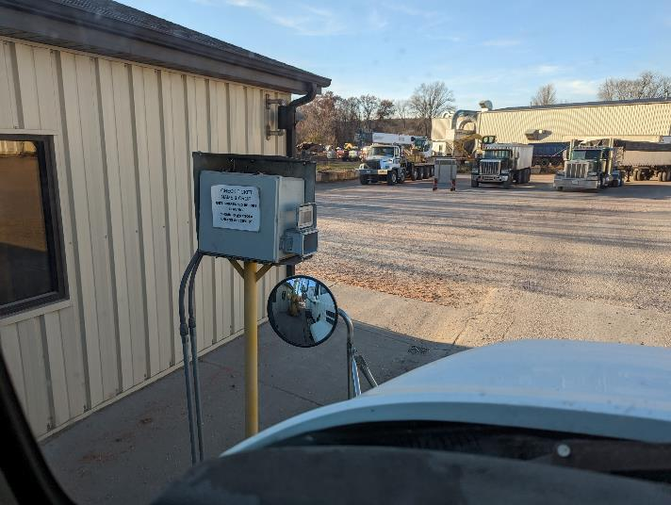
Agenda
Project overview
Progress to date/Status
Working Session
Review User Stories
Review BPMN/Sequence Diagrams
Create matrix of stories – diagrams
Identify any Agrisemantic requirements
Next steps, additional working groups

Slide 3
WG15 Scale Ticket Project Overview
Nov 2022 Update

Slide 4
WG15 Status And Background
Value of standardized digital scale ticket:
Processing receipts electronically in real-time, eliminating stacks of paper receipts
Provide a means to transfer the proof of delivery back to the shipper’s system for integration
Improving the awareness of source and downstream locations
Support the settlements process
Helping build a foundation for traceability
Minimize the impact and exposure of contaminated commodities and improve recall time
To-date, 10 Use Cases identified in charter captured or consolidated
BPMN/Process Diagrams from CART ready to be reviewed
Several existing API’s and other materials shared to gap check against

Slide 5
Working Session
Review Use Cases
Review BPMN/Process Diagrams
Link Diagrams to Use Cases (Matrix)
Agrisemantic Needs

Slide 6
Agrisemantic Needs
Controlled vocabularies?
Identify what if any needs, suggested sources from use cases

Slide 7
Next Steps Discussion

Slide 8
Continue WG Progress
Scope and Deliverables:
Review AgXML, UBL for completeness or utilization of components. Will focus on transport by truck but should also consider rail and barge.
Sequence diagrams showing interactions among parties
OpenAPI spec for MVP based on use cases
Link to charter for additional detail

Slide 9
Need for Subsequent WG’s?
Rail, barge specifc
Other commodities, products
Settlement structure/elements

